Slide 1



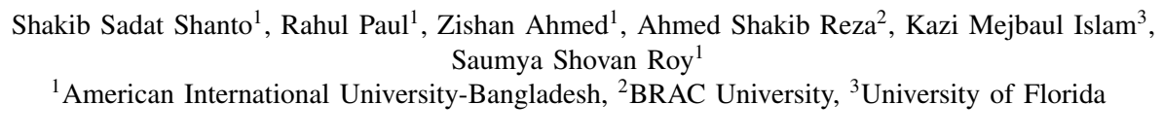


Console Log Explainer: A Framework for Generating Automated Explanations using LLM
Paper ID: 61
Date: 08/09/2024
1

Slide 2
Table of Content
Introduction
Problem Statement
Objective of the Study
Proposed Model
Proposed Framework
Dataset and Data Preprocessing
Result and Evaluation
Discussion
Conclusion and Future Works
2

Slide 3



Introduction
Log analysis is complex
Console log messages are unstructured and difficult to interpret due to free-form text, codes, and timestamps.
Traditional methods are limited
Most existing techniques are domain-specific, rule-based, and require extensive labeled data.
LLMs offer promise
Large Language Models provide a breakthrough in automated log analysis with minimal additional data requirements.
3

Slide 4



Problem Statement
Domain-specific approaches
Current methods depend heavily on domain-specific, rule-based systems that do not generalize well to diverse log types.
High costs for labeled data
Statistical and neural log analysis models require extensive labeled datasets, which are expensive to curate.
Complexity in interpreting raw logs
Log messages are often cluttered with technical jargon, making it difficult for both machines and humans to extract useful insights.
4

Slide 5



Objective of the Study
Create a generalized system
Develop a framework that can interpret console logs across diverse applications using minimal labeled data.
Utilize LLMs with PEFT
Combine large language models with Parameter Efficient Fine-Tuning techniques to enhance log explanation performance.
Benchmark against existing models
Evaluate the proposed system by comparing it to baseline models like Falcon and LLaMA.
5

Slide 6
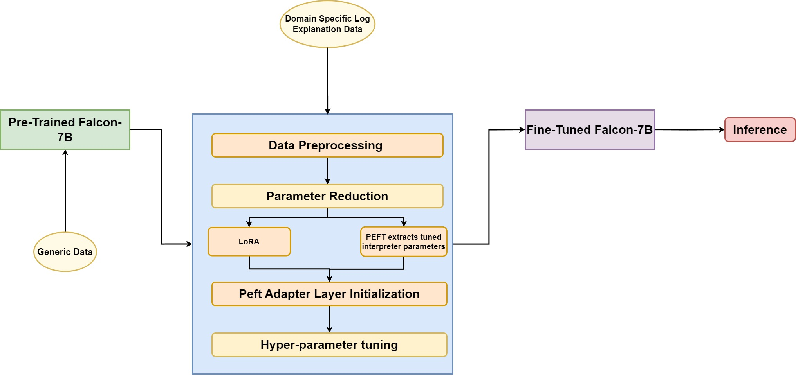
Proposed Model
6

Slide 7
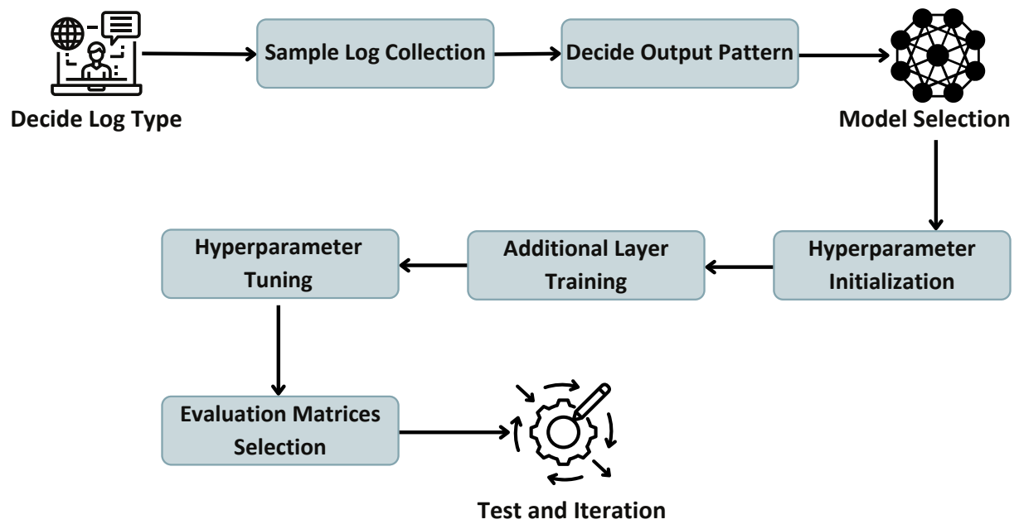
Proposed Framework
7

Slide 8
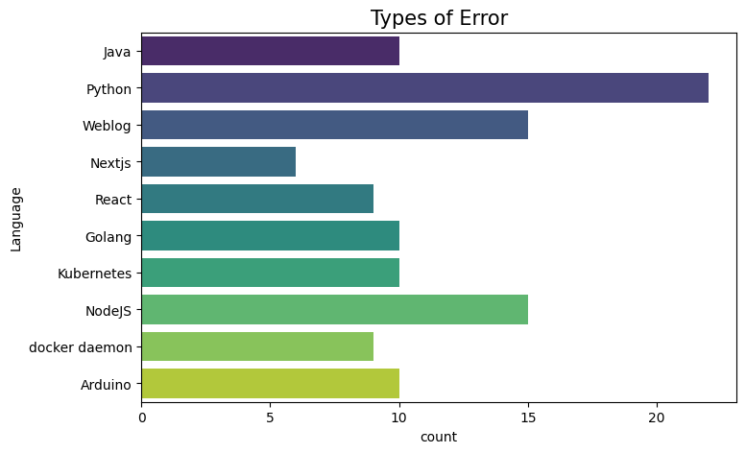
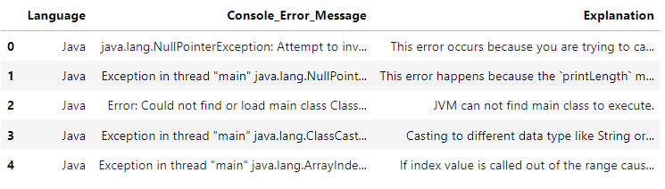
Dataset and Data Processing
Diverse log types: Dataset includes over 100 error logs from 10 applications, ensuring diverse and representative log types.
Minimal preprocessing: Data was kept in near-raw form to retain the complexity of console errors.
Stack Overflow source: Many log errors were sourced from real-world cases on Stack Overflow for authenticity.
8

Slide 9
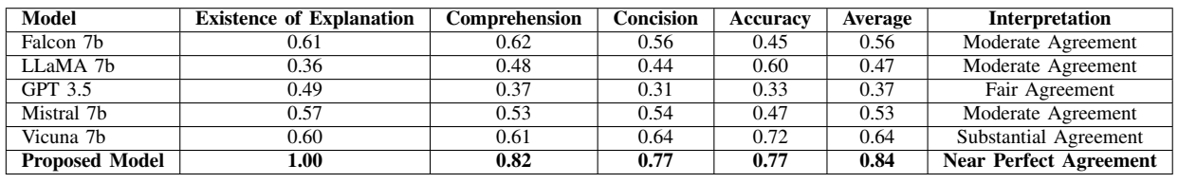
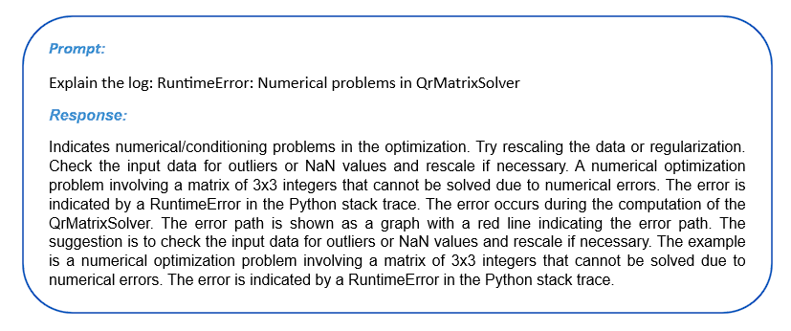
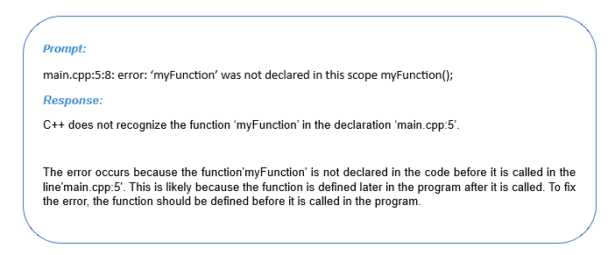
Results and Evaluation
Metrics assessed: Comprehensibility, conciseness, accuracy, and existence of explanation were evaluated.
Near-perfect performance: The proposed model achieved near-perfect agreement (Kappa = 0.84) in all categories.
Comparison with baselines: Significant improvements over other LLMs, including Falcon, LLaMA, and GPT-3.5.
9

Slide 10
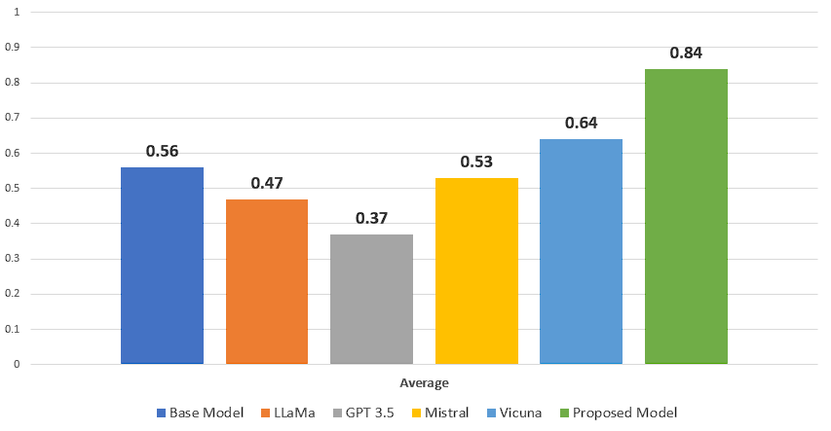
Discussion and Insights
LoRA fine-tuning impact: The Low-Rank Adaptation technique significantly improved model performance by reducing overhead.
Specialized adapter layer: The addition of a log-specific interpreter layer helped the model handle complex technical logs.
Generalization capabilities: The model demonstrated strong generalization, performing well on both seen and unseen log types.
10

Slide 11



Conclusion and Future Work
Key findings
The proposed model achieved high performance in automated log explanation using LLMs and PEFT.
Limitations
The dataset size and diversity could be expanded to cover more error types and applications.
Future directions
Plans to explore encoder-decoder models and expand the dataset for better real-world applications.
11

Slide 12

THANK YOU
12

