Slide 1
Mining Student Data to Predict Result
GROUP MEMBERS | ID
NISMA HOSSAIN | 20-41982-1
FAHIM HAIDER | 20-42087-1
SHAKIB SADAT SHANTO | 20-43074-1
ZISHAN AHMED | 20-42085-1
Machine Learning
Group – 7
Presented to: DR. M M MANJURUL ISLAM

Slide 2

Table of Contents
Introduction
Dataset Description
Data Analyzing
Model building with different Algorithms
Finding Best Accuracy
Discussion
References

Slide 3


Introduction
This project’s objective is to classify student’s final results (pass or fail) using different machine learning classification algorithms (KNN, Naïve Bayes, Decision Tree, Random Forest, SVM, Kernel SVM(RBF) and deep learning method (ANN).

Slide 4
Dataset Description
This dataset was collected from Kaggle.
https://www.kaggle.com/datasets/dinhanhx/studentgradepassorfailprediction
The secondary student achievement statistics from two Portuguese schools is presented here.
The data was gathered through school reports and surveys and includes student grades, demographic, social, and educational aspects.
Target attribute G3 (final grade) strongly correlates with attributes G2 (second period grade) and G1(first period grade).

Slide 5
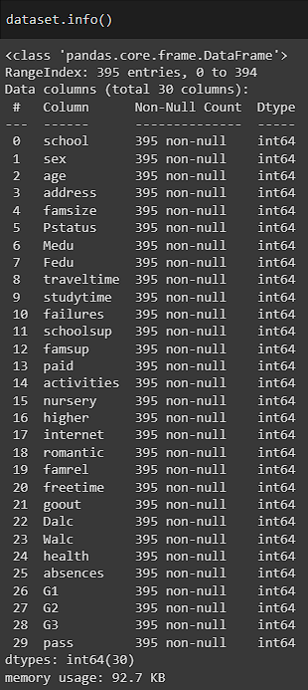
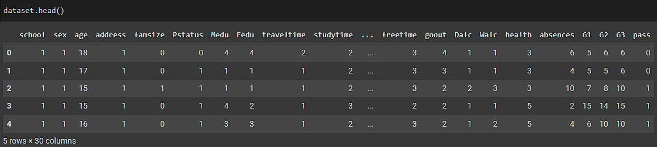
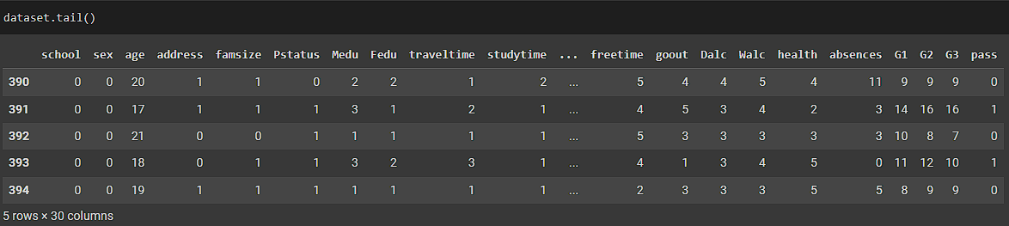
Data Analyzing
Dataset head
Dataset info
Dataset tail

Slide 6
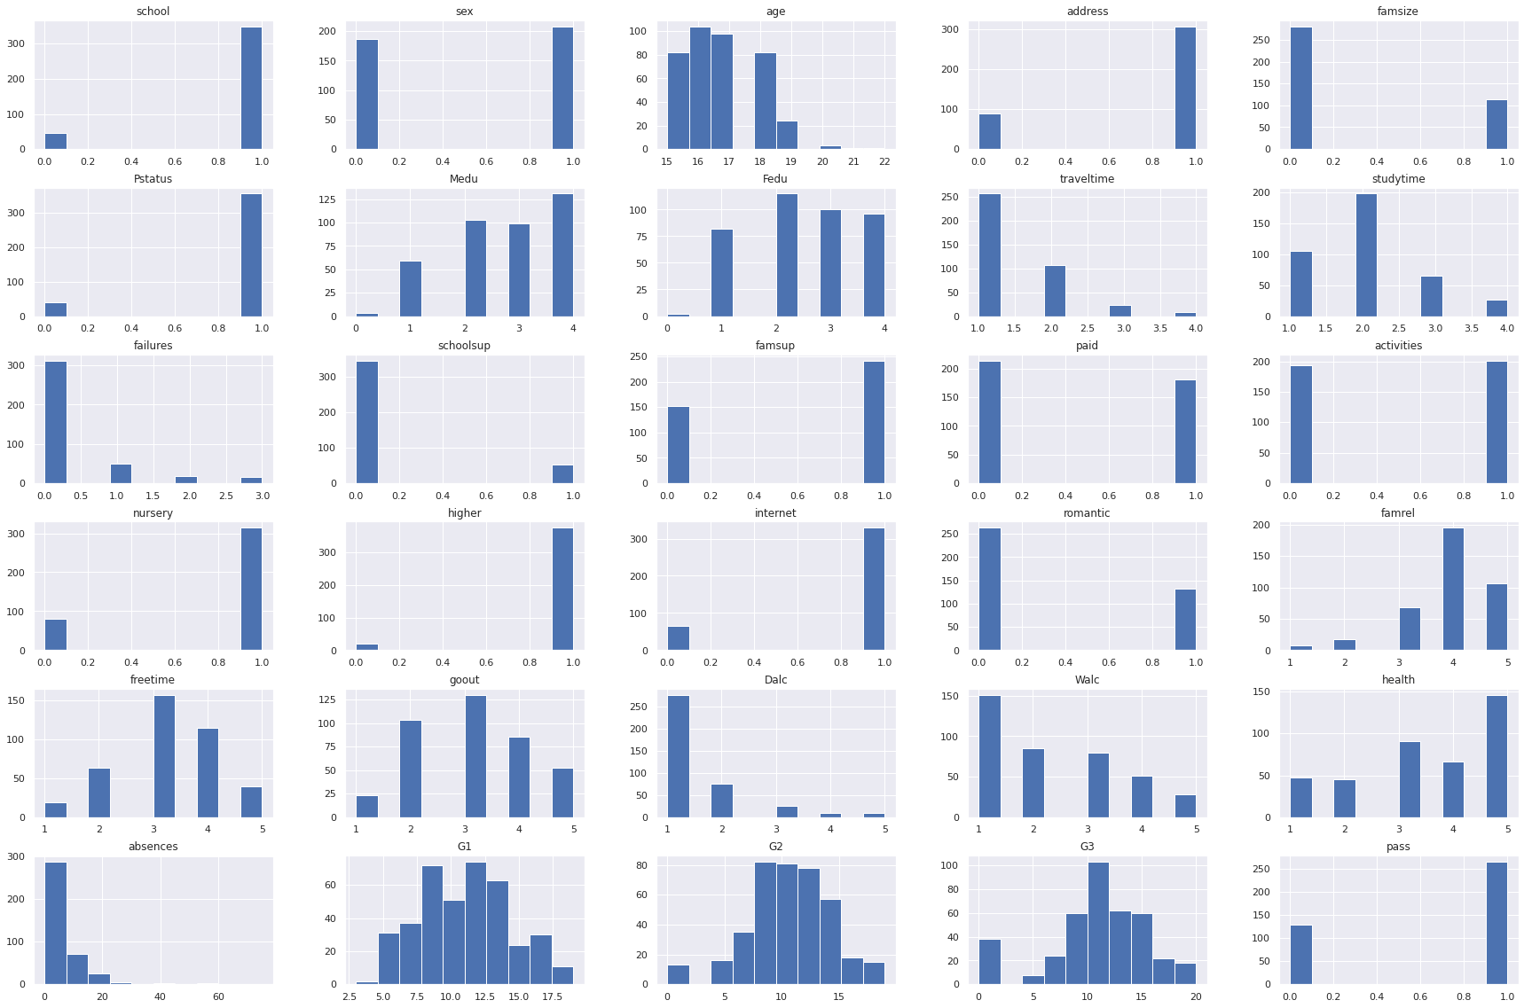
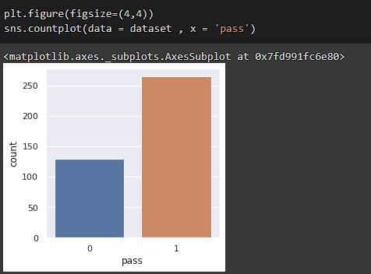
Data Analyzing
Bar plot of class attribute (pass)
Histogram of all attributes

Slide 7
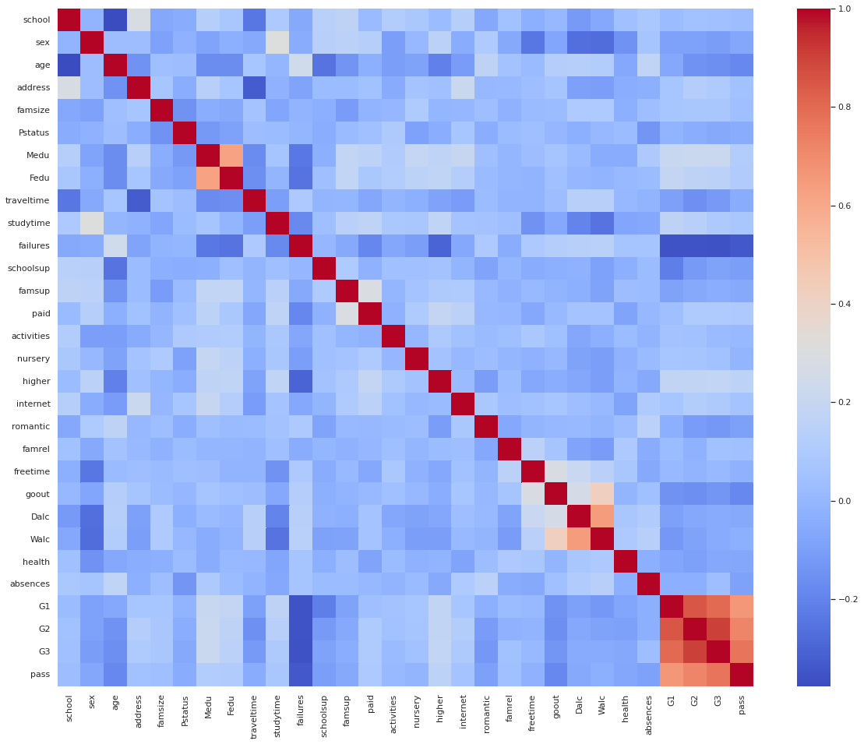
Data Analyzing
Correlation Heatmap

Slide 8
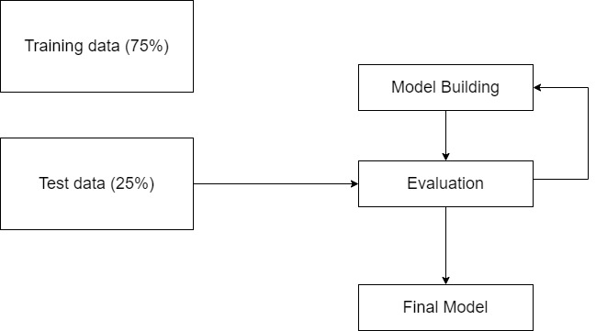
Model Building with different Algorithms

Slide 9
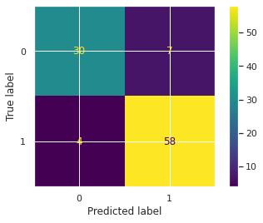
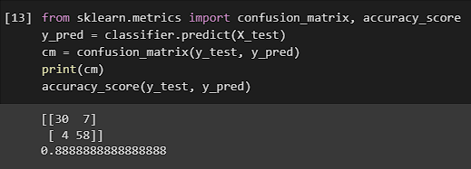
NAÏVE BAYES
Prediction Accuracy and Confusion matrix for naïve bayes classifier

Slide 10
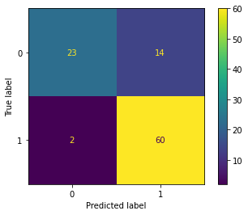
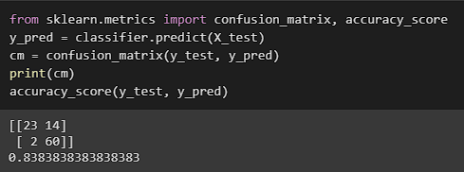
KNN
Prediction Accuracy and Confusion matrix for KNN classifier

Slide 11
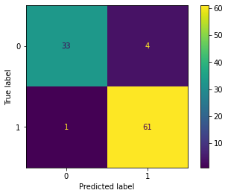
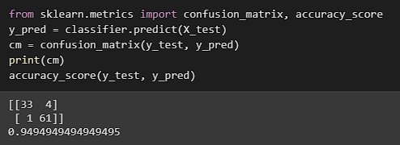
SVM
Prediction Accuracy and Confusion matrix for SVM classifier

Slide 12
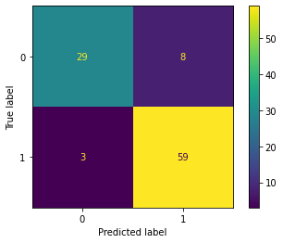
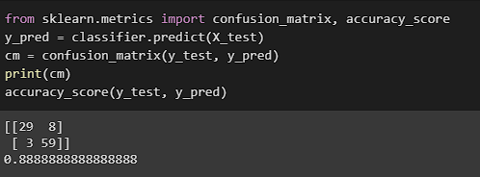
KERNEL SVM (RBF)
Prediction Accuracy and Confusion matrix for Kernel SVM classifier

Slide 13
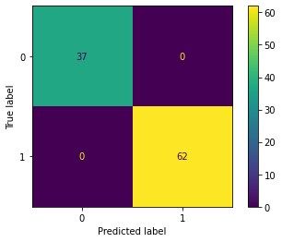
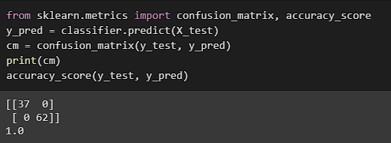
Decision Tree
Prediction Accuracy and Confusion matrix for Decision Tree classifier

Slide 14
Random Forest
Prediction Accuracy and Confusion matrix for Random Forest classifier

Slide 15
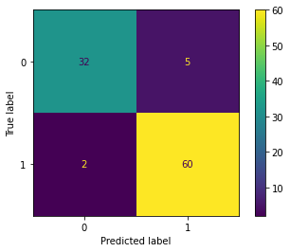
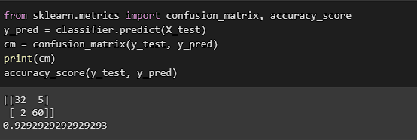
Logistic Regression
Prediction Accuracy and Confusion matrix for Logistic Regression classifier

Slide 16
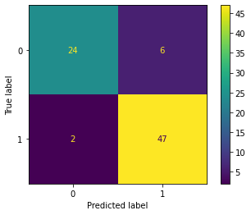
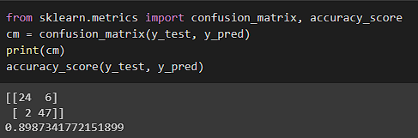
ANN
Prediction Accuracy and Confusion matrix for ANN classifier

Slide 17
Finding Best Accuracy
For validation, we split the dataset into 75% train and 25% test data.
After applying all algorithms we can observe that decision tree and random forest classifiers has the highest accuracy of 100%.
Other than these two, SVM gives the best accuracy of 95%.

Slide 18
Discussion
The secondary student achievement statistics from two Portuguese schools is presented here.
We would be able to identify comparable real-world datasets with similar features if we used Decision Tree or Random Forest to create a model on the dataset because it provided the best accuracy.
In the future, if a suitable dataset is available, we can classify students according to their performance into good, bad, or average rather than forecasting their results.

Slide 19
References
1.
2.
3.

Slide 20

THANK YOU

