Slide 1
FAIKR Module 03
The application of Bayesian Network for Food Safety Risk in Cattle Slaughtering Industry

Slide 2
Main Idea
Food safety has an important role for consumers.
Foods that are processed without regard to food safety aspects has negative impact on human health in the short or long term.
According to WHO, there are 600 million cases and a lot deaths caused by foodborne diseases, so training activities, government, and private cooperation are needed to support the implementation of food safety.
This study aims to :
identify the risk event of food safety.
Measure the opportunities for these risks with Bayesian Network.
This research contributes to the development of the use of the BN method to determine the risk of food contamination based on aspects of food safety.
Notes:
Flaky tests exhibit both passing and failing results although neither the code nor test has changed. Maintaining flaky tests is costly, especially in large-scale software projects.

Slide 3
Data
This research was conducted in three phase, namely observation, data collection, risk statistical analysis.
Observations were carried out at one of the Animal Slaughter Houses in Indonesia.
Data was collected using the checklist.
‘ Y ‘ is YES : means activities are at risk of food safety.
‘ N ‘ is NO : means activities are not at risk of food safety.
Risk statistical analysis, here data is processed by one of the statistical methods, namely the Bayesian Network (BN).
Stages:
identification of risk event in case study.
determination of probability of risk event.
development of Bayesian network structure.
calculation for condition probability table (CPT).

Slide 4
Modeling Of The Paper

Slide 5
Stage 1) identification of risk event in case study. (Variables) (there are 8 risk events that are at risk for food safety.)
No | Code | Description | Process
1 | Fs1 | The risk of animals is not healthy | Pre-slaughter (P1)
2 | Fs2 | Animal risk is stress and pain | Pre-slaughter (P1)
3 | Fs3 | The risk of the knife used to slaughter is not hygienic | Slaughter (P2)
4 | Fs4 | The risk of cow body parts is not safe because they contain bacteria | Slaughter (P2)
5 | Fs5 | The risk of a knife used to cut unhygienic (rusty) parts of an animal | Slaughter (P2)
6 | Fs6 | The location of cutting animal parts is not hygienic | Slaughter (P2)
7 | Fs7 | Transportation equipment for meat distribution is not hygienic | Post-slaughter (P3)
8 | Fs8 | Meat distribution equipment is not equipped with refrigerators | Post-slaughter (P3)

Slide 6
Stage 2) determination of probability of risk event observations were carried out on 50 cows (aim : the chances for food safety contamination is identified for each risk factor)
Code | Y (Number of risk event) (contaminated) | N (Number of risk event) (not contaminated) | Total
Fs1 | 2 | 48 | 50
Fs2 | 2 | 48 | 50
Fs3 | 3 | 47 | 50
Fs4 | 3 | 47 | 50
Fs5 | 2 | 48 | 50
Fs6 | 2 | 48 | 50
Fs7 | 2 | 48 | 50
Fs8 | 4 | 46 | 50

Slide 7
Prior probabilities of root nodes
Code | Y (Risk event probability) | N (Risk event probability)
Fs1 | 0.04 | 0.96
Fs2 | 0.04 | 0.96
Fs3 | 0.06 | 0.94
Fs4 | 0.06 | 0.94
Fs5 | 0.04 | 0.96
Fs6 | 0.04 | 0.96
Fs7 | 0.04 | 0.96
Fs8 | 0.08 | 0.92

Slide 8
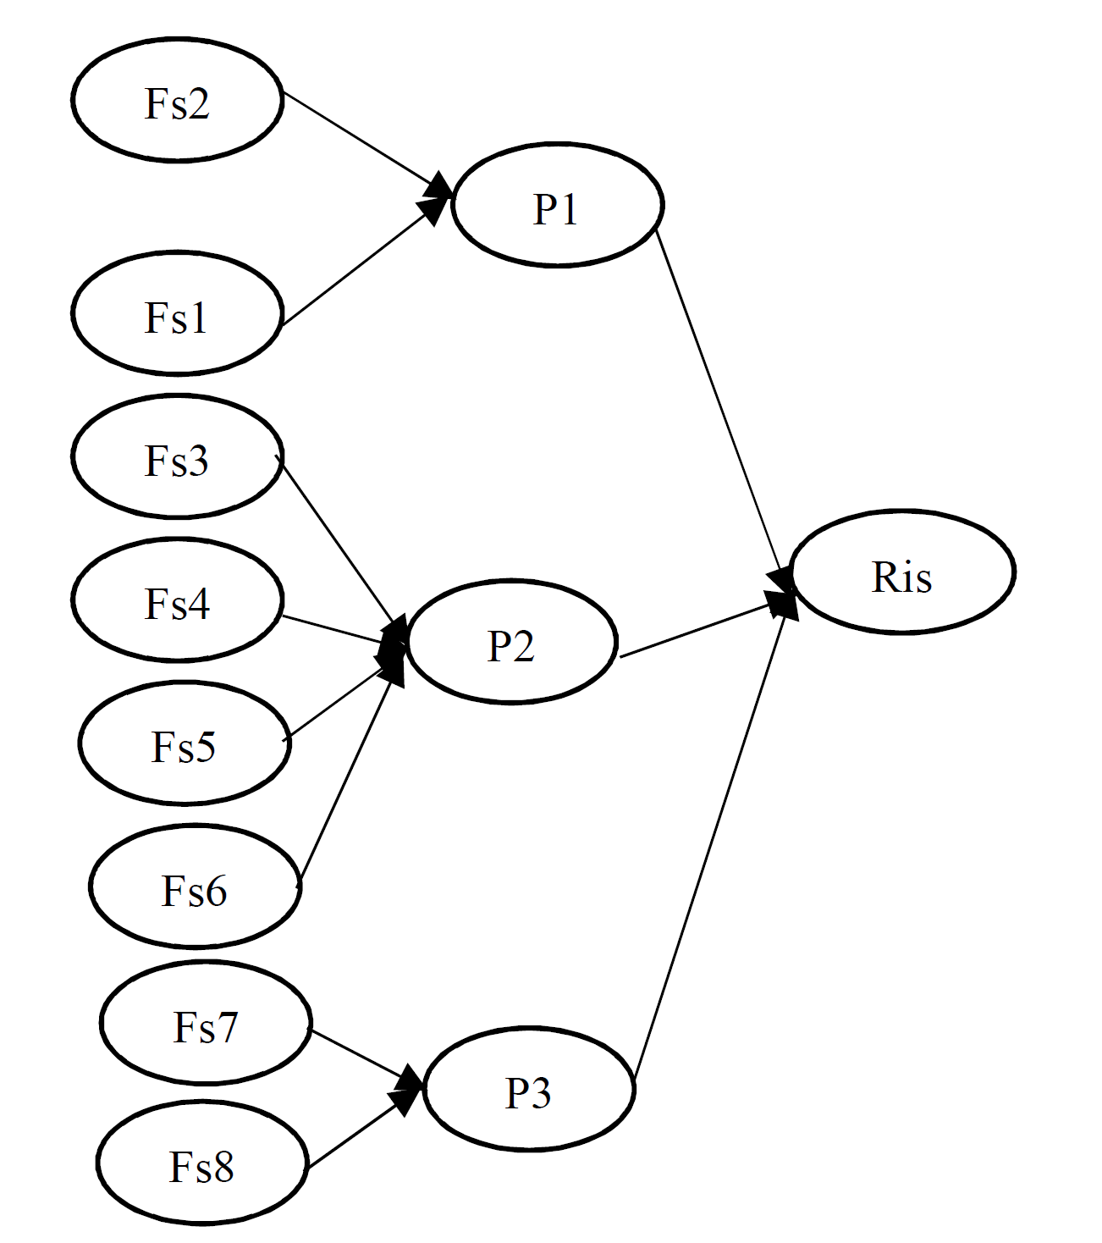
Stage 3) Bayesian network structure
Notes:
This is the final Bayesian network of our model

Slide 9
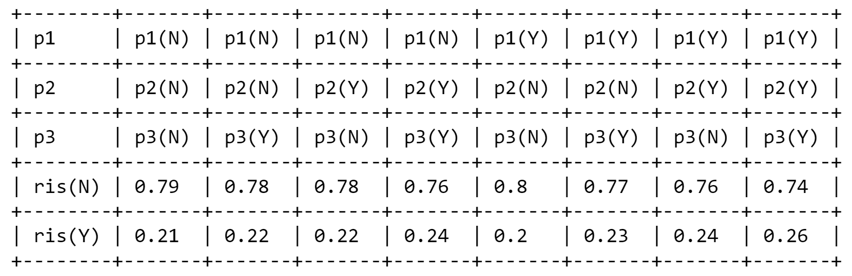
Stage 4) Calculation for Condition Probability Table (CPT) (4 CPTs → P1, P2, P3, risk) Risk:

Slide 10
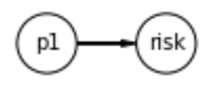
Flow of probabilistic influence: (6 types)
Direct cause :
(directly affect)
pre-slaughtering process (P1)
Risk in food safety (risk)
Direct effect :
(can be an affect of)
pre-slaughtering process (P1)
Risk in food safety (risk)

Slide 11
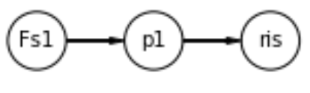
Flow of probabilistic influence
Causal trail & evidential trail
(Fs1 indirectly affect on ris)
(evidence(ris) can influence(Fs1) via (p1) when p1 is unobserved.)
The risk of animals is not healthy (Fs1)
pre-slaughtering process (P1)
risk in food safety (ris)

Slide 12
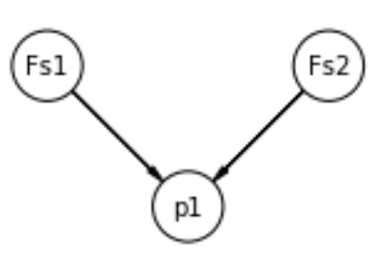
Flow of probabilistic influence
Common cause & Common effect (V structure):
(not)
(when p1 not observed -> any changes in (Fs1) reflects some changes in P1 but not in Fs2)
(when p1 observed -> if Fs1 is also observed, this will change the probability of Fs2)
The risk of animals is not healthy (Fs1)
Animal risk is stress and pain (Fs2)
Pre-slaughter(P1)

Slide 13
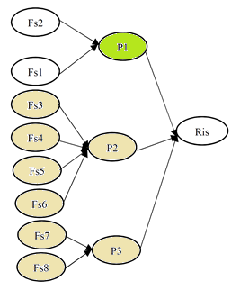
Independence
Conditional Independence
: a variable is conditionally independent of non-descendant variable give it is parents.
Notes:
In our network, there can be made 9016 valid independence assertions, with respect to all possible given evidence.
For example, for the variable TF (the last one), we see that given ND, IC, IS and HTC, which are the Markov blanket of this node, it will be independent of other variables.

Slide 14
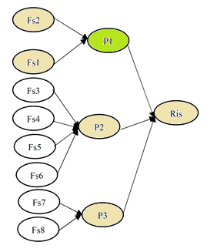
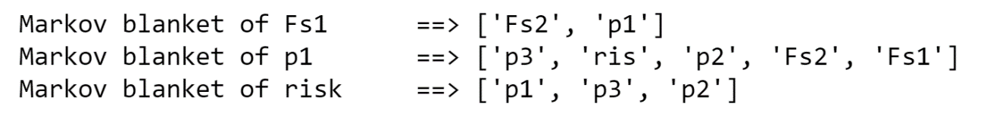
Independence
2) Markov blanket
: a variable is independent of all other variables given it is Markov blanket, which is parents, children and children’s parents.
Notes:
The Markov blanket of a node (in red) consists in the set (in yellow) of:
Its parents
Its children
Its children ‘s other parents
Each node is conditionally independent of all others (in gray), given its Markov blanket.

Slide 15
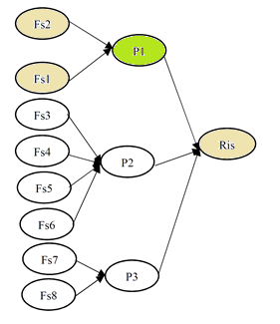
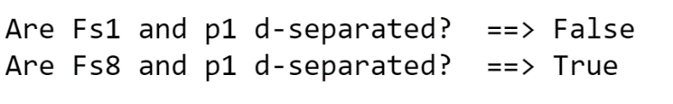
Dependency
1) Active trail
:When influence can flow from X to Y via Z then trail X—Z—Y is active. We investigated active trails for all the nodes in the network. Node (risk) has the most active trail with all other nodes:
2)Direct separation
:Two nodes are d-separated if there is no active trail between them. According to this definition, nodes (Fs8) has active trail to (P1)

Slide 16
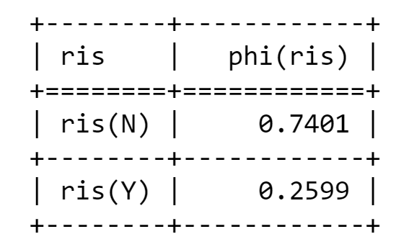
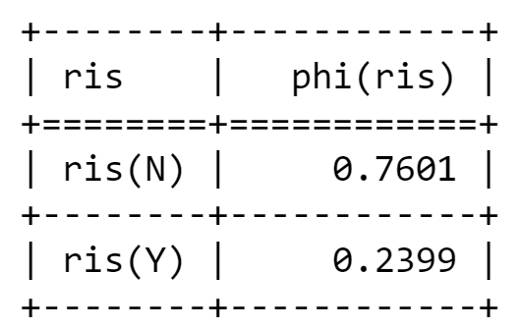
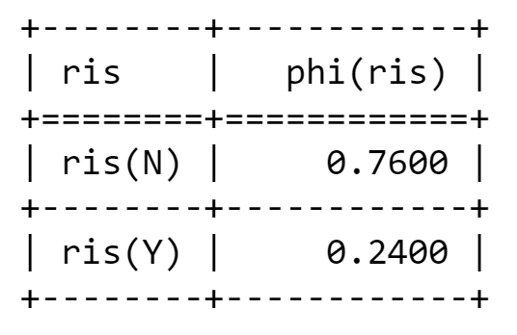
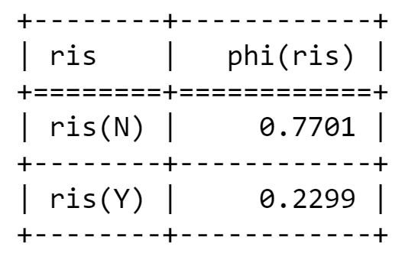
Exact Inference with variable elimination
What is the probability of risk factor (Risk). without any evidence:
What is the probability of Risk given its parent:
P(risk|p1 is N)
P(risk|p3 is N)
P(risk|p2 is N)
Notes:
The probability of having a flaky test without evidence is 64%. The probability of having a flaky test given that HTC, IC, ND and IS are false is 10%.
It is expected to have such a result since HTC, IC, ND and IS are causal factors of having a flaky test and their absence must lower the probability of test flakiness occurrence. This is an example of a causal reasoning.

Slide 17
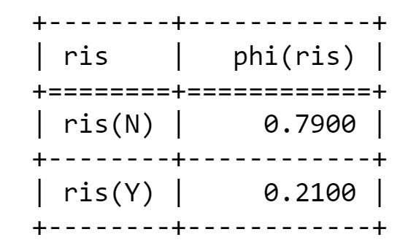
Exact Inference with variable elimination
What is the probability of risk factor (Risk):
P(risk| p1, p2, p3 is N)
--- time of execution: 0.0720 seconds ---
Considering different elimination order:
MinNeighbors: 0.0714 seconds
MinFill: 0.0640 seconds
MinWeight: 0.0730 seconds
WeightedMinFill: 0.0720 seconds
Notes:
The probability of non determinism without evidence is 12%. The probability of non determinism given that TF is true is 17%.
It is expected to have such a result since non determinism leads to flaky test and given that there is a flaky test, increases the probability of non determinism. This is an example of an evidential reasoning.

Slide 18
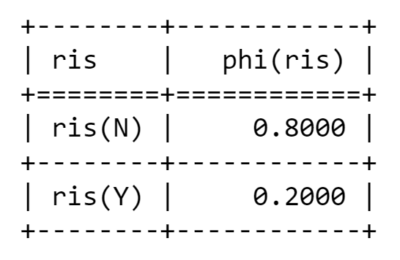
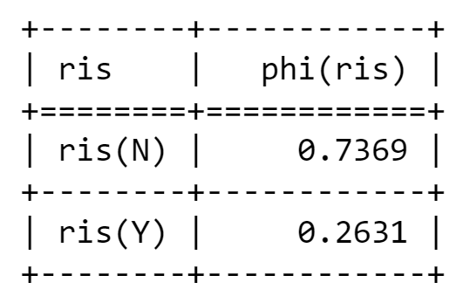
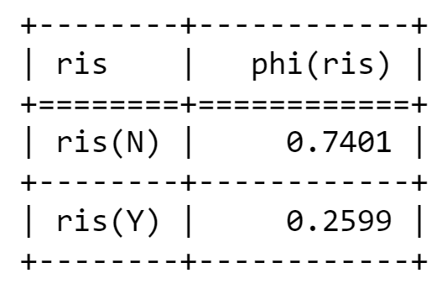
Approximate Inference Sampling from an empty network
Probabilities of Risk:
N samples = 20
N samples = 10000
Exact inference

Slide 19
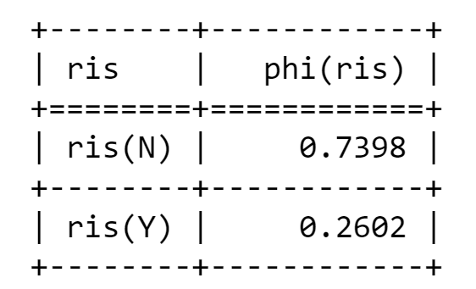
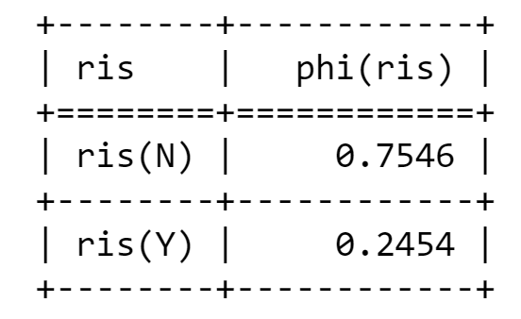
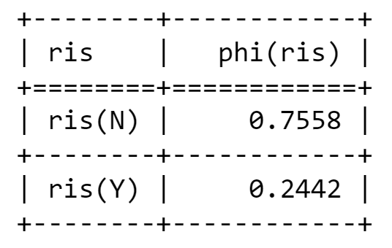
Approximate Inference
Probabilities of Risk:
forward_sampling
Without evidence
Likelihood weighted Sampling
P(risk| p1 is N)
Rejection Sampling
P(risk| p1 is N)

Slide 20
Conclusion
The final results show that:
The probability of food safety risks in the process of providing in cattle slaughtering industry is 24%. Which is the opportunity for food safety contamination

