Slide 1
CLOUD COMPUTING TECHNOLOGIES
Project 2
Distributed Data
MinIO Object Storage · Microservice Application · Non-Functional Properties
University of Milan
Professors: Anisetti & Ardagna
Academic Year 2025/2026
Shakiba Fotouhi
Notes:
Introduce yourself, the project topic, and mention you chose the MinIO variation.

Slide 2
OVERVIEW
Agenda
01
Technology Choice
02
System Architecture
Why MinIO over GlusterFS and HDFS
8 containers, 3 layers, one network
03
Microservice Application
04
Two Demo
5 independent Python/Flask services
Non-Functional Properties – Fault tolerance, HA, security
Security Demo – Authentication, Authorisation, Integrity
05
Fault Simulation & Demo
06
CAP Theorem & Conclusions
Live node killing and recovery
CP behaviour and trade-offs
Notes:
Walk through the agenda briefly. The whole presentation is ~12 minutes.

Slide 3
TECHNOLOGY
Why MinIO? Comparison of Options
FULLY DISTRIBUTED
MASTER / WORKER
SELECTED
GlusterFS
HDFS
MinIO ✓
✓ Truly peer-to-peer
✓ Battle-tested at scale
✓ Pure Docker – no OS changes
✓ No master node
✓ Strong fault tolerance
✓ S3-compatible HTTP API
✓ No single point of failure
✓ Good for big data
✓ Built-in metrics & console
✗ Kernel module required
✗ NameNode = single point of failure
✗ Centralised API endpoint
✗ Cannot run in Docker
✗ Java-heavy setup
✗ Mitigated by nginx LB
✗ Complex network config
✗ Overkill for this project
HIGH difficulty
HIGH difficulty
LOW difficulty
Notes:
Explain why GlusterFS needs a kernel module and HDFS is overkill. MinIO runs as plain Docker containers, has a built-in web console, and uses erasure coding automatically.

Slide 4
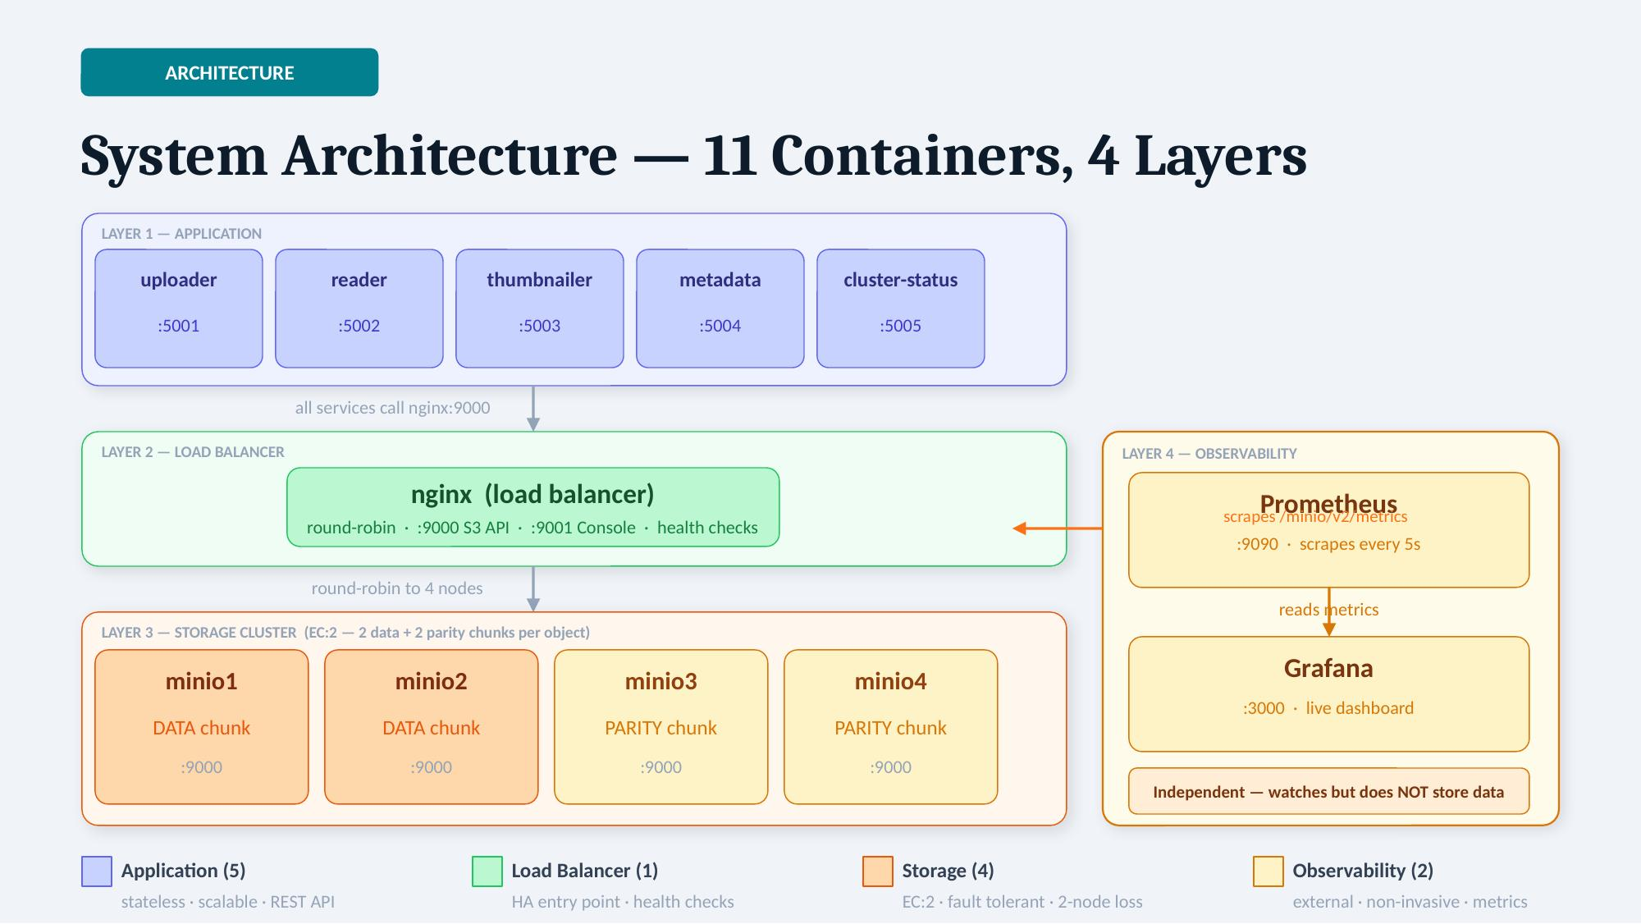
3

Slide 5
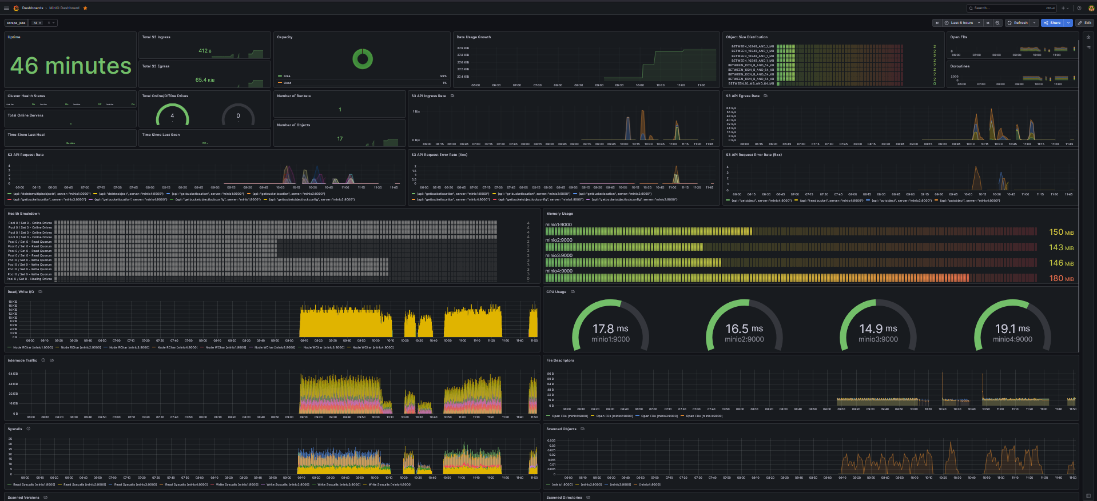

Slide 6
STORAGE
Erasure Coding EC:2 — How Files Are Stored
EC:2 Formula
vs Full Replication
4 nodes → 2 data chunks + 2 parity chunks
4 copies of each file = 4× storage waste
Any 2 nodes can die — file remains readable
EC:2 = only 2× storage overhead
minio1
minio2
minio3
minio4
DATA chunk A
DATA chunk B
PARITY chunk
PARITY chunk
5 MB
5 MB
5 MB
5 MB
EC:2 defines two separate quorums.
write quorum requires N/2 + 1 = 3 nodes
Read quorum requires N/2 = 2 nodes
💀 DEAD
💀 DEAD
minio3 + minio4 dead → chunk A + chunk B still available → file fully reconstructed ✓
Notes:
Explain that EC:2 is NOT configured manually — MinIO derives it automatically from the number of nodes. With 4 nodes, the formula is always N/2 data + N/2 parity.

Slide 7





APPLICATION
5 Independent Microservices
uploader
POST /upload
Receives file, generates UUID key, stores to MinIO via nginx
:5001
reader
GET /files · DELETE
Lists objects, streams downloads in 32 KB chunks, deletes
:5002
thumbnailer
POST /thumbnail/{key}
Reads image from MinIO, generates 128×128 thumbnail via Pillow, stores back
:5003
metadata
POST /metadata · GET
Stores file metadata as JSON objects back into MinIO bucket
:5004
cluster-status
GET /cluster/status
Probes each node individually, returns online count, quorum state, storage stats
:5005
Notes:
Emphasise that each service has its own Dockerfile and requirements.txt — they are truly independent. If the thumbnailer crashes, the uploader and reader keep working.

Slide 8




NON-FUNCTIONAL
Non-Functional Properties
Fault Tolerance
High Availability
→ EC:2 erasure coding — tolerates 2 simultaneous node failures
→ nginx round-robin load balancer across 4 nodes , health checks before nginx starts routing
→ nginx health checks route around unresponsive nodes
→ No single point of failure in the storage layer , automatic restart on crash
→ restart: always — Docker auto-restarts crashed containers
→ Stateless microservices — scale horizontally with replicas
Security
Observability
→ Bucket policy: mc anonymous set none → HTTP 403 for anonymous
→ Prometheus scrapes MinIO every 5s via JWT bearer token
→ RBAC: read-only user (readeruser) vs admin user
→ Grafana live dashboard: nodes online, throughput, storage
→ All credentials via env vars — never hardcoded
→ cluster-status microservice: real-time quorum state via API
Notes:
Link each property back to the course slides. Fault tolerance = masking failures. HA = always reachable. Security = authentication + authorisation. Observability supports the demo.

Slide 9
DEMO
Fault Simulation — Step by Step
1
4 / 4 nodes
Baseline
Upload + download → HTTP 201 / 200 ✓
2
3 / 4 nodes
minio1 stopped
File still readable — erasure coding masks failure ✓
3
2 / 4 nodes
minio2 stopped
Still readable — at EC:2 minimum quorum ✓
But can’t write — at EC:2 minimum write quorum is 3
4
1 / 4 nodes
minio3 stopped
HTTP 500 — quorum lost, MinIO refuses (CP behaviour) ✓
5
4 / 4 nodes
All restarted
Self-healed in ~15 s — full recovery, no data loss ✓
Step 4 demonstrates the CAP theorem: MinIO is a CP system — it chooses Consistency over Availability when quorum is lost.
Notes:
Run demo_fault_tolerance.sh live. After each docker stop, call curl on cluster-status to show the node count dropping in real time. Step 4 is the key moment — explain CP.

Slide 10
SECURITY
Security Demo — Step by Step
BLOCKED
Anonymous Access
ALLOWED
RBAC — readeruser Read
1
5
curl http://localhost:9000/uploads/ (no credentials)
mc ls readonly/uploads + mc cp readonly/uploads/{key}
Bucket policy: mc anonymous set none
s3:GetObject + s3:ListBucket are in readonly-policy
ALLOWED
Authentication
ALLOWED
Admin Full Access
2
6
curl http://localhost:5002/files (via microservice)
POST /upload then DELETE /files/{key}
Credentials injected via environment variables
Admin role has unrestricted s3:* permissions
BLOCKED
RBAC — readeruser Upload
DETECTS
SHA256 Integrity Check
3
7
mc cp evil.txt readonly/uploads/evil.txt
sha256sum original vs sha256sum downloaded vs sha256sum corrupted
Role-Based Access Control — write permission missing
Response failure detection — accidental data corruption
BLOCKED
RBAC — readeruser Delete
4
mc rm readonly/uploads/{key}
Role-Based Access Control — delete permission missing
Authentication credentials required for all operations · Authorisation RBAC: readonly-policy vs admin · Integrity SHA256 detects response failures
Notes:
Run demo_security.sh live. Each step pauses so you can narrate. Key moments: step 1 shows the bucket policy working, steps 3-4 show RBAC blocking writes and deletes, step 5 proves read-only access still works, step 7 demonstrates SHA256 catching data corruption.

Slide 11
THEORY
CAP Theorem — Where MinIO Sits
C
A
P
Consistency
Availability
Partition Tolerance
Every read returns the most recent write. All clients see the same data at the same time.
Every request receives a response — even if some nodes are down.
System keeps working even when the network splits and nodes cannot communicate.
Any distributed system can guarantee at most 2 of the 3 properties simultaneously.
Since network partitions are always possible in practice, every real system must tolerate P — the real choice is CP vs AP.
MinIO is CP
Below quorum (< 2 of 4 nodes), MinIO refuses requests rather than return stale data → demonstrated in Step 4 with HTTP 500.
Notes:
The professor will almost certainly ask this. MinIO is CP: it sacrifices availability to preserve consistency when quorum is lost. This is the right choice for a storage system.

Slide 12
THEORY
Failure Taxonomy — Course Model vs Our System
Crash failure
✓ Handled
EC:2 reconstructs file from remaining nodes
Process halts and stops working
Omission failure
✓ Handled
nginx health checks stop routing to unresponsive node
Process stops responding to messages
Timing failure
~ Partial
nginx timeouts configured; no SLA guarantee
Response arrives outside expected time window
Response failure
~ Partial
Erasure coding detects corruption; no Byzantine guard SHA256 checksum verification?
Process responds with wrong value
Arbitrary (Byzantine)
✗ Not covered
Requires 3f+1 nodes and PBFT consensus — out of scope
Process behaves maliciously/randomly
Notes:
The professor will almost certainly ask about failure types from the course. Be ready to map each type to what your system does or doesn't handle.

Slide 13
THEORY
Distribution Transparency in Our System
Access transparency
Location transparency
✓
✓
Microservices use the same HTTP API regardless of how many nodes hold the data
Clients call nginx:9000 — they never know that minio1, 2, 3, 4 physically exist
Replication transparency
Failure transparency
✓
✓
Erasure coding is invisible to the application — it just calls put_object()
When minio1 dies, the application receives no error — failure is masked by EC:2
Migration transparency
Concurrency transparency
~
~
Docker volumes can be moved but no automatic object migration between nodes
MinIO handles concurrent reads; write conflicts not explicitly managed at app level, serialized by MinIO
Notes:
Transparency is a core concept from the course. Be ready to give an example for each type. The location and replication transparencies are the most important for this project.

Slide 14
CONCLUSIONS
What Was Built & Proved
→
Distributed storage:
4-node MinIO cluster with automatic EC:2 erasure coding across all objects
→
High availability:
nginx load balancer + restart policies — no single point of failure in the storage layer
→
Fault tolerance:
Demonstrated: 2-node failure masked transparently, 3-node failure → CP refusal
→
Microservice application:
5 independent stateless Python/Flask services, each deployable separately
→
Security:
Bucket policy (403 for anonymous), RBAC (read-only vs admin user)
→
Observability:
Prometheus + Grafana live metrics + custom cluster-status API
→
CAP theorem:
MinIO is CP: refuses requests below quorum rather than returning stale data
https://github.com/shakibafotouhi01/Cloud-Computing-Project
Notes:
Close by linking everything back to the course: fault tolerance, NFPs, CAP theorem, microservice independence. Be ready for questions on any of the 20 topics in the exam prep list.

Slide 15
FUTURE IMPROVEMENTS
What Could Be Added Next
🔒
Security
TLS Encryption
⚖️
High Availability
Second nginx Instance
Add HTTPS on nginx endpoint — encrypt data in transit between all services and clients.
Eliminate the nginx single point of failure by running a primary + backup with Keepalived and a floating IP.
→ nginx ssl_certificate + secure=True in MinIO SDK
→ Keepalived heartbeat — failover in < 1 second
🗂️
Data Governance
Audit Logging
⏱️
Data Governance
Data Lifecycle Policies
Record who accessed which file and when. Required for full data governance and compliance.
Auto-expire files after N days. Prevents unbounded storage growth and enforces retention rules.
→ MinIO audit log → separate logging container
→ mc ilm rule add local/uploads --expiry-days 30
☸️
Scalability
Kubernetes Deployment
🛡️
Fault Tolerance
Byzantine Fault Tolerance
Replace Docker Compose with Kubernetes for automatic container scheduling, rolling updates, and self-healing at scale.
Scale to 7 nodes (EC:3) and add PBFT consensus to tolerate malicious node behaviour, not just crashes.
→ Deployments + StatefulSets + PersistentVolumes
→ 3f+1 nodes + PBFT protocol + SHA256 verification
Current system is demo-ready and academically complete · These extensions would bring it to production standard
Notes:
Use this slide to close the presentation. Shows the professor you understand the limitations of the current system and know how to extend it. Key points: TLS for security, second nginx for true HA, Kubernetes for production scalability, PBFT for Byzantine tolerance.

