Slide 1

University Assistant Android App
Presented By
Md. Shakib Hossain
ID: 16cse031
Dept. of CSE, BSMRSTU
Supervised By
Sakifa Aktar
Lecturer,
Dept. of CSE, BSMRSTU

Slide 2
Outlines
Introduction
Motivation
Objectives
Implementation
Conclusion
Future Work

Slide 3

INTRODUCTION
What is University Assistant?
An Assistant is a person who assists or gives aid and support .
A versity assistant is helper that’s supports for student , teacher and other worker of versity.
[1]

Slide 4
INTRODUCTION
Versity Assistant App
Online class room
Service
Video conference
Ride sharing
Online Quiz Exam
Versity Bus Time Schedule

Slide 5

objectives
Ride sharing
Student can earn money.
Student can move their destination.
Real time Map advantage.
Collect money or paid money inside app also or outside too like hand cash.
Online classroom
Meet video conference without link conflict and no time limit

Slide 6
objectives
Bus Scheduling
To know bus schedule time also .
And its updated by the admin.
Online Quiz Exam
Auto generate marks .
Take input over image with ML
Take input with less typing.

Slide 7
MOTIVATION
Generally, in a international versity, We can see many students have a cars, bikes. And they are came alone. Most of the sits of that vehicles remain un filled.
Improving utilization of this system and gives ride sharing owner of the vehicles get pocket money and other students get a minimum cost for travel .
Communicate with each other to get rider chatting system and video conference system.
For identification makes finger print verification and also phone verification attach this system.

Slide 8
Relative work
Ride sharing
Uber, Pathao.
Online classroom
Zoom, Google meet
Online Quiz
Google drive
Bus Scheduling
Kuet trips, DU Bus Time

Slide 9
Methodology
Profile
Ride sharing
Create post /Request
view post /Request
Phone
Login
Communication
Data
valid
Verification
Location share
Invalid
Payment/ deposit

Slide 10
Methodology
Profile
Online class
Create class/ course
Add student/ request
Email
Login
Data
Password
valid
Video Conference
Invalid
Computer Science and Engineering

Slide 11
Methodology
Profile
Online Quiz
Create quiz
Time maintain
Email
Login
Set Quiz with ML
Data
Password
valid
Process result automatically
Invalid
Computer Science and Engineering

Slide 12
Methodology
Bus Scheduling
CURD Operation
Admin
Data
View schedule
Student
Computer Science and Engineering

Slide 13
Implementation
To sign up, User need to phone verification, and finger print detection.
After successfully log in go they can post for ride sharing or request to get service.
They can see each other positon who want to share ride.
Green indicator indicate the student available to online else these are disabled automatically in this application by default.

Slide 14
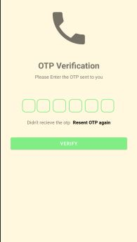
Present state

Slide 15
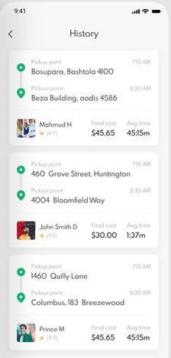
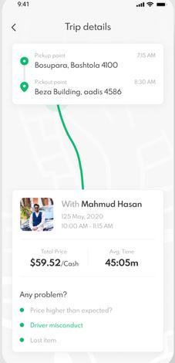
Pickup point
PickOut point
Expected treat

Slide 16
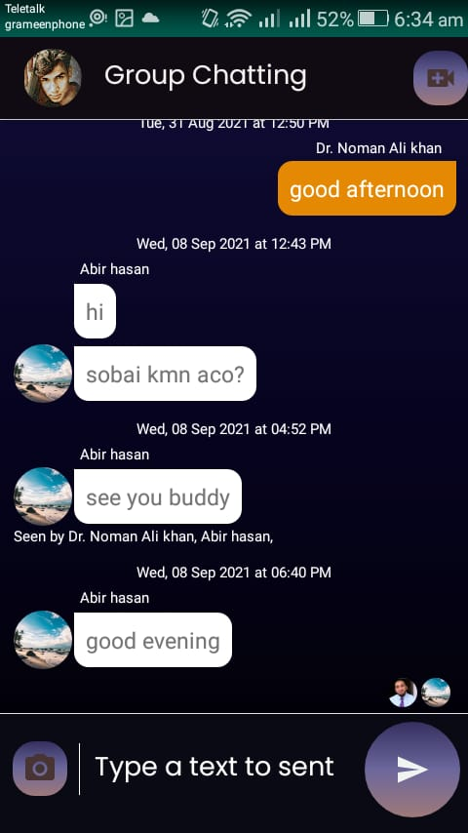
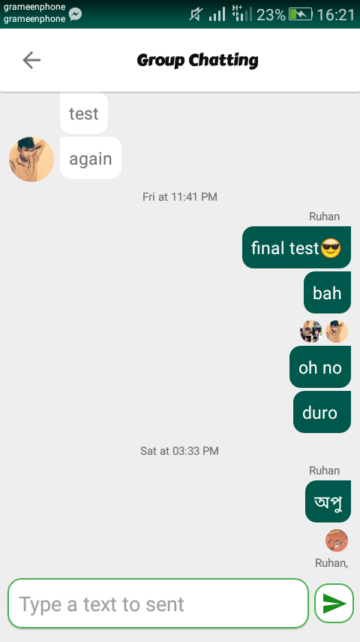
Group chat
Others Text message
Last viewer
Your Text message
Sender name
Send button

Slide 17
CONCLUSION
I assured you that this application will make it easier to Online meeting classes without any link conflict. just enter the class and press video conference.
This project helps students ride-sharing and get pocket money by helping other students to reach their destination rapidly.
MCQ will implement with less typing because it collects questions from an image and Consume time.

Slide 18
FUTURE WORK
Will implement Other service and administrate work of University .
Library management under service of this app.
Result sheet of Students Or official notice service

Slide 19
References
https://i.pinimg.com/originals/e8/f3/b1/e8f3b12247f16da40bb4a1767ea0c9c1.jpg

Slide 20
Thank you

