Slide 1

University Assistant Android App
Presented By
Md. Shakib Hossain
ID: 16cse031
Dept. of CSE, BSMRSTU
Supervised By
Sakifa Aktar
Lecturer,
Dept. of CSE, BSMRSTU

Slide 2
Outlines
Introduction
Motivation
Objectives
Implementation
Conclusion
Future Work

Slide 3

INTRODUCTION
What is University Assistant?
An Assistant is a person who assists or gives aid and support .
A versity assistant is helper that’s supports for student , teacher and other worker of versity.
[1]

Slide 4
INTRODUCTION
Versity Assistant App
Online class room
Service
Video conference
Ride sharing
Online Quiz Exam
Versity Bus Time Schedule

Slide 5

objectives
Ride sharing
Student can earn money.
Student can move their destination.
Real time Map advantage.
Collect money or paid money inside app also or outside too like hand cash.
Online classroom
Meet video conference without link get from teacher

Slide 6
objectives
Bus Scheduling
To know bus time also .
And its updated by the admin.
Online Quiz Exam
Auto generate marks .
Take input over image with ML
Take input with less typing.

Slide 7
MOTIVATION
Generally, in a international versity, We can see many students have a cars, bikes. And they are came alone. Most of the sits of that vehicles remain un filled.
Improving utilization of this system and gives ride sharing owner of the vehicles get pocket money and other students get a minimum cost for travel .
Communicate with each other to get rider chatting system and video conference system.
For identification makes finger print verification and also phone verification attach this system.

Slide 8
Relative work
Ride sharing
Uber, Pathao.
Online classroom
Zoom, Google meet
Online Quiz
Google drive
Bus Scheduling
Kuet trips, DU Bus Time

Slide 9
Methodology
Profile
Ride sharing
Create post /Request
view post /Request
Email
Login
Communication
Data
Password
valid
Location share
Invalid
Payment/deposite
Computer Science and Engineering

Slide 10
Methodology
Profile
Online class
Create class/ corse
Add student/ request
Email
Login
Communication
Data
Password
valid
Video Conference
Invalid
Payment/deposite
Computer Science and Engineering

Slide 11
Implementation
To sign up, User need to phone verification, and finger print detection.
After successfully log in go they can post for ride sharing or request to get service.
They can see each other positon who want to share ride.
Green indicator indicate the student available to online else these are disabled automatically in this application by default.

Slide 12
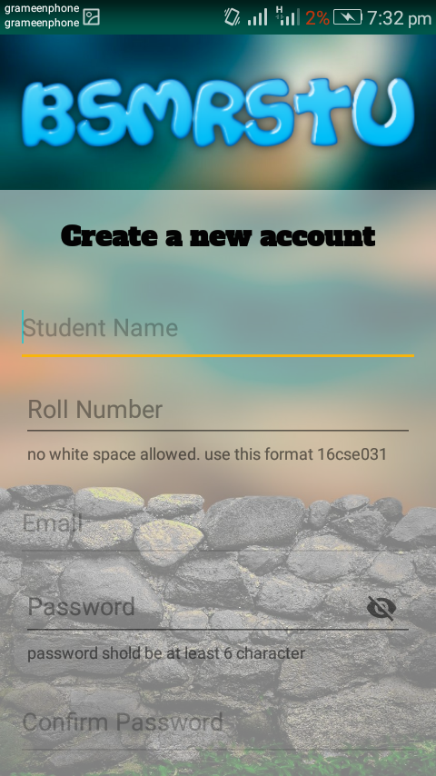
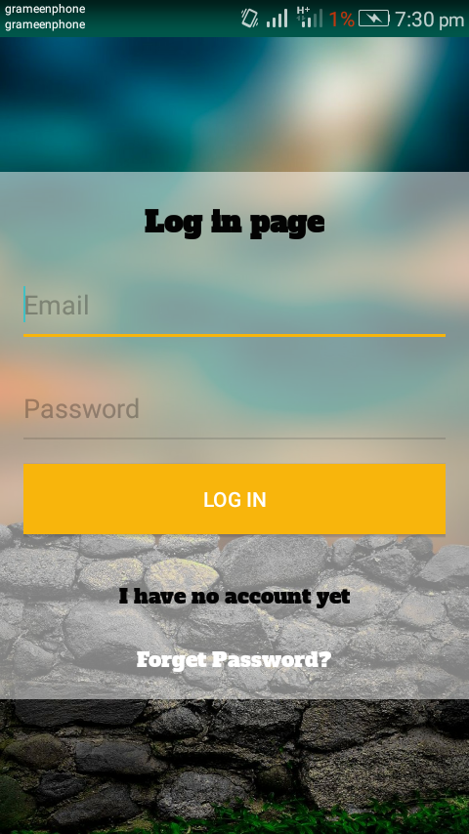
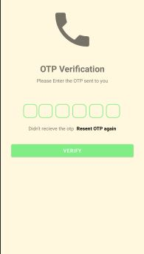
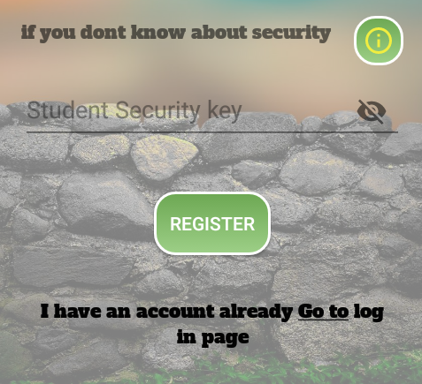
Registration

Slide 13
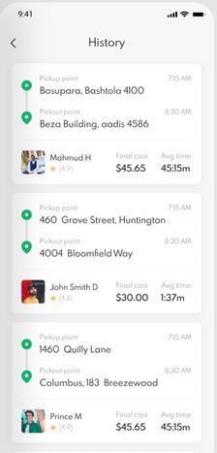
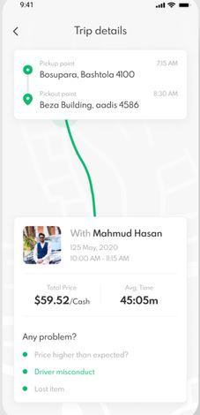
Pickup point
PickOut point
Expected treat

Slide 15
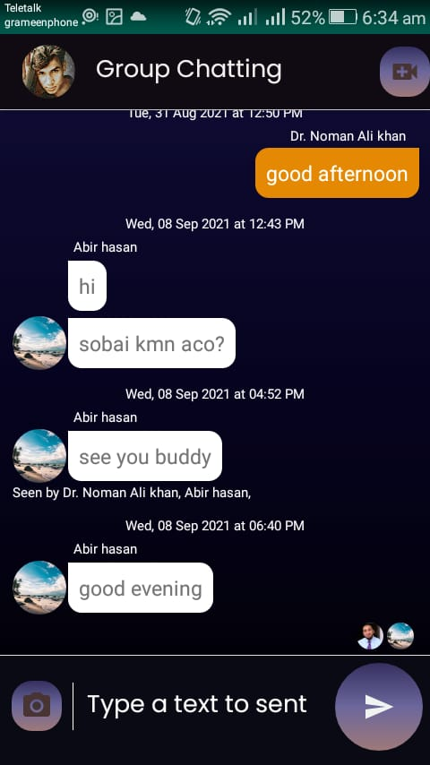
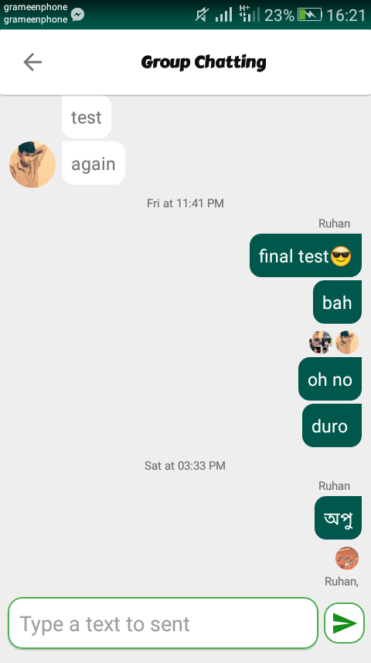
Group chat
Others Text message
Last viewer
Your Text message
Sender name
Send button

Slide 16
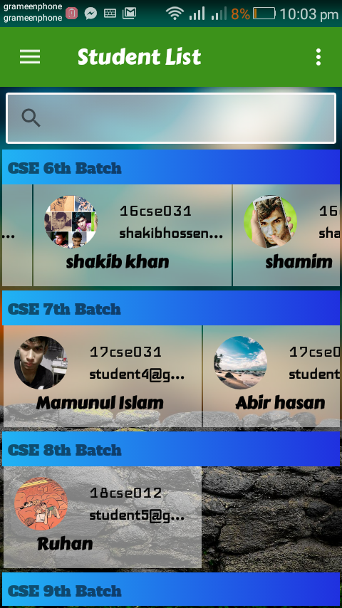
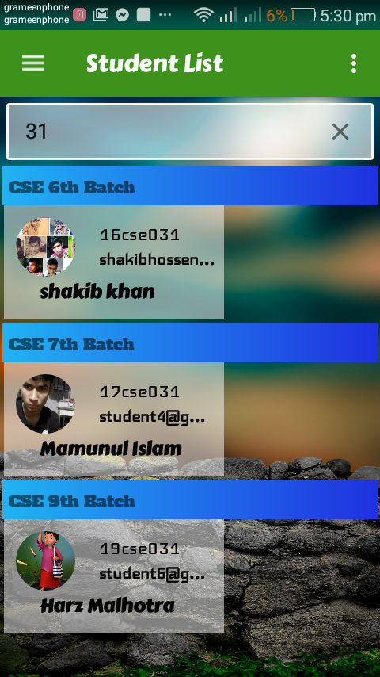
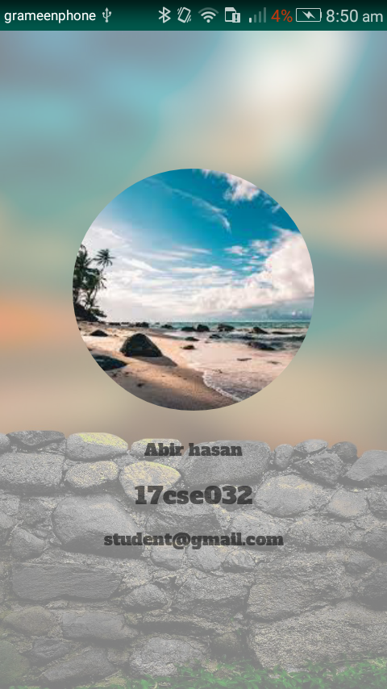
Student List

Slide 17
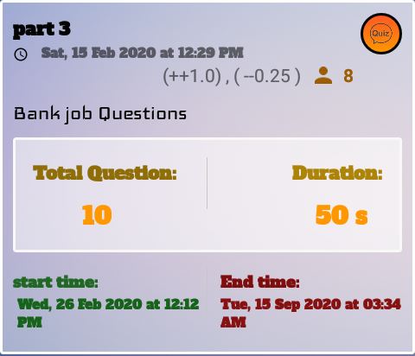
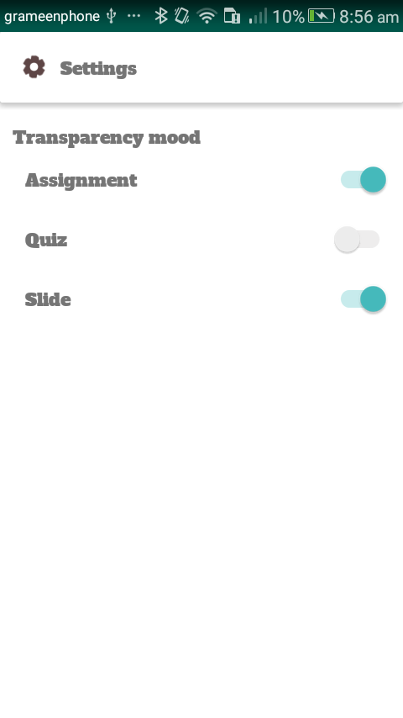
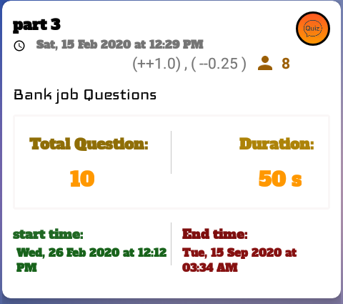
Setting
Transparency mood ON
Transparency mood OFF

Slide 18
CONCLUSION
Async task thread helper, Convert data from the millisecond, handle uploading, delete many documents in a while, reduce storage consumption, and many more.
After all, This project gives me precious experience in android development.
Understanding how the development should be carried out and the things that can go wrong in the development process is more important to develop an Application.
I assured that this application will make easier to share file and show the ability of study by giving MCQ exam and it ensures an end period of submitting the assignment.

Slide 19
FUTURE WORK
Develop a Smooth notification and when pressing on it, it brings you to the corresponding course or activity instance of Application default page.
Each question has a different option to choose positive and negative marks instance remains the same.
Add advanced options with pause resume to handle download more efficient manner.

Slide 20
References
https://i.pinimg.com/originals/e8/f3/b1/e8f3b12247f16da40bb4a1767ea0c9c1.jpg

Slide 21
Thank you

