Slide 1


Weather Station M5GO Stack
Internet of Things(IOT)
Prof. J. Oakes
Presented by: Shakib Khatri

Slide 2
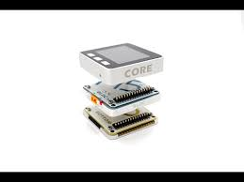
Contents
Introduction
Components
Data and Storage
Lessons Learned
Future Enhancement
Conclusion

Slide 3
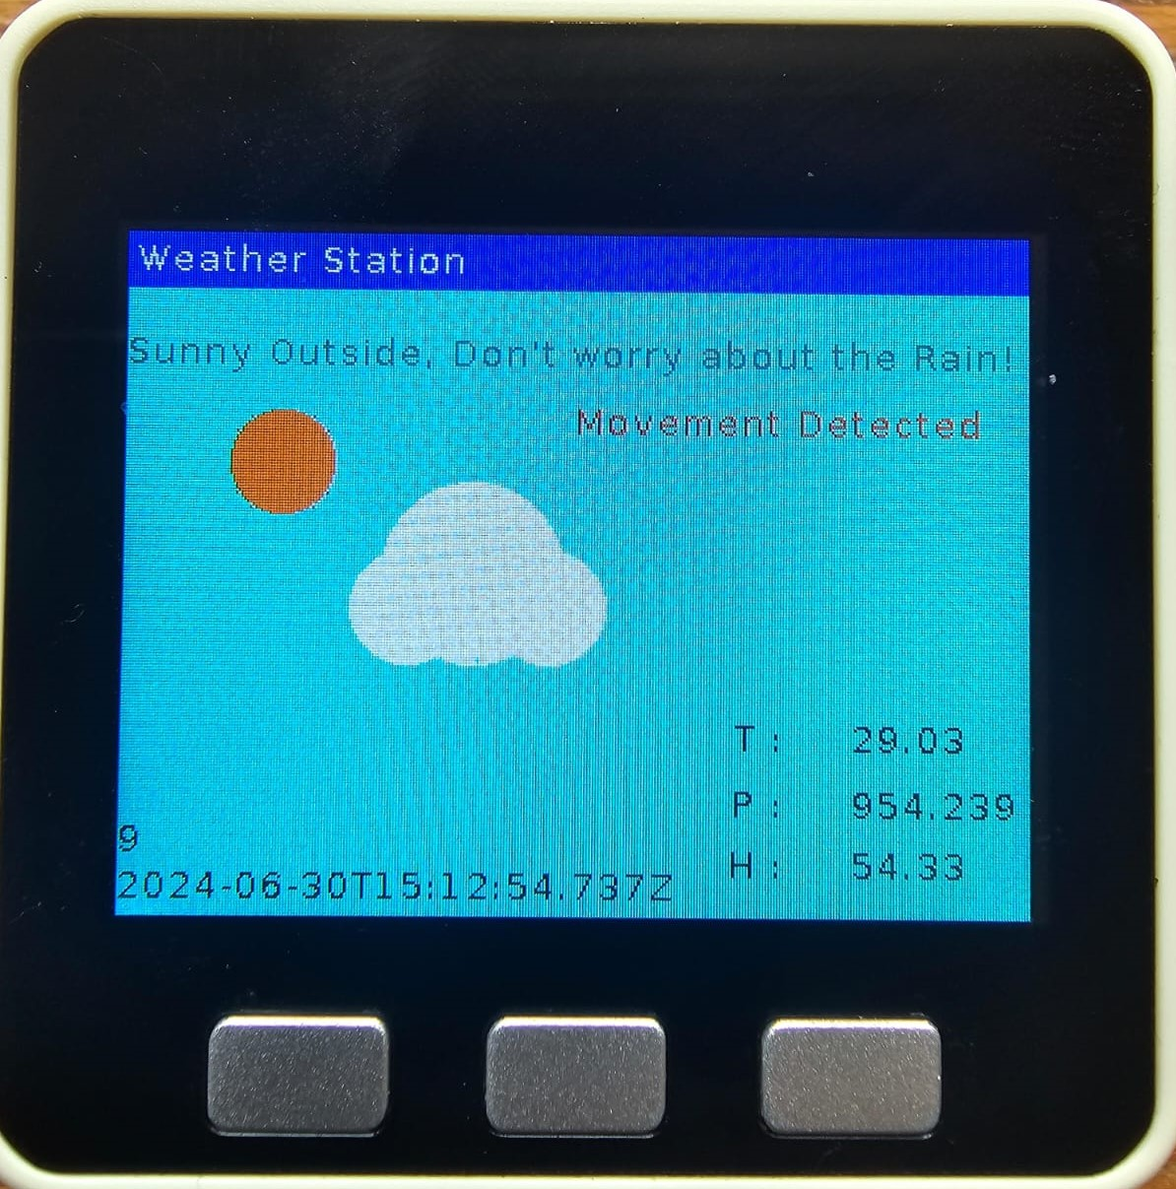
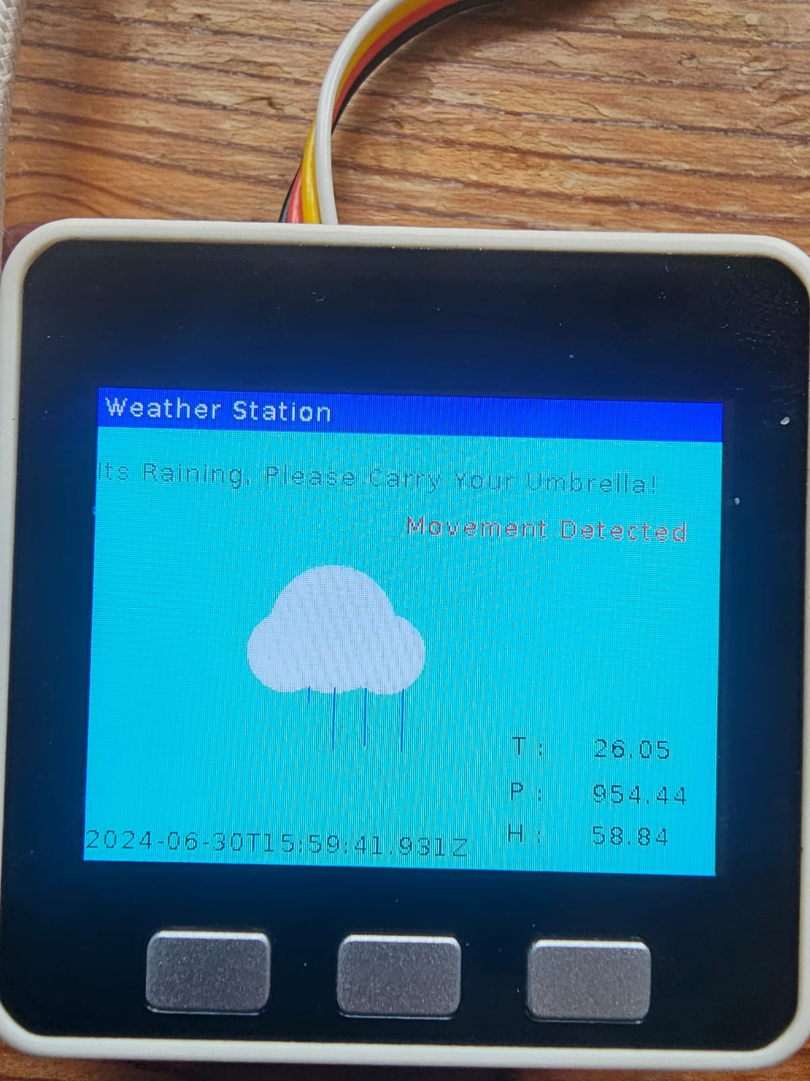
Introduction
Portable Weather station
Measures Temperature, Humidity, and Pressure
Visual display of Environmental data
multiple sensors are used

Slide 4
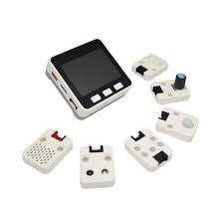
Components
M5GO Stack Core
ENV III Sensor
Motion Sensor
IR Remote
RGB LED
Grove Hub

Slide 5
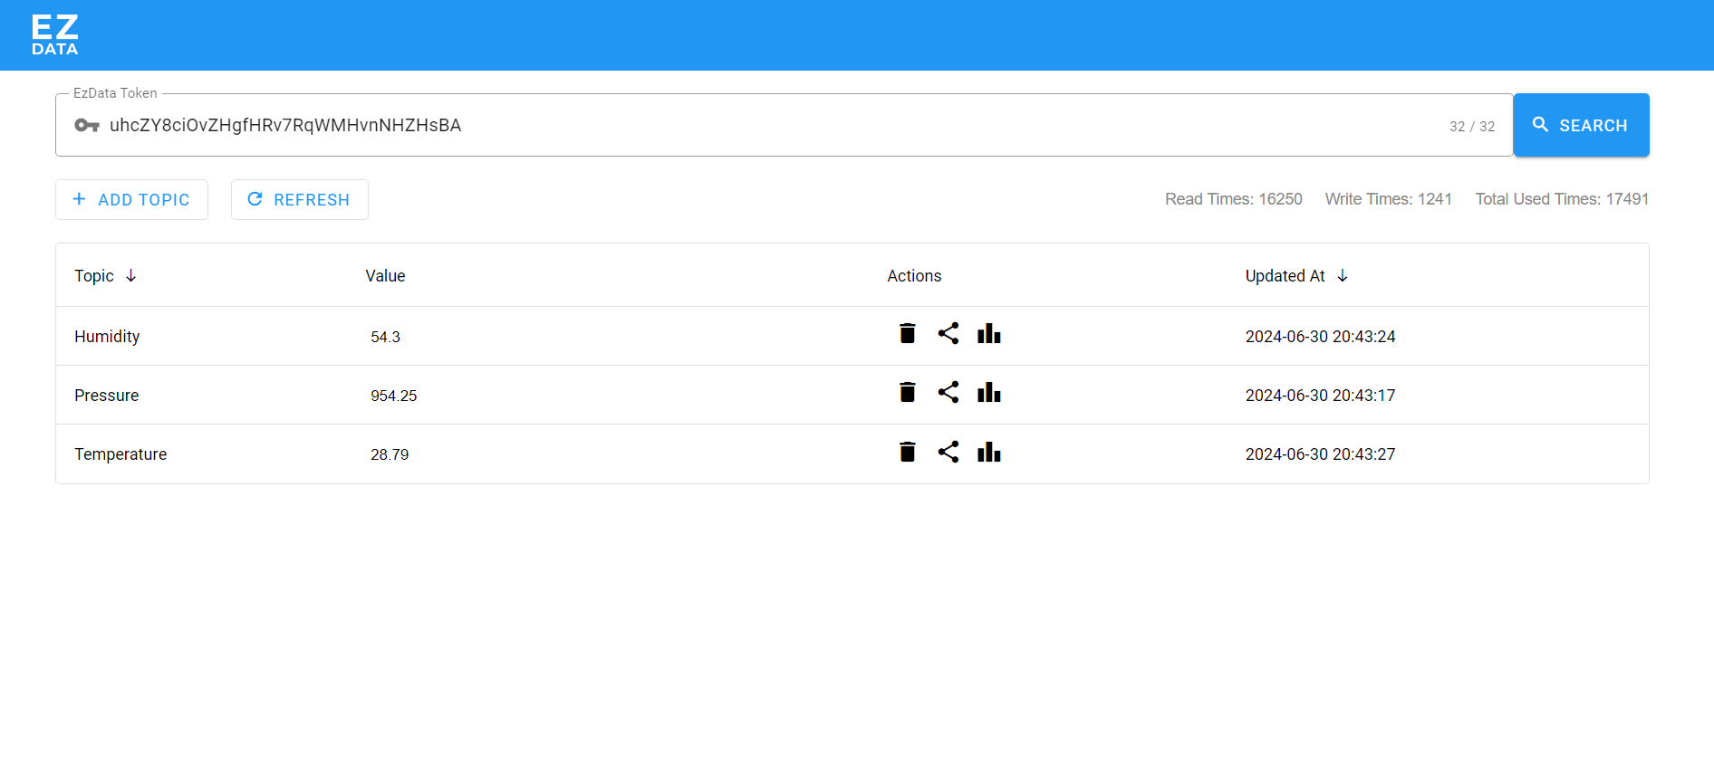
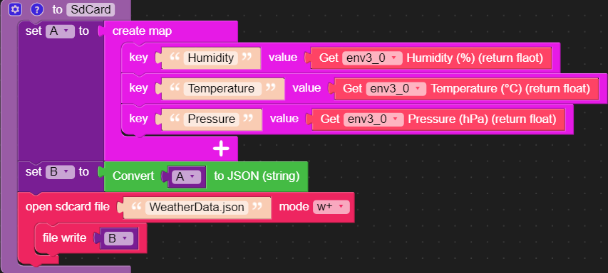
Data and Storage
EZData
SDCard
Real-time sensor data displayed on the M5Stack screen.
User-friendly interface showing Temperature, Humidity, Pressure, etc.

Slide 6
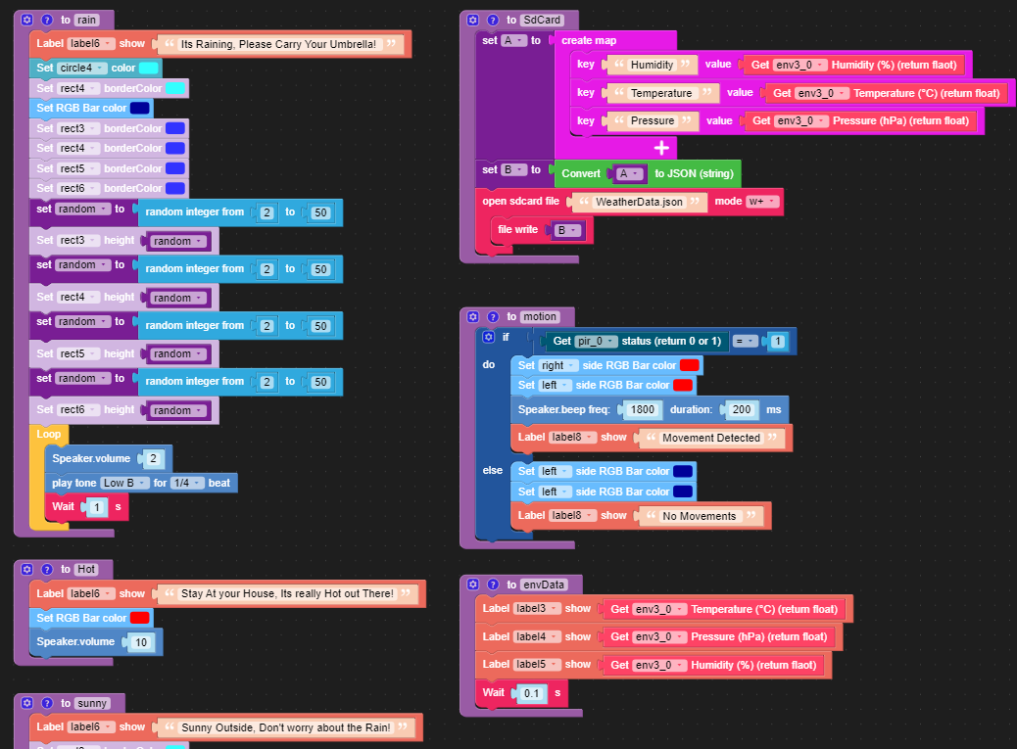
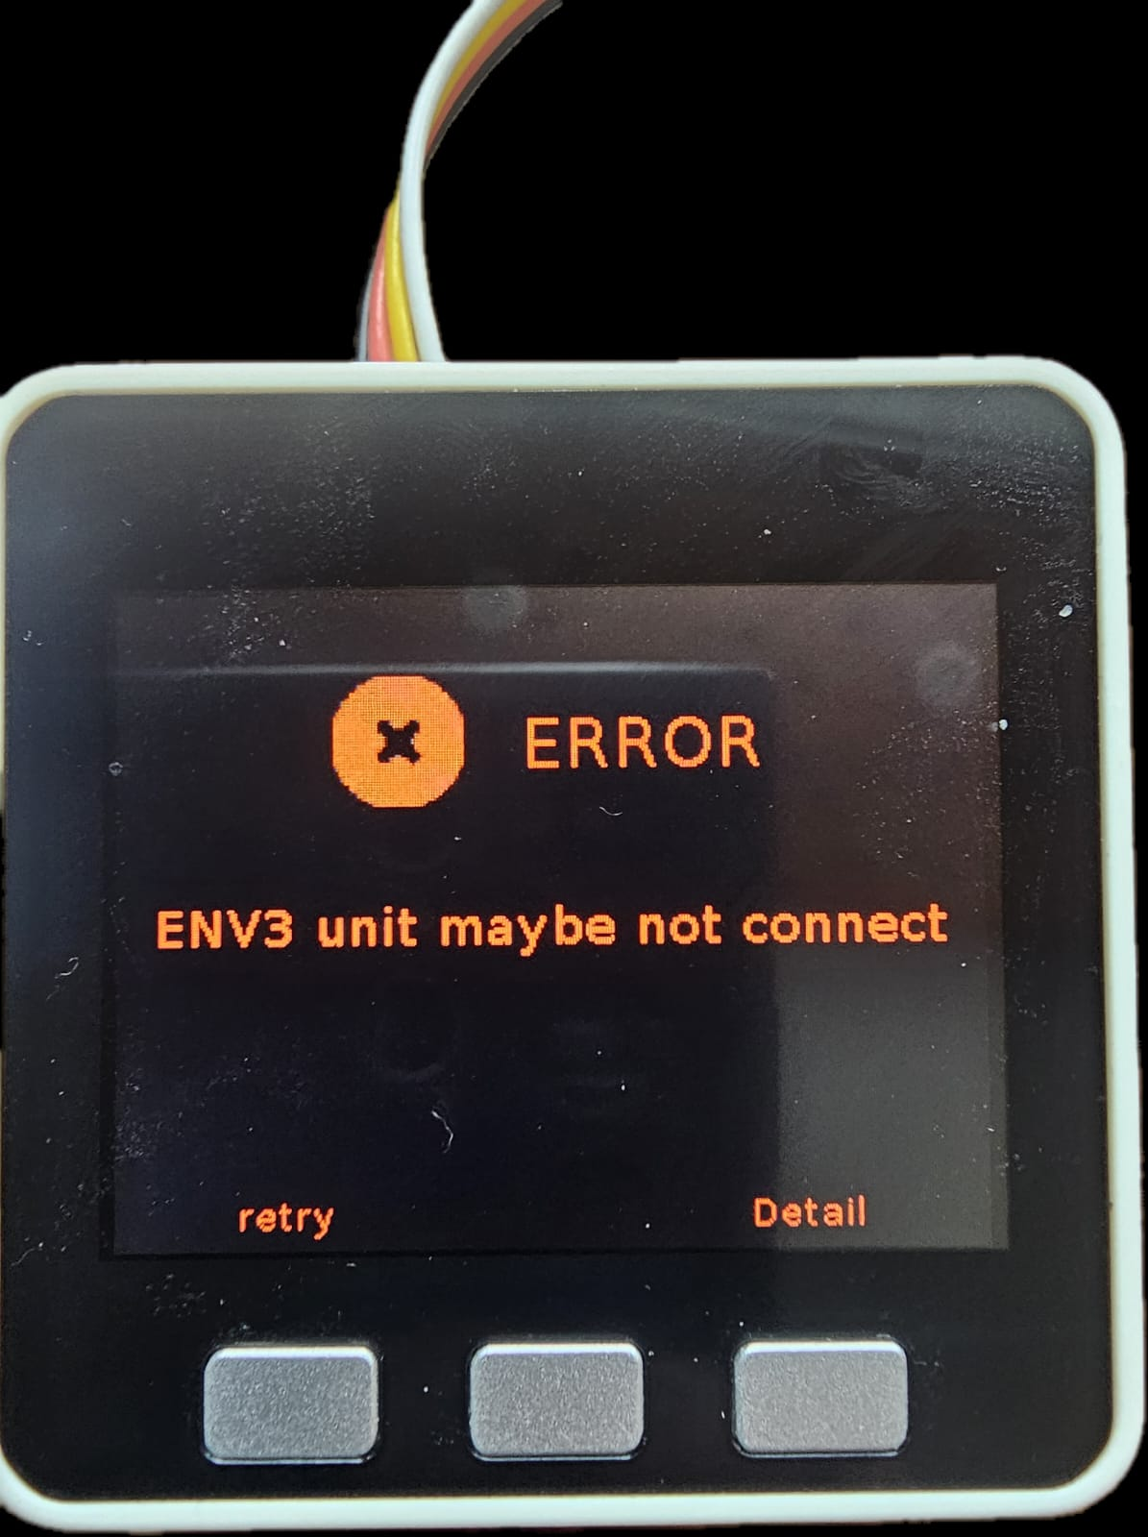
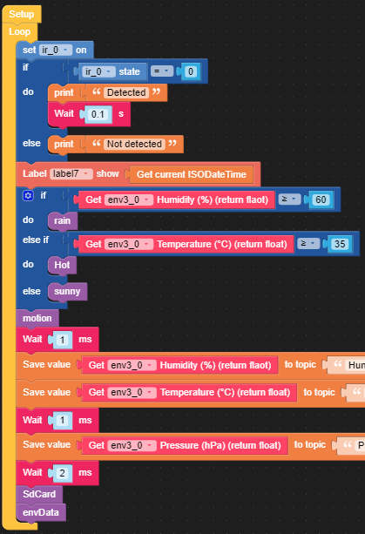
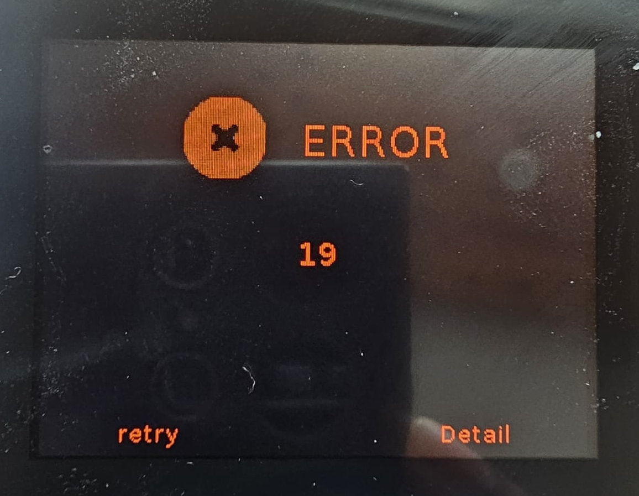
Lessons Learned
UIFlow Blockly
Memory Management
Sensor Integration
Data Logging
Remote Uses
Error Handling

Slide 7
Future Enhancements
More Sensors, Wind Speed, Rainfall
Data display
Better Remote Monitoring
Alert via email or Mobile Application

Slide 8
Conclusion
The M5Stack weather station is a compact and portable tool for environmental monitoring.
Provide Real-time data
Offers Visual feedback
Eco-Friendly

Slide 9
Thank You

