Slide 1
MEDITALK HEALTHCARE PLATFORM
Health records
that move with you.
A simple, secure companion for prescriptions, reminders, reports, and doctor-ready history.
PRODUCT PRESENTATION | 2026
MD Shakib Ahmed | Tarek Rahman | Mayesha Islam
01

Slide 2
One calm place for a complex health journey
Meditalk turns scattered medical moments into one clear daily routine.
01
02
03
Remember
Record
Share
Upcoming doses and simple Take / Skip actions
Prescriptions, reports, and visits stay searchable
Export a clean summary for the next doctor visit
DESIGNED FOR THE MOMENT THAT MATTERS
When the patient is busy, the prescription is handwritten, and the doctor needs the full story.

Slide 3
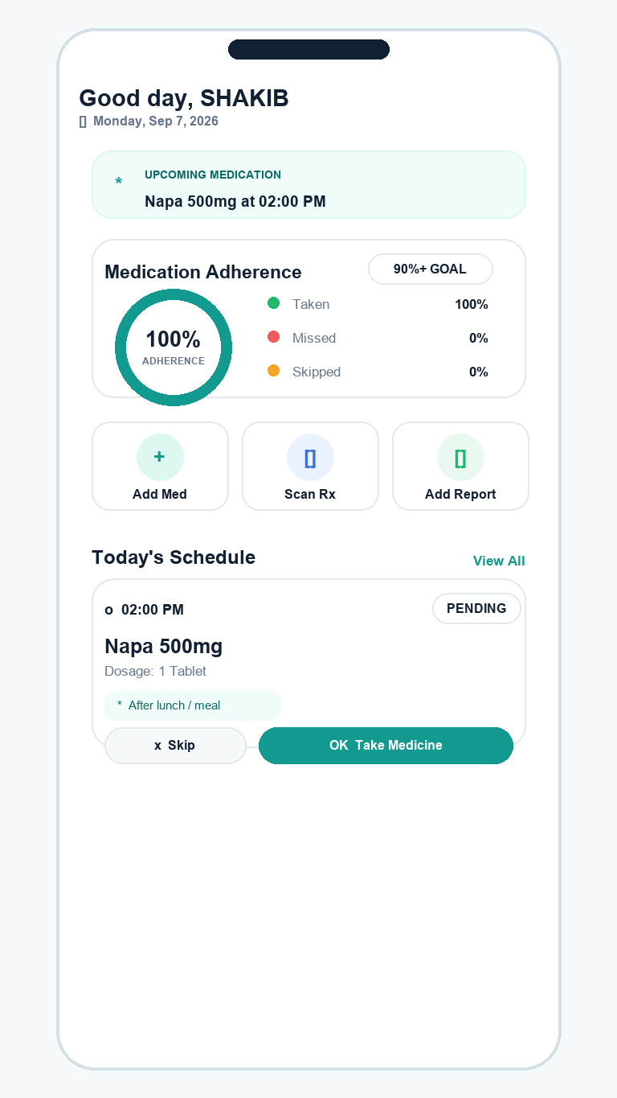
The dashboard answers: what do I do next?
A glanceable home screen for today's care routine.
1
Upcoming dose
The next medication is visible before the user has to search.
2
Adherence ring
Taken, missed, and skipped doses become an immediate signal.
3
Quick actions
Add Med, Scan Rx, and Add Report are one tap away.
CLICK FLOW → Take Medicine → adherence updates

Slide 4
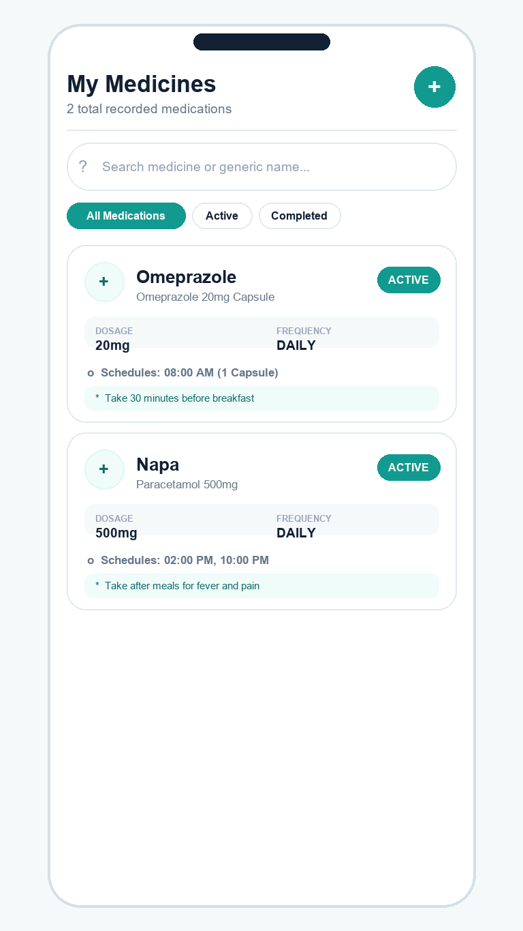
Medication management without the clutter
Search, filter, schedule, and safely remove active treatments.
1
Search + filters
Find a medicine by brand or generic name, then narrow by status.
2
Schedule clarity
Dose, frequency, time, and food instruction sit together.
3
Safe controls
Status toggles and delete confirmation reduce accidental changes.
PATIENT-FIRST DETAIL | before / after meal guidance

Slide 5
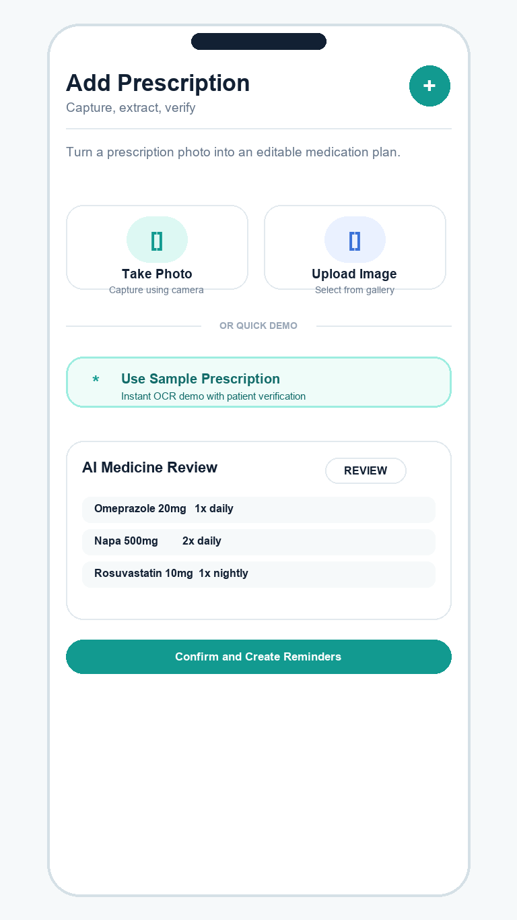
From prescription photo to verified plan
OCR accelerates entry; the patient remains in control before anything is saved.
Capture
1
Camera or gallery image
Extract
2
OCR text and medicine details
Verify
3
Edit before creating reminders
SAFETY GATE | no schedule is committed without confirmation

Slide 6
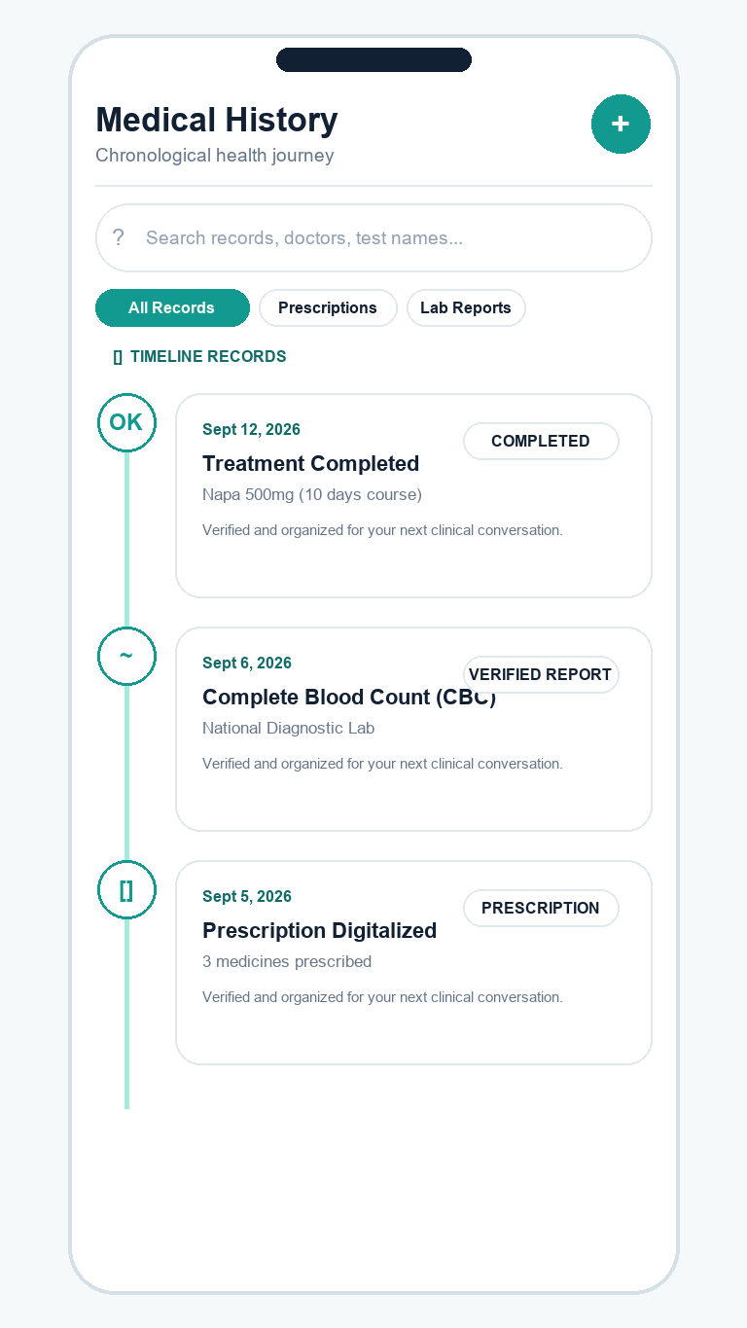
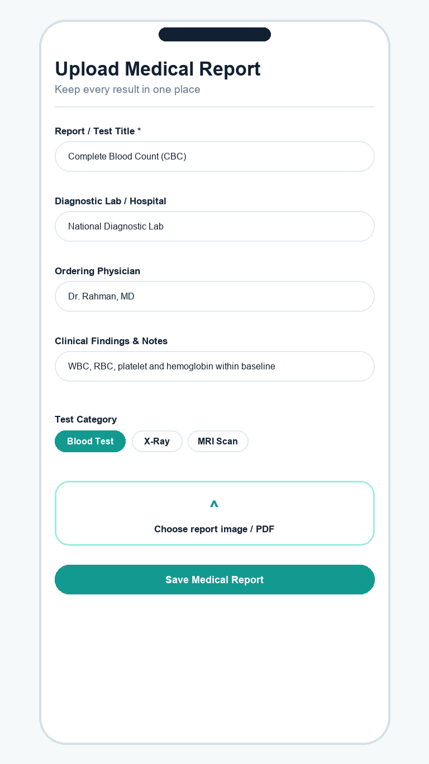
A health story that is easy to scan
Timeline records connect treatments, tests, prescriptions, and visits.
1
Filter the story
Search by doctor, test, or record type.
2
Add evidence
Upload report image or PDF with notes.
3
Keep it clinical
Doctor, facility, category, and findings stay attached to the record.

Slide 7
Ready for the next consultation
Meditalk turns everyday tracking into a doctor-ready summary.
MOBILE
SERVICES
DATA
React Native + Expo
TypeScript + Zustand
Spring Boot
JWT + OCR + OpenPDF
MySQL + JPA
User-isolated records
PDF EXPORT → Profile + Active Medicines + Prescriptions + Lab Results
Safety boundary: Meditalk organizes records and reminders; it does not replace medical advice.

Slide 8
A simple click journey
Every primary action has a visible next step and a clear outcome.
1
→
2
→
3
→
4
Home
Take
History
Export
See next dose
Log adherence
Find the record
Share the summary
The product stays useful because it keeps the user's next decision obvious.

Slide 9
Built by the Meditalk team
A focused product for safer, more organized everyday care.
MD SHAKIB AHMED
ID: 0112230862
TAREK RAHMAN
ID: 0000000000000
MAYESHA ISLAM
ID: 000000000
Meditalk | Secure records. Clear reminders. Better conversations.

Slide 10
A clearer health journey
starts with one small action.
Remember the dose. Record the moment. Bring the full story.
MEDITALK
Thank you

