Slide 1
HEALTHCARE RECORD PLATFORM
Meditalk
Smart Medication Schedules, Prescription OCR & Clinical History
✓ Real-Time Dose Alarms
✓ Prescription OCR Scanner
✓ Doctor-Ready PDF Export
✓ Human Verification Gate
PROJECT TEAM MEMBERS & PRESENTERS
MD Shakib Ahmed
ID: 0112230862
Full-Stack Architecture & Lead Dev
Tarek Rahman
ID: 01111111111111
Backend Security & PDF Engine
Mayesha Islam
ID: 0122222222222
Mobile UI/UX & OCR Integration

Slide 2
PROBLEM & SOLUTION
Bridging the Everyday Healthcare Adherence Gap
The Healthcare Challenge
The Meditalk Solution
THE PROBLEM
MEDITALK SOLUTION
• High Medication Non-Adherence: Over 50% of patients forget prescribed doses or take them with incorrect meal timing.
• Lost Paper Prescriptions: Physical prescription slips get misplaced, damaged, or become unreadable over time.
• Scattered Medical Records: Lab reports, diagnostic tests, and doctor notes remain disconnected across physical folders.
• Rushed Consultations: Doctors lack a structured, comprehensive medical history during acute consultations.
• Smart Daily Schedule: Automated alarm slots with clear Before/After meal dietary guidance.
• AI-Assisted OCR Digitization: Instant camera capture converts prescriptions into structured schedules in seconds.
• Human Verification Gate: Mandatory patient review ensures 100% accuracy before committing to the database.
• Doctor-Ready PDF Export: One-click standardized clinical summary ready for doctor appointments.

Slide 3
SYSTEM ARCHITECTURE
Decoupled 3-Tier Client-Server Architecture
1. Client Layer
Cross-Platform Mobile & Web
2. Service & Gateway Layer
Enterprise Spring Boot API
3. Persistence Layer
Relational Database Schema
• Engine: React Native (Expo SDK 57)
• Language: TypeScript & JSX
• Navigation: Expo Router (File-based)
• State Management: Zustand reactive store
• Networking: Axios with dynamic LAN interceptor
• Framework: Spring Boot 3.3.5 / Java 26
• Security: Spring Security 6 + JJWT Tokens
• OCR Engine: Rule-based regex NLP parser
• Document Engine: OpenPDF 2.0.3 clinical compiler
• File Storage: Multipart local document manager
• Database: MySQL 8.0 / MariaDB (XAMPP)
• ORM: Spring Data JPA / Hibernate 6.5
• Connection Pool: HikariCP high-throughput
• Entities: Users, Doctors, Prescriptions, Medicines, Schedules, Logs, Reports
🔒 Security Protocol: Stateless JWT Bearer Authentication • BCrypt 12-Round Hashing • Strict User Isolation

Slide 4
CORE FEATURES
6 Pillars of the Meditalk Healthcare Platform
Smart Dashboard
Prescription OCR
Medicine Catalog
01
02
03
• Real-time daily adherence ring (Taken / Missed / Skipped)
• Prominent upcoming medication alert banner
• 1-tap dose action controls (Take / Skip)
• Camera capture and photo gallery upload
• NLP regex tokenization for medicines, dosages & frequencies
• Human verification gate before saving
• Multi-time daily schedule reminders (e.g. 08: 00 AM, 02:00 PM)
• Food guidance tags (Before Meal, After Meal, With Food)
• Status toggle (Active / Completed) and safe deletion
Medical Timeline
Clinical PDF Export
Security & Profiles
04
05
06
• Unified chronological stream of all patient healthcare events
• Diagnostic lab report archival with findings & doctor notes
• Multi-category filtering (Prescriptions, Reports, Meds)
• Standardized doctor-ready medical summary compiled via OpenPDF
• Customizable export sections (Profile, Meds, Rx, Reports)
• Instant browser streaming & native document sharing
• Stateless JWT authentication with 24-hour token validity
• Demographics, blood group, allergies & chronic condition tracking
• One-click demo credentials and automatic data seeding

Slide 5
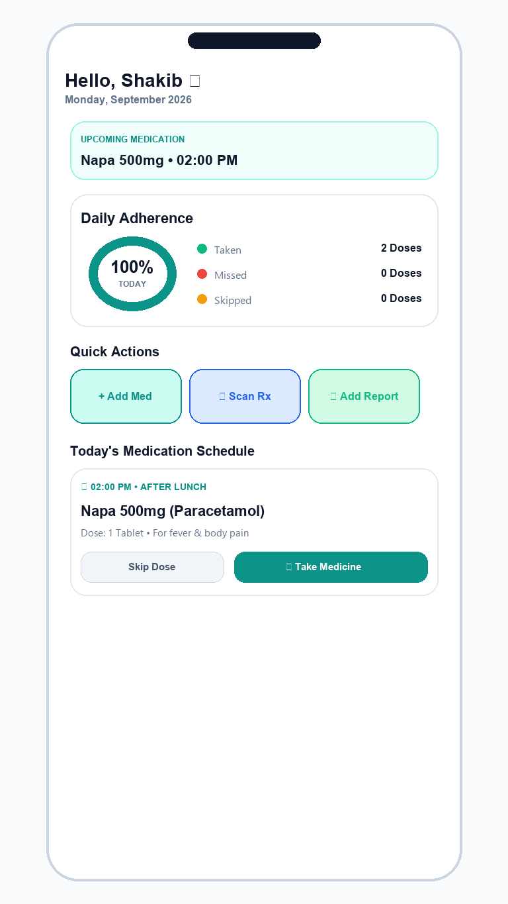
FEATURE IMPLEMENTATION
Smart Dashboard & Daily Adherence Engine
Dynamic Adherence Percentage Engine
CALCULATION ENGINE
• Real-Time Formula: Calculated on-demand as (Taken Doses / Total Scheduled Doses) * 100.
• Visual Status Ring: Dynamic circular progress chart providing immediate visual reinforcement.
• Categorized Breakdown: Tracks Taken (Green), Missed (Red), and Skipped (Amber) dose metrics.
Interactive Dose Intake Cards
ACTION LOGGING
• 1-Tap Action Controls: Users log dose status via [Take Medicine] or [Skip Dose] in 1 touch.
• Optimistic UI Updates: Immediate local state response via Zustand with background REST synchronization.
• Meal-Timing Context: Displays dietary tags (e.g. 'After Lunch', 'Before Breakfast') directly on the card.
Quick Action Workflow Bar
1-TOUCH ACCESS
• Add Med: Manual entry dialog for custom prescription creation.
• Scan Rx: 1-click launcher for the OCR camera digitization pipeline.
• Add Report: Instant upload interface for diagnostic test files and doctor findings.

Slide 6
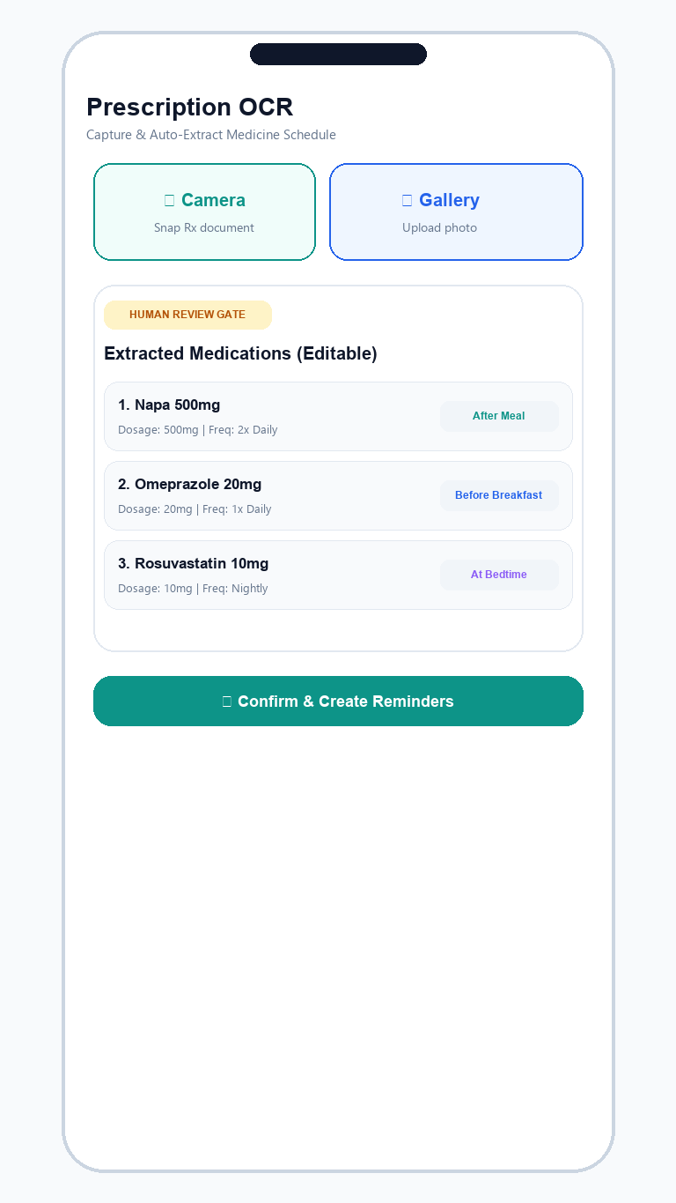
FEATURE IMPLEMENTATION
Prescription OCR Pipeline & Verification Gate
Step 1: Document Capture
Patient captures physical prescription via Camera or selects image from Gallery using expo-image-picker.
1
Step 2: NLP Tokenization
Server-side regex parser extracts drug brand names, dosages (500mg), frequency patterns (1+0+1, 2x daily), and durations.
2
Step 3: Human Verification Gate
Crucial Safety Layer: Extracted items are displayed on an interactive review screen where the patient can edit/correct every field.
3
Step 4: Schedule Generation
Upon confirmation, automatically creates database entities for Medicine and daily MedicineSchedule alarm slots.
4

Slide 7
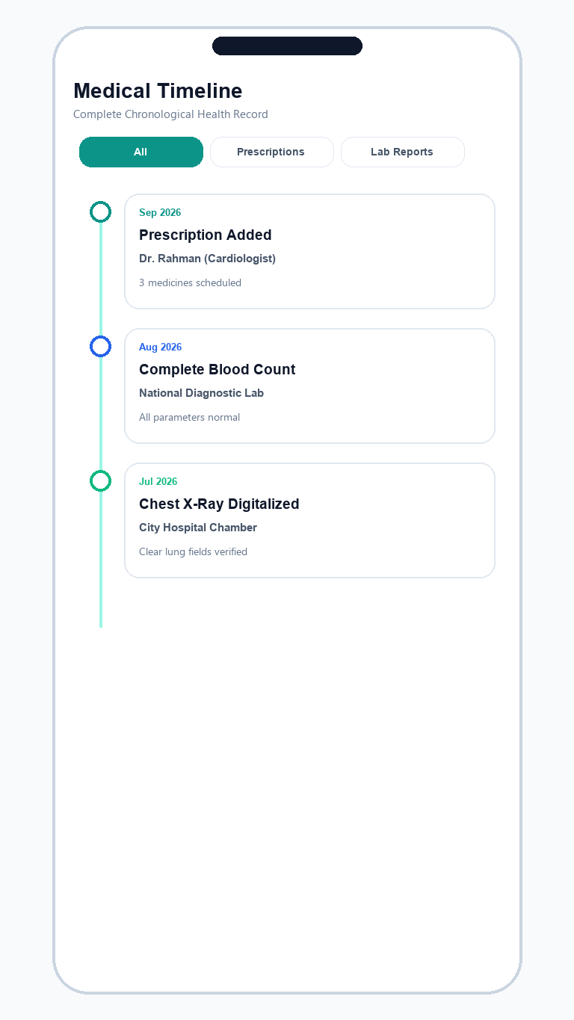
FEATURE IMPLEMENTATION
Medical History & Chronological Timeline
Unified Chronological Health Stream
CHRONOLOGICAL STREAM
• All Healthcare Records in One Stream: Integrates doctor prescriptions, diagnostic lab reports, clinical consultations, and completed medication cycles.
• Visual Timeline Architecture: Grouped by date with color-coded category bullets and connecting vertical flow lines.
• Multi-Filter Tabs: Instant switching between [All Records], [Prescriptions], [Lab Reports], and [Medicines].
• Real-Time Search: Full-text search across doctor names, test titles, and medication names.
Diagnostic Lab Report Archival
REPORT ARCHIVAL
• Structured Metadata: Stores Report Title, Diagnostic Lab/Hospital, Ordering Physician, and Test Findings.
• Document Storage: Multipart file attachment support for PDF reports and high-resolution imaging scans (X-Rays, MRIs).
• Clinical Safety Boundary: Organizes patient-provided records; does not generate diagnostic conclusions without physician oversight.

Slide 8
FEATURE IMPLEMENTATION
Doctor-Ready Clinical PDF Generation
1. Server-Side OpenPDF Engine
2. Modular Section Controls
PDF EXPORT
PDF EXPORT
• Engine: OpenPDF 2.0.3 Java document compiler.
• Vector Tables & Formatting: Clean clinical layout with customized header styling, zebra tables, and metadata bars.
• Zero Frontend Heavy Lifting: PDF binaries compiled securely on the server and streamed directly as byte arrays.
• Patient Demographics: Blood group, known allergies, chronic conditions, and contact details.
• Active Medications: Dosages, frequencies, schedules, and dietary instructions.
• Prescription History: Diagnoses, physician names, and original prescribe dates.
• Diagnostic Results: Lab reports and clinical impressions.
3. Date Range Filtering
4. Instant Sharing & Export
PDF EXPORT
PDF EXPORT
• All-Time History: Complete lifelong record for new primary care physicians.
• Last 30 Days: Focused view for recent acute illness follow-ups.
• Last 90 Days: Standard quarterly consultation summary.
• Past 1 Year: Annual physical checkup report.
• Web Browser: One-click direct blob download.
• Mobile (iOS & Android): Native document sharing intent via Expo Sharing API.
• Print-Ready Format: Standardized A4/Letter format ready for physical doctor review.

Slide 9
TECHNOLOGY STACK
Tools & Technologies Specification
Mobile & Web Frontend
Backend & API Services
Database & Persistence
Developer Tools & Build
• React Native (0.86.3): Cross-platform UI engine
• Expo SDK (57.0.20): Native bridges & bundling
• TypeScript: Type safety across 100% of screens
• Expo Router (57.0.19): File-based navigation
• Zustand (5.0.15): Reactive lightweight state
• Axios (1.20.0): REST client with interceptors
• Lucide React Native: Vector medical icon pack
• Java 26 / JDK: Modern JVM runtime
• Spring Boot 3.3.5: Enterprise microservices
• Spring Security 6: Stateless route security
• JJWT (0.12.6): JSON Web Token crypto sign/verify
• Spring Data JPA: Object-relational mapping
• OpenPDF 2.0.3: Server-side PDF rendering
• BCrypt: 12-round password encryption
• MySQL 8.0: Relational data store
• XAMPP: Local development server environment
• Hibernate 6.5: Schema auto-migration & DDL
• HikariCP: High-performance connection pool
• Multipart Storage: Prescription & report files
• Git & GitHub: Distributed version control
• Maven Wrapper (mvnw): Backend build pipeline
• npm & npx: Node package manager & Expo runner
• ReportLab & python-pptx: Document tooling

Slide 10
GIT WORK
Git Workflow, Repository Structure & Commit Milestones
Repository Architecture & Organization
Milestone Commits & Version Control
MONOREPO REPO
GIT HISTORY
• GitHub Repository: https://github.com/shakibthe69/meditalk-app
• Decoupled Monorepo Structure: Cleanly separates frontend and backend codebases for independent deployment.
• Directory: /mobile — React Native Expo application with app routes, components, hooks, and stores.
• Directory: /backend — Spring Boot API with controllers, services, repositories, and entities.
• Directory: /docs — Technical documentation, presentation decks, and visual assets.
• Environment Isolation: Independent dependency management via pom.xml and package.json.
• Commit a512466: First commit — Initial repository setup and baseline configurations.
• Commit 335111d: Initial Meditalk project — Database entity models and architectural scaffolding.
• Commit c2022e4: Add backend & mobile applications — Complete REST endpoints, JWT security, and React Native UI.
• Commit 6176ecb: Documentation & Presentation — Technical architecture specifications and presentation deck.
• Branch Strategy: Production-stable main branch with clean milestone-driven commit hygiene.

Slide 11
PROJECT TEAM
Meditalk Development Team & Contributions
MD Shakib Ahmed
ID: 0112230862
Lead Full-Stack Architect
Tarek Rahman
ID: 01111111111111
Backend Security & Services
Mayesha Islam
ID: 0122222222222
Mobile UI/UX & OCR Engineer
TEAM MEMBER
TEAM MEMBER
TEAM MEMBER
• Spring Boot REST API architecture & entity modeling.
• React Native dashboard & adherence ring UI implementation.
• Zustand state store & dynamic Axios client configuration.
• System integration, database schemas & project leadership.
• Spring Security 6 configuration & JWT token filters.
• OpenPDF clinical medical summary generation service.
• BCrypt password hashing & authentication endpoints.
• Backend test verification & database health checks.
• Prescription OCR capture UI & human review modal.
• Medical history timeline screens & category filters.
• Diagnostic lab report upload interface & styling.
• Responsive mobile components & cross-platform UX.

Slide 12
PRODUCTION READY HEALTHCARE PLATFORM
Better Medication Adherence.
Organized Health Records.
Meditalk transforms physical prescriptions and scattered lab tests into one calm daily routine and doctor-ready summary.
▶ START LIVE DEMO
Thank You! Questions & Answers (Q&A)

