Slide 1



Enterprise Network Automation
and Hybrid-Cloud
Infrastructure as Code
Project ENT-HYBRID-NET | GNS3 · Ansible · Git · Terraform on AWS
[Member 1 name]
Network Design (Part A)
[Member 2 name]
Ansible Automation (Part B)
[Member 3 name]
Terraform & AWS (Part C)
Notes:
Member 1 opens: introduce the team, the client scenario and the three parts of the project.

Slide 2
Agenda and presenters
All members | Team
Three parts, one engineering approach: define it as code, keep it in Git, apply and verify automatically
Member 1
Member 2
Member 3
Part A | Enterprise network
Part B | Ansible automation
Part C | Terraform on AWS
Hierarchical GNS3 design
IP plan, VLANs, OSPF
Services & security
Connectivity evidence
Source of truth + roles
Vault-protected secrets
Idempotency & compliance
Day-2 change via Git
VPC architecture
Terraform workflow
Deploy, verify, destroy
Cost control & Git history
Notes:
Member 1: walk through who presents which part. Closing slides are shared by the whole team.

Slide 3



The challenge
Member 1 | Network Design (Part A)
A multinational enterprise moving from manual CLI administration to automated hybrid cloud
Inconsistent configs
Objectives
Each device configured by hand drifts from the standard
Design a scalable, secure network for HQ, Branch and Data Centre
Automate configuration, backup, verification and compliance with Ansible
Provision secure AWS infrastructure with Terraform
Version-control everything in Git
Slow change
Every change typed on many consoles, one at a time
Weak audit trail
No record of who changed what, or why
Notes:
Member 1: explain why manual administration does not scale and list the four objectives.

Slide 4
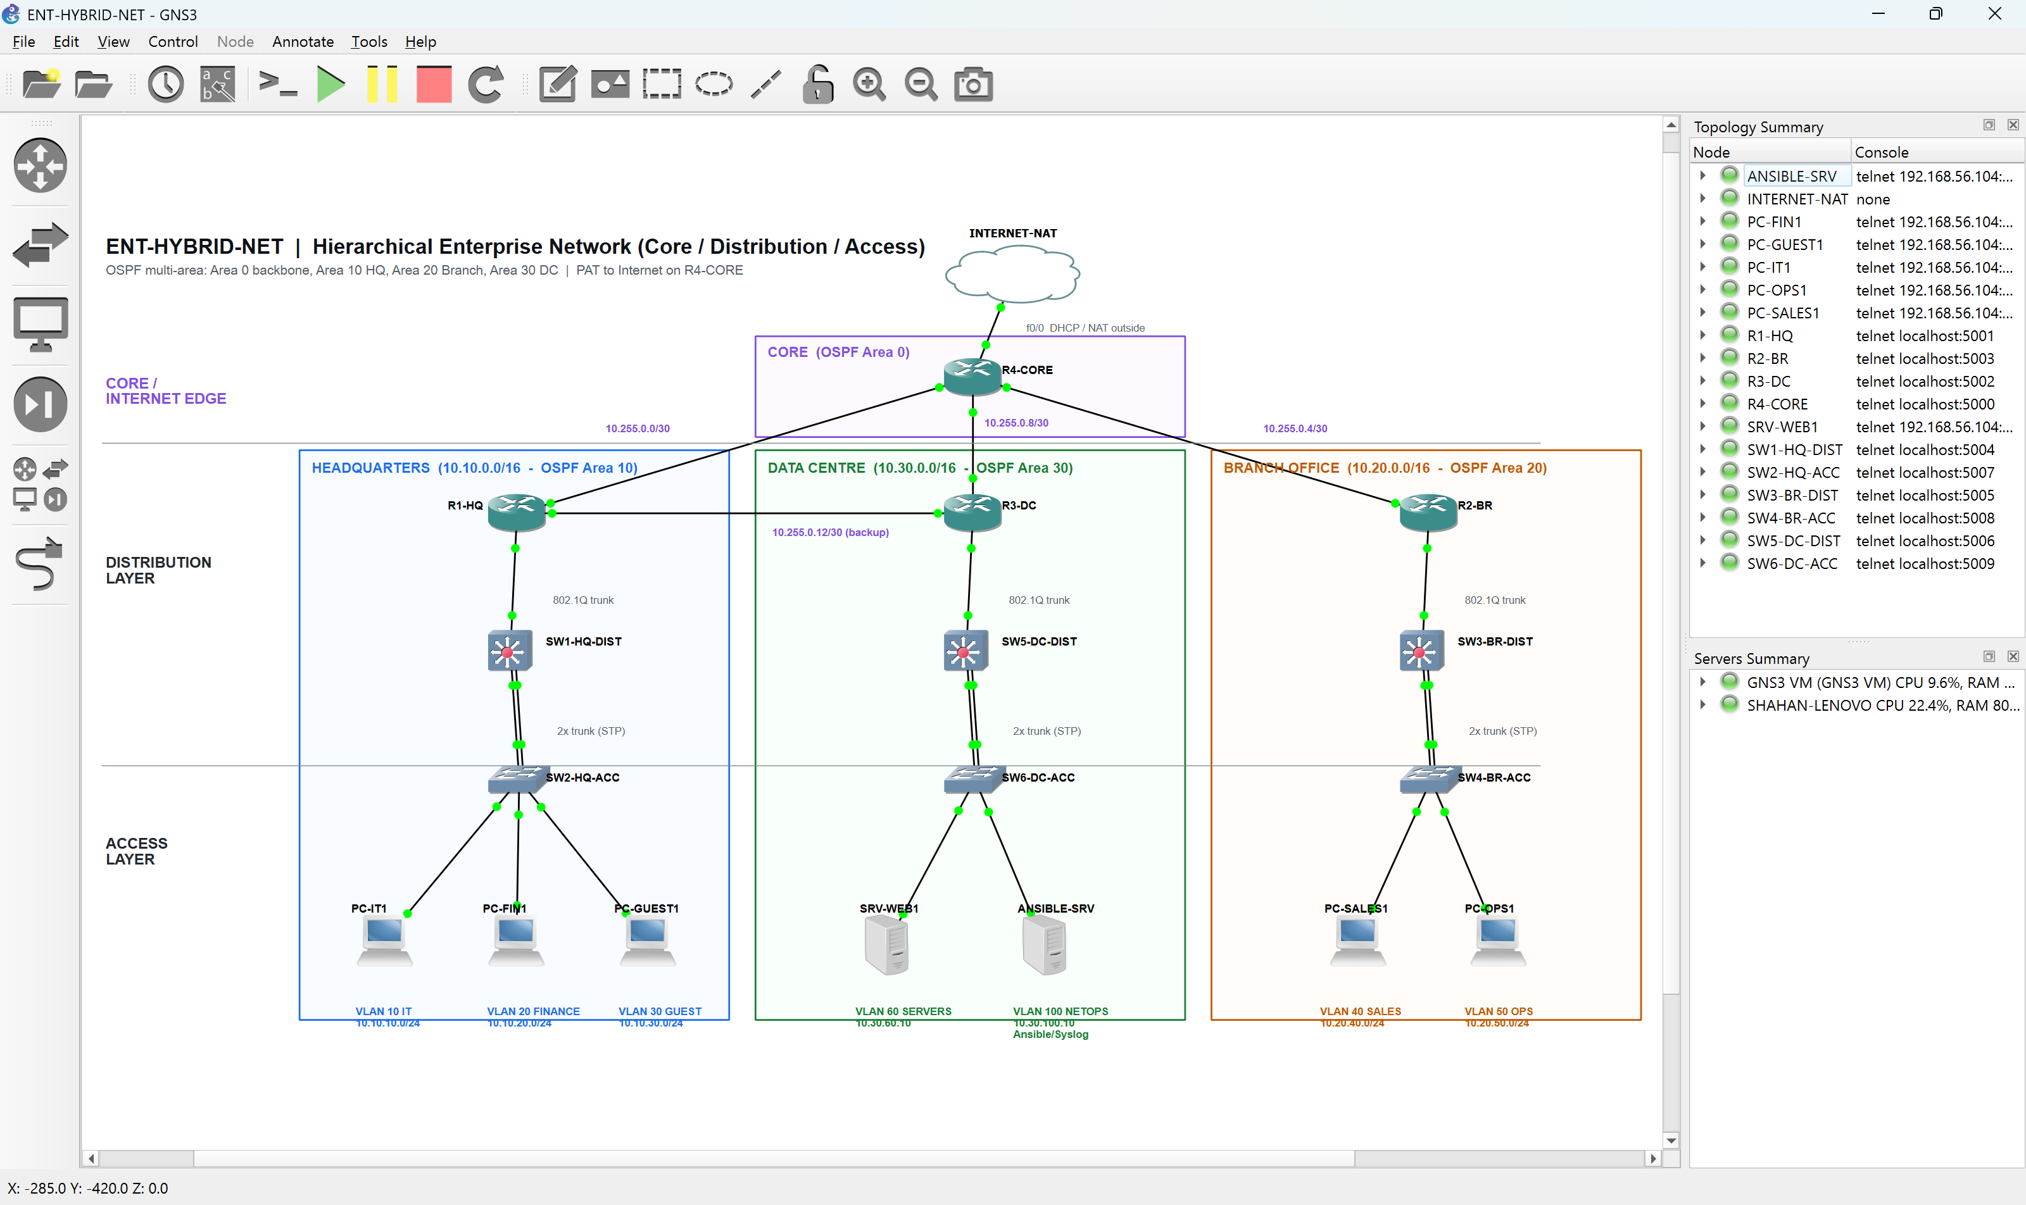
Hierarchical network design
Member 1 | Network Design (Part A)
Core / distribution / access across three sites - built from code through the GNS3 REST API
4
Cisco 7200 routers
6
EtherSwitch switches
3
sites + core
1
Linux automation server
Notes:
Member 1: core R4 connects the three site routers; each site has a distribution and an access switch. Redundant R1-R3 link and dual trunks give resilience.

Slide 5

IP addressing and VLANs
Member 1 | Network Design (Part A)
One summarisable /16 per site keeps the core routing table to three routes
Site | VLAN | Subnet | Purpose
HQ | 10 / 20 / 30 | 10.10.x.0/24 | IT, Finance, Guest (DHCP)
Branch | 40 / 50 / 45* | 10.20.x.0/24 | Sales, Operations, Marketing (DHCP)
Data Centre | 60 / 100 | 10.30.x.0/24 | Servers, NetOps (Ansible + Syslog)
All sites | 99 | 10.x0.99.0/24 | Switch management
Core | - | 10.255.0.0/24 (/30s) | Point-to-point WAN links
AWS | - | 172.20.0.0/16 | VPC - no overlap with on-premises
Multi-area OSPF
Area 0 backbone, one area per site, ABR summarisation, MD5 authentication and a cost-100 backup link.
* VLAN 45 was added later as a Day-2 change through Git
Notes:
Member 1: explain the addressing logic and why summarised areas make the design scalable.

Slide 6





Services and security
Member 1 | Network Design (Part A)
Every requirement configured, each with a clear purpose
VLANs & inter-VLAN
OSPF
DHCP
DNS
Router-on-a-stick, dual trunks, STP root
Multi-area, summarised, authenticated
Local pools per site - survives WAN failure
corp.local on R3-DC, forwards to Internet
NTP & Syslog
SSH
ACLs
NAT
R4 time source; central log collector
SSH v2 only, VTY limited to NetOps/IT
Guest Internet-only, Finance & servers protected
Single PAT Internet edge on R4
Notes:
Member 1: summarise how each required service was implemented and the security thinking behind the ACLs.

Slide 7
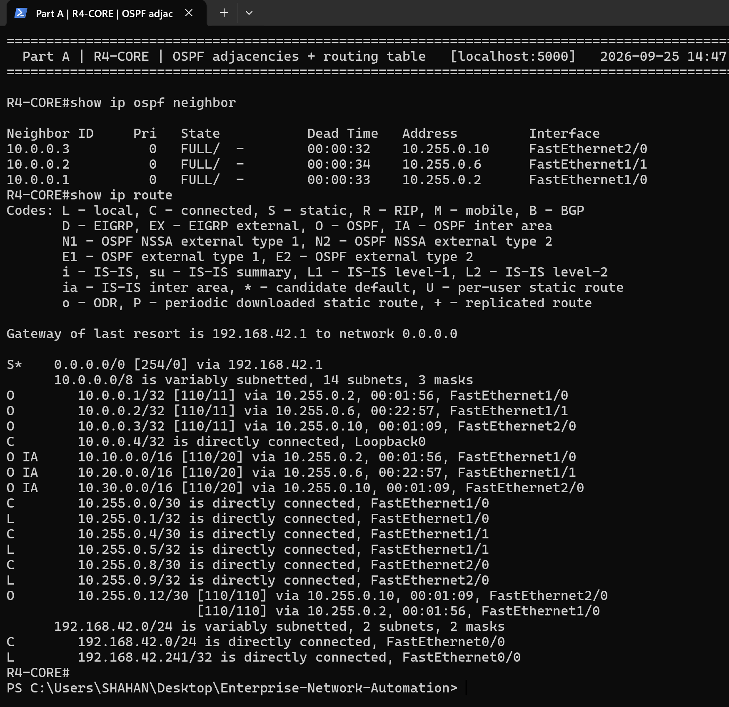
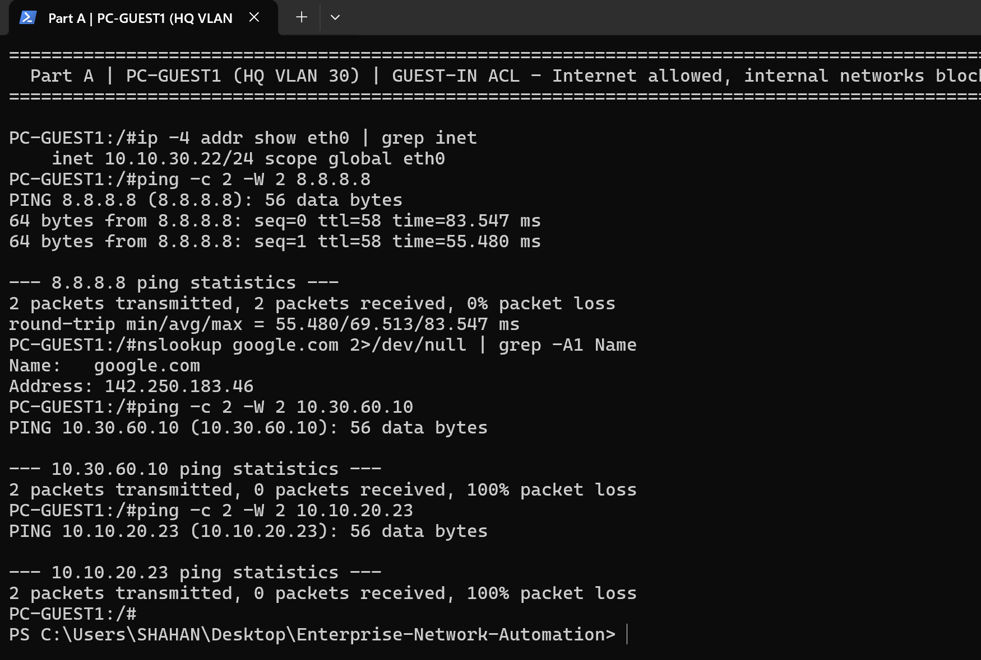
Connectivity verification
Member 1 | Network Design (Part A)
Tested from the devices and from real end hosts
R4-CORE: 3 FULL OSPF neighbours, site summaries, default route
Guest PC: Internet allowed, internal networks blocked
Notes:
Member 1: point out the FULL adjacencies and the ACL result; hand over to Member 2.

Slide 8





Automation architecture
Member 2 | Ansible Automation (Part B)
The network's desired state lives in Git; Ansible makes the devices match
Git
YAML data
Jinja2 roles
Ansible
Verify & audit
Reviewed commits
Single source of truth
Render IOS config
SSH to 10 devices
Assertions + reports
Control node: ANSIBLE-SRV in the Data Centre NetOps VLAN
Inventory grouped by role (routers/switches) and by site (HQ/Branch/DC)
Credentials encrypted with Ansible Vault (AES-256), never in Git
Notes:
Member 2: explain the pipeline from a Git commit to verified devices.

Slide 9
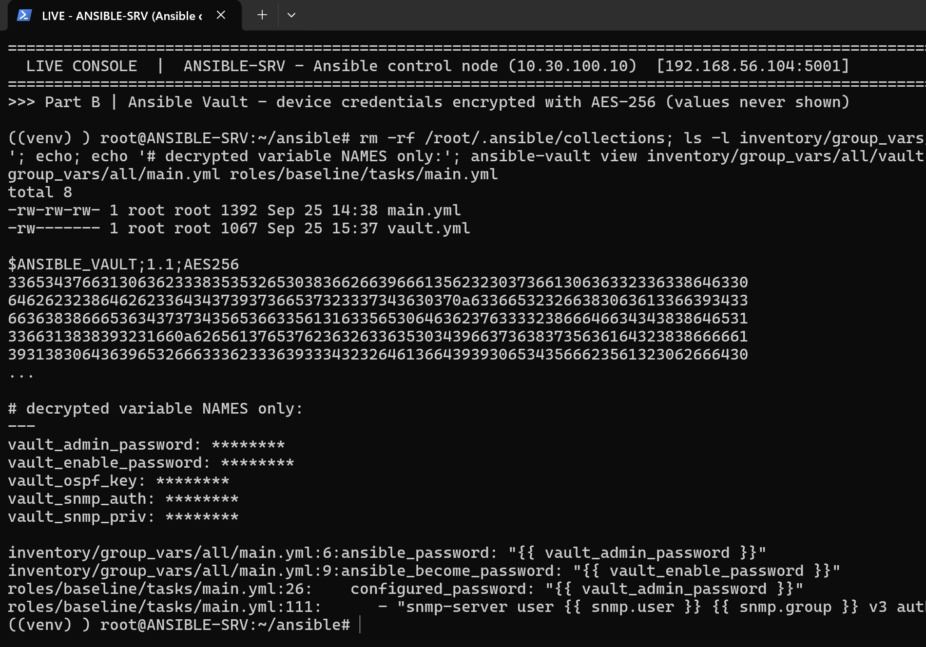
Eight roles, ten playbooks
Member 2 | Ansible Automation (Part B)
One pipeline: back up, build, secure, verify, audit
backup
baseline
Timestamped running-config backups
Hardening, SSH, NTP, Syslog, SNMPv3, banner
vlans
routing
VLANs, trunks, access ports, STP
Sub-interfaces, P2P links, OSPF
services
acl
DHCP, DNS records, NAT
Declarative security ACLs
verify
compliance
OSPF, routes, VLANs, reachability asserts
14 security rules per device
Vault: secrets encrypted, names only shown
Notes:
Member 2: briefly describe each role; stress that secrets are encrypted.

Slide 10
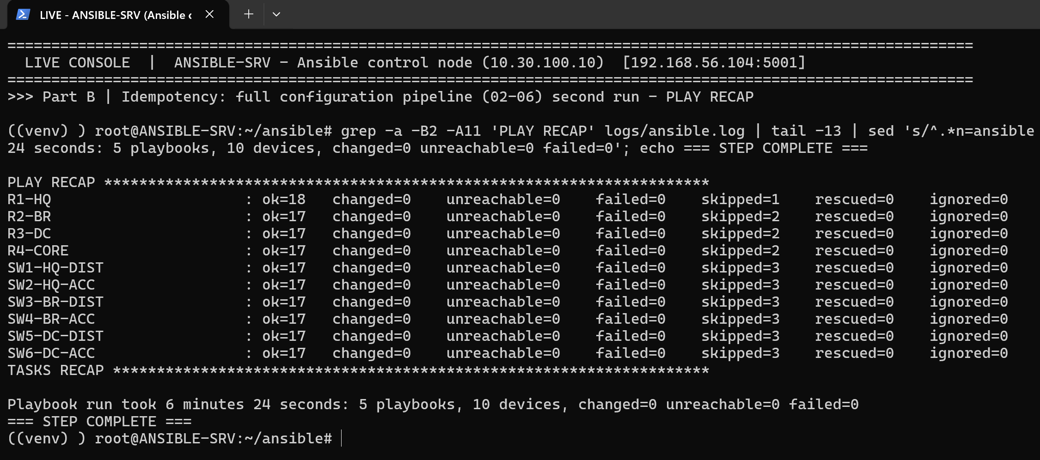
Automation results
Member 2 | Ansible Automation (Part B)
Proven by the pipeline's own output
10 / 10
devices configured and verified
14 / 14
compliance rules on every device
0
changes on a second run (idempotent)
0
failures across all playbooks
Full configuration pipeline re-run: changed=0, failed=0 on all 10 devices
Notes:
Member 2: idempotency means the automation is safe to re-run and corrects drift.

Slide 11
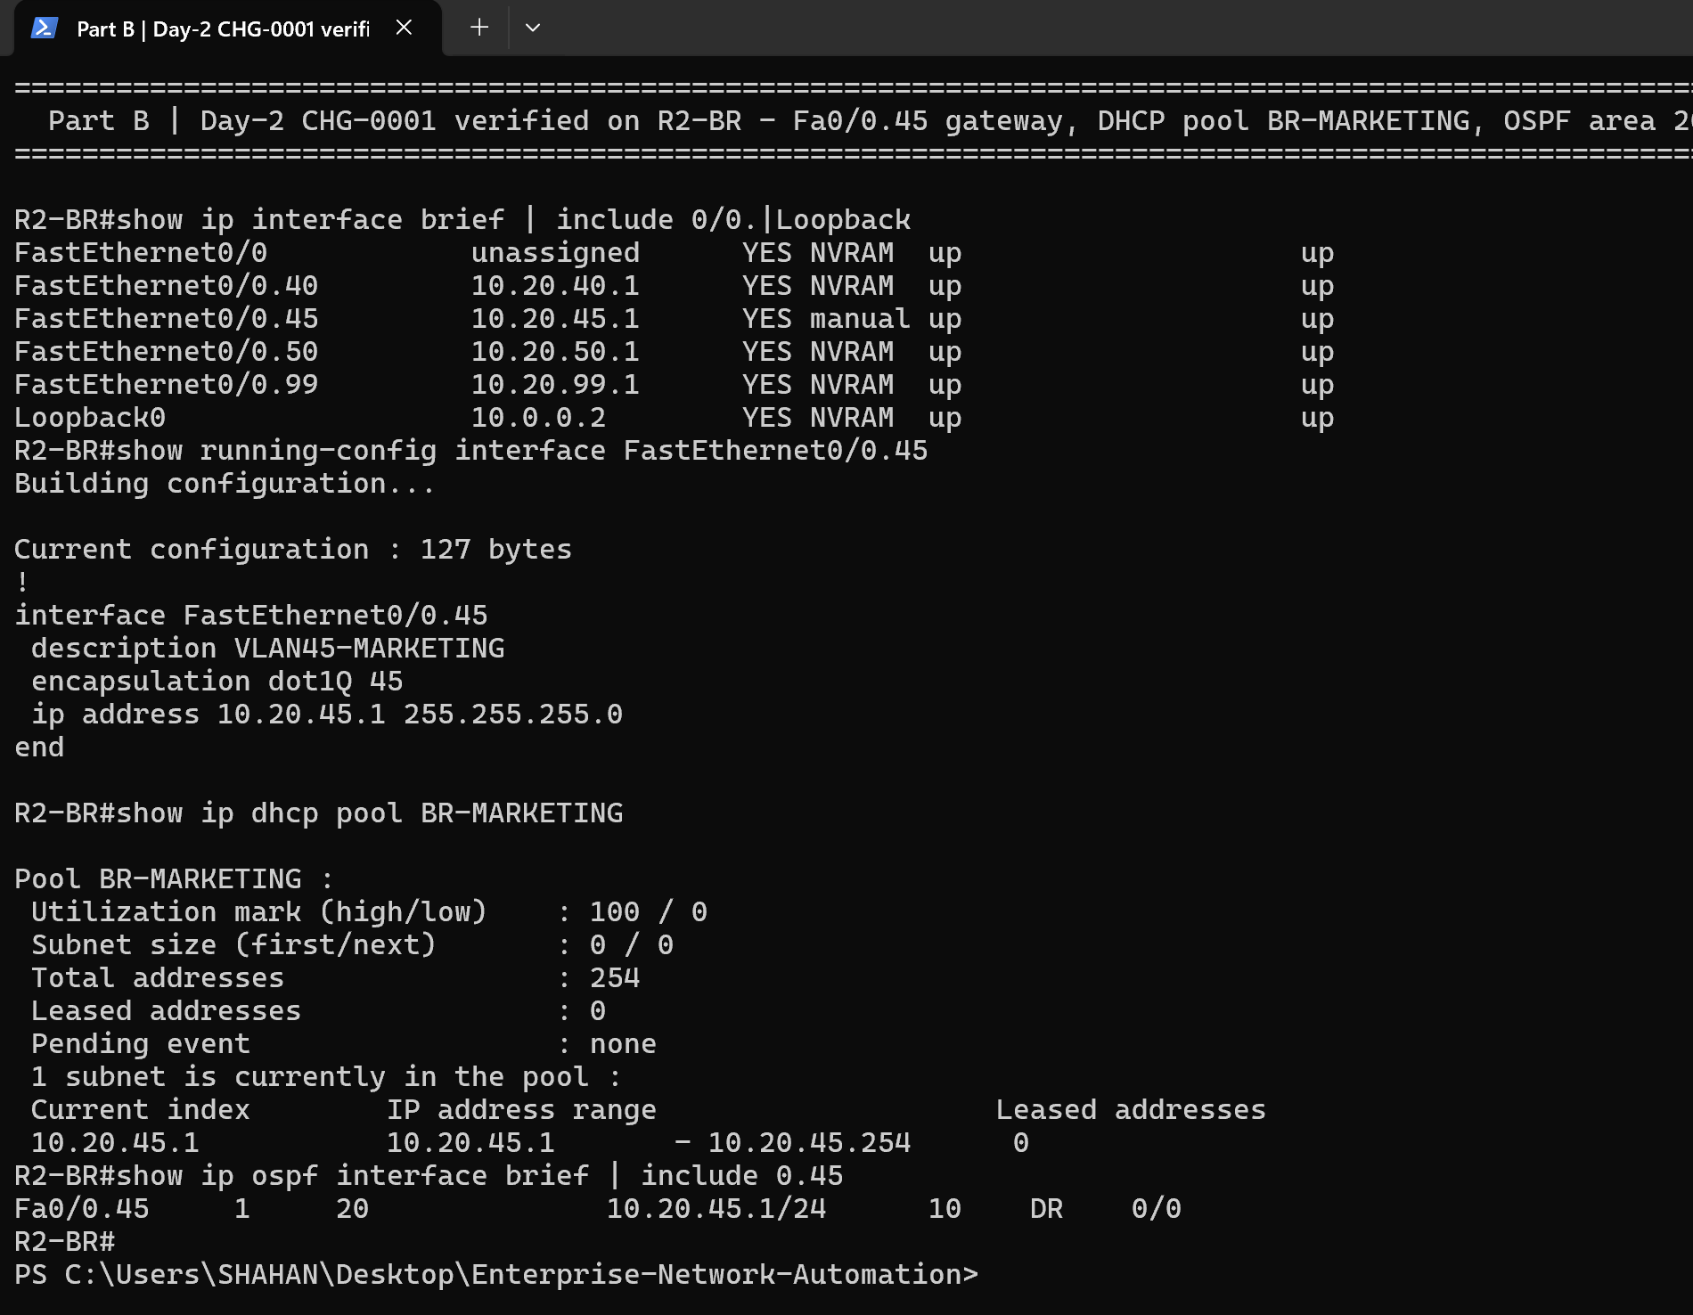
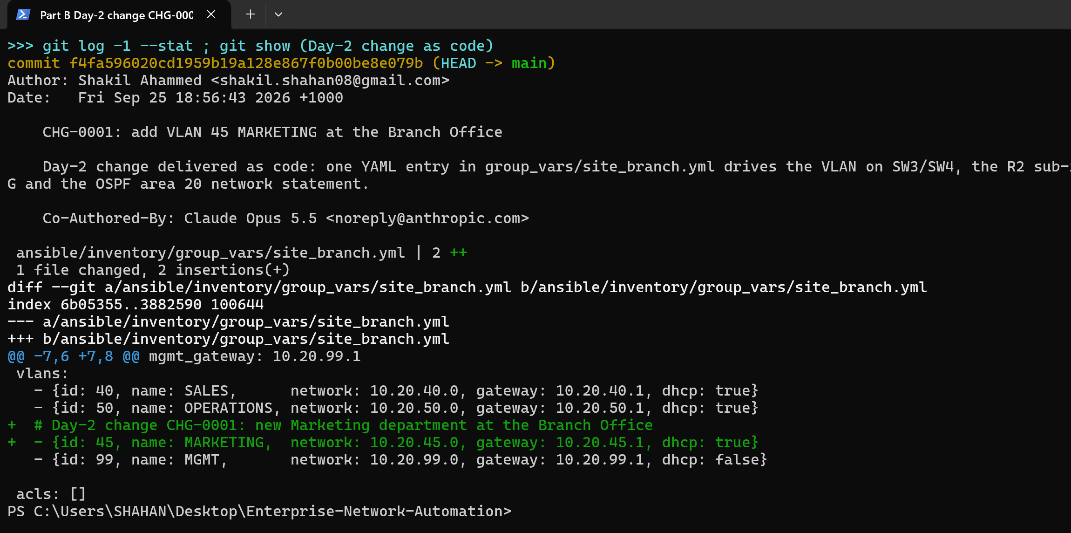
Day-2 change delivered as code
Member 2 | Ansible Automation (Part B)
Adding VLAN 45 MARKETING at the Branch - no CLI typed by hand
1
Edit YAML
2
Git commit
3
Dry run
4
Apply
5
Verify
2 lines in site_branch.yml
CHG-0001 reviewed
--check --diff preview
Switches, router, DHCP, OSPF
Devices confirm change
The whole change is a two-line Git diff
R2-BR after the change: gateway, DHCP pool, OSPF area 20
Notes:
Member 2: one YAML entry drove changes on three devices; hand over to Member 3.

Slide 12
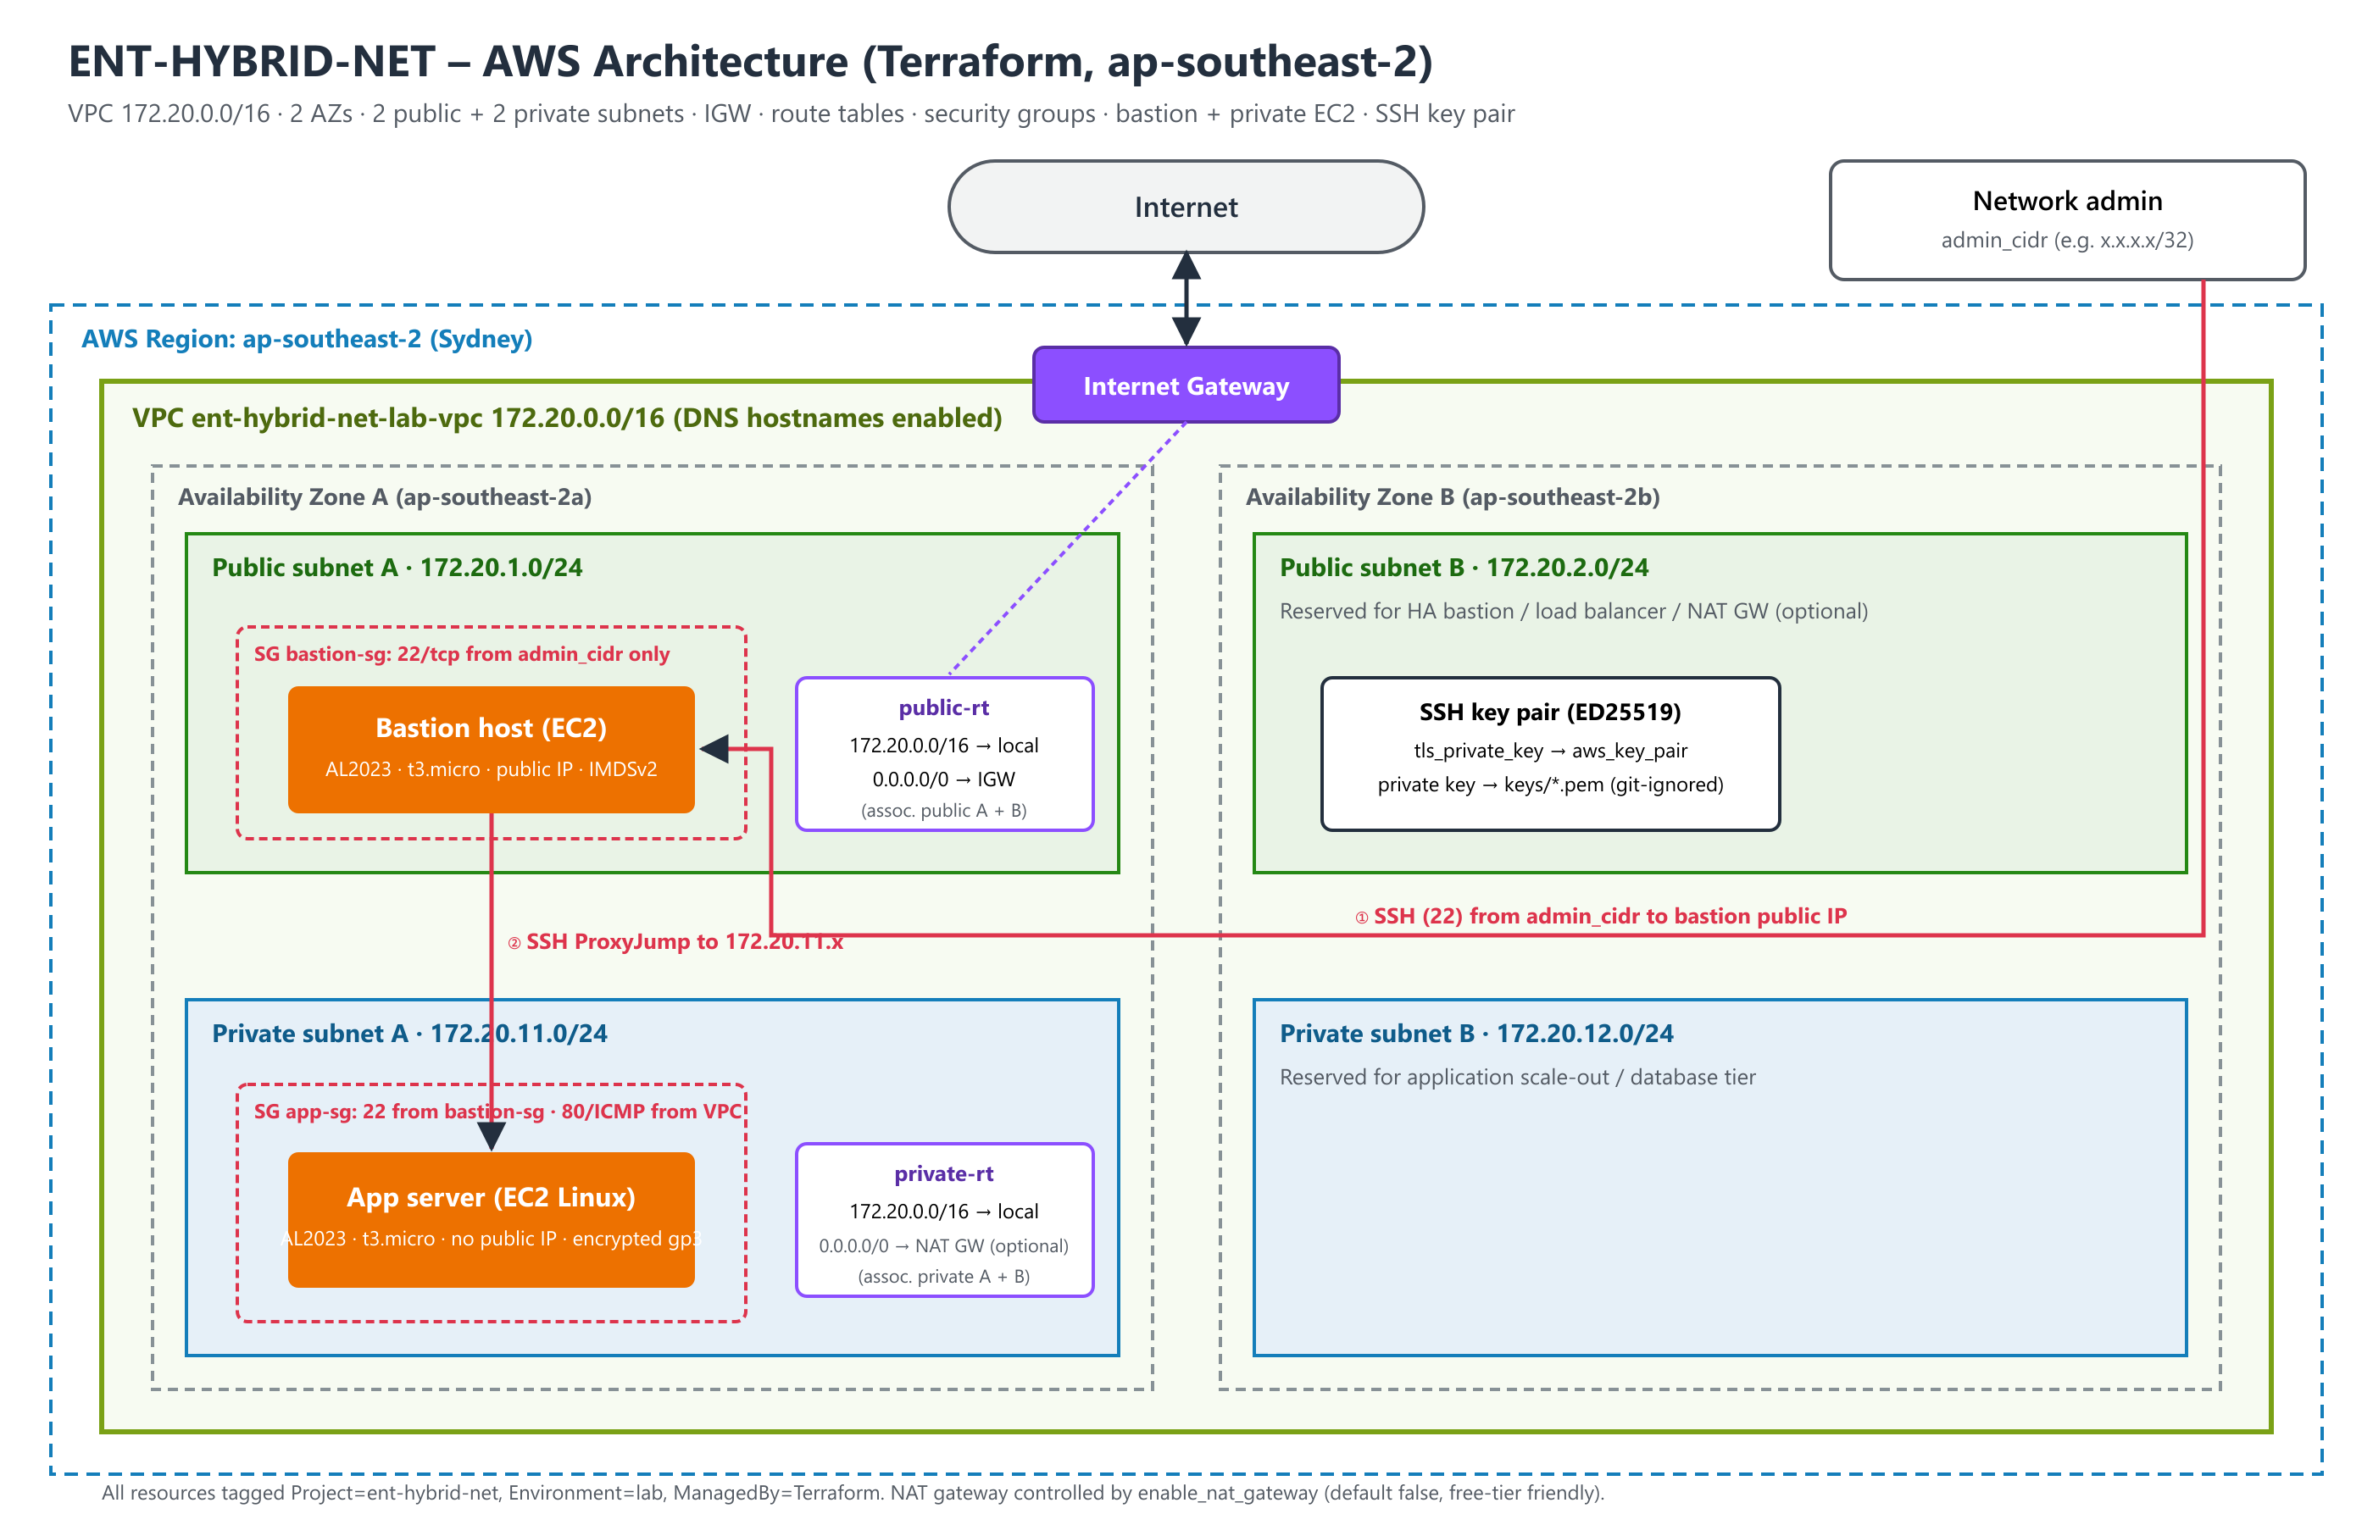

AWS architecture
Member 3 | Terraform & AWS (Part C)
Secure two-AZ VPC defined entirely in Terraform
VPC 172.20.0.0/16
2 public + 2 private subnets in 2 AZs
Bastion + private EC2
Only the bastion faces the Internet
Security groups
SSH from admin /32 → bastion → app
ED25519 key pair
Generated by Terraform, never in Git
Notes:
Member 3: explain the network layout and the bastion access model.

Slide 13
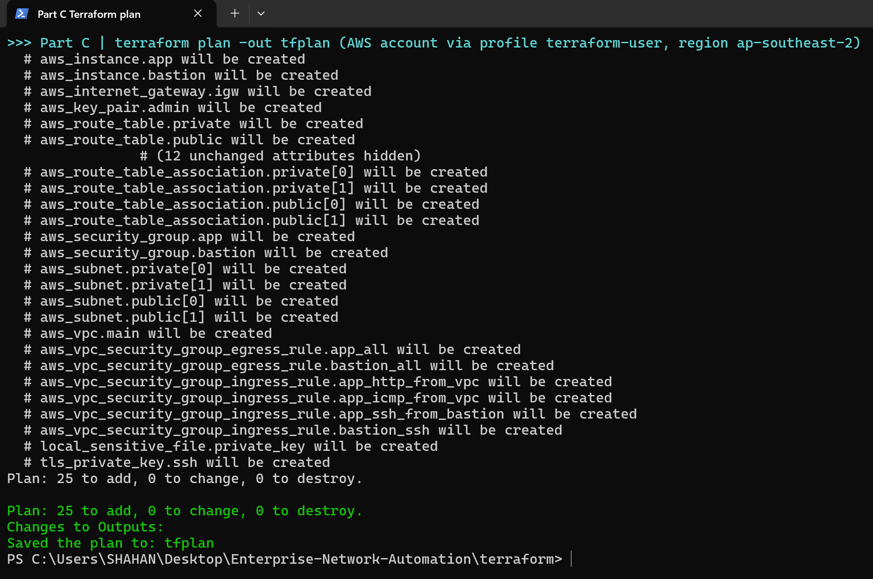
Terraform workflow
Member 3 | Terraform & AWS (Part C)
Declarative: describe the end state, Terraform plans the changes
init
validate
plan
apply
verify
destroy
25
~30 s
6
resources created
to deploy
staged Git commits
Code split by concern: versions, variables, network, security, compute, outputs
Variables validated (admin CIDR can never be 0.0.0.0/0)
State, keys and variable files excluded from Git; provider versions pinned
Notes:
Member 3: walk through each command and why the plan is saved before apply.

Slide 14
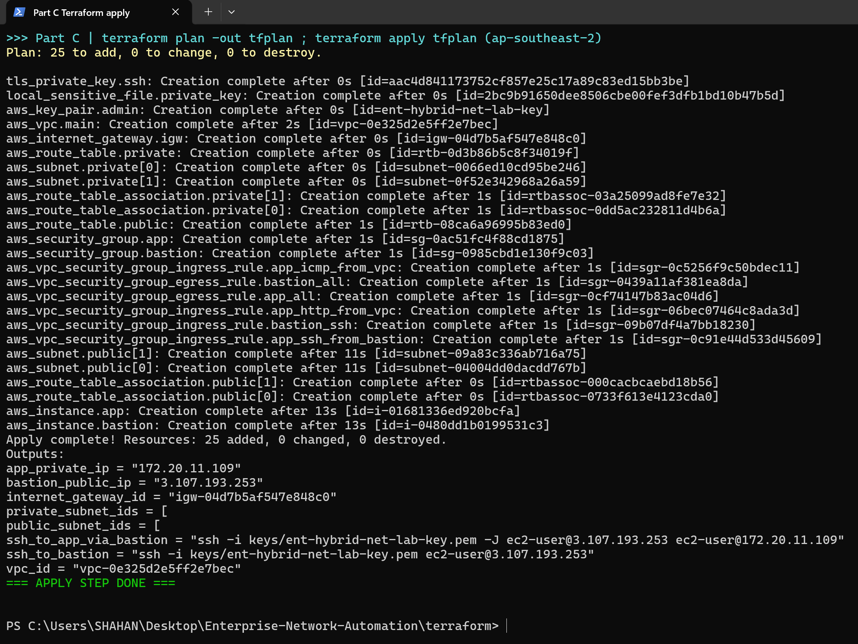
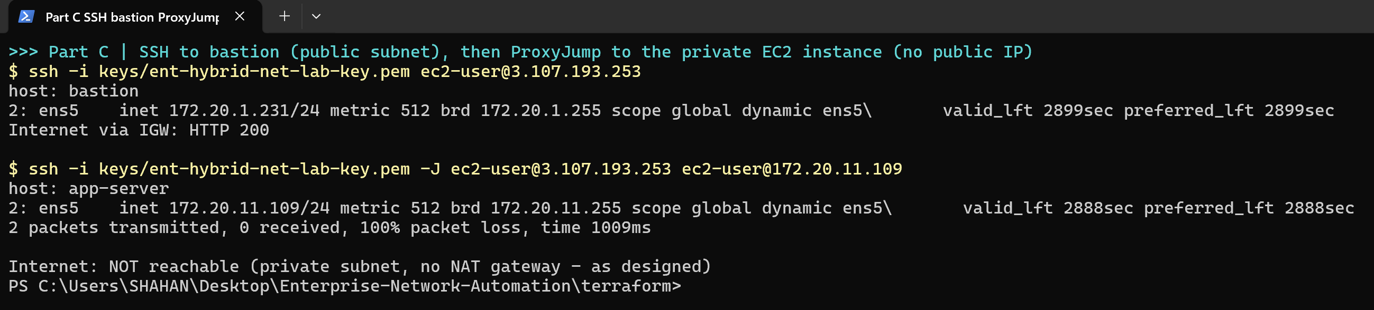
Deployment evidence
Member 3 | Terraform & AWS (Part C)
Applied to AWS, then verified independently
terraform apply: 25 resources and outputs
SSH to bastion, then ProxyJump to the private server
Notes:
Member 3: the private server has no Internet path by design; access only through the bastion.

Slide 15
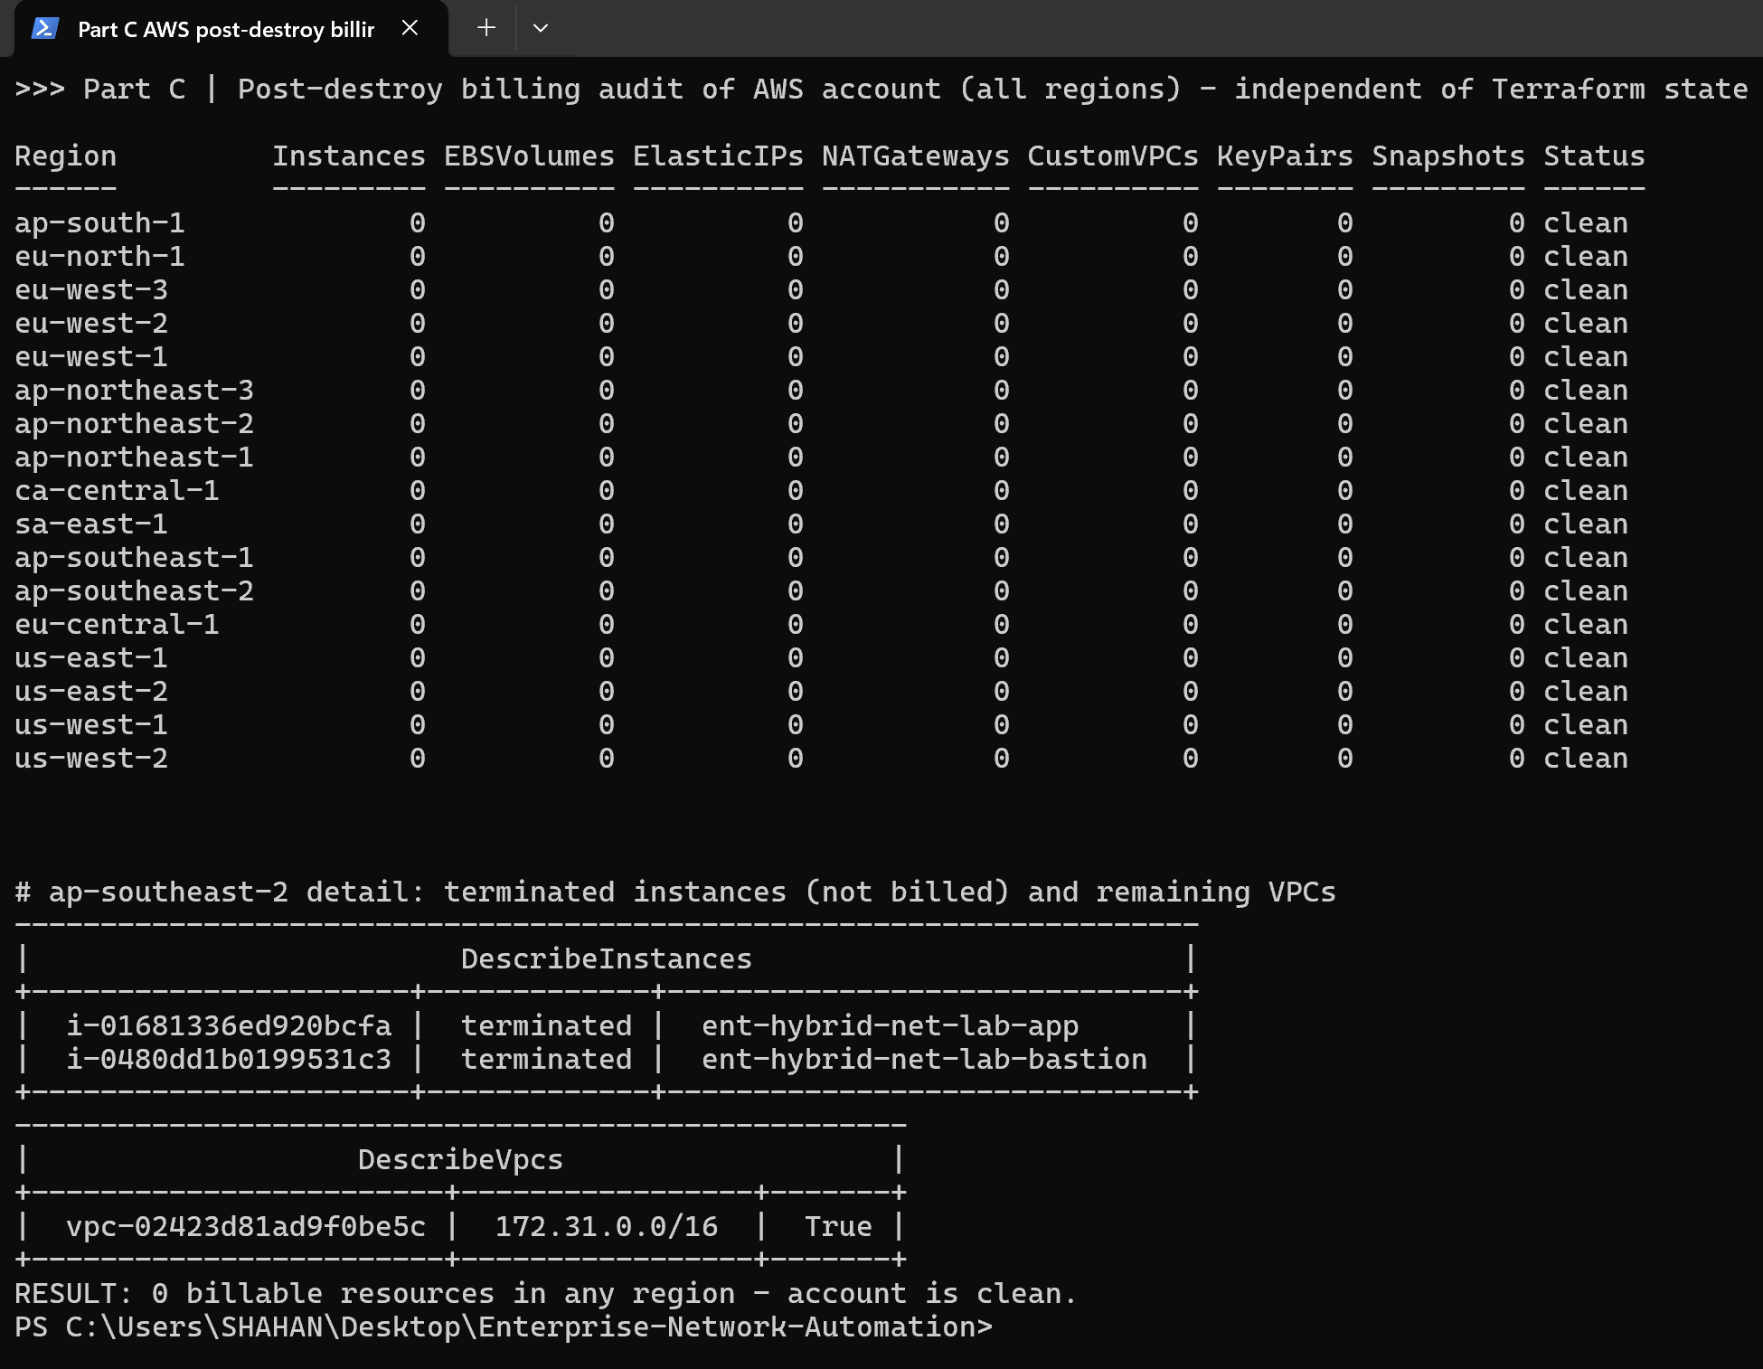
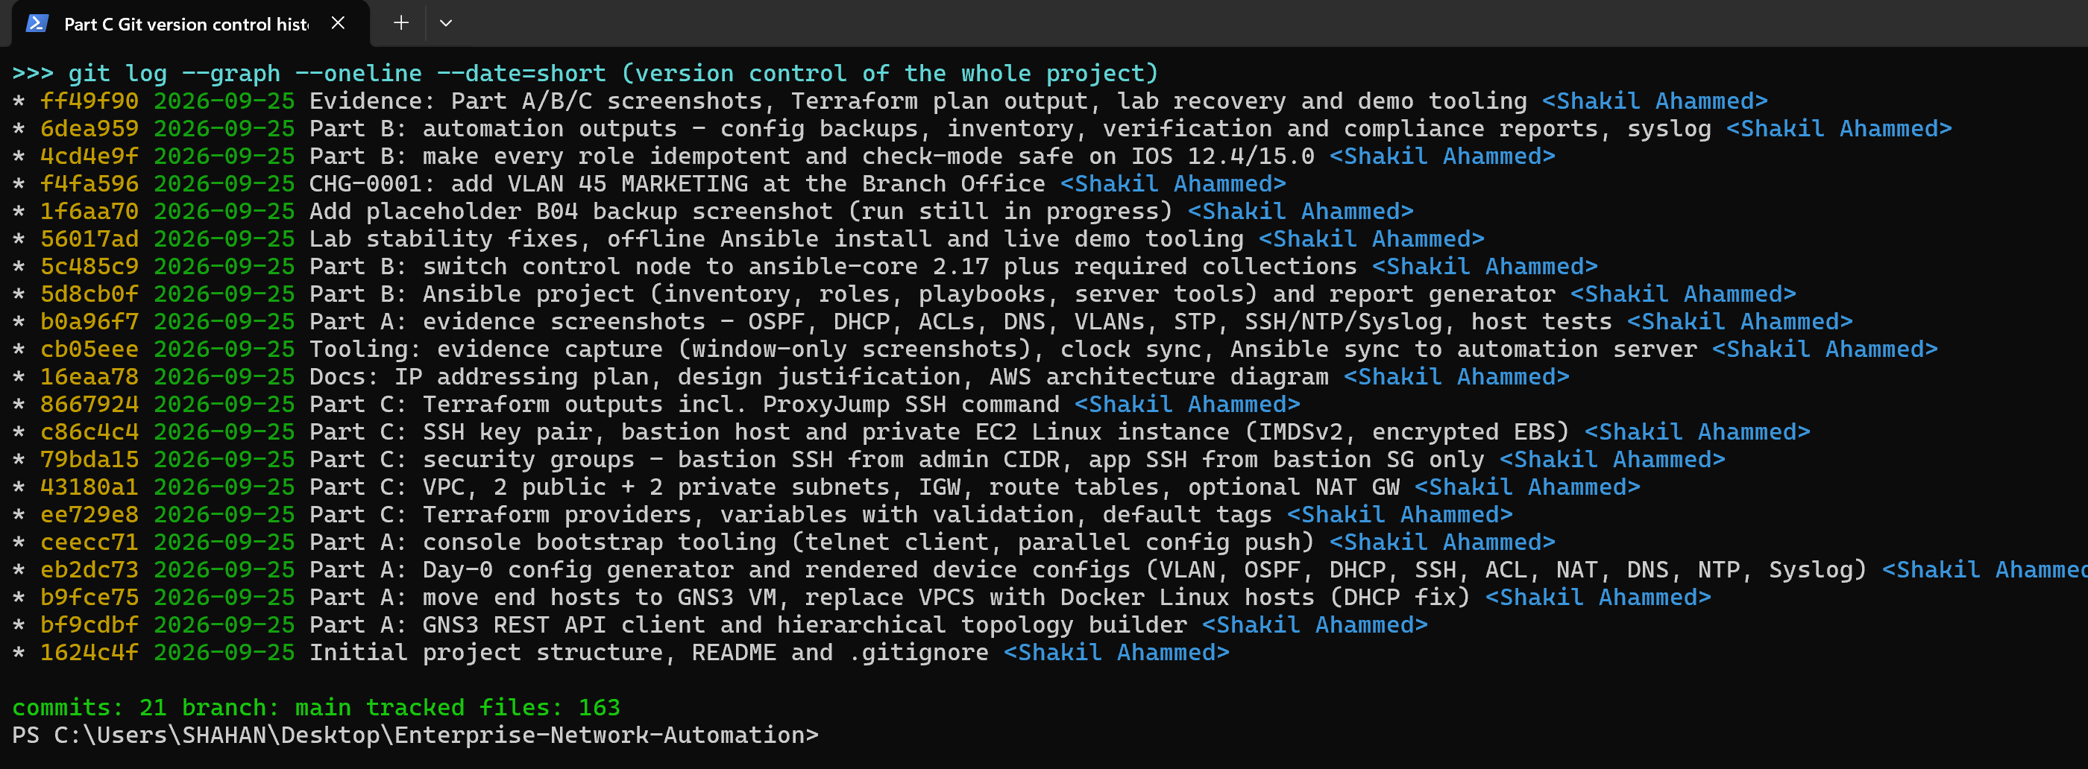
Clean teardown and version control
Member 3 | Terraform & AWS (Part C)
No ongoing cloud cost; full history in Git
After destroy: 0 billable resources in all 17 regions
Git history: small, descriptive commits for every part
Notes:
Member 3: terraform destroy removed all 25 resources and an all-region audit confirmed nothing is left.

Slide 16

Challenges and lessons learned
All members | Team
Real problems we solved along the way
VPCS DHCP failure
Emulator freezes & drift
Replaced test PCs with Linux containers
Recovery script; NTP limited by clock drift
IOS idempotency
Secrets in evidence
Push exactly what IOS stores
Vault, git-ignored files, redaction
Future work: CI/CD pipeline · NetBox source of truth · site-to-site VPN to AWS · remote Terraform state
Notes:
Any member: explain the challenges briefly and what we would do next.

Slide 17
All members | Team
Conclusion
Secure hierarchical network built and verified
Managed as code: idempotent, audited, version-controlled
AWS deployed, tested and cleanly removed with Terraform
Thank you - Questions?
Notes:
Member 3 closes, then the whole team takes questions.

