Slide 1

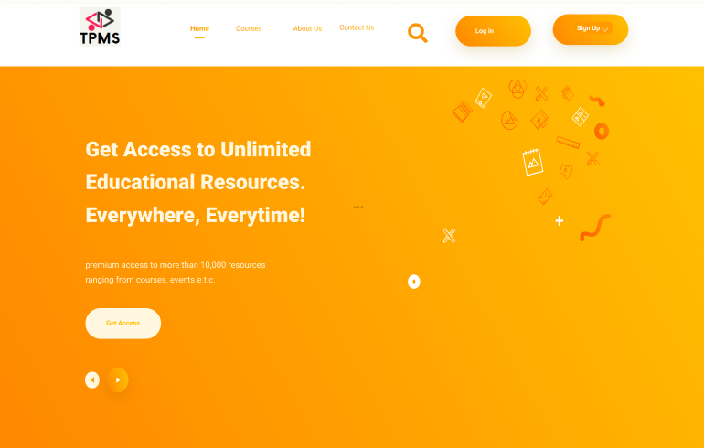
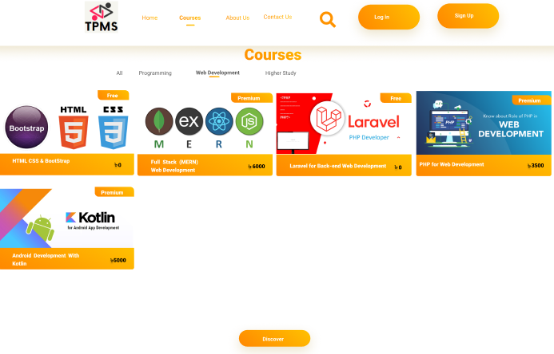
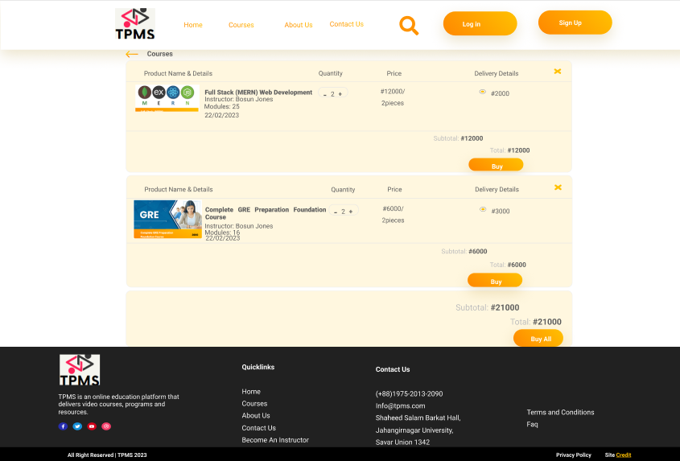
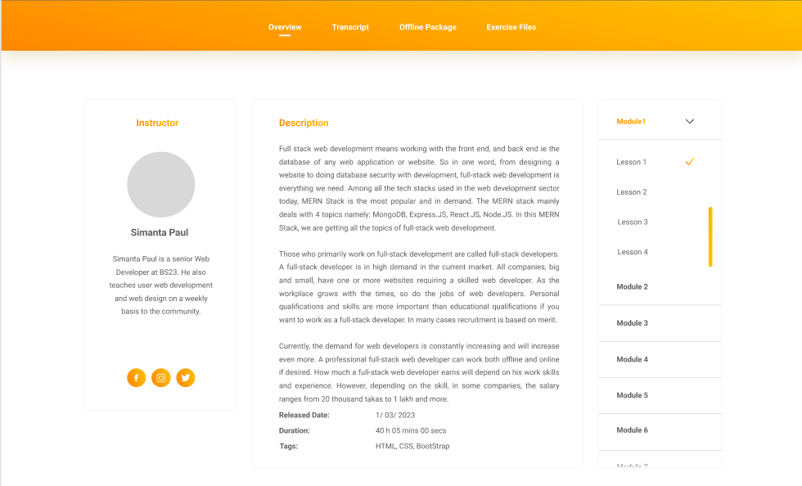

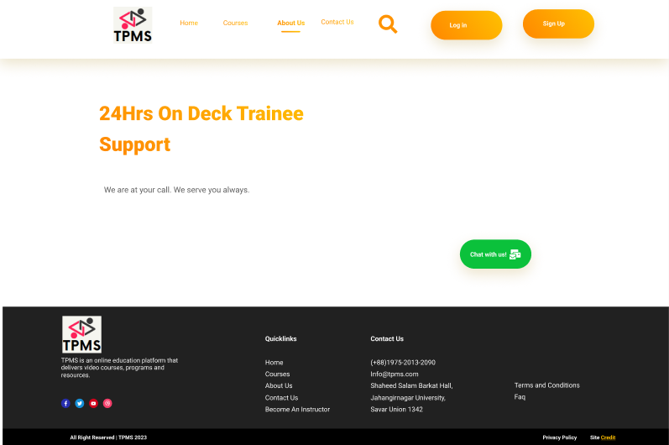
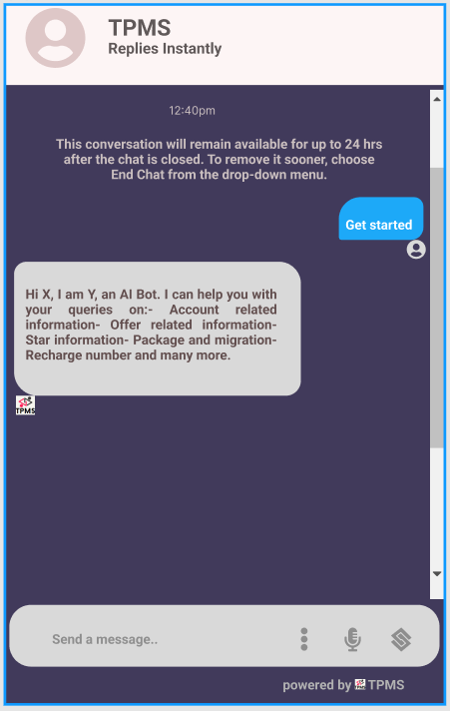
TRAINING PROGRAM MANAGEMENT SYSTEM
Group-21
Mst. Sumiya Siddika (Roll-1975)
Md. Shakil Ahmed (Roll-2013)
Amit Azim Amit (Roll-2090)
Abstract
Design
A Training Program Management System (TPMS) is a software application that facilitates the management and administration of training programs in an organization. The system provides a centralized platform for managing various aspects of training programs, including course scheduling, participant registration, resource allocation.
Figure 1: First Page
Figure 2: Course Page
Introduction
A training program management system (TPMS) is used for the administration, documentation, tracking, and reporting of instructor-led-training programs. TPMS are focused on back-office processes and are considered a tool for corporate training administrators. A training management system acts as a central enterprise resource planning (ERP) software specific to the training industry. They can be complemented by other learning technologies such as a learning management system, and are part of the educational technology ecosystem.
Figure 3: Add to cart
Figure 4: Course Module
Limitation
Data privacy concerns.
Limited customization.
Limited engagement.
Limited assessment options.
Inability to deliver targeted content.
High response time.
Figure 1: TPMS
Future Work
Problem Statement
Content enhancement.
Assessment System.
Interesting ways of training.
Mobile Accessibility.
Gamification Techniques.
Social Learning.
Minimizing Response Time.
A problem statement is a concise description of the problem or issues a project seeks to address. Problems that have to be solved in our system they are:-
Problem 1 - Scalability Problem.
Problem 2 - Limited interactions with trainee.
Problem 3 - Lack of Instant Communication and Feedback.
Conclusion
Proposed Solution
A training program management system is an essential tool for managing and organizing training programs. It provides a centralized platform for tracking and managing the various aspects of training programs, such as scheduling, enrollment, and participant progress.
Overall, a training program management system can help organizations improve interaction with trainees, and the effectiveness and efficiency of their training programs, ultimately leading to better employee performance and organizational success.
The solution can be the increment of the storage capacity of hardware and server to increase the scalability of the website. There are learning platforms that support learner surveys, questionnaires, push notifications, and actionable reports that allow managers to communicate with their learners. To create a live chat application to solve the interaction problem.
Reference
Books:
[1] Software Engineering 10th Edition by Ian Sommerville
Website:
[2] 10 Minute School, [Online]
Available: https://10minuteschool.com [Last access on 25/3/2023]
[3] Bohubrihi, [Online]
Available: https://bohubrihi.com [Last access on 25/3/2023]
Figure 1: Trainee Support
Figure 2: Live Chatting

