Slide 1
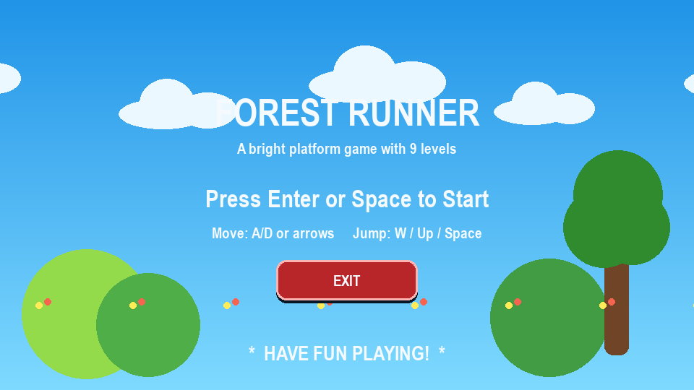
Forest Runner
Python Pygame platform game project
A bright side-scrolling platformer built with Python and Pygame.
Player collects coins, avoids enemies, and reaches the flag to clear each level.
The project uses custom drawn sprites, tile-map levels, smooth camera movement, and a fullscreen presentation mode.
playable levels
frames per second
9
60
01

Slide 2
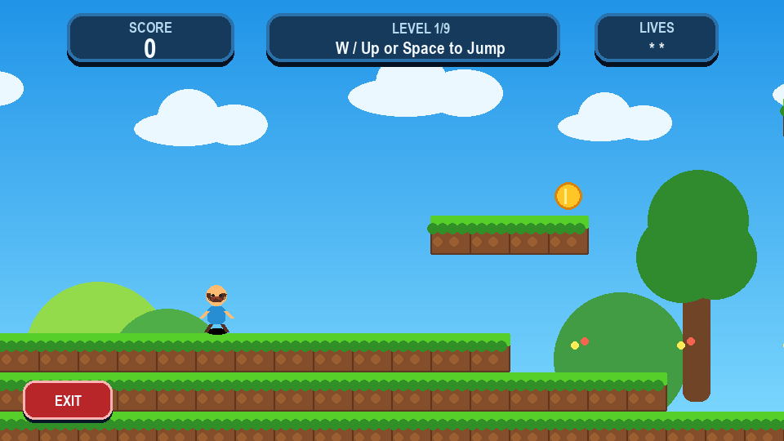
Project Overview
What the game is about
Genre: 2D platform runner.
Theme: colorful forest world with hills, trees, clouds, grass blocks, coins, and red enemy bugs.
Objective: move from the spawn point to the flag while collecting coins and staying alive.
Game states: menu, playing, win, and game over.
02

Slide 3
Gameplay Loop
Simple, clear, and replayable
Start from the main menu.
Run, jump, and land on platforms.
Collect coins to increase the score.
Avoid red enemies and falling below the map.
Touch the flag to advance to the next level.
Finish all levels to reach the win screen.
Core win condition
if player touches flag:
load next level
if last level is complete:
show YOU WIN screen
03

Slide 4
Controls & Player Feel
Responsive movement settings
A / D
Space
F11
R
move left and right
jump
toggle fullscreen
restart after end
Gravity, jump power, speed, and fall speed are stored in one Settings dataclass.
Coyote time lets the player jump shortly after leaving a platform.
Jump buffering makes a jump press register just before landing.
Collision is separated into horizontal and vertical movement for stable platform behavior.
04

Slide 5
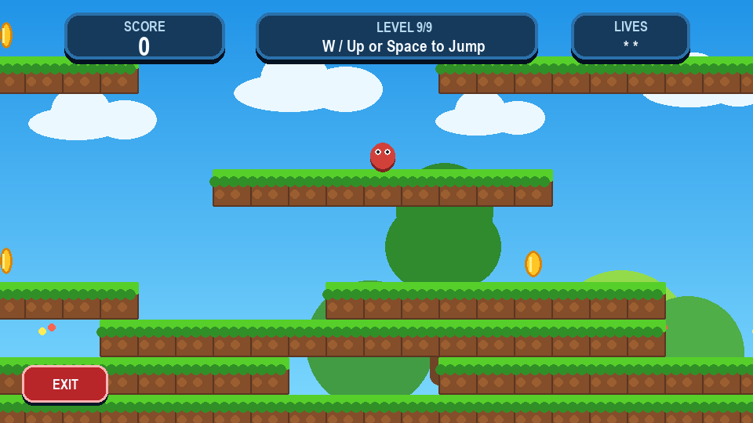
Level Design
Tile-map based worlds
Each level is stored as rows of characters.
# creates platforms, C creates coins, E creates enemies, P sets the player spawn, and F sets the finish flag.
Long maps are wider than the screen, so the camera follows the player smoothly.
Later levels add more enemy placement, longer jumps, and more repeated platform patterns.
05

Slide 6
Game Objects
Main entities
Player: animated character with movement, jumping, respawn, and collision.
Platforms: grass and dirt tiles that form the ground and floating paths.
Coins: animated collectibles with floating score text.
Enemies: red moving hazards that cause game over on contact.
Flag: level exit that moves the player to the next stage.
Camera: follows the player while staying inside the world bounds.
Tile symbols
P = player
# = platform
C = coin
E = enemy
F = flag
06

Slide 7
User Interface
Readable HUD and state screens
HUD displays score, current level, controls hint, lives, and exit button.
Menu screen explains how to start and how to move.
End screens show win or game-over status with restart and quit options.
The game renders to a fixed 960 x 540 surface and scales cleanly to fullscreen.
07

Slide 8
Technical Architecture
How the project is organized
Files
The game loop runs event handling, update logic, drawing, and presentation every frame.
Pygame Rect objects handle collision checks.
Rendering is procedural, so no external image files are required.
The code separates settings, entities, level data, UI helpers, and game orchestration.
main.py starts the game
game.py loop, states, rendering
entities.py player, enemies, coins
levels.py level tile maps
ui.py text, panels, buttons
config.py settings and colors
08

Slide 9
Scoring & Challenge
What makes the game interesting
Coins give immediate score feedback with floating '+1' text.
Enemies patrol horizontally, forcing timing decisions.
Falling costs a life and respawns the player at the level start.
Touching an enemy ends the run immediately.
The flag rewards forward progress and creates a clear finish line for every level.
2
+1
starting lives
score per coin
150px
5
enemy patrol range
coyote frames
09

Slide 10
Future Improvements
Next steps for the project
Add sound effects and background music.
Create a level-select screen and saved best scores.
Add more enemy types and moving platforms.
Include power-ups such as shields, double jump, or speed boost.
Package the project as a standalone executable for easier sharing.
Thank you
10

