Slide 1
Project Proposal
Course: Senior Design (CSE 499A)
Section: 19
Submitted to:
DR. Mohammad Monirujjaman Khan
Submitted By:
Name | ID
Hasanul Banna | 1612536642
Shakil Ahmed | 1721087042
Mohammad Arshadul Alam Rakib | 1731487042

Slide 2
Introduction
The "Easy Bank" website is an online banking platform. It is an information-based website. This website presents all the information of all the banks for the customers like, insurance, home loan, saving accounts, study loans, car loans, family loans, mutual funds etc. So, people can compare easily and find the best financial option for them.

Slide 3
Scope & Vision
Project Scope:
From this user will be able to check his credit score and which different banks can offer credit cards at a certain rate with immediate approval. People can also apply for loans through this website with immediate approval and 0% paperwork. Everything online.
Project Vision:
This is an online financial website designed for people who do not have time to visit a bank to get a loan or credit card instead of roaming banks with the approval of loans or credit cards.

Slide 4
Problem Statement:
Example problem No 1:
MR. X is a retired banker. He has recently decided that he will make a house for his family because he had been living in a rented house for a long time. So, MR X calculates that he needs approximately 3 Lakhs taka to complete the project. However, this tremendous amount of money he does not have, so he thinks he needs a loan. However, though it is COVID-19 ( A Worldwide Pandemic), he does not want to go outside because the second wave of this pandemic is running. So, what is the possible solution for this problem? On the other hand, MR X would not want to delay the project.

Slide 5
Continue..
Example problem No 2:
Mr. Y stays in Dhaka for a long time. He is a corporate job holder. Every day he goes to his office standing on the local bus. Moreover, sometimes it so happens that he can get the bus and for this, he cannot go to the office in time. So, it makes it a little bit problematic for him. Furthermore, the distance between his office to home is almost 20 KM. So, it is complicated to continue the job without a car, and though it is Pandemic time and overall, the safety issue rises in the public transportation system, so MR Y has decided to buy a car by a bank loan.

Slide 6
Continue..
Example problem No 3:
Mr. Z is a university student, and he wants to start a business along with his friends. He does not have the money he needs and does not want to give up his dreams. He tries to manage the money from some of her relatives, but at last, he would not manage at all. Moreover, though It is a COVID time, he would not go outside frequently for safety issues. So, he needs some startup loans to fulfill his dream business and look for the low-interest type bank around his area at home

Slide 7
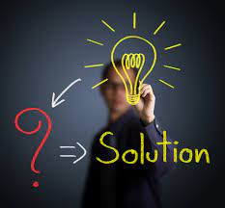

Problem analysis & solutions:
When we think of taking loans there always comes negative thoughts in our mind. Like how would we take the loan, which bank is going to offer which loans and how much interest will I have to pay everything
If any one wants a loan, wants to make the startup or seeking any kind of fund though us they are always welcome to us. We will provide him the best solution for this problem so that he can proceed further and don’t get stuck in the financial problem and fulfill his dream. All we want to make a hassle free banking solution for everyone which will make the users more comfortable with the banking system.

Slide 8

Features:
Account Registrations
Apply for credit card
Compare and Apply for Personal Loans
Loan against property
Home loan
Education Loan
Car loan
Business & Startup

Slide 9
Existing similar system
We Spotted some leading companies which are related to our work.
Paisabazar .com
BankBD.com
Paytm.com
MobiKwik
PolicyBazar
FinTech BD

Slide 10
Software Tools:
Xampp Software
VS Code
Anaconda Navigator ( Alternative of VS Code)
MySQL
Adobe photoshop
Adobe illustrator
Adobe XD
Documentation Tool Spinax
Django and Python

Slide 11
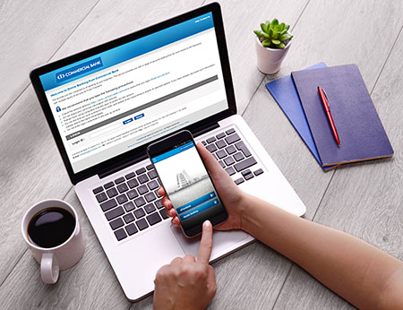
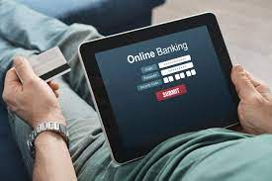

Propose Users:
Apply for a bank loan through us.
Want a credit card within a short period of time.
Apply for life insurance & investment plan
Desire to know which bank will be best for him.
Best suitable plan.
Category-wise division of multiple sections.

Slide 12
Project Budget:
Name | Price | Total Price
Front End Develop | 10K
Back End Develop | 20K
Host and Publishing | 10K
Data Collection & Others | 10K
Graphics and Designing | 10K
TOTAL | ---- | 60K

Slide 13
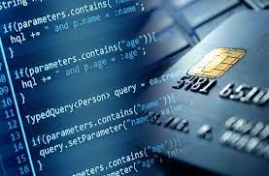
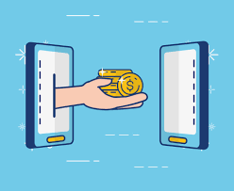
How People will benefited with the project :
People can find here various types of options related to their needs. They can find here and their desired option, which will provide them the result for their issue. They can apply for a bank loan through us, apply for a credit card, and analyze them by comparing with the other bank. In the past, people had to go outside to seek a loan or a credit card. But here, we provide them all information with just one click on our apps.
Here the power of the decision belongs to the user at all.

Slide 14

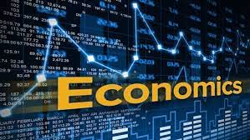
What is the positive impact on environment, social, economic :
We aim to give the best service to our users, to more personalized and accessible financial products within lending, payments, investing, and digital banking. We know that now the technology allows fintech companies to contest with traditional financial institutions by delivering faster, easier, compelling, and often cheaper financial solutions

Slide 15
Monetization & Quality
Monetization
The bank's services are welcomed to place ads in the website, which will cost 100 BDT per day.
Google AdSense
We will ask the user to pay a commission of approximately 5% around it .to us when they use our services.
Quality
The UI of the application will be user friendly so that anyone can use it.
Each and every feature will be arranged in their category wise.

Slide 16

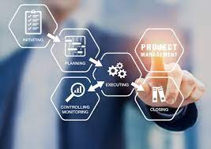
Step The Work and Milestone:
We build our project only for that user who uses our version because we have not enough money or fanatical support to do this. However, if some Bank or Gov't organization takes the responsibility to give us financial support.

Slide 17
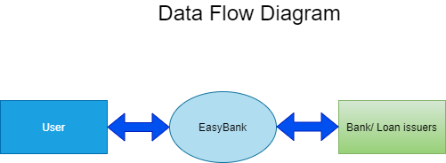
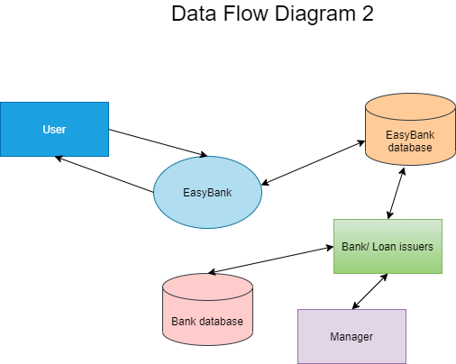
Data Flow Diagram (DFD)

Slide 18
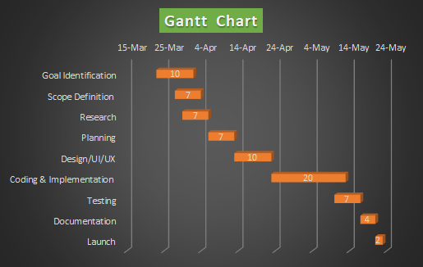
Gantt Chart

Slide 19
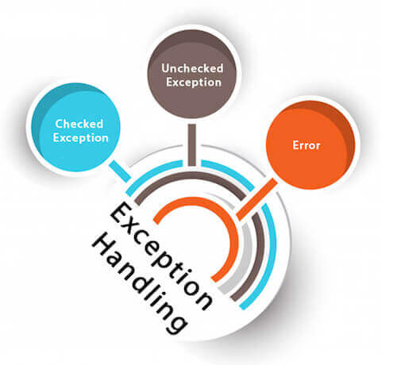
What are the risks? How will the risks be managed?
We put the “Exception Handling” if anything goes wrong. Sometimes we may find errors in any of the sections. To solve it we need a plan for the possible exception and make some mechanism to solve the exception automatically.
.

Slide 20
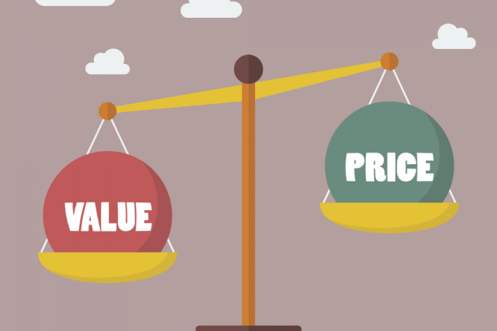
What is the value for money?
Yes. The application we are going to make it is value for money. Here our proposed user here finds a completely “hassle and broker free” baking system..

Slide 21

Conclusion
In this pandemic situation most of the banks operate their operations online. Government imposed restrictions on going outside. People can't go outside also in this situation it’s not safe. We gather all information about all the banks. People can easily find their desired information through this website. We ensure the information security of our customers. This is a hassle free, easy and secure online marketplace platform.

Slide 22


