Slide 1
LAND VERIFICATION SYSTEM USING BLOCKCHAIN TECNOLOGY
BANGLADESH ARMY UNIVERSITY OF
ENGINEERING AND TECHNOLOGY
Presented By
Supervisor
SM. Shakil Ahmed
Id:16104025
Md. Almash Alam
Lecturer,CSE
BAUET
Nur A Alam Khan
Id:16104032
Md. Abdul Azim
Id:16104049

Slide 2
Content
What is blockchain?
Land Registration
Existing System
Drawbacks
Proposed Model
User Interface
Impact
Roadblocks
Solutions
Components
Conclusion

Slide 3
WHAT IS BLOCKCHAIN?
Open, distributed ledger that can record transaction between two parties efficiently and in a verifiable and permanent way.
Distributed Ledger
Peer-to-Peer network
Decentralized
Secure
Immutable

Slide 4
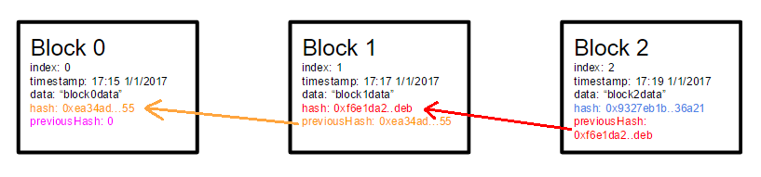
CONT…

Slide 5
LAND REGISTRATION
Land Registry is one of the use cases that involve a lot of trust.
Keeping an up-to-date and accurate registry is one of the biggest challenges for land governance in developing countries
issues of unclear ownership
Blockchain has a great solution!

Slide 6
Existing System
Confirm the record of rights from the Land Office
Check & Verify Bia Deeds, Khatiayans
Physical Survey
Prepare deed of transfer and pay stamp duty
Apply for registration at the relevant Sub-registry
Recording the Land in latest survey

Slide 7

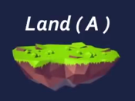
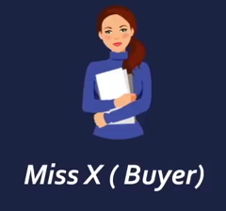
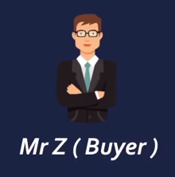
DRAWBACKS
Same land was sold Miss X and Mr. Z here, which shows the case of land fraud

Slide 8
CONT…
More Time Consuming
Less Secure
No Transparency
Easily Changeable

Slide 9
PROPOSED MODEL
Migrate and run DAPP
True
False
Adding super admin
Error in migration
True
Registration of land
False
Unsuccessful! registration not done by super admin
Land registration success

Slide 10
CONT…
Seller makes land available for transaction
True
False
Buyer send request
No transaction
Accept
True
Buyer buy this property
False
Transaction Cancelled
Success transaction ownership

Slide 11
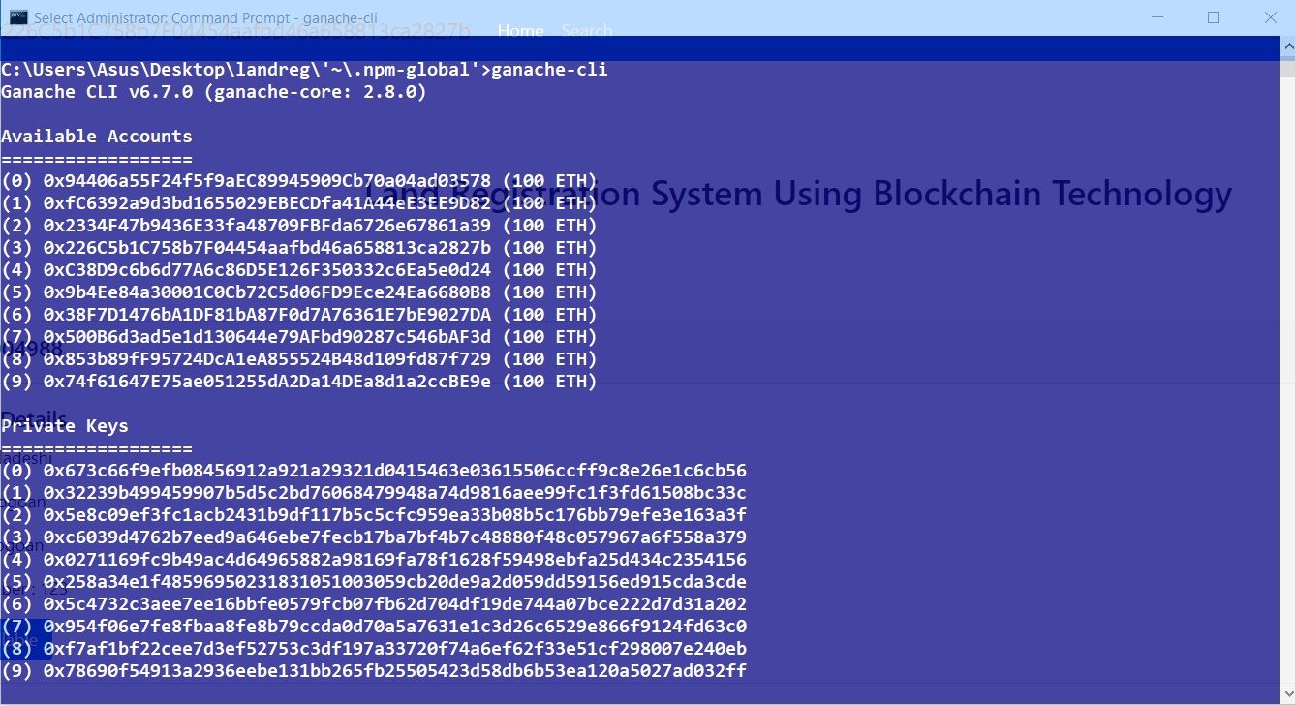
USER INTERFACE
Fig: Ethereum Account

Slide 12
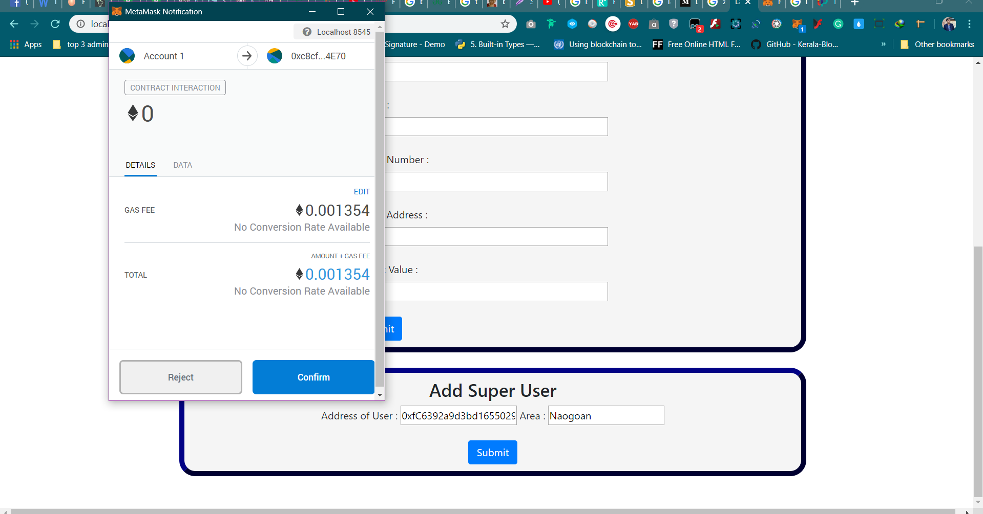
CONT…
Account 1
Fig: Add Super User

Slide 13
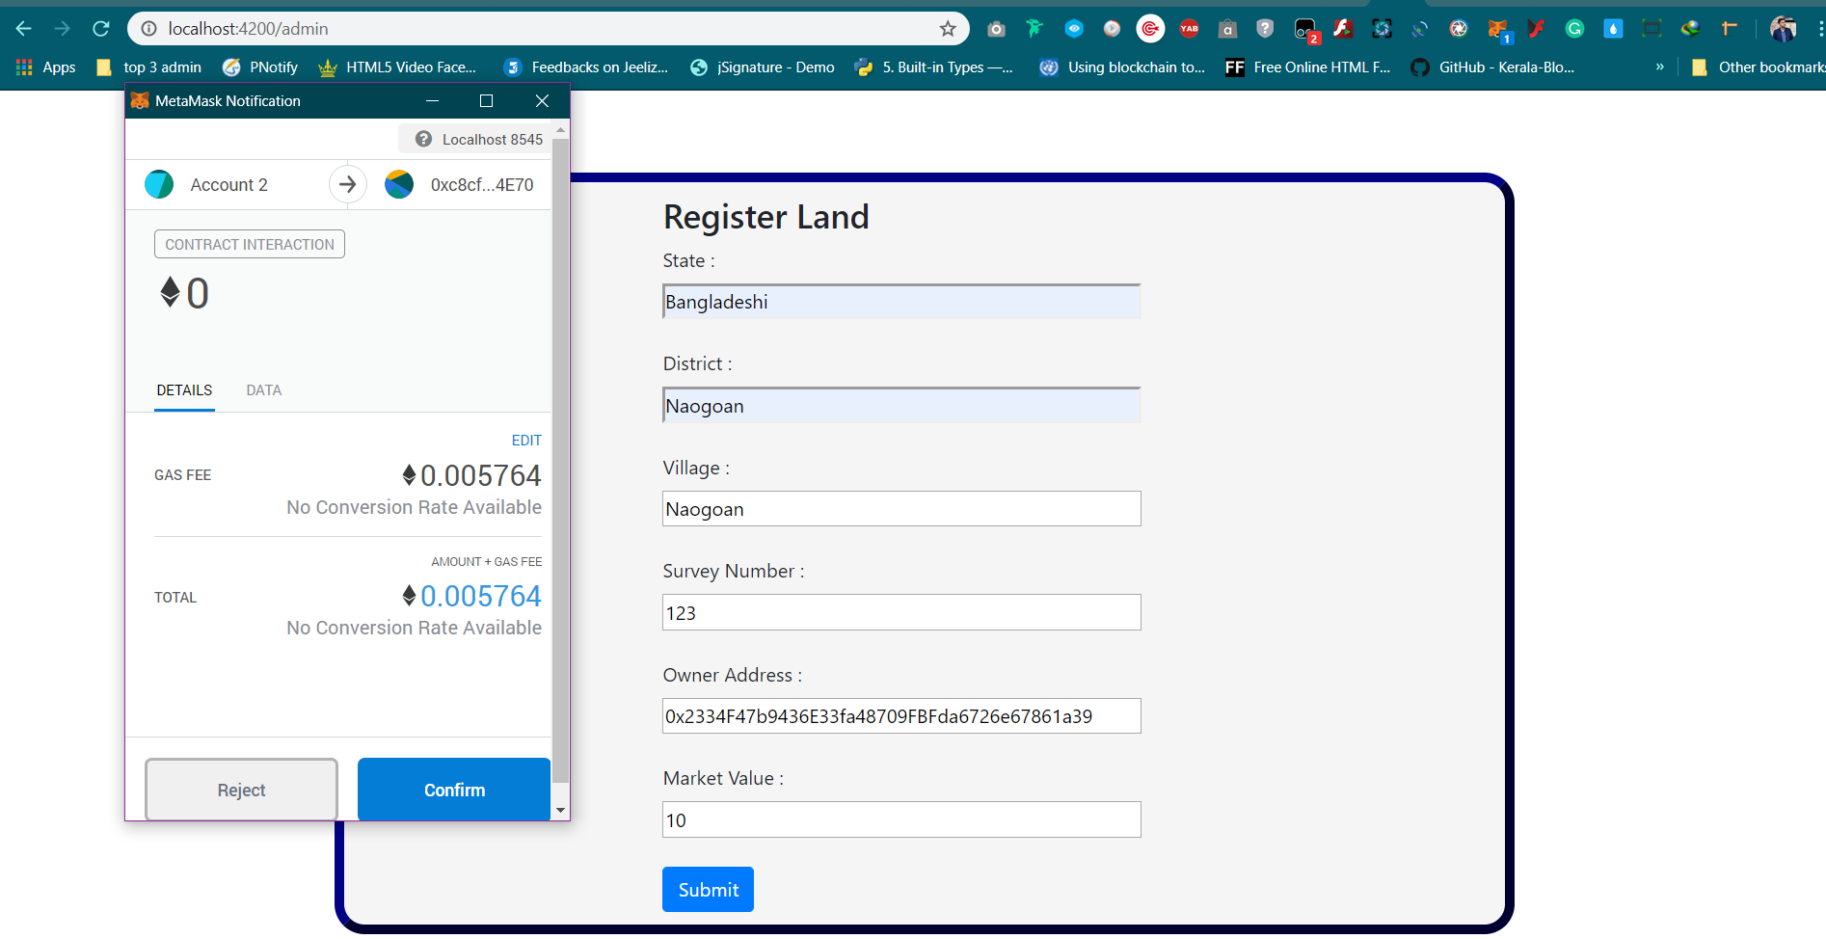
CONT…
Account 2
Fig: Ownership Allocation

Slide 14
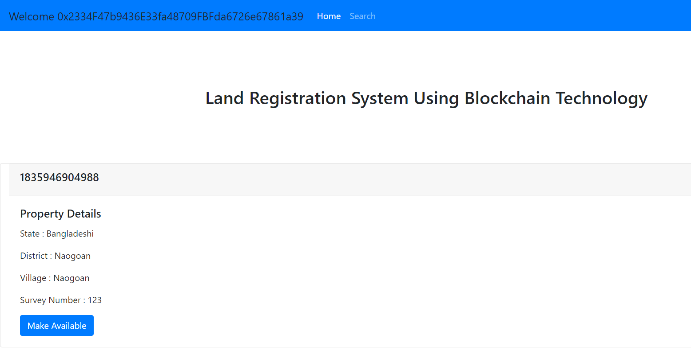
CONT…
Account 3
Fig: My property

Slide 15
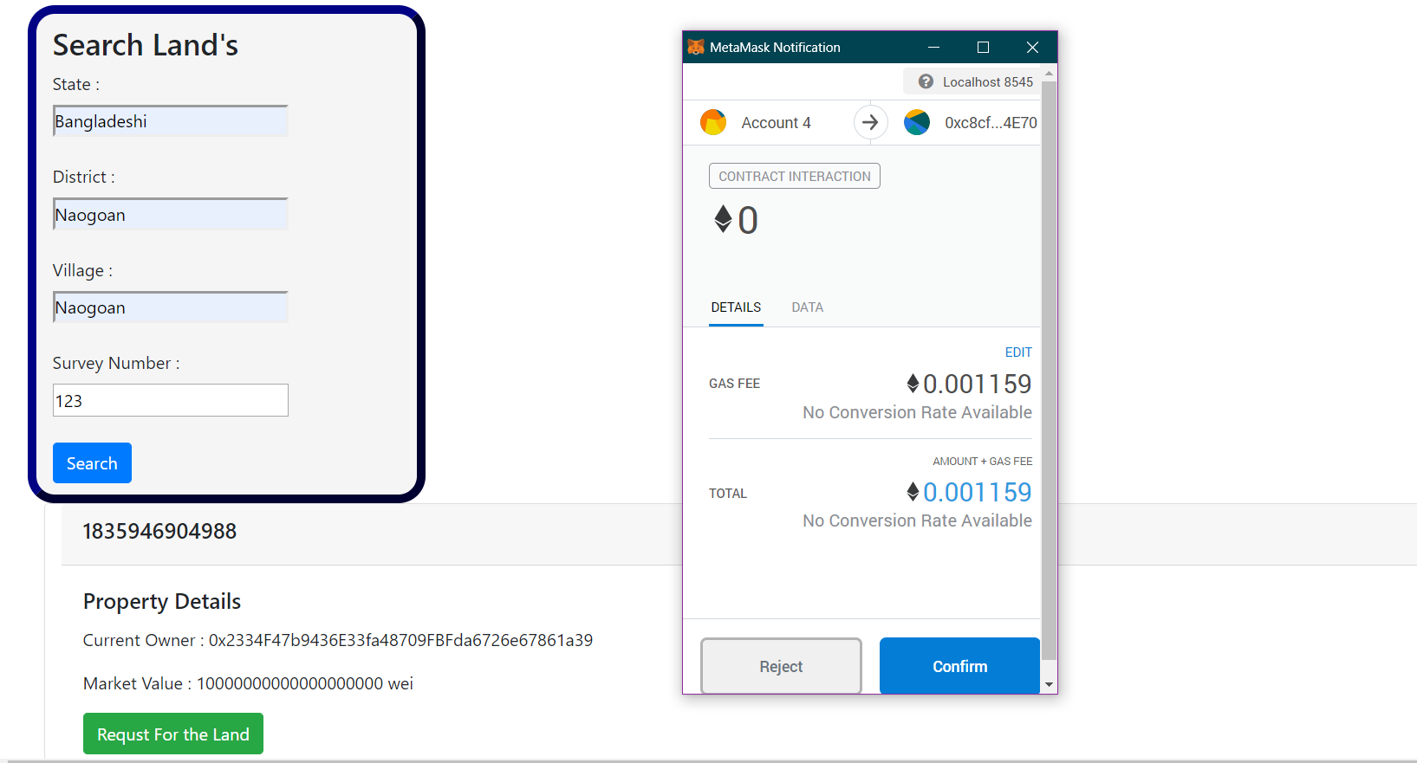
CONT…
Account 4
Fig: Search and attempt to buy

Slide 16
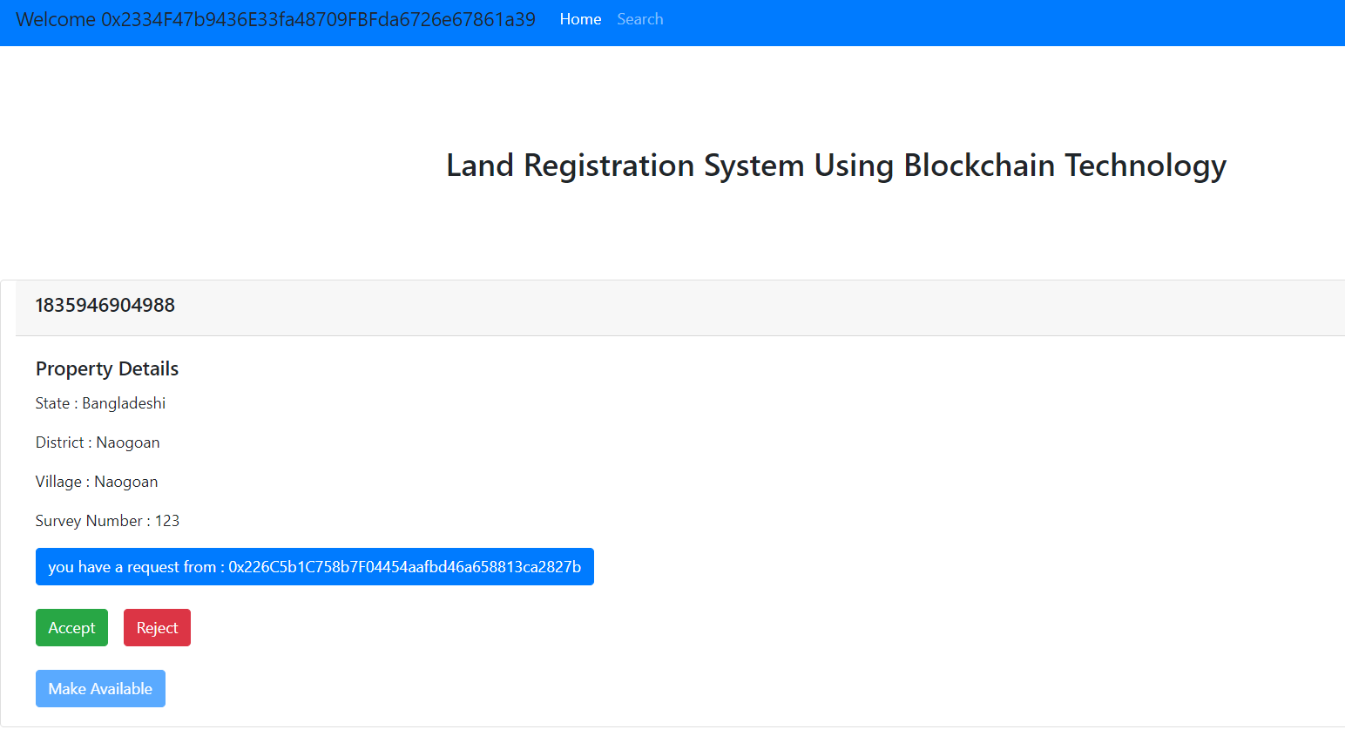
CONT…
Account 3
Fig: Accept the buyer request

Slide 17
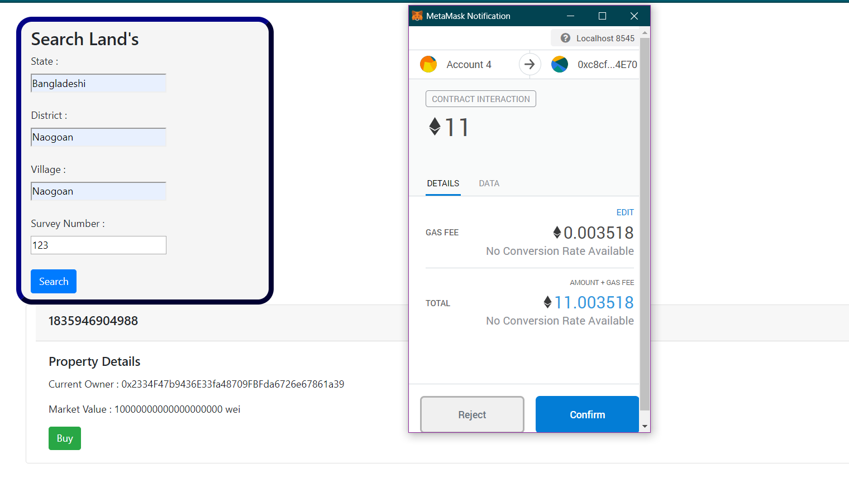
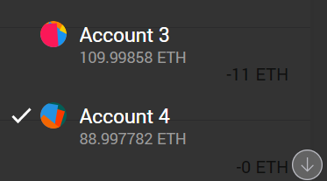
CONT…
Fig: New ownership Allocation

Slide 18
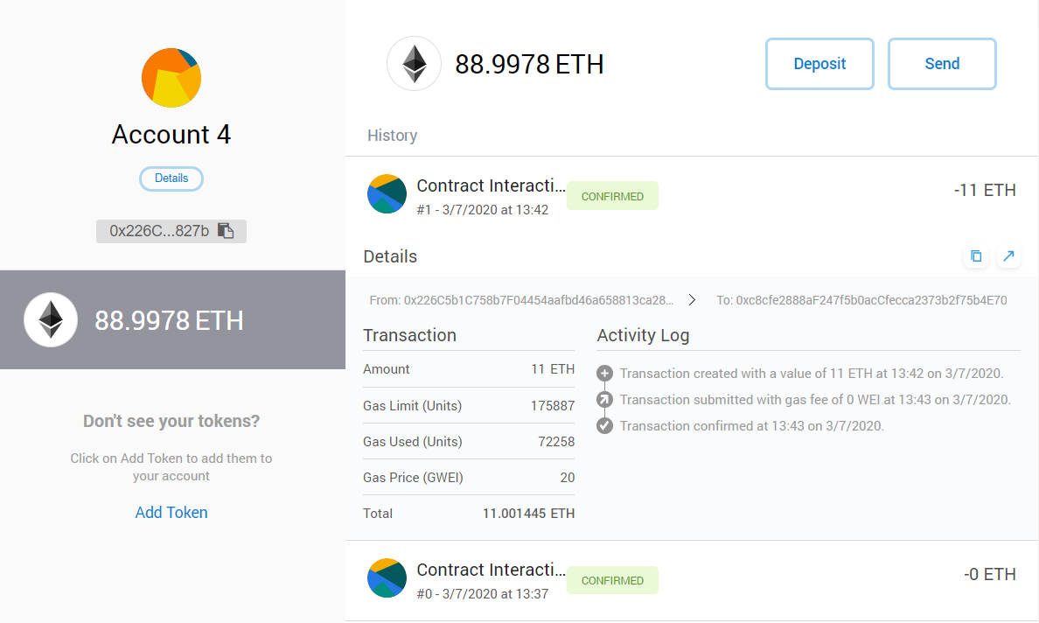
CONT…
Fig: Transaction log

Slide 19
Impacts
More secure than existing system
Less time consuming
Decrease the fraud and corruption activity
Increase trust to the government

Slide 20
ROADBLOCKS
User are anonymous and only defined by private, public key
Permission less Blockchain
Single shared ledger

Slide 21
SOLUTION
Use the private/hybrid Blockchain
Private Blockchain is a permissioned blockchain
Multiple ledger
Using hyperledger fabric may be better solution to deal with land verification system.

Slide 22
COMPONENTS
Membership service provider(x.509 certificate)
Ordering Node
Peers
Endorser peer
Anchor peer
Orderer peer
Channel
Smart contracts (chaincode)

Slide 23
CONCLUSION
Land administration system in Bangladesh is corrupt, inefficient, and unreliable and inherently contains systematic weaknesses. The blockchain is the only solution. No one has demonstrated a trustworthy solution for creating, enacting, verifying, storing and securing digital contracts.

Slide 24
REFERENCES
“Hyperledger” - https://blockgeeks.com/guides/hyperledger/
“Blockchain Property registration” - https://github.com/mayanku/Blockchain-Property-registration
“Land registry with Blockchain” - http://potdar.info/index.php/2018/07/06/how-to-build-a-land-registry-blockchain/
“Blockchain land registry platform” - https://www.leewayhertz.com/blockchain-land-registry-platform/
“Hyperledger Fabric” - https://hyperledger-fabric.readthedocs.io/en/release-1.4/blockchain.html

Slide 25
Thank You

