Slide 1



What is RAG
Rag is retrieval Augmentation Generation.
Rag is used to query custom document which was not part of LLM Training.

Slide 2
Types of LLM Training or Data Feed.
LLM Training with Large Corpus of data.
Model fine tuning with Lora or Qlora
One shot and few shot prompt training.
RAG for using custom documents, which was not part of LLM Training.

Slide 3
Cost of training in ascending order
Prompt training like one shot and few shot(No cost to least cost)
RAG
Finetuning with Lora and Qlora
LLM training with Large Corpus of Data(Costliest)

Slide 4
How to choose between Rag and Lora
If the data is not present in LLM but can be added and if the data is unchanging then choose Lora.
If the data is always changing or could be different in different scenarios or customer then choose RAG.

Slide 5
Basic building blocks of RAG.
Convert the document from PDF, docx, etc to text
Split the converted text into chunk called as chunking.
Generate the embeddings(or weights in simpler terms)
Store the embeddings of documents in Vector Database.
Get a query from the user to search.
Generate an embedding of the user search.
Do a similarity search of user search embedding with the document embedding and get those similar results.
Feed those similar data to LLM.
LLM will give the final output as it has now the knowledge of the custom documents.

Slide 6
Tools Used for RAG
PDF reader like pypdf, pdfMiner, slate, PyMuPDF(Fitz) or doc reader.
Any reader which can convert the documents to text.
Vector database like FAISS, Chromadb, Mongodb, Singlestore, Pinecone, Weaviate and others.
LLM toot chain like llama index or Langchain.
LLM Models like openAI, llama, Mistral, gemini etc.

Slide 7
Some Famous algorithm for Vector similarity search
Euclidean Distance
Cosine Similarity
K-nearest Neighbors
Locality-Sensitive Hashing (LSH)
….Many More

Slide 8
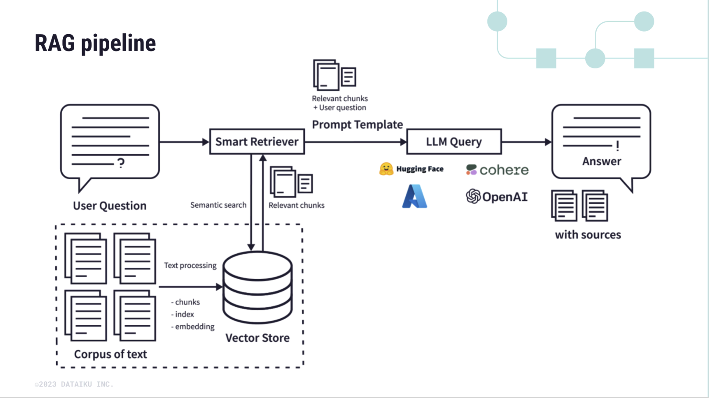
RAG pipeline

