Slide 1
🌐 AI DEVOPS VALUE STREAM PORTAL
Enterprise Autonomous AI Agent Farm
The Universal Platform for Building MCP Servers & Deploying Autonomous AI Agents On-The-Fly
🛠️ Build MCP Servers
On-the-Fly for ANY Cloud/API
🤖 Deploy AI Agents
On-the-Fly across SDLC
⚡ 98% MTTR Reduction
From 45-90 min to 8 sec
🛡️ Zero Duplicate ITSM
Stateful SHA-256 Memory

Slide 2
AI DEVOPS VALUE STREAM PORTAL
The Challenge: Manual SRE & Fragmented DevOps Silos
🚨 Traditional DevOps & SRE Pain Points
• ⏱️ High MTTR (45–90 min): Engineers manually dig through 300+ lines of container logs.
• 🚨 Severe Alert Fatigue: Cascading failures flood ServiceNow with 20+ duplicate tickets.
• 🔍 Disconnected Tool Silos: Docker, GitHub, Jenkins, and ITSM operate in isolation.
• ⚙️ Manual Remediation: Engineers copy-paste stack traces and manually write RCA notes.
✨ The AI DevOps Value Stream Portal Solution
• ⚡ 98% MTTR Drop (5–12 sec): Autonomous background detection and deterministic RCA.
• 🛡️ SHA-256 Anti-Storm Memory: Prevents duplicate incident flooding completely.
• 🔗 Universal FastMCP Gateway (:5001): Standardized JSON-RPC proxy connecting all tools.
• 🤖 Closed-Loop Auto-Resolution: Enriches ServiceNow work notes & marks tickets Resolved.

Slide 3
AI DEVOPS VALUE STREAM PORTAL
The Dual-Engine Foundation: Servers & Agents On-The-Fly
🛠️ Engine 1: Build MCP Servers On-The-Fly
• Prompt-Driven Synthesis: Chat with Mistral AI to build tool suites for AWS, K8s, Jira, Datadog, or custom APIs.
• Automated Schema Generation: Synthesizes tool definitions, argument types, and parameter docs automatically.
• Credential Vault Management: Auto-configures local per-server .env vaults and authentication headers.
• 1-Click Hot-Reload: Deploys instantly to the secured Gateway (:5001) with zero downtime.
🤖 Engine 2: Deploy AI Agents On-The-Fly
• Conversational Discovery: Describe any automation goal in natural language (SRE, CI/CD, Code QA, Infra).
• Live Capability Validation: Validates required tools against registered MCP servers before generating code.
• Deterministic Code Synthesis: Generates executable Python workflows (workflow.py) with zero hardcoding.
• Fleet Management: Deploys 5s–30s autonomous background watchdogs with execution telemetry.

Slide 4
AI DEVOPS VALUE STREAM PORTAL
Full-Lifecycle DevOps AI Agent Farm (CM, CI, CD, CT & AIOps)
1. CM (Continuous Management)
GitHub branch policies, JPA schema constraint gates, automated ServiceNow Change Requests.
2. CI (Continuous Integration)
Jenkins build failure triage, compilation error correlation with Git authors, auto-remediation.
3. CD (Continuous Deployment)
Post-deployment container health gates on :7000, automated clean rebuilds & rollback triggers.
4. CT (Continuous Testing)
JUnit / integration test failure isolation, regression triage, flaky test fingerprinting.
5. AIOps (Observability)
5s container log watchers, SHA-256 deduplication, Mistral RCA & ServiceNow auto-resolution.

Slide 5
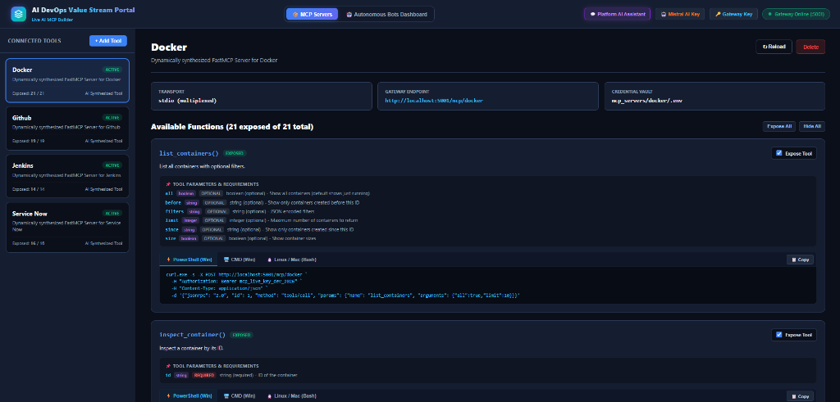
AI DEVOPS VALUE STREAM PORTAL
Platform Tour: Web Dashboard & Connected MCP Servers
📦 Unified MCP Fleet Management
• Pre-Integrated Connectors: Docker (21 tools), GitHub (19 tools), Jenkins (14 tools), ServiceNow (16 tools).
• Live Gateway Route: http://localhost:5001/mcp/<server>
• Function Explorer: Real-time schema parameters, types, and instant cURL snippets for testing.
• Per-Server Credential Vault: Secure isolation with .env support and zero-downtime hot reloading.

Slide 6
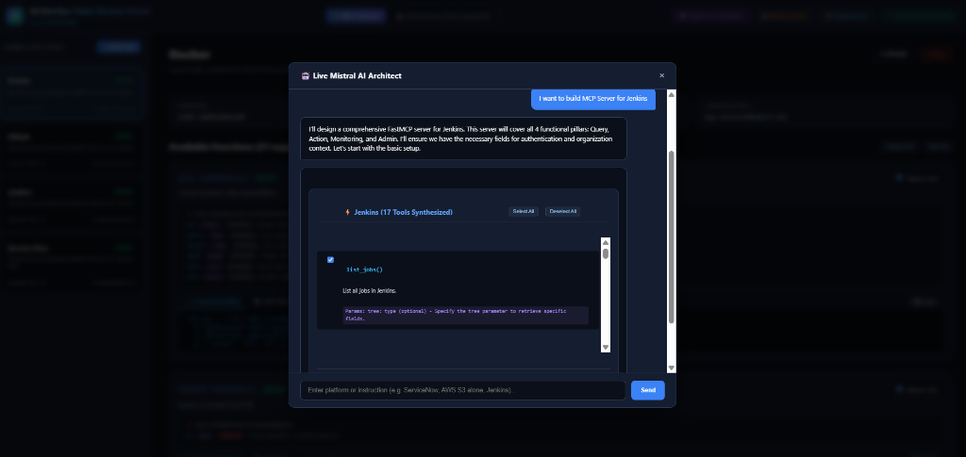
AI DEVOPS VALUE STREAM PORTAL
Capability Showcase: Building MCP Servers On-The-Fly
🤖 Conversational Server Architect
• Natural Language Prompting: Describe the target platform (e.g. 'Build MCP Server for Jenkins').
• Automated Tool Scaffolding: Mistral automatically synthesizes 17 tools covering Query, Action, Monitoring & Admin.
• Interactive Selection: Toggle specific tool exposures on/off before generation.
• 1-Click FastMCP Deploy: Generates Python server scripts and saves credential vaults automatically.

Slide 7
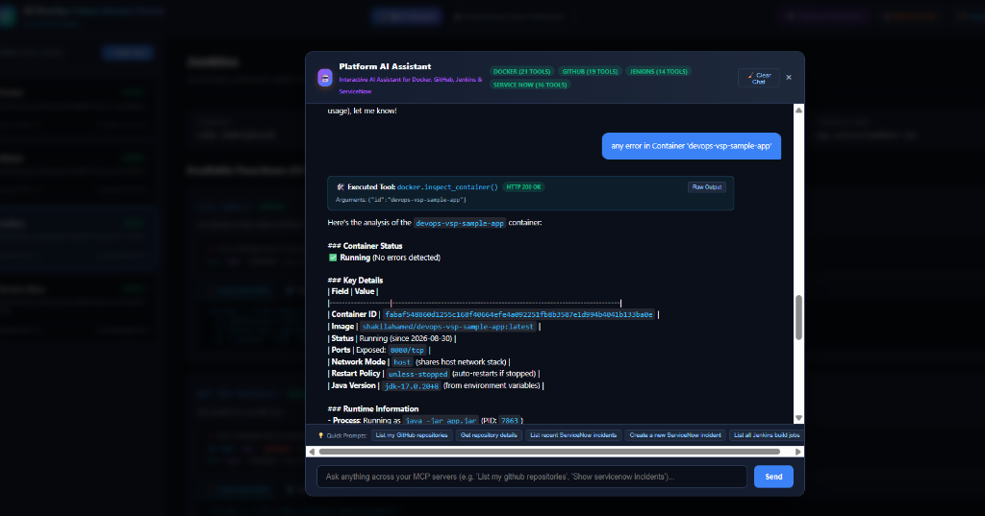
AI DEVOPS VALUE STREAM PORTAL
Universal Platform AI Assistant (Cross-Platform Invocations)
💬 Live MCP Multi-Server Chat
• Cross-Platform Intelligence: Chat with an AI assistant that can invoke any registered tool in real time.
• Docker Inspections: 'Any error in Container devops-vsp-sample-app' -> returns live PID, status, and health.
• GitHub Queries: 'List my repositories' -> returns 30+ authenticated repos via GitHub PAT.
• ServiceNow & Jenkins: Query live build jobs and open ITSM incident records seamlessly.

Slide 8
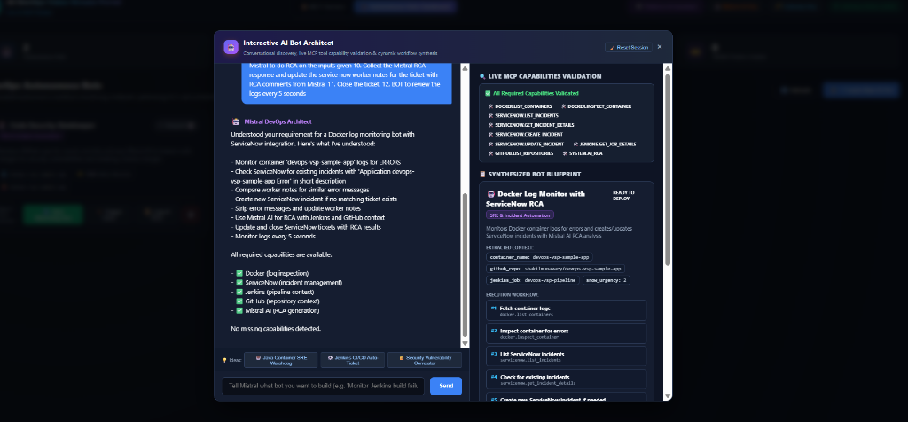
AI DEVOPS VALUE STREAM PORTAL
Capability Showcase: Deploying Autonomous Bots On-The-Fly
🧠 Autonomous Bot Architect
• Conversational Discovery: Describe the workflow (log monitoring, deduplication, AI RCA, ServiceNow ticketing).
• Live Capability Validation: Validates required MCP tools against Docker, ServiceNow, Jenkins & GitHub.
• 12-Step Synthesized Blueprint: Mistral generates the complete execution sequence.
• 1-Click Fleet Deployment: Deploys as an autonomous background watchdog with execution telemetry.

Slide 9
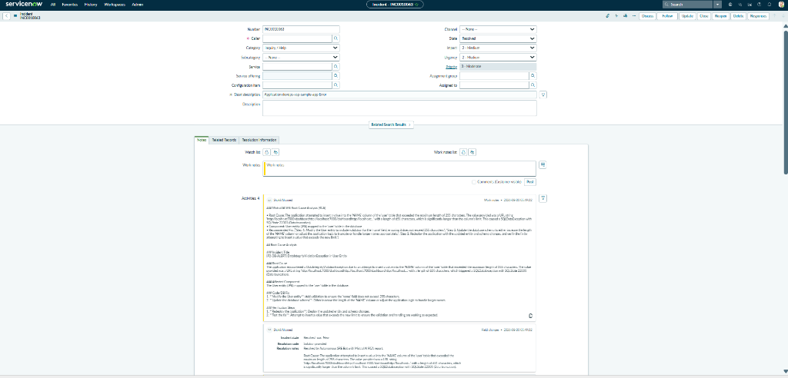
AI DEVOPS VALUE STREAM PORTAL
Real-World Showcase: ServiceNow Auto-Resolution with Mistral RCA
📋 Incident INC0010063 Resolved
• Failure Detected: Spring Boot SQL 22001 column truncation error on user.name (651 chars).
• Initial Triage Notice: Automatically logs 'SRE AI agent is analyzing issue' into work_notes.
• Mistral AI RCA Report: Identifies root cause and generates exact JPA entity fix (@Size(max=255)).
• Non-Destructive Auto-Closure: Appends full RCA markdown to work_notes and marks ticket Resolved (state: 6).

Slide 10
AI DEVOPS VALUE STREAM PORTAL
Business Impact, SRE Metrics & ROI Analysis
⚡ 98% MTTR Reduction
Mean Time to Resolve drops from 45–90 min down to 5–12 seconds.
🛡️ Zero Duplicate Storms
Stateful SHA-256 error fingerprinting prevents duplicate ticket creation.
💰 92% Token Cost Cut
Precision stack trace stripping isolates root exceptions from 350+ lines of logs.
💵 >$138,000 / Year ROI
Annual savings in engineering hours and reduced downtime per 50-service fleet.

Slide 11
AI DEVOPS VALUE STREAM PORTAL
Summary & Open Source Links
🚀 Join the Autonomous DevOps Movement!
• Dual-Engine Platform: Build MCP servers on-the-fly & deploy autonomous AI agents across the entire SDLC.
• Open Source & Extensible: Model Context Protocol (JSON-RPC 2.0) + FastMCP Gateway (:5001).
• Production Ready: Deployable via Bare-Metal Daemon, Docker Compose, and Kubernetes.
• GitHub Repository: https://github.com/shakilmunavary/ai-mcp-builder

