Slide 1
AVAIL-EDGE PROJECT BY TEAM TROJAN HORSE
Name : Shakin Shahria ID: 011201055
Name : Md Muzadded chowdhury ID: 011201037
Database Management System Laboratory
Sec: B
Faculty: Sadia Islam

Slide 2
PROBLEM IT SOLVES
Job finding.
Helps to display your skill set to larger number of people.
Builds professional networking.
Easy to get all the service at the same place.

Slide 3
AIMS AND OBJECTS
To provide regular service .
Bring all in one page.
Decrease the hazard of finding Service.

Slide 4


EXISTING SYSTEM

Slide 5
Comparison table
Comparison | SimplyHired | Bdjobs.com | Avail-edge
All kinds of jobs
Regular day service
Free trial
Budget control
Easy to get service

Slide 6
PROPOSED SYSTEM
Categorize By the time of Hire Service
Hourly(Writer,Photographer...)
Daily(Electrician,Plumber…)
Monthly(Teacher,Data Collector…)

Slide 7
Shakin Shahriar’s Contribution
Contribution | Methods used
Website landing page | HTML,CSS,Bootstrap
User’s dashboard | HTML,CSS,Bootstrap,PHP(insert,select query)
User’s profile | HTML,CSS,Bootstrap,PHP(insert,select query)
Modify user’s profile | HTML,CSS,Bootstrap,PHP(select,update,delete query)
Admin’s profile | HTML,CSS,Bootstrap,PHP(insert,select query)
Modify admin profile | HTML,CSS,Bootstrap,PHP(select,update,delete query)
Contact us form | HTML,CSS,Bootstrap,PHP(select,insert query)
Admin message box | HTML,CSS,Bootstrap,PHP(select,insert query)
Block/Unblock user | HTML,CSS,Bootstrap,PHP(select,join query)

Slide 8
FEATURES
Can Search Service By Key-words
Only Contact with those who you choose
User can contact with Admin
Admin can block and unblock a user

Slide 9
FRAMEWORKS
LANGUAGE
and
HTML
CSS
PHP
Javascript
MYSQL
Bootstrap

Slide 10
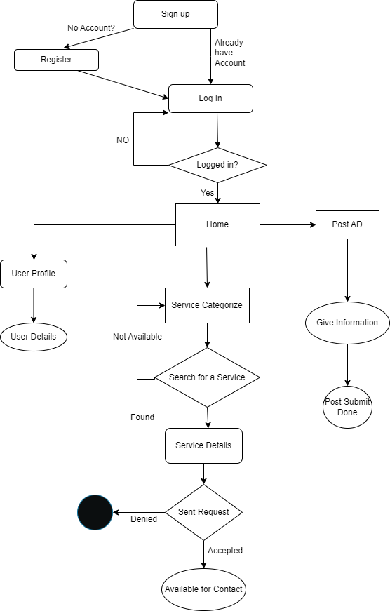
System Architecture

Slide 11
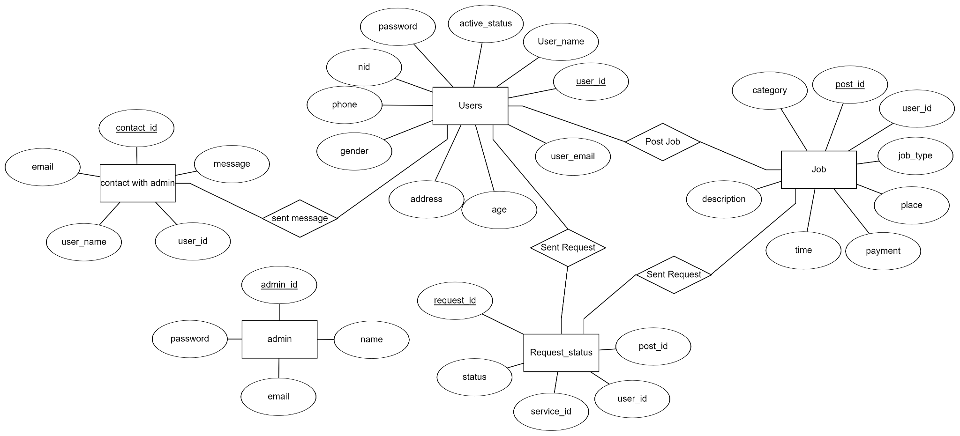
ER Diagram

Slide 12
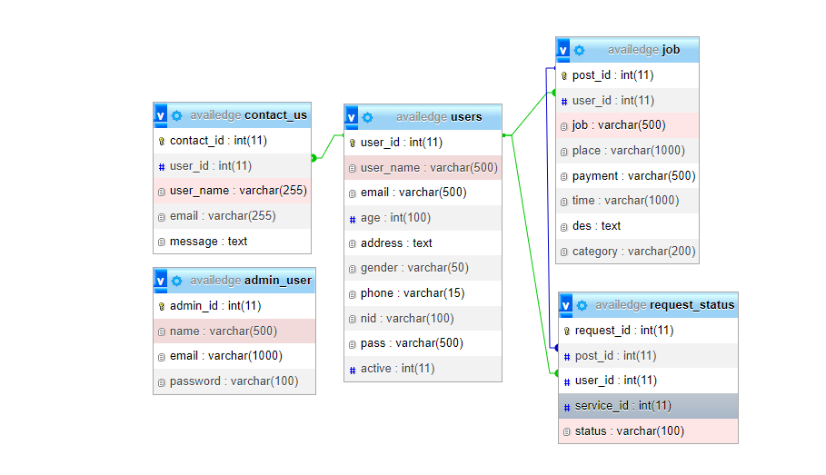
Relation Schema

Slide 13
Future plan
Introduce more Jobs
More efficient search system
Add more security
Give a better Look

Slide 14
Muzadded’s Contribution
Contribution | Methods used
Registration | HTML,CSS,Bootstrap,PHP(insert query)
User Login | HTML,CSS,Bootstrap,PHP(select query)
Post Service(Hourly,Daily,Monthly) | HTML,CSS,Bootstrap,PHP(insert query)
Hire Service | HTML,CSS,Bootstrap,PHP(select,LIKE query)
Job information | HTML,CSS,Bootstrap,PHP(INNER JOIN query)
Search Service By Service ID,salary,time | HTML,CSS,Bootstrap,PHP(select,LIKE query)
Sent,Unsent and Accept request for service to make contact | HTML,CSS,Bootstrap,PHP(insert,UPDATE,DELETE, SUBQUERY(3), LIKE, INNER JOIN query)
Request Received & Sent History | HTML,CSS,Bootstrap,PHP(insert, INNER JOIN query)
Admin Login | HTML,CSS,Bootstrap,PHP(select query)
Admin Dashboard | HTML,CSS,Bootstrap,PHP(select query)
All Post Record | HTML,CSS,Bootstrap,PHP(select query)
All Job Request Record | HTML,CSS,Bootstrap,PHP(select query)
Total user, Total post, Total Service User, Total message Count | HTML,CSS,Bootstrap,PHP(select, COUNT, DISTINCT query)

Slide 15
CONCLUSION
The “AvailEdge” website is design to help people. We believe we will have our success to achieve our GOAL.

Slide 16
THANK YOU
Team Trojan Horse

