Slide 1
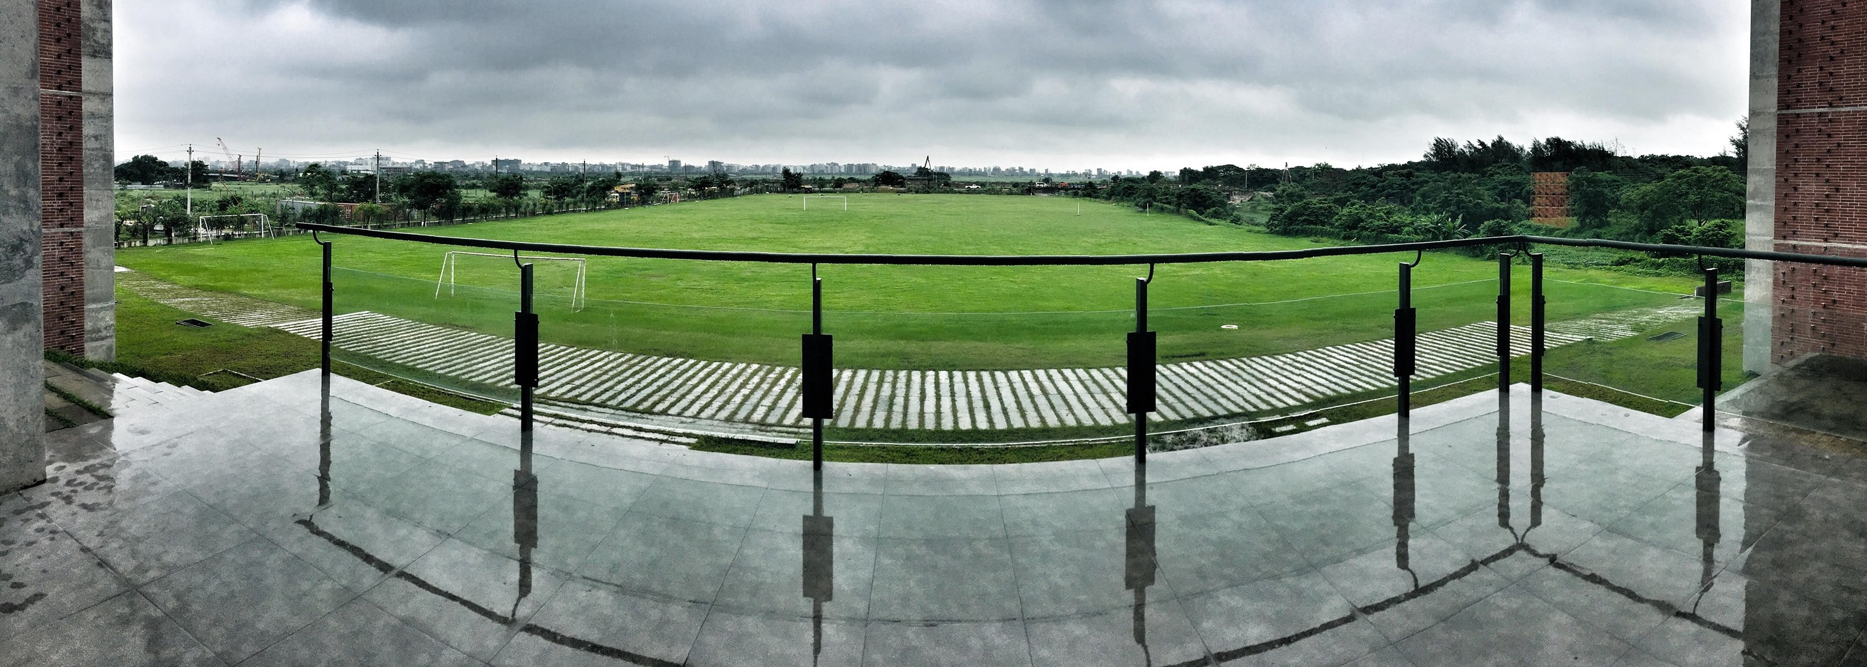

Assessment
CSE 4000A & CSE 4000B
Final Year Design Project
Credit: Modified slides based on the slides prepared by Prof. Swakkhar Shatabda

Slide 2
Facts about this course
Course Title: Final Year Design Project Course Code: CSE 4000A, CSE 4000B
CSE 4000A is a pre-requisite of CSE 4000B Total Credit Hour: 2.0+2.0 = 4.0
In each course, a student must get at least C grade!
Requirements of FYDP
Required by BAETE
Represents a culminating demonstration of the program outcomes at the level of solving complex engineering problems.
Based on the knowledge and skills acquired in earlier course work
Incorporating appropriate engineering standards and multiple realistic constraints.
Assessment

Slide 3
Program Outcomes (POs)
PO a Engineering knowledge PO b Problem analysis
PO c Design/development of solutions PO d Investigation
PO e Modern tool usage
PO f The engineer and society
PO g Environment and sustainability PO h Ethics
PO I Individual work and teamwork PO j Communication
PO k Project management and finance
PO l Life-long learning
Assessment

Slide 4
Course Outcomes (COs)
CO1 Identify a real-life problem that can be translated to an engineering and/or computing solution through design, development and validation. (b Problem Analysis)
CO2 Identify the existing solutions of a problem, critically review these solutions and conduct a gap analysis. (d Investigation)
CO3 Identify outcomes and functional requirements of the proposed solution considering software and/or hardware specification and standards. (b Problem analysis)
CO4 Identify sub-components of a complex problem, prepare a timeline and appropriate budget using the project management skill. (k Project management and finance)
CO5 Present current status of the project through written report and oral presentations. (j Communication)
Assessment

Slide 5
Course Outcomes (COs)
CO6 Analyze, design, build, and evaluate engineering/computing system/subsystem with given specifications and requirements. (c Design/development of solutions)
CO7 Identify the impact of environmental considerations and the sustainability of a system/subsystem of a complete project. (g Environment and sustainability)
CO8 Assess professional, ethical, and social impacts and responsibilities of the design project. (f The Engineer and society h Ethics)
CO9 Function effectively in a multi-disciplinary team. (( i Individual work and teamwork))
CO10 Use modern analysis and design tools in the process of designing and validating a system and subsystem. (e Modern tool usage)
CO11 Present design project results through written technical documents and oral presentations. (j Communication)
CO12 Identify and engage in independent learning activities due to technological changes as required in the process of design and development of the project. (k Lifelong Learning)
Assessment

Slide 6
Course Teacher and Mentor
Two separate persons Course teacher
Who is conducting CSE 4000A in the first trimester
Mentor
Faculty member who will supervise the FYDP
Will work as a guide and advise the students towards the successful completion of the project
The students will solely be responsible for the successful
completion of the FYDP
A course teacher for one section
Might be mentor for other section of the same trimester Or mentor for other trimesters
Assessment

Slide 7
Selection of Mentors
The students’ group should talk to their desired faculty member(s)
After the faculty member agrees, the group should fill out a form collecting the signature of the faculty member
After the submission of the form, the department will finally assign the mentor for a particular group after checking the availability of the mentor
A faculty will not be allowed to supervise more than 3 projects simultaneously
Assessment

Slide 8
External Mentor
The students can also approach an external mentor
Students are encouraged to approach members of Industry Advisory Panel
(cse.uiu.ac.bd/about-cse/industry-advisory-panel/)
Department will also assign an internal mentor to oversee the quality of the project
Assessment

Slide 9
Selecting a topic for FYDP
The topic should reflect the passion and interest of the group of students.
The topic should be realistic, has practical value and applications.
The project idea may come from the experience, thoughts and learning of the students
Students are highly encouraged to survey and analyze societal and industrial needs
Faculty members have already given some sample topics
Students may propose their own topic and approach any faculty member to be their mentor
The topic and the mentor must be fixed by the end of second week
Assessment

Slide 10
Outline of the Project Report
Title of the, Abstract Chapter 1: Introduction
Problem Statement Motivation / Scope Goals / Objectives
Chapter 2: Background
Preliminaries
Review of the literature
Similar Applications Research Papers
Gap Analysis
Chapter 3: Problem Analysis and Design
Requirement Engineering Detailed Design
Plan and Task Allocation
Chapter 4: Development and Validation
Chapter 5: Standards and Constraints
Standards and Compliance with Specification
Impacts and Constraints Budget and Cost Analysis Compliance with Complex Engineering Requirements
Learning Experience
Chapter 6: Conclusion References
Assessment

Slide 11
Course Activities - CSE 4000A
Continuous Assessment 20% (Teacher)
Weekly Tasks Journals
Teamwork 10% (Teacher) Interim Report
Mentor 20%
Teacher 20%
Interim Presentation
Mentor 10%
Teacher 10%
Q&A 10%
All activities will be measured for individual and team work.
Assessment

Slide 12
CO Assessment - CSE 4000A
CO | Measurement | Part | Marks | Assessor
CO1:Real life Problem | Report | Chapter 1 | 10% | Mentor
CO2: Gap Ana- lysis | Report | Chapter 2 | 10% | Mentor
CO3: Require- ments and Standards | Report | Section 3.1, 5.1 | 10% | Teacher
CO4: Compon- ents, Plan and Budget | Report | Section 3.2- 3, 5.3 | 10% | Teacher
CO5: Commu- nication | Presentation | – | 30% | Teacher (15%) Mentor(15%)
CO9: Teamwork | Journal, Weekly Activit- ies | – | 10% | Teacher
Assessment

Slide 13
Course Activities - CSE 4000B
Continuous Assessment 20% (Mentor)
Weekly Tasks Journals
Teamwork 10% (Mentor) Final Report
Mentor 20%
Teacher 20%
Final Presentation & Demo
Mentor 10%
Teacher 10%
Q&A 10%
All activities will be measured for individual and team work.
Assessment

Slide 14
CO Assessment - CSE 4000B
CO | Measurement | Part | Marks | Assessor
CO3: Require- ments and Standards | Report | Section 3.1, 5.1 | 5% | Teacher
CO6:Design | Report | Chapter 3 | 10% | Mentor
CO7: Environ- ment | Report | Section 5.2 | 5% | Teacher
CO8: Society, Ethics | Report | Section 5.2 | 5% | Teacher
CO9: Teamwork | Peer Observa- tion, Journal | – | 10% | Mentor
C10: Tool & Val- idation | Report | Chapter 4 | 5% | Mentor
CO11: Commu- nication | Presentation, Demo | – | 30% | Teacher (15%) Mentor(15%)
CO12: Learning | Report | Section 5.5 | 5% | Mentor
Complex Eng. | Report | Section 5.4 | 5% | Teacher
Assessment

Slide 15
Weekly Activities - CSE 4000A
W1 Course details and intro to selection of topics W2 Topic Presentation, Justify the topic
W3 Art and Science of Writing
W4 Art and Science of Presentation W5 Literature Review
W6 Constraints and Standards
W7 Project Management and Ethical Constraints W8-9 Weekly Progress Report via Presentation
W11-12 Weekly Progress of Final Report and Presentation
Assessment

Slide 16
How to Maintain Weekly Journal?
What is a Journal: A reflective document that provides personal, thoughtful analysis of individual participation/progress
Why keep a journal: articulate what you learned as a leadership major and why you do the things you do
Submit weekly journal entries. At the end of the semester, submit full, aggregated collection of entries
“thoughtful” Journal entry
What did you learn during this interaction? What did you contribute?
Independent research/readings you have done to support the
project
New technological skills you need to develop and your plans for going about doing that
What happened when I tried something new? Why did I succeed
or fail?
You should be honest in your journal entries. If you have not spent any time or given any thought to this course/project during the week, then that is what you should record.
Assessment

