Slide 1
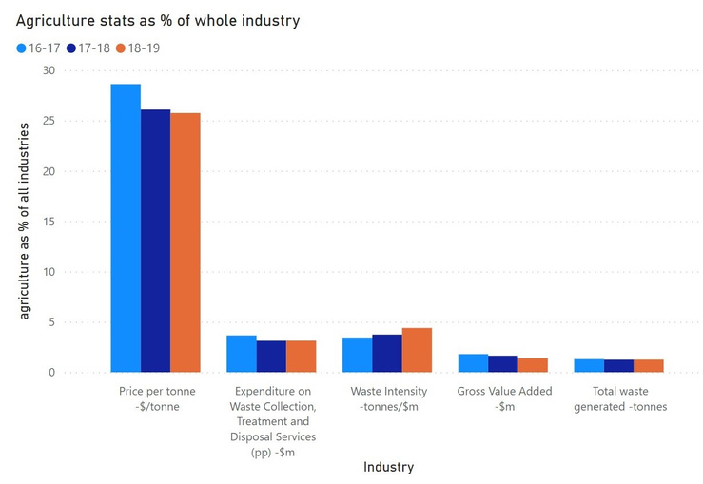
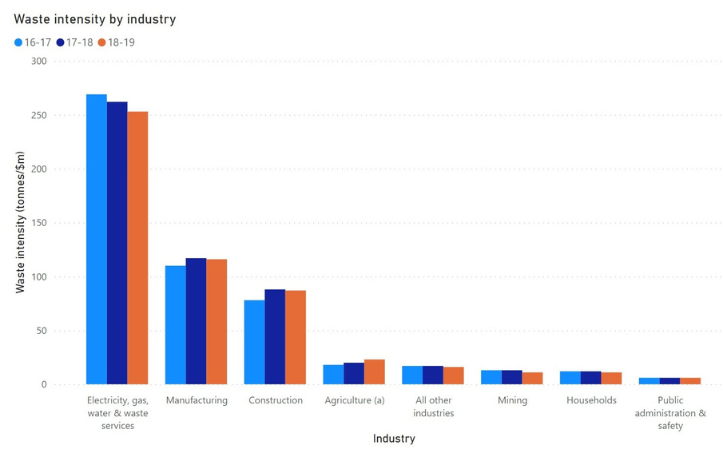
ESG Performance Tracking - Industry stats
Which industry statistics should we track to track the performance of the agricultural industry in waste management?
The agriculture industry spends the most per tonne of waste
Share of waste intensity from the agriculture industry increased over the years
The only industry to have rising waste intensity over each year
Waste intensity: Total waste produced as a share of gross value added.
Rising waste intensity and high price: The agriculture industry has rising waste intensity combined with highest price per tonne indicating a very expensive industry.
Tracking the statistics across industries in this manner will reveal areas of improvement.
Notes:
In order to deal with the current challenges that haunt the agricultural industry it is very important that we track all the macro and micro stats of our industry.
So let us start by asking ourselves which industry-wide stats should we track and look deeper into to track the efficiency of the agricultural industry in waste management based on the data from 2016-2019.
To get a holistic view of how our industry is performing we measure our industry metrics as a percentage of the whole industry. At first glance, we notice the staggering share of price per tonne of the agricultural industry compared to all the other as they make up more than 25% of the industry total, infact they actually spend the most per tonne of waste among all the other industries. But on the brighter side we see that since 2016 this share of price per tonne has steadily decreased indicating that the agricultural industry might have improved efficiency in waste management. However, even though the price per tonne has decreased the share of waste intensity has been increasing over the years. This means that a larger quantity of waste is being generated per unit of output produced by the industry. This could indicate a fall in efficiency in the production agricultural goods. If we look deeper into the comparison we will notice that the agricultural industry is the only industry to have rising waste intensity over each year since 2016. This helps us to rule out that production inefficiency is a economy-wide trend and solidify that it is specific to the agricultural industry.

Slide 2
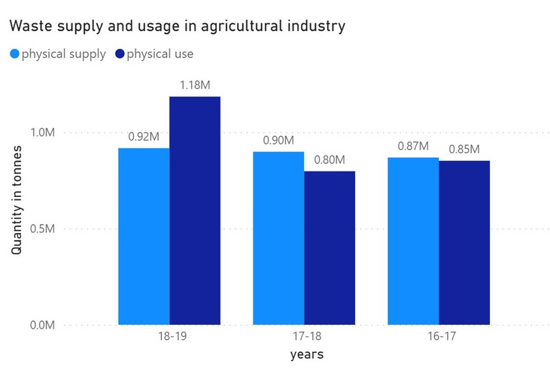
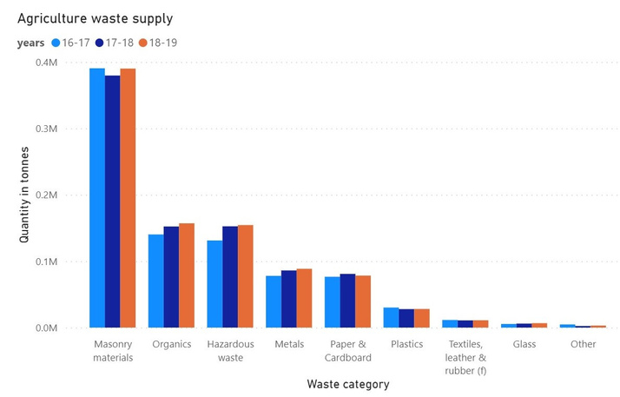
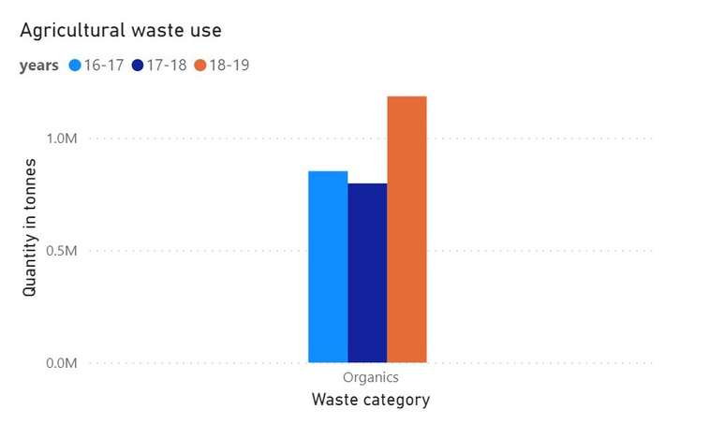
ESG Performance Tracking - Supply and Usage
Which waste categories have been the driving force behind the trend in supply-usage across 2016-2019?
Lower Gross value added for the agricultural industry but higher waste suppy in 2018-19
Overall waste supply increased by 20000 tonnes between 2017-18 and 2018-19
Masonry materials is the highest wasted category
Usage of physical waste surpassed the supply for the first time in three years in 2018-2019
Even though higher waste usage, supply increased in almost all categories. Only organic waste is used, so not all wastage is consumed
Notes:
Now let us take a closer look to see whats happening inside the industry. In doing so let us answer which waste categories have been the driving force behind the trend in supply-usage across 2016-2019.
the term 2018-2019 has been a good period in terms of ESG for the agricultural industry as for the first time in 3 years their total waste usage surpassed their waste supply however waste supplied was also highest in the 3 years exceeding the previous term by 20000.
Further investigation shows us that waste supplied rose almost in all categories but the increase in organic waste usage drove the overall waste usage higher than the waste supply.
One important point to note is that the only waste that is used is organic waste so even though the waste usage is higher than the waste supply waste generated in other categories is not consumed and is contributing to overall waste generation.

