Slide 1

Amazon Seller : Order Status Predication
Final Evaluation
Presenter
Shakir Malik (2020A1R019)
CSE - 5th semester
DEPARTMENT OF COMPUTER SCIENCE AND ENGINEERING
MIET(Autonomous), JAMMU

Slide 2
Contents
Introduction
Problem Statement
Solution
Tech Stack
Methodology
Datasets
Workflow
Demonstration
References

Slide 3
What is Amazon Seller?
Introduction.
Selling on amazon is a program that lets individual and businesses sell their product and inventory on in Amazon stores like Amazon.com
A person/businessman who sell there products on the Amazon is Called Amazon Seller.

Slide 4
Problem Statement
Aim: Build a model in machine learning to predict the status of the order.(whether it is Delivered to buyer or Returned to seller)
Due to covid and the advancement in the technology many business find an opportunity in switch there business to online mode. It helps them to expand the reach of there products and earn a huge amount of profit in less time.
Over the past few years, it has incurred some loss due to return orders. Now, Businessmen seeks help to predict the likelihood of a new order being rejected. This would help them to take necessary actions and subsequently reduce the loss.

Slide 5
Solution
This model helps in predicting the status of the order.
This model reads the dataset and analysis the attributes or factors one by one given in dataset.
The model check whether there is any specific relation or pattern of any attribute with the Order status or not.
After that it will take that attributes into the consideration and on the bases of that our model can make the prediction on the existing date set.

Slide 6
Tech Stack
Python
NumPy
Pandas
Seaborn
Matplotlib
Missingo
SciKit Learn

Slide 7
Methodology
Data Exploration
Gather data, upload it into program and take a look on the data like what kind of data is there what are the feature ,type of datatypes, type of dataset etc .
Data Cleaning
Checking for null values, missing values and check for the column which is better to take out of the model, what are the redundant variables.

Slide 8
Visualization
Visualization of data through graphs and plots.
Modelling
Selecting predictive model .
Performance analysis
Checking for evaluation and accuracy of the model.

Slide 9
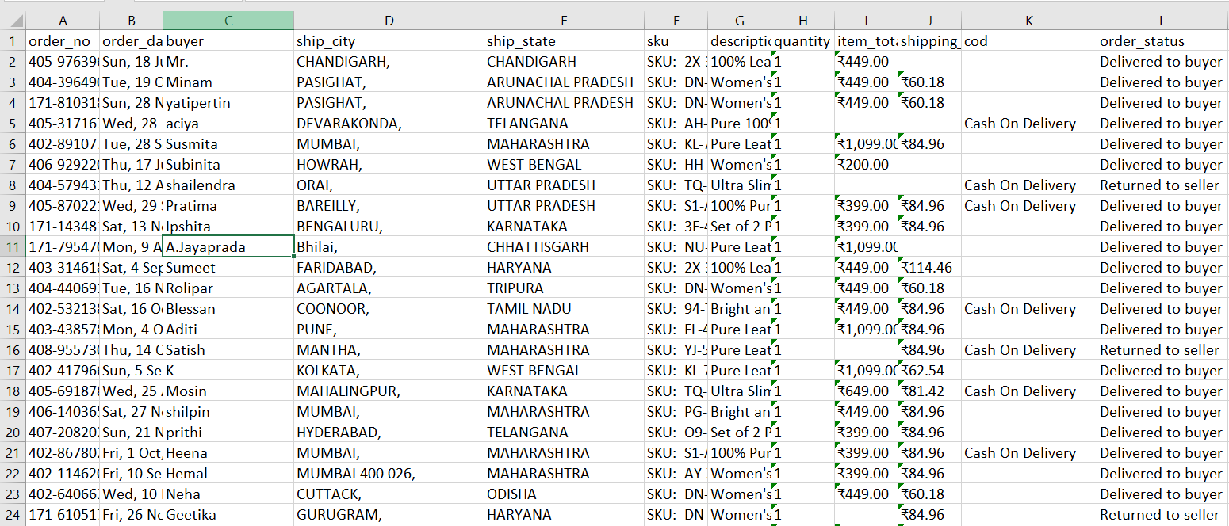
Datasets :
Amazon Dataset(https://www.kaggle.com/datasets/pranalibose/amazon-seller-order-status-prediction)

Slide 10
WORKFLOW
&
DEMONSTRATION

Slide 11
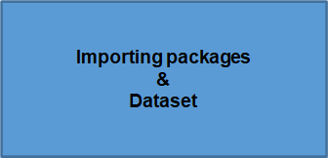
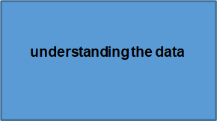

Data cleaning
Exploratory Analysis of Data
Correlation Analysis
Classification Models

Slide 12
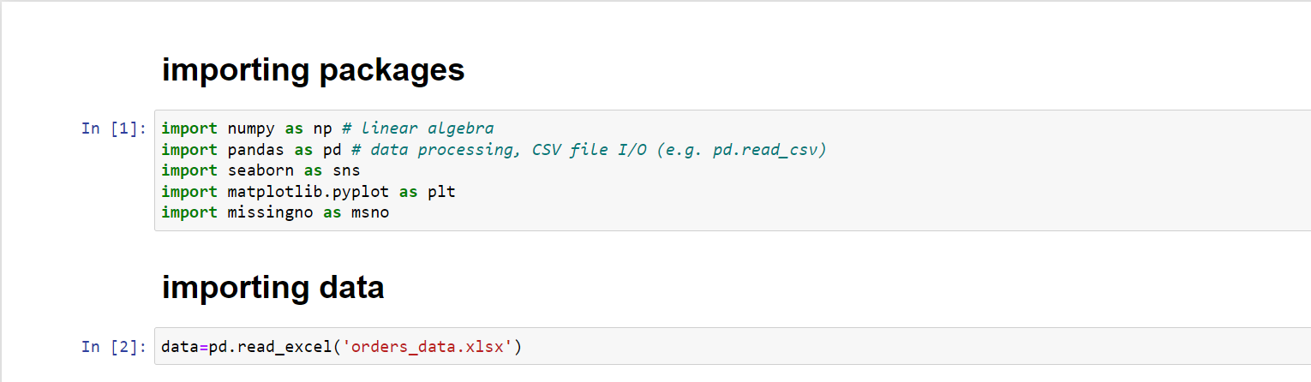
Importing packages and dataset

Slide 13
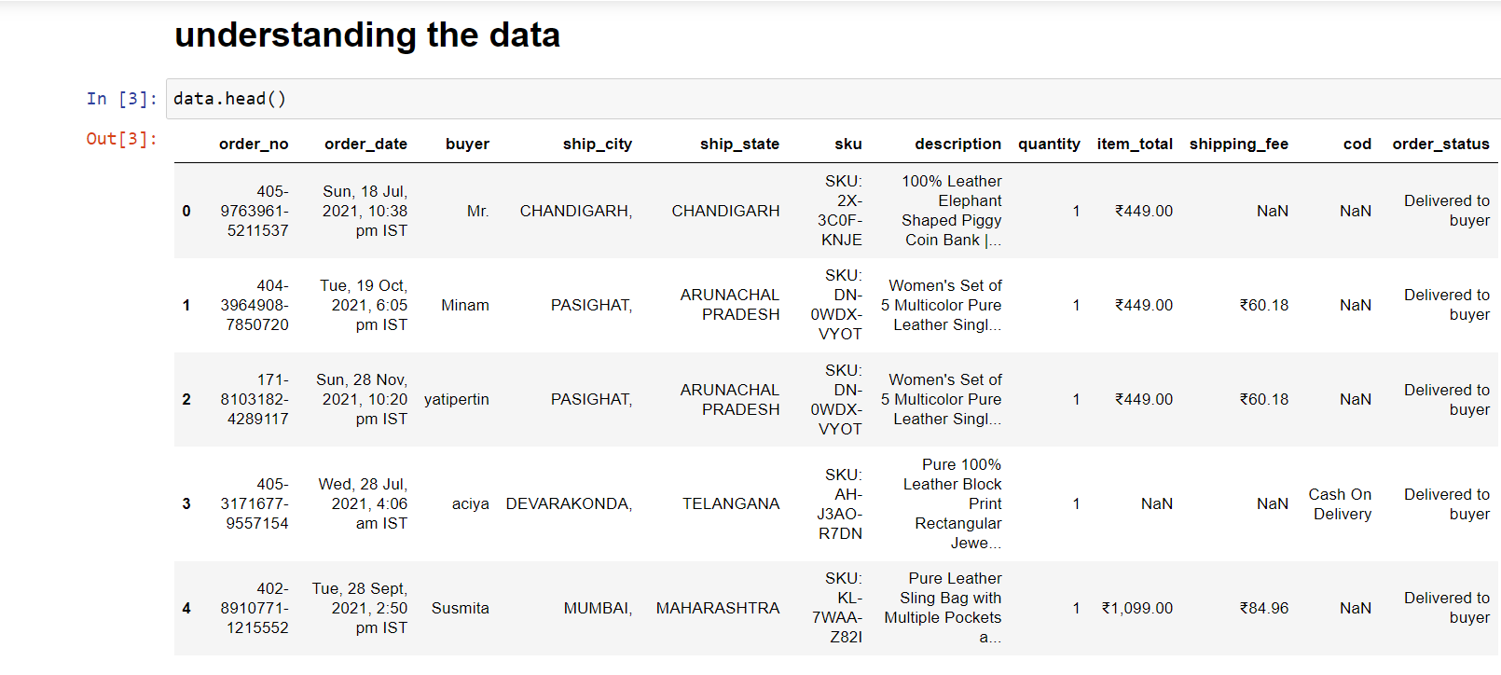
Understanding the data

Slide 14
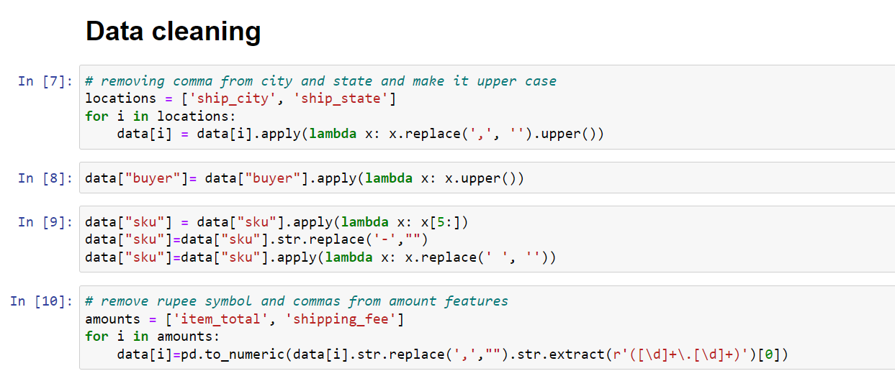
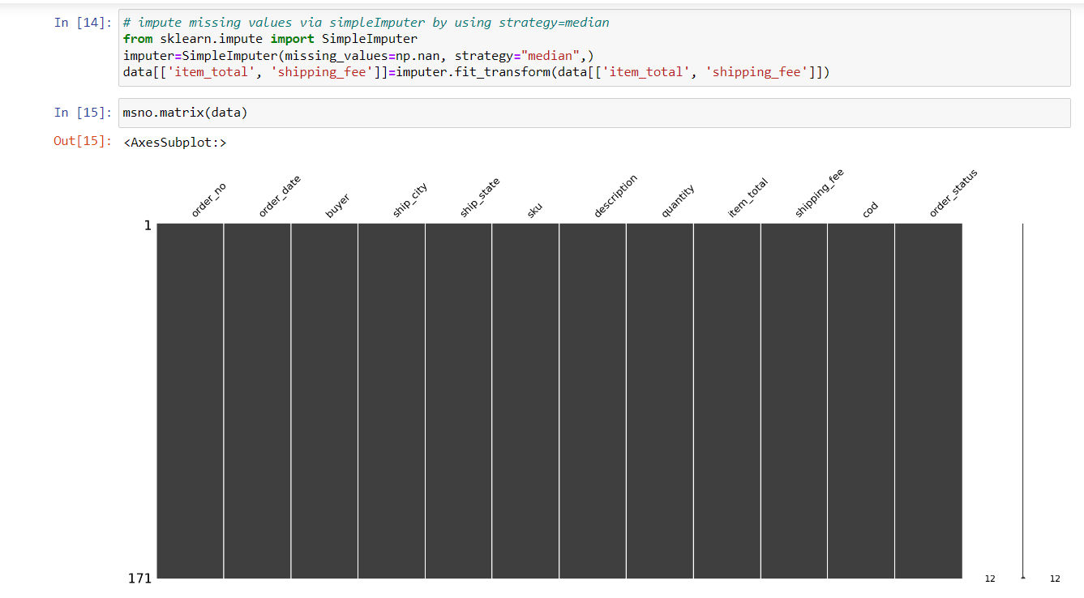
Data Cleaning

Slide 15
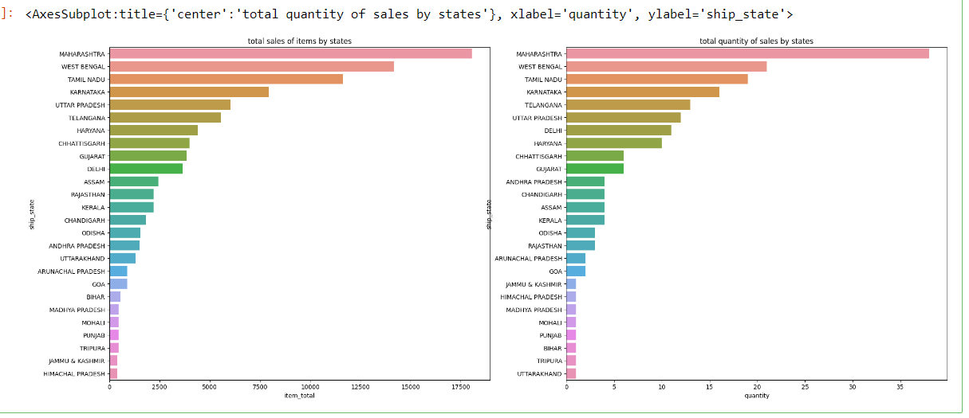
Exploratory Analysis of Data
sale vs state

Slide 16
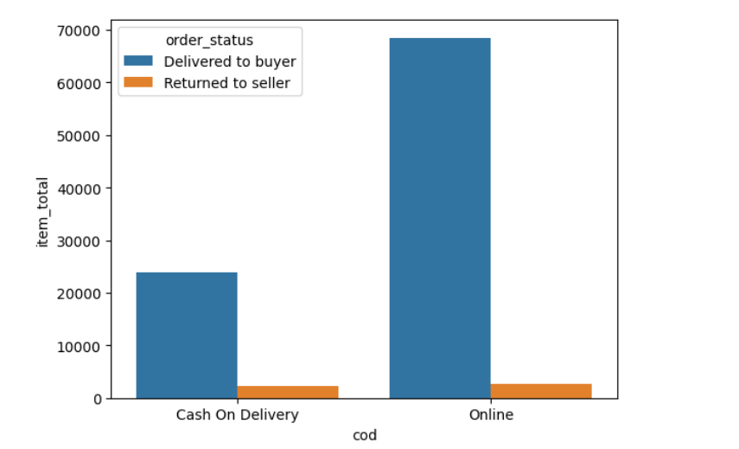
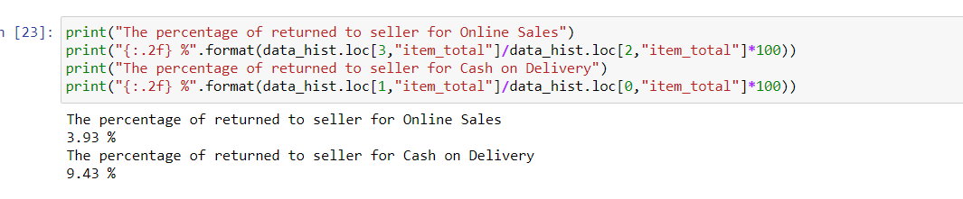
Sales vs Payment Method and Returned to Seller

Slide 17
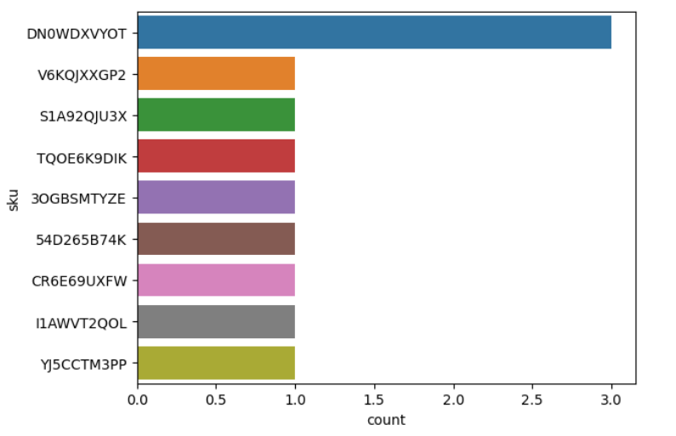
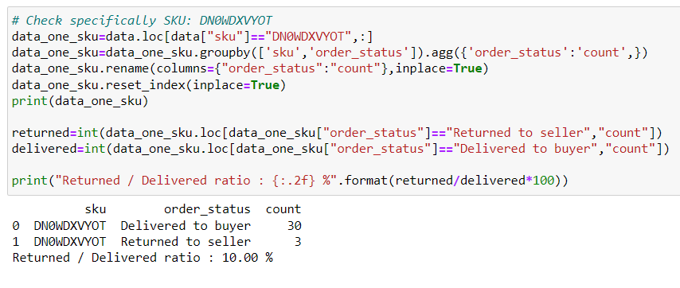
SKU and Buyer vs Returned to Seller

Slide 18
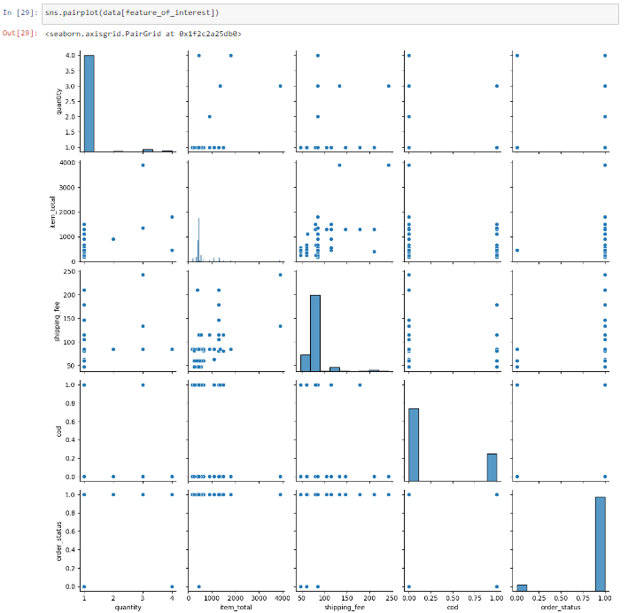
Correlation Analysis

Slide 19
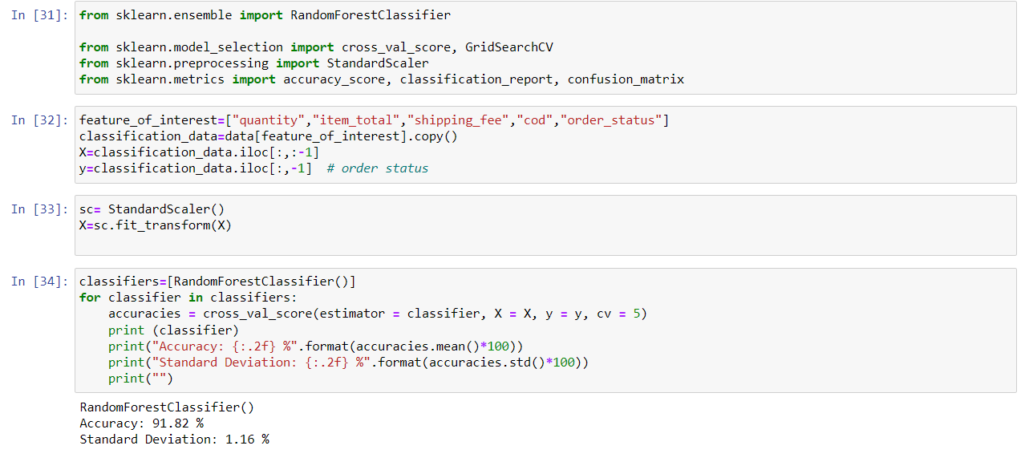
Classification Models

Slide 20
References
For different kind of query and doubt:
https://www.quora.com/search?q=what%20is%20the%20dilevery%20model%20for%20online%20apps
For study and research purpose:
https://www.amazon.in/gp/help/customer/display.html?nodeId=GJK6YT2NCPCAV7DC
For the dataset and project detail:
https://www.kaggle.com/
For the code and graph:
https://www.kaggle.com/datasets/pranalibose/amazon-seller-order-status-prediction

Slide 21


