Slide 1
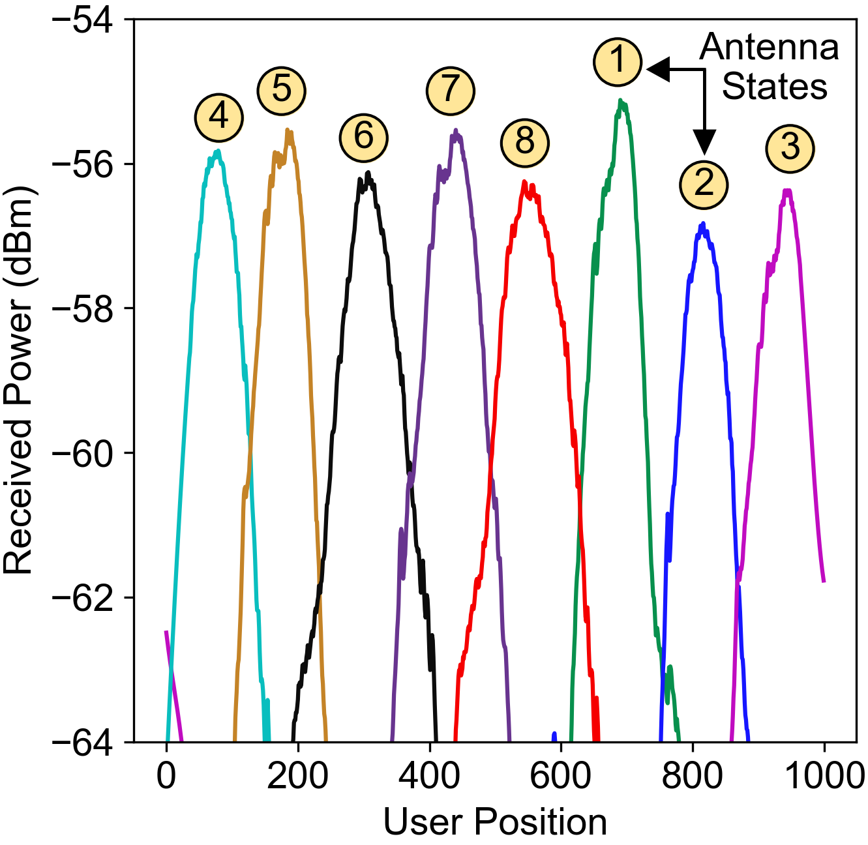
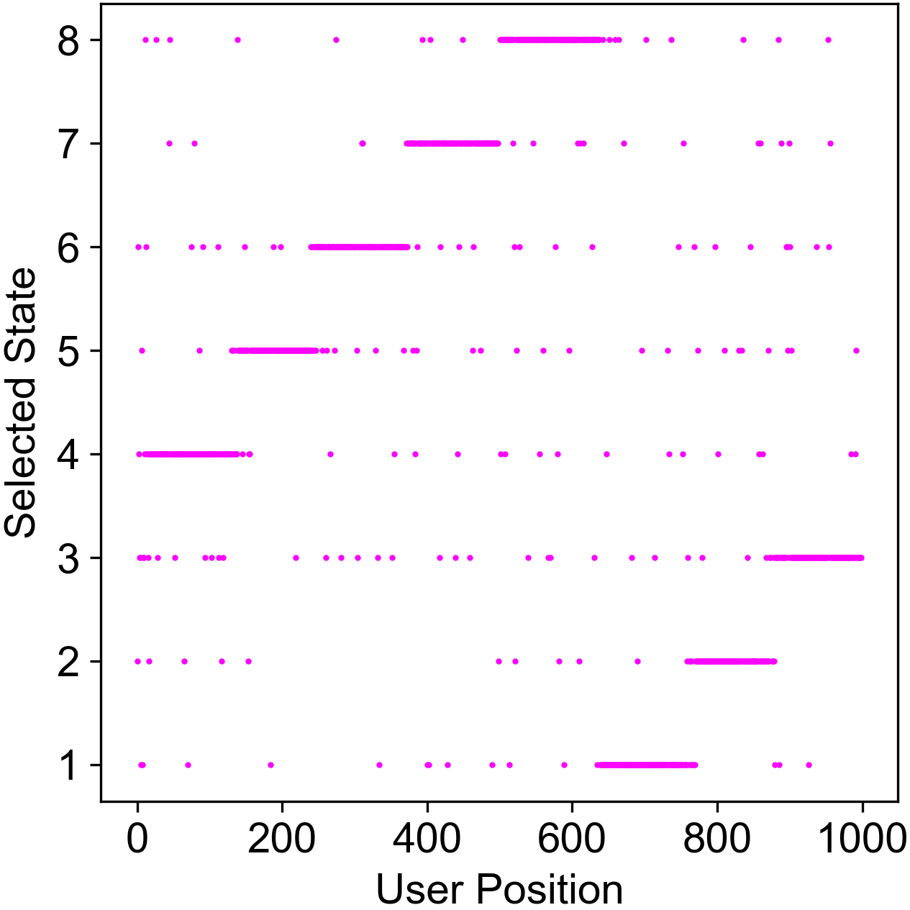
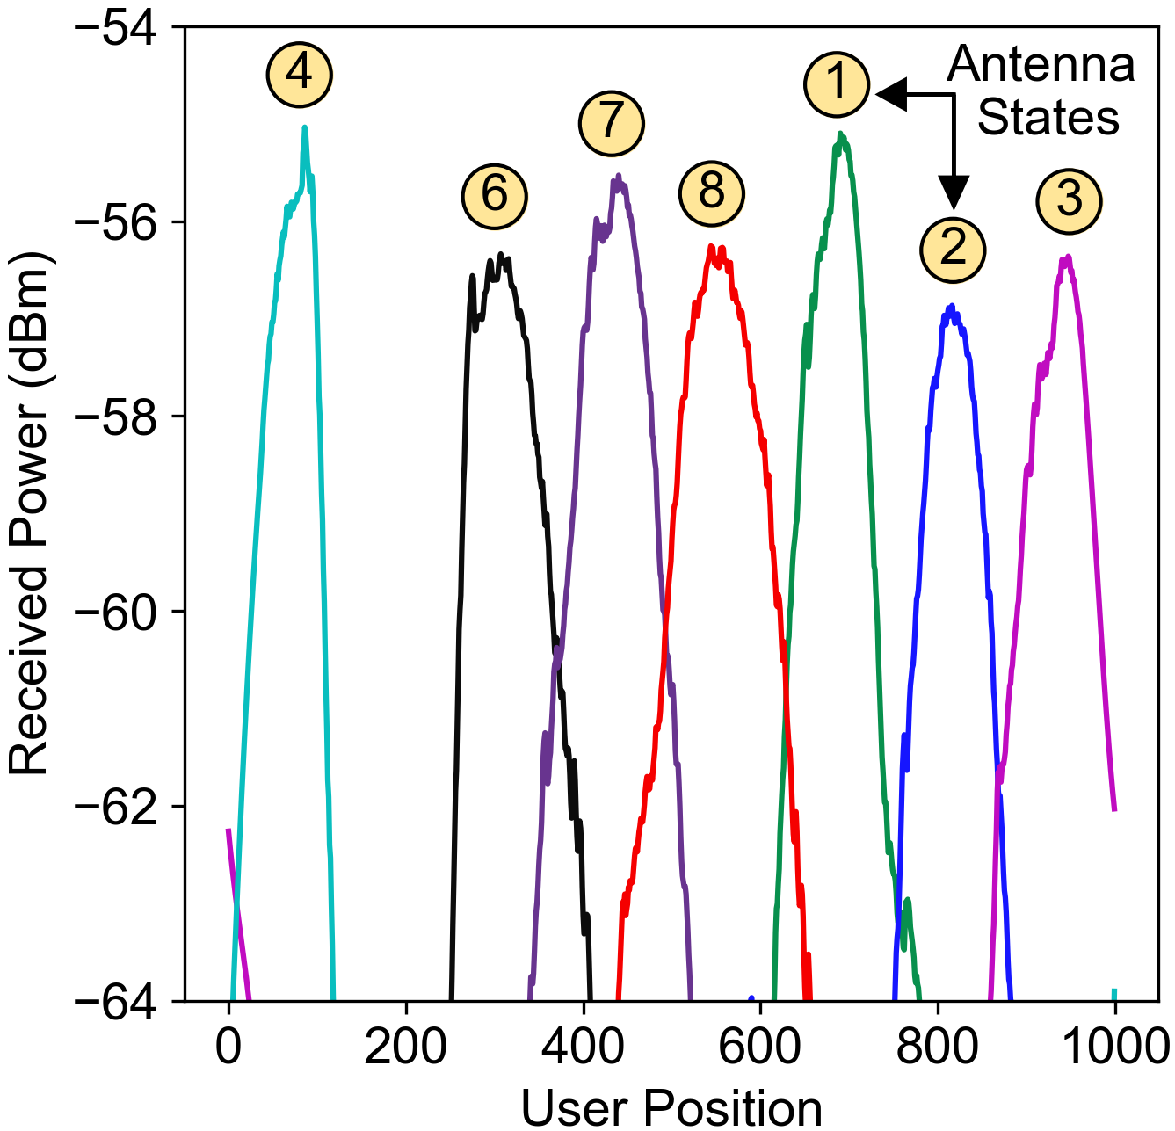
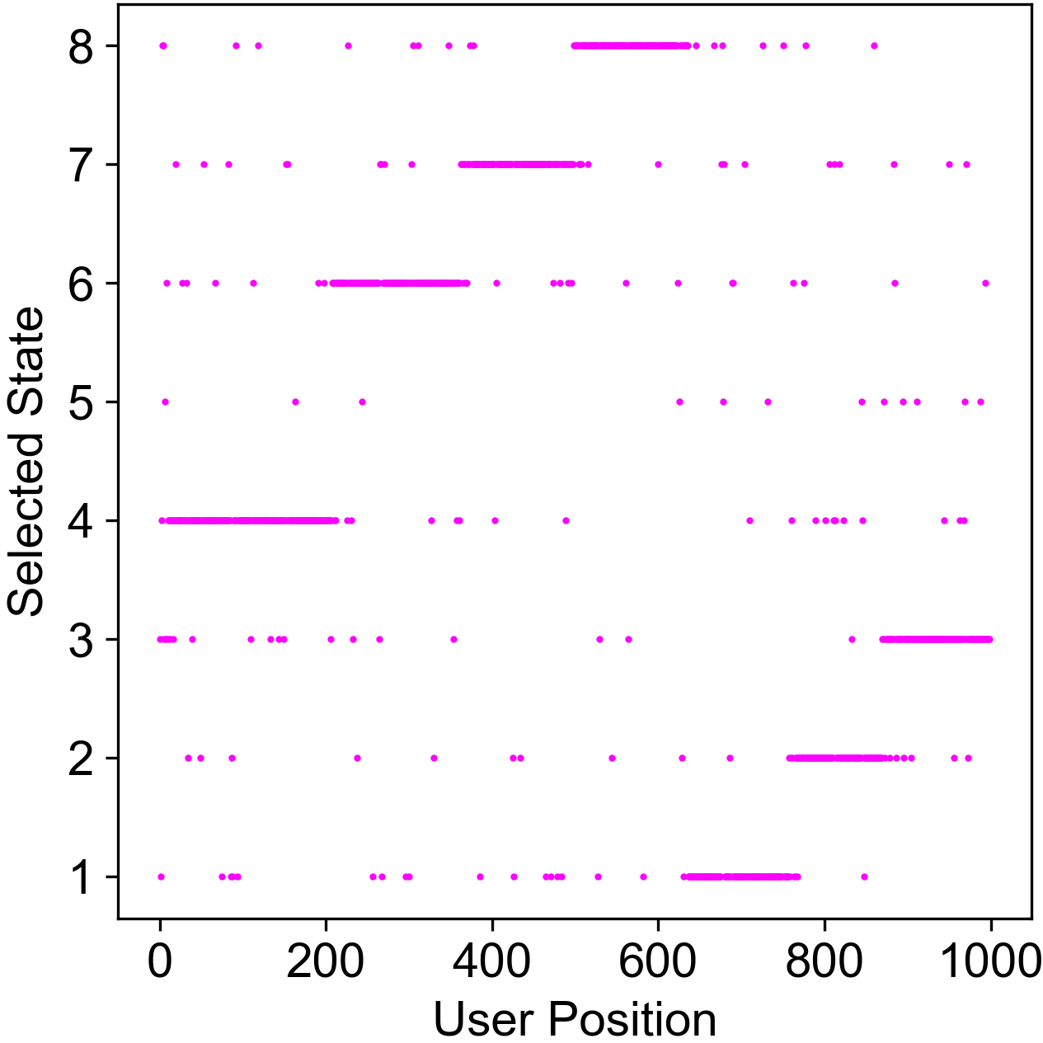
(a)
(a)
Effect of Absorber
(b)
(b)

Slide 2
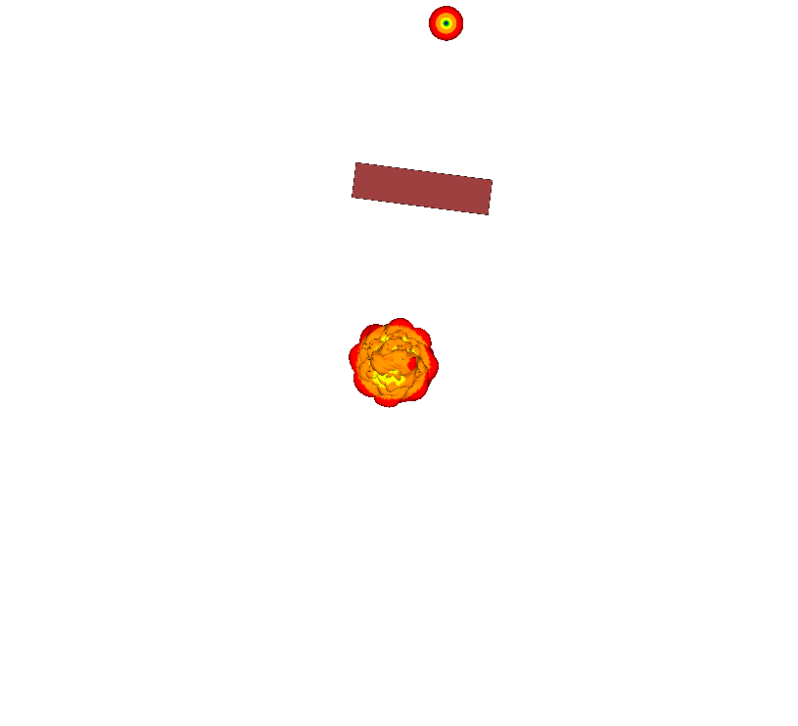
2.5
Direction of
Movement
User
1.25
2m
6
5
4
0.0
7
3
8
2
Antenna
States
1
-1.25
Conformal
Antenna
Y
X
-2.5
-1.25
1.25
2.5

Slide 3
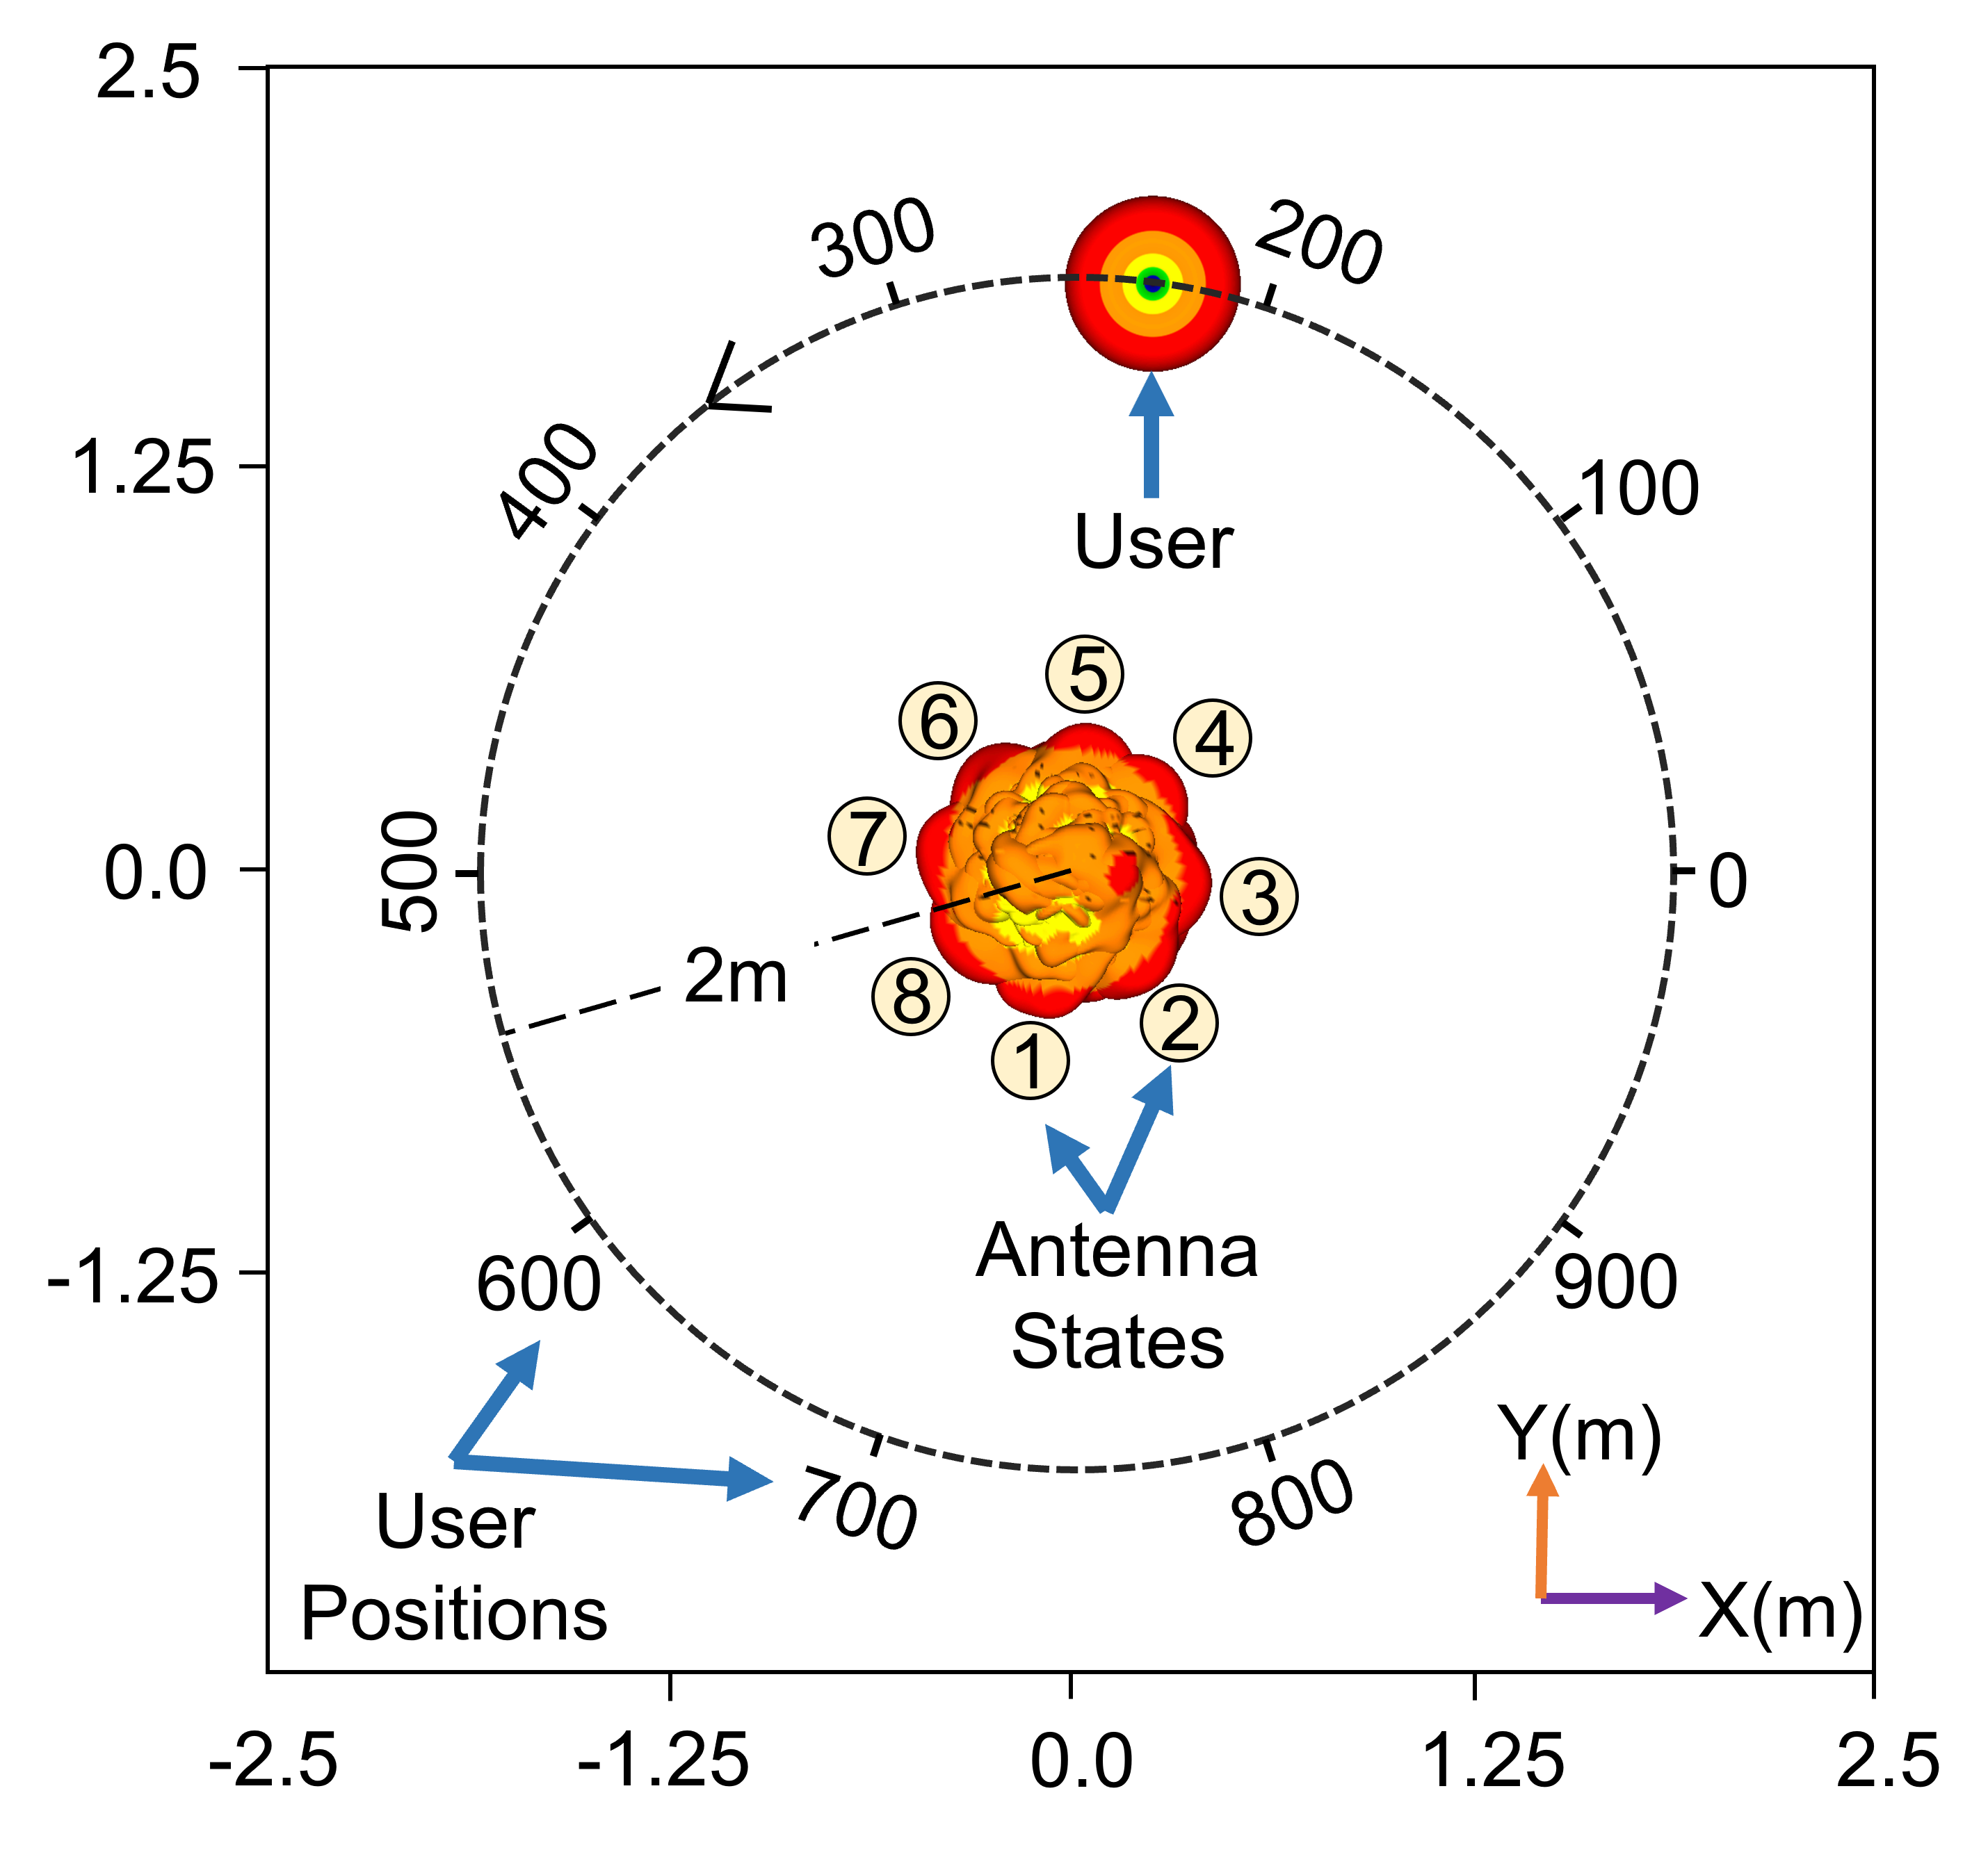
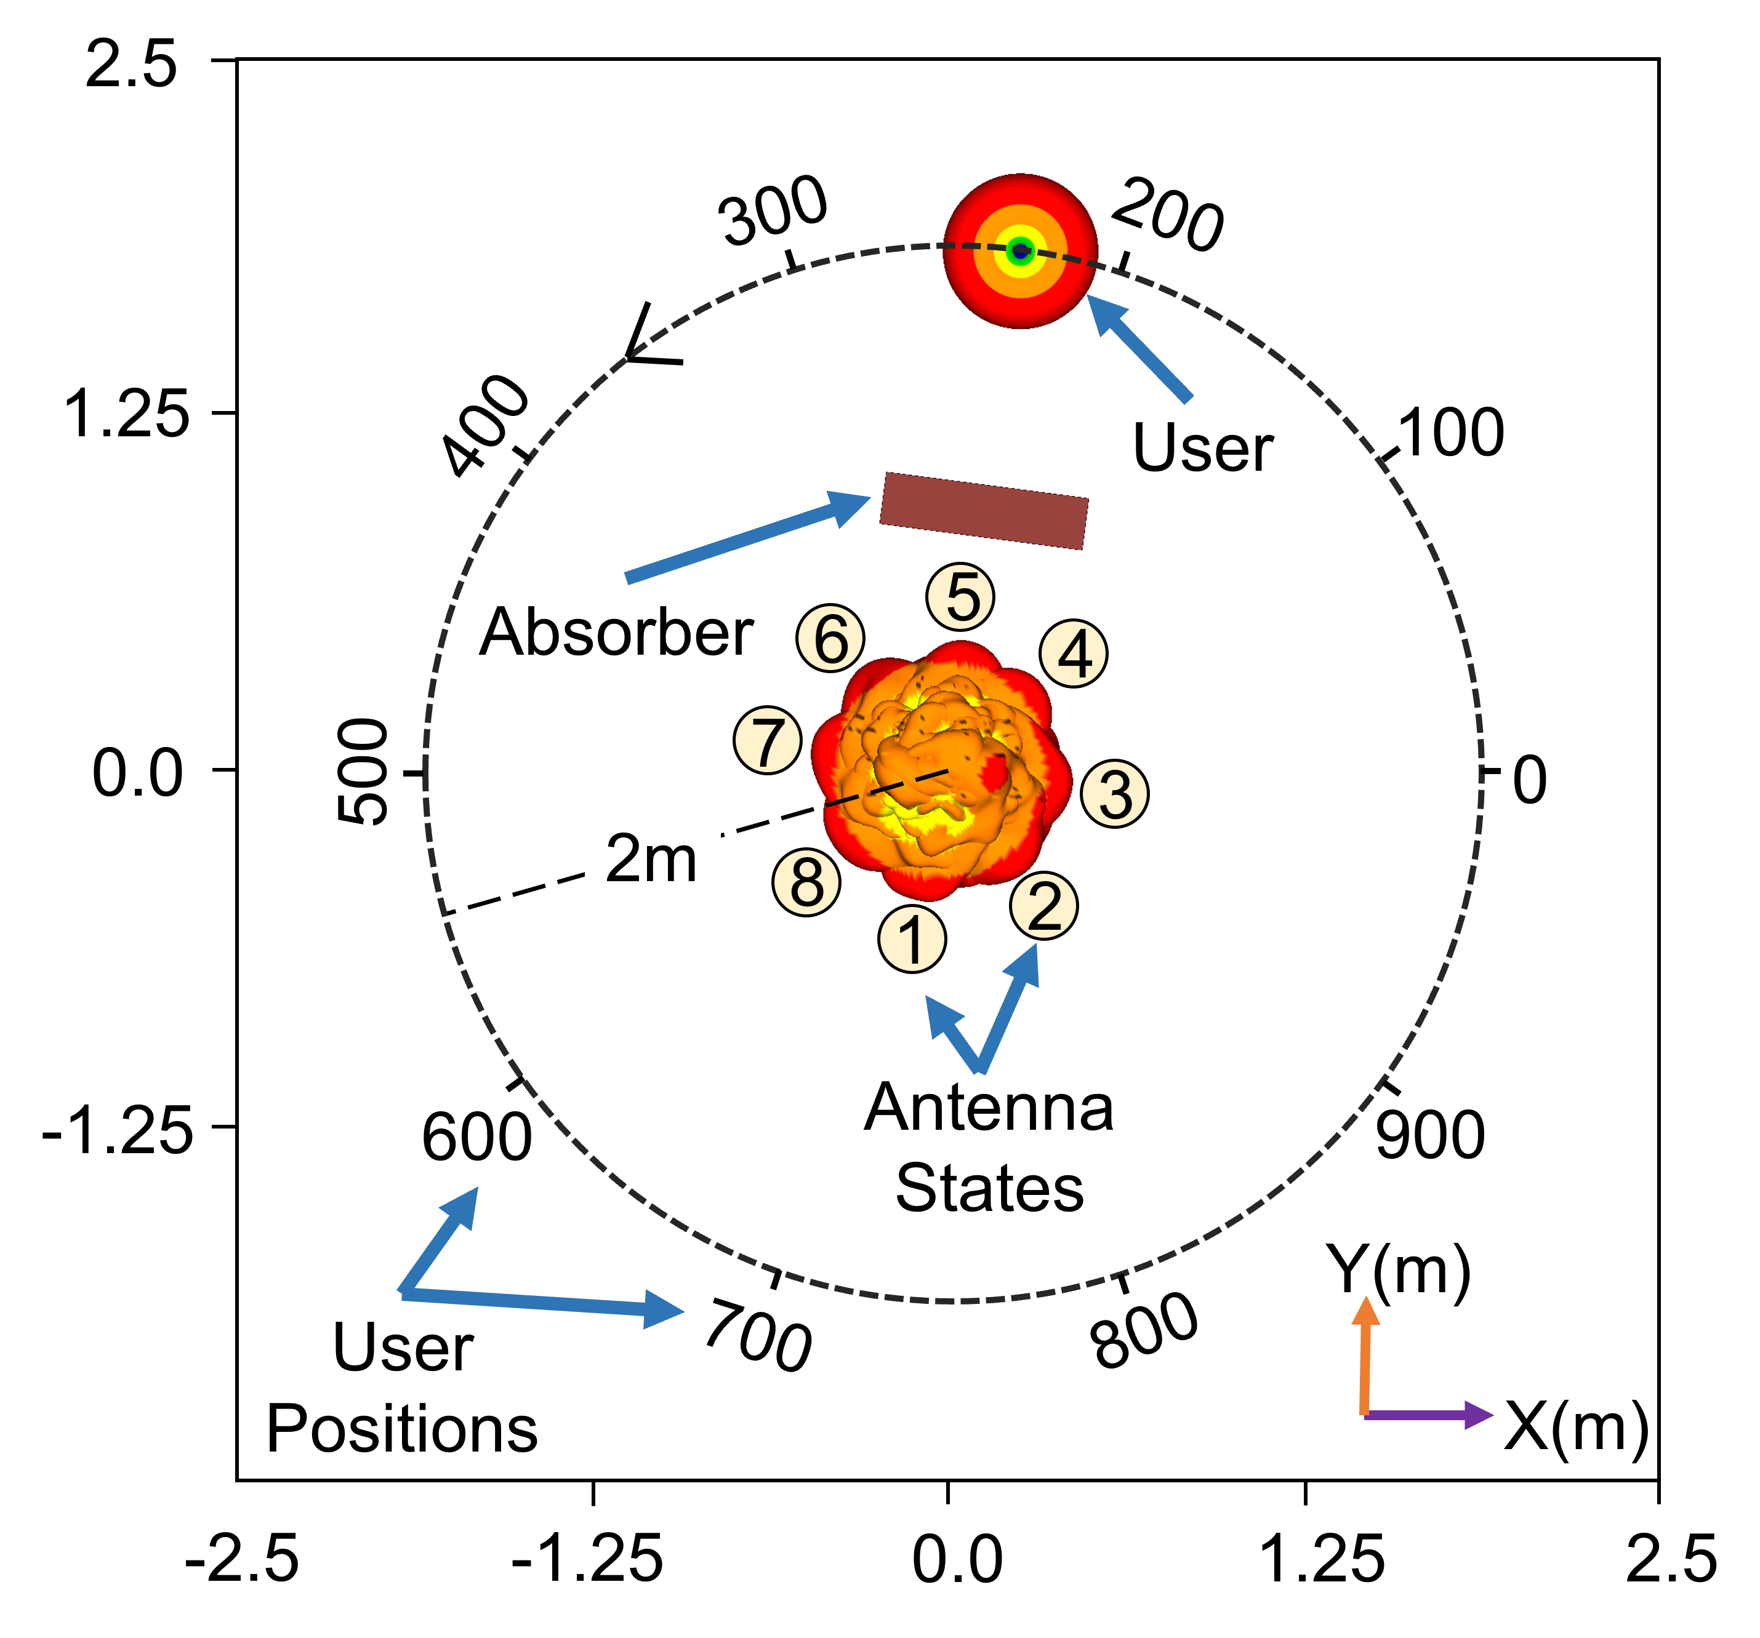
(a)
(b)

Slide 4
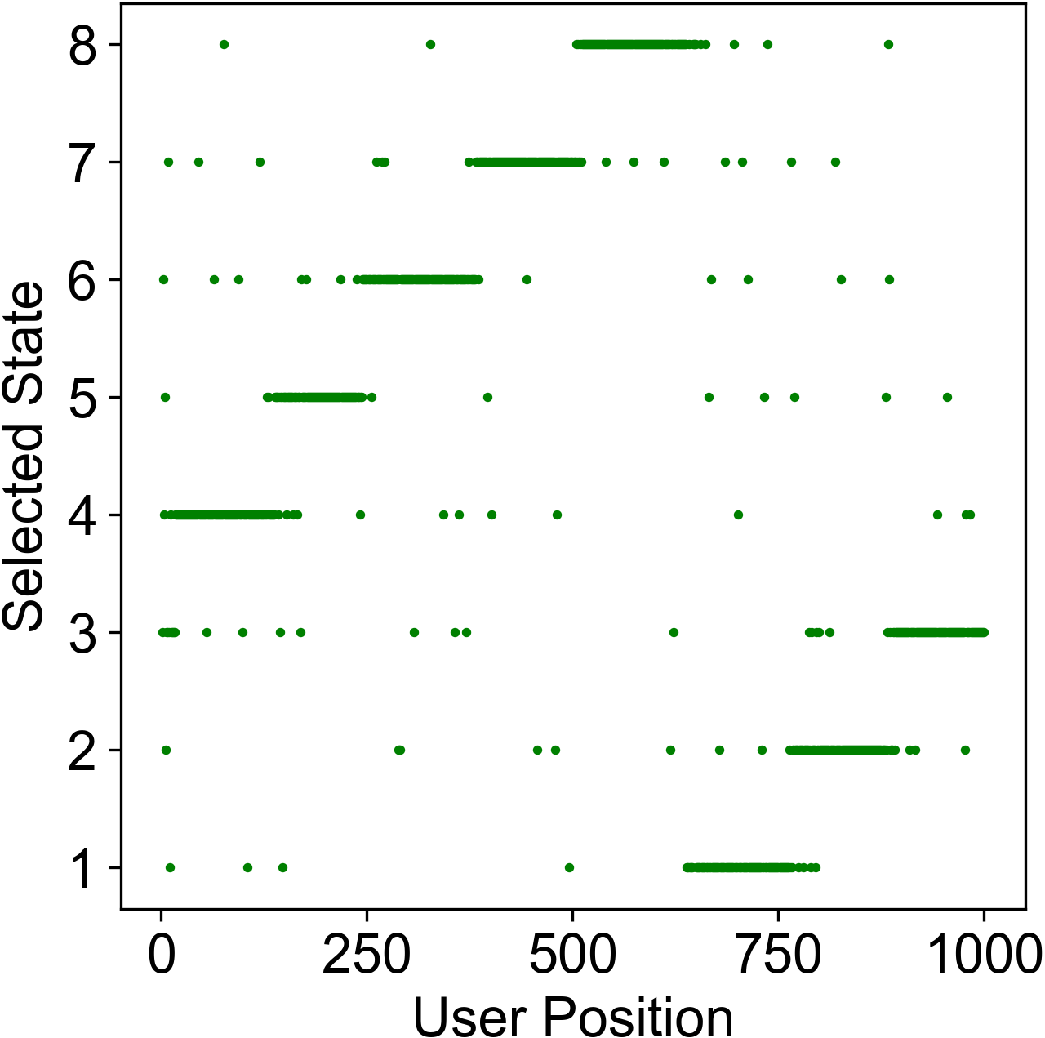
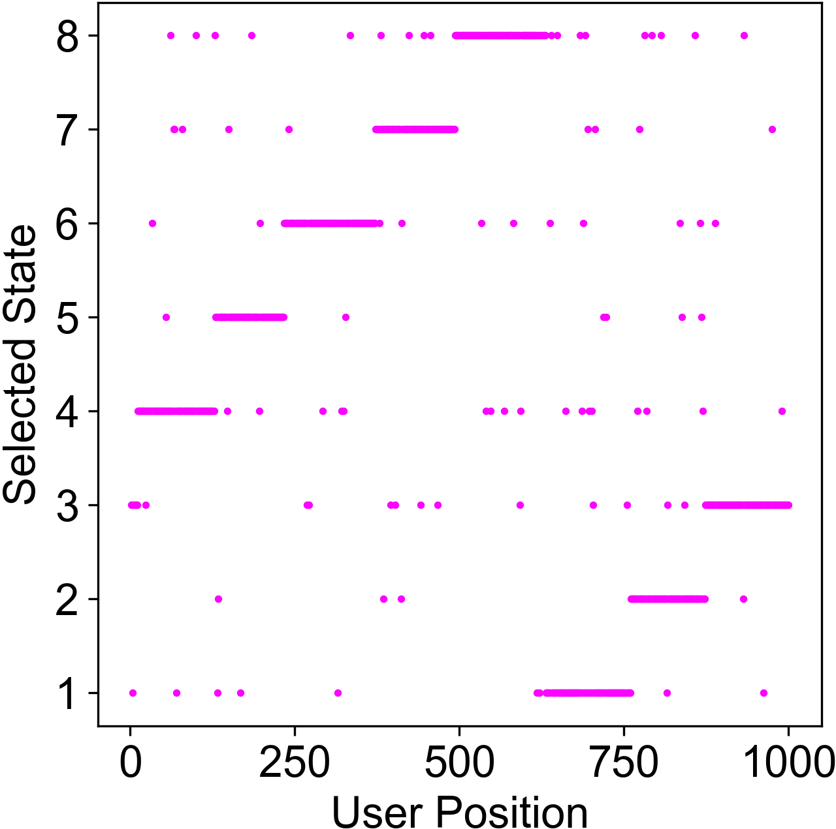
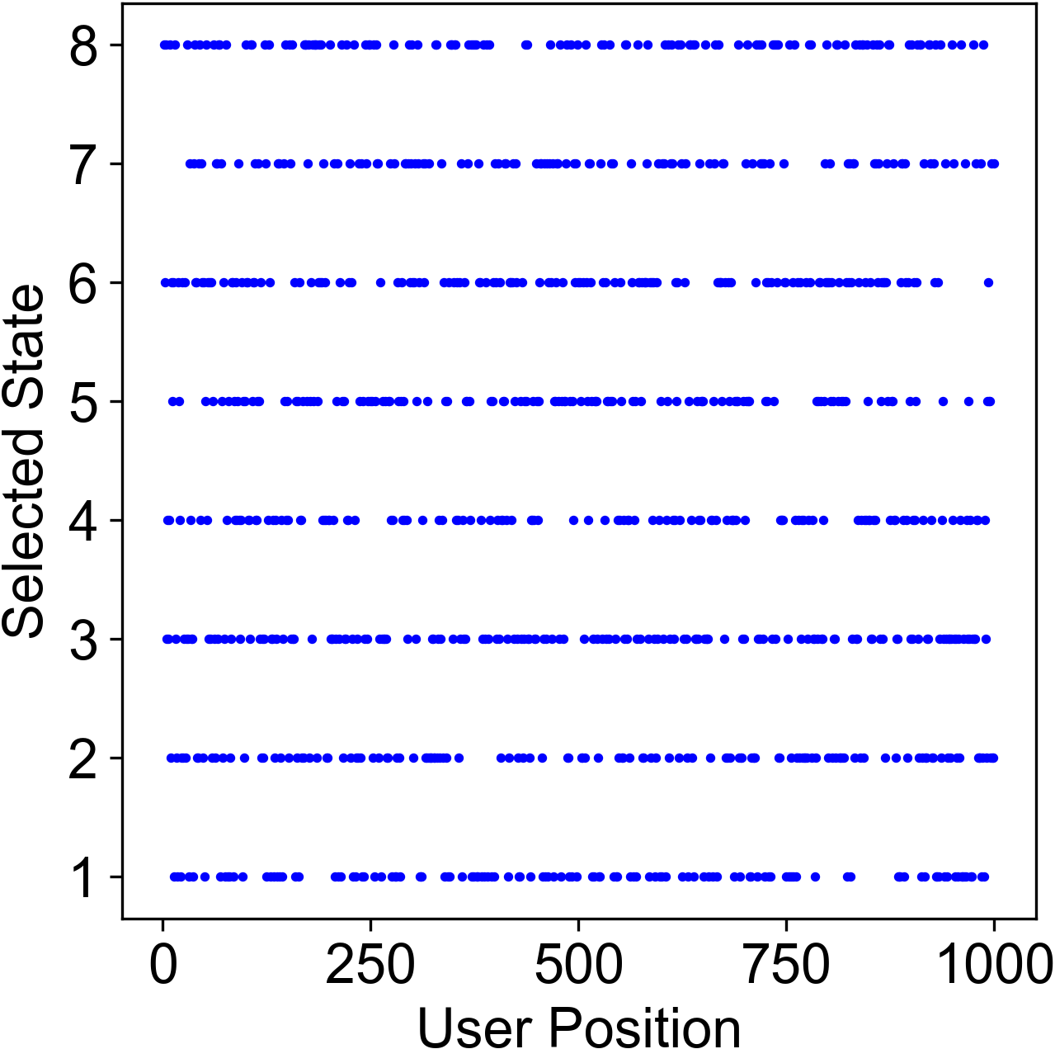
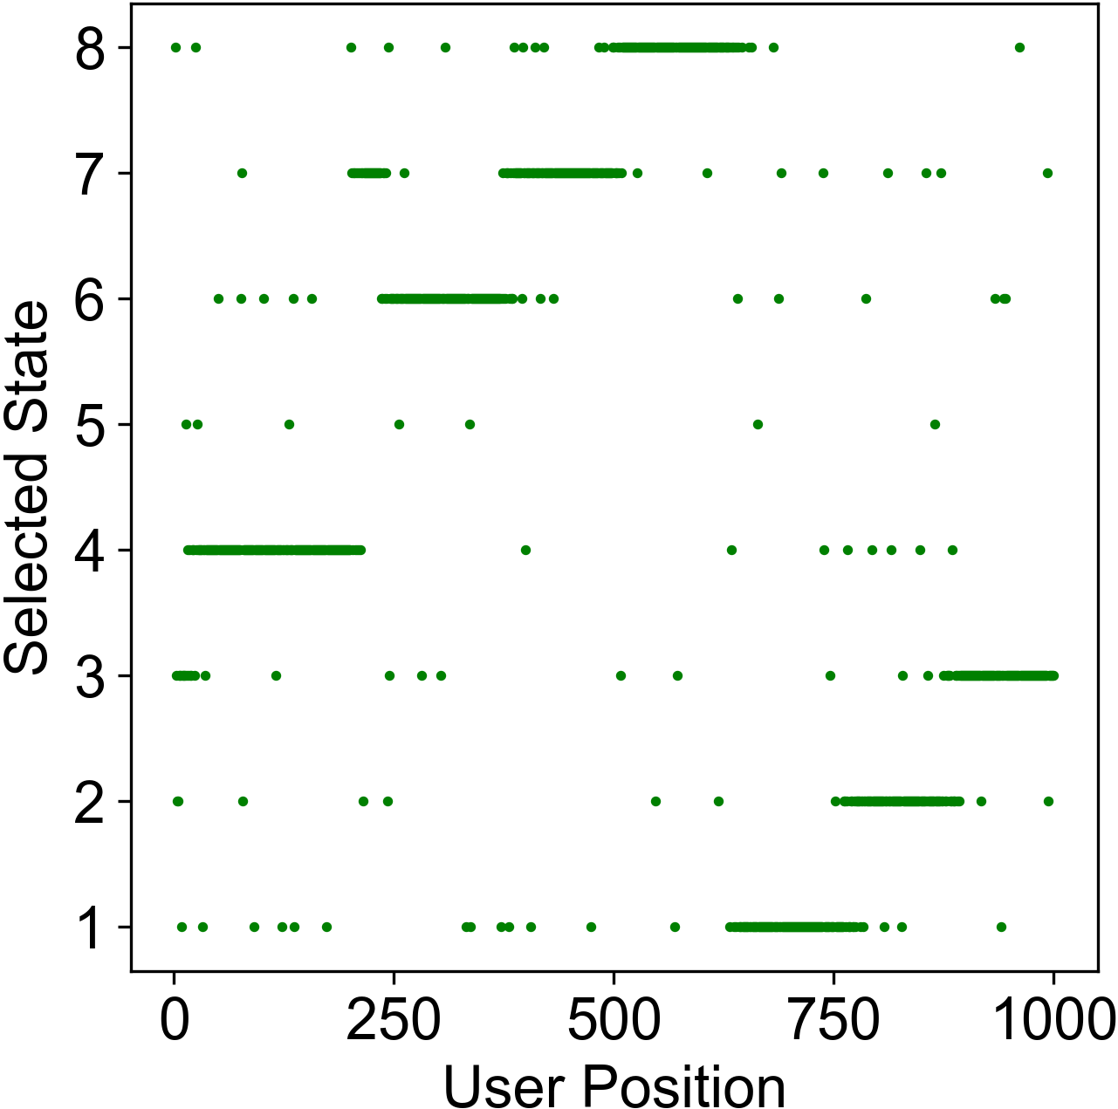
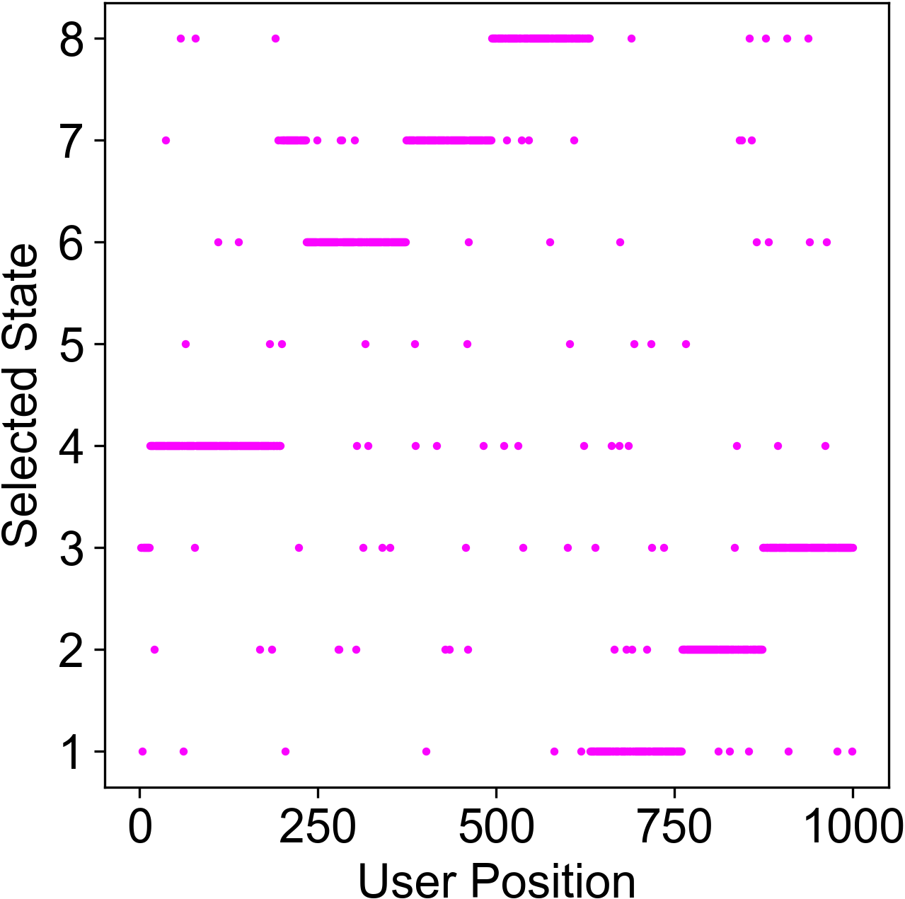
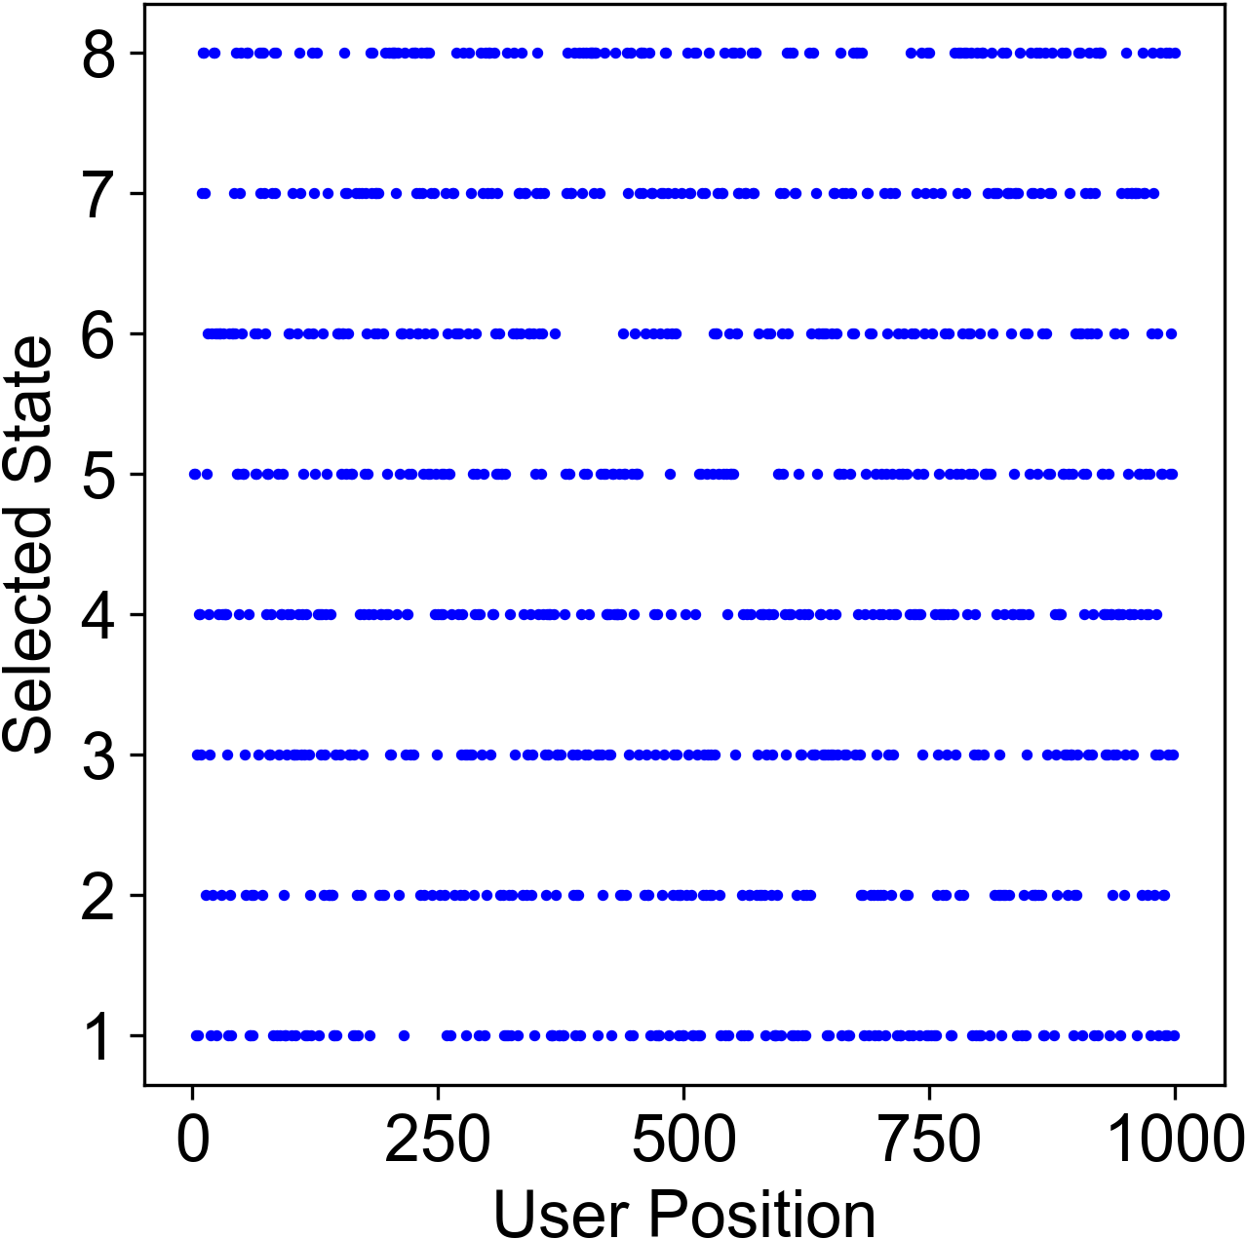
a.
Adaptive Pursuit
b.
Epsilon greedy
c.
Random Selection
d.
e.
f.
Effect of the absorber
Effect of the absorber

Slide 5
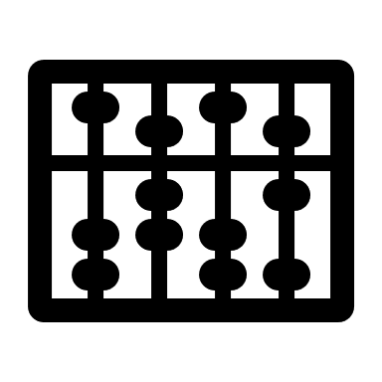
a.
Adaptive Pursuit
b.
Epsilon greedy
c.
Random Selection
d.
e.
f.

Slide 6
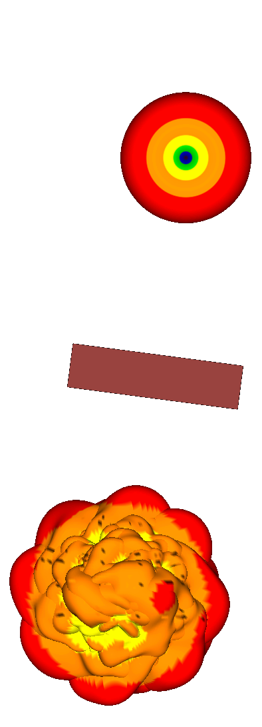
2.5
300
200
1.25
400
100
User
Absorber
5
6
4
0.0
500
7
3
0
2m
8
1
2
-1.25
600
Antenna States
900
Y(m)
User
Positions
700
800
X(m)
-2.5
-1.25
0.0
1.25
2.5

Slide 7
