Slide 1


Slide 2
matplotlib.pyplot is a collection of command style functions that make matplotlib work like MATLAB. Each pyplot function makes some change to a figure: e.g., creates a figure, creates a plotting area in a figure, plots some lines in a plotting area, decorates the plot with labels, etc

Slide 3
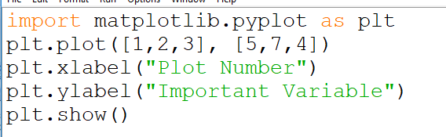
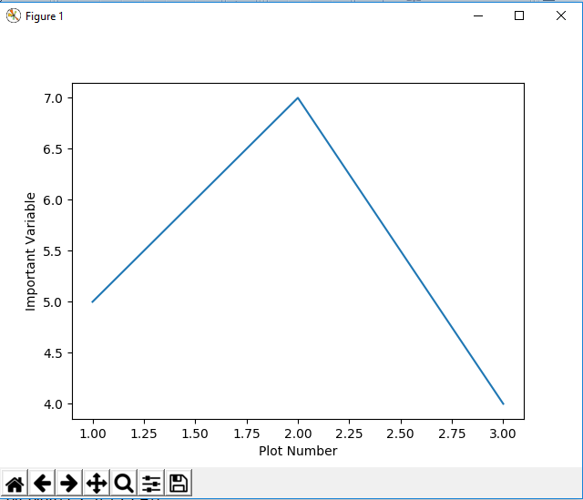
Notes:
import matplotlib.pyplot as plt
plt.plot([1,2,3], [5,7,4])
plt.xlabel("Plot Number")
plt.ylabel("Important Variable")
plt.show()

Slide 4
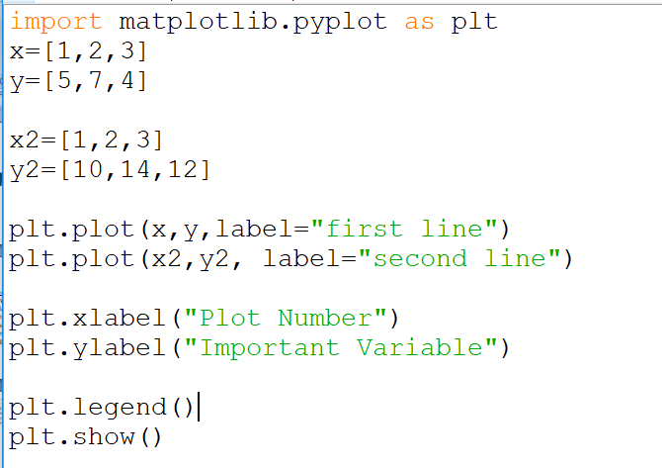
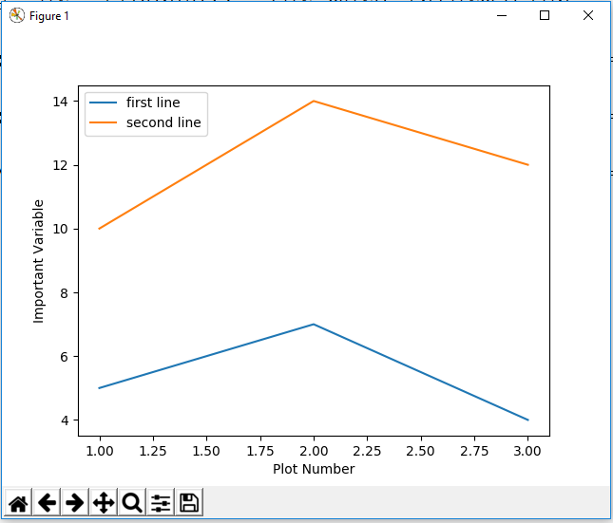
Notes:
import matplotlib.pyplot as plt
x=[1,2,3]
y=[5,7,4]
x2=[1,2,3]
y2=[10,14,12]
plt.plot(x,y,label="first line")
plt.plot(x2,y2, label="second line")
plt.xlabel("Plot Number")
plt.ylabel("Important Variable")
plt.legend()
plt.show()

Slide 5
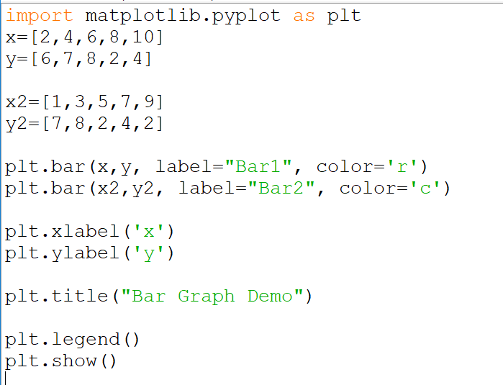
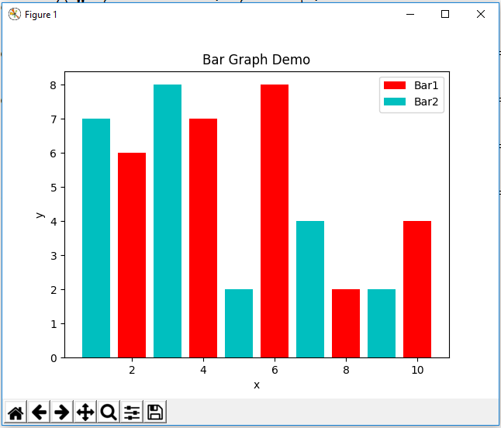

Slide 6
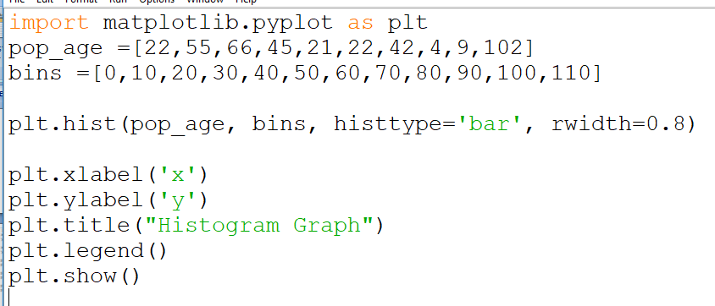
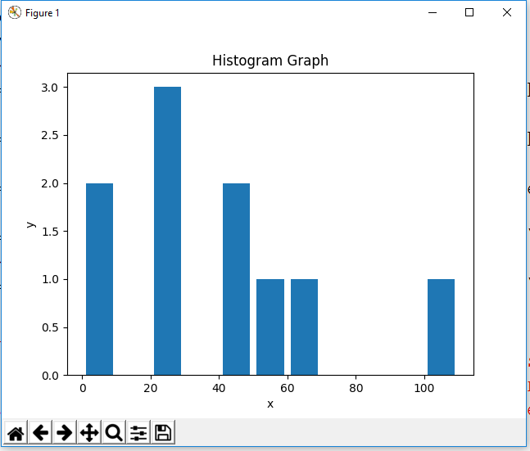

Slide 7
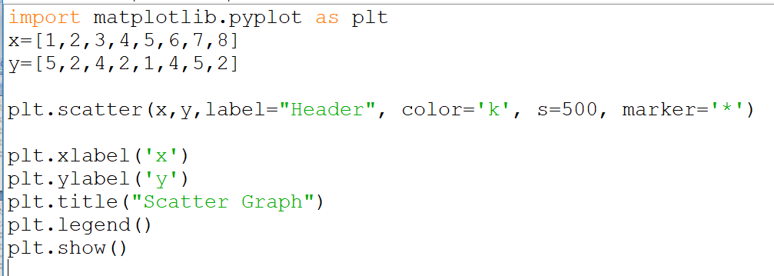
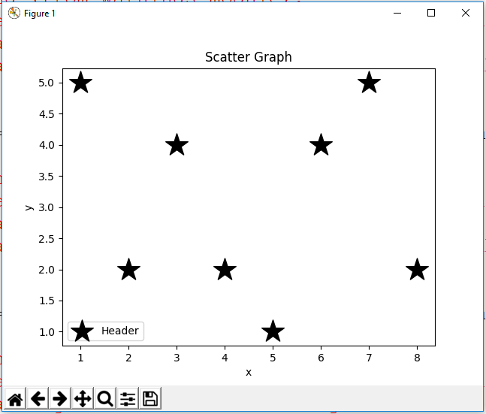

Slide 8
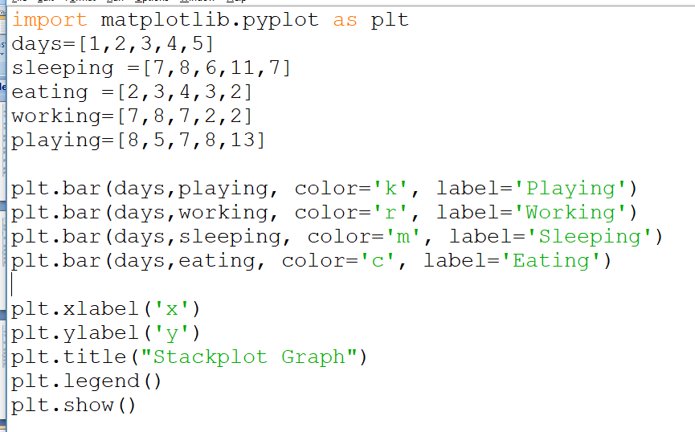
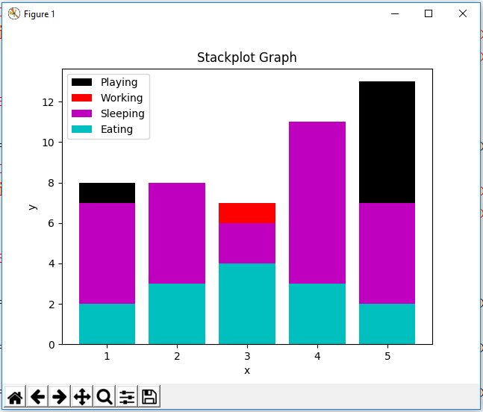

Slide 9
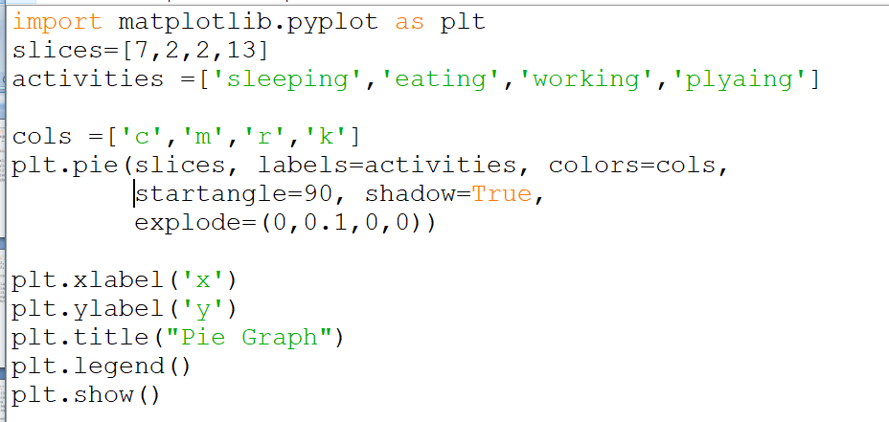
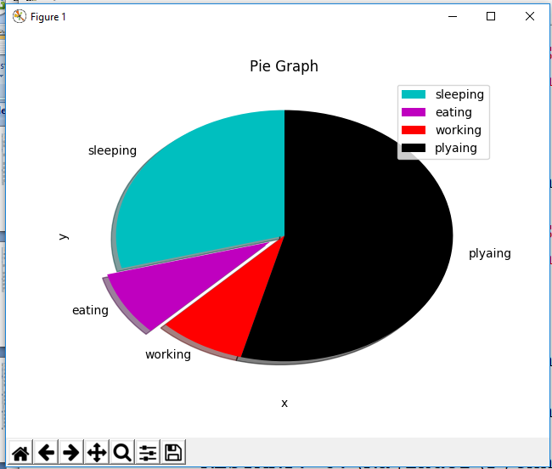

Slide 10
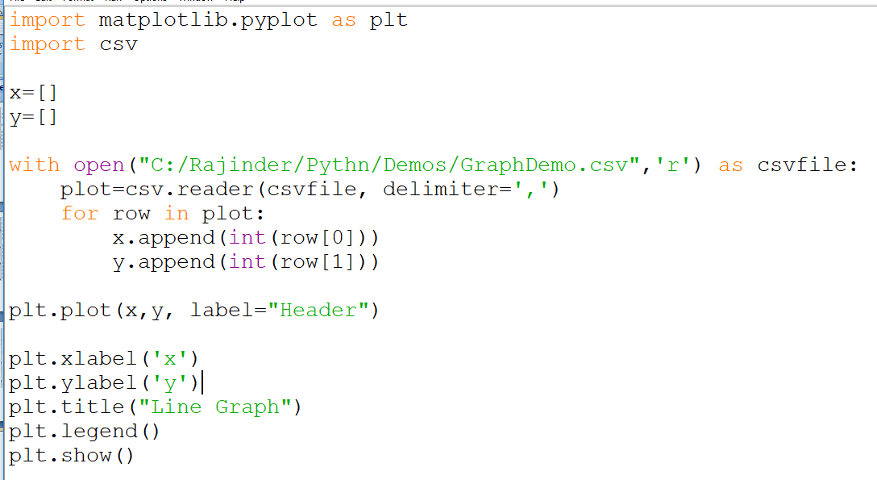
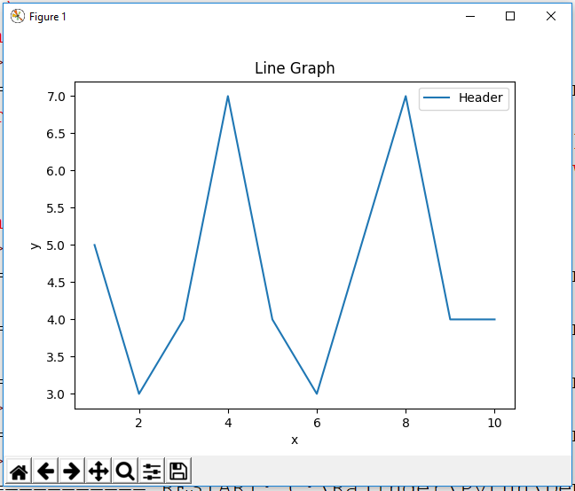

Slide 11
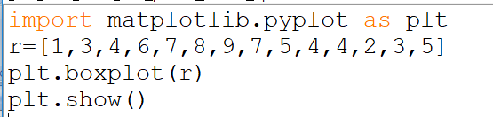
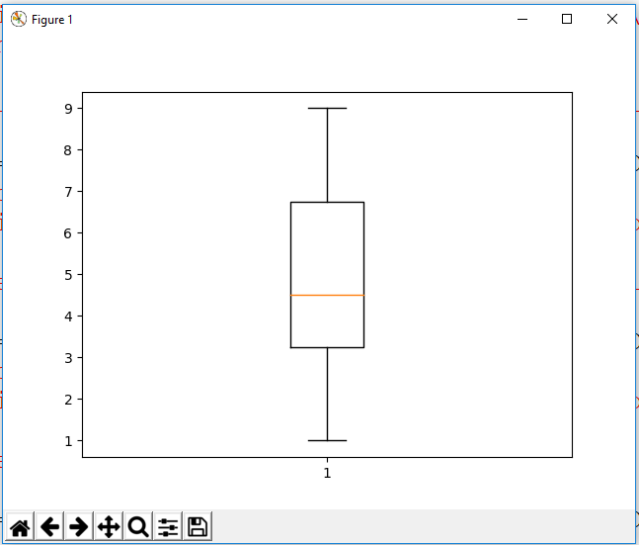

Slide 12
Adjusting Legend Box
plt.legend(loc=“upper left”)
plt.legend(loc=1)
upper left upper right
#2 #1
lower left lower right
#3 #4

Slide 13
Re-size Chart Area
# Get current size
fig_size = plt.rcParams["figure.figsize"]
# Prints: [8.0, 6.0]
print ("Current size:", fig_size)
# Set figure width to 12 and height to 9
fig_size[0] = 12
fig_size[1] = 9
plt.rcParams["figure.figsize"] = fig_size

Slide 14
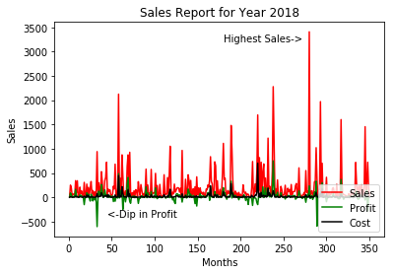
Adding Annotation
plt.annotate(xy=[45,-400], s='<-Dip in Profit', color='r')
plt.annotate(xy=[180,3200], s='Highest Sales->', color='b')

Slide 15
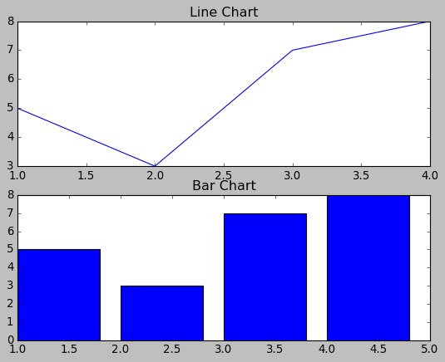
Sub Plotting
fig, (ax0, ax1) = plt.subplots(2, 1)
c = ax0.plot([1,2,3,4],[5,3,7,8])
ax0.set_title('Line Chart')
c = ax1.bar([1,2,3,4],[5,3,7,8])
ax1.set_title('Bar Chart')
plt.show()
#plt.savefig('timevsdist.pdf',
format='pdf')
Notes:
x = [1, 2, 3, 4]
y = [1, 4, 9, 6]
labels = ['Frogs', 'Hogs', 'Bogs', 'Slogs']
plt.plot(x, y, 'ro')
# You can specify a rotation for the tick labels in degrees or with keywords.
plt.xticks(x, labels, rotation='vertical') # Pad margins so that markers don't get clipped by the axes
plt.margins(0.2) # Tweak spacing to prevent clipping of tick-labels
plt.subplots_adjust(bottom=0.15)
plt.show()

Slide 16
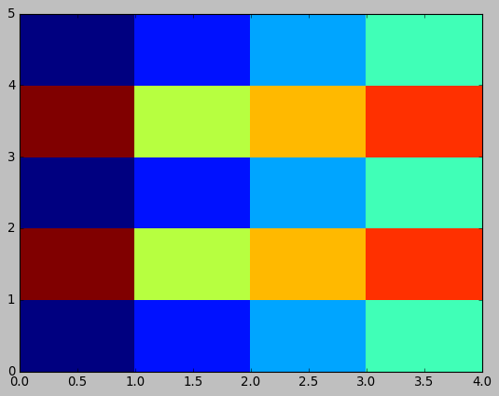
Heat Chart
from pandas import DataFrame
import matplotlib.pyplot as plt
data=[{1,2,3,4},{5,6,7,8},{1,2,3,4},{5,6,7,8},{1,2,3,4}]
df = DataFrame(data)
print(df)
plt.pcolor(df)
plt.show()

Slide 17
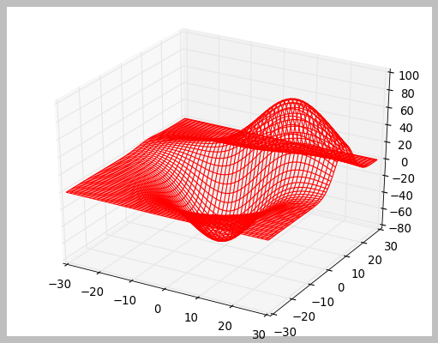
3d Charts
from mpl_toolkits.mplot3d import axes3d
import matplotlib.pyplot as plt
chart = plt.figure()
chart3d = chart.add_subplot(111, projection='3d')
# Create some test data.
X, Y, Z = axes3d.get_test_data(0.04)
# Plot a wireframe.
chart3d.plot_wireframe(X, Y, Z,
color='r',rstride=2, cstride=3)
plt.show()

