Slide 1
Welcome to our presentation

Slide 2
Presentation on Android music player

Slide 3
Group members:
ROKSANA AKTER (151-15-4864)
S.M.TAREQ (151-15-5150)
REDWAN ISLAM(143-15-4615)

Slide 4
What is android music player?
Music player is an android application that can play various audio player.
The application will play audio files with format of mp3,AAC,amr etc.

Slide 5
Motivation
To make use of android os with more public interest.
More user friendly so all can use it.
To play all the audio in android we need music player.
A simple elegant music player make an android device fulfill.

Slide 6
Features insight
Main Screen.
Player screen.
Equalizer and tone.
Folders
Artist
Album
Coverflow
Playlist

Slide 7
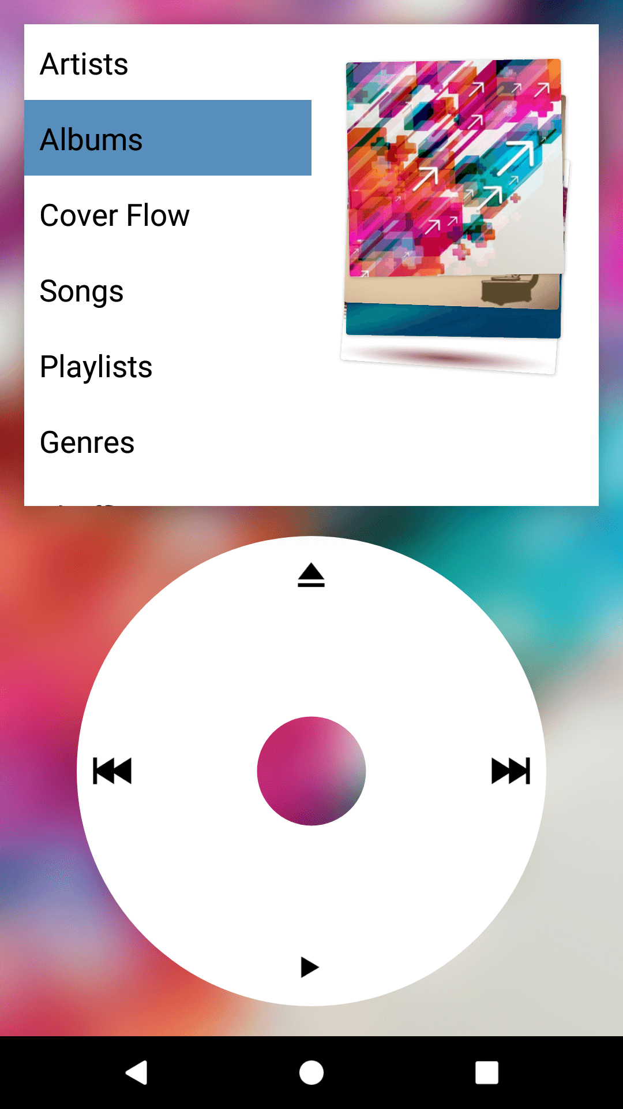
ScreenShot

Slide 8
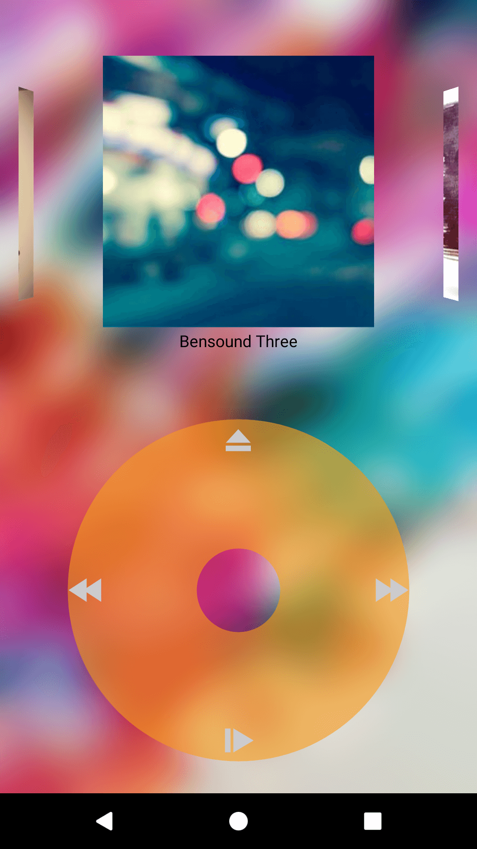

Slide 9
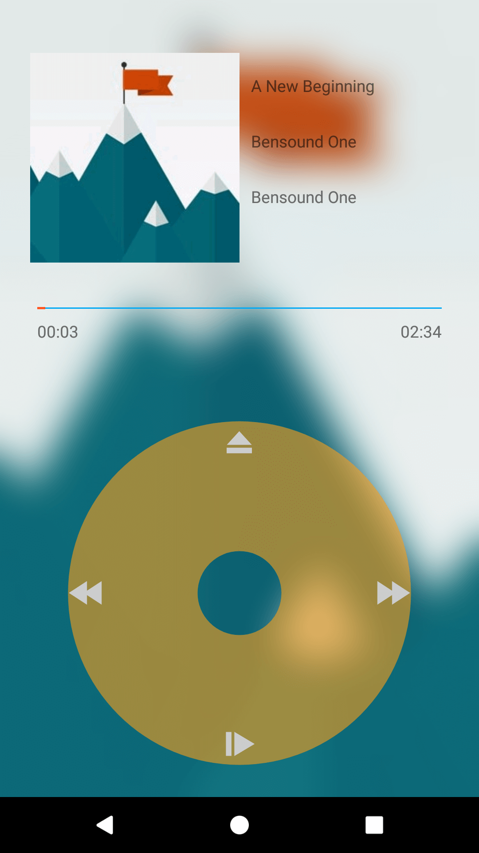

Slide 10
Tools and technology
Android Studio
Android SDK
Java
XML

Slide 11
Advantage
All types of music can play
Simple and user friendly UI
Lightening fast

Slide 12
Conclusion
By doing this project we can learn about android studio and how to make a simple music player.

