Slide 1
Welcome to our presentation

Slide 2
Monira Akter Laboni : 151-15-5044

Slide 3

Why ?

Slide 4

Why ?

Slide 5
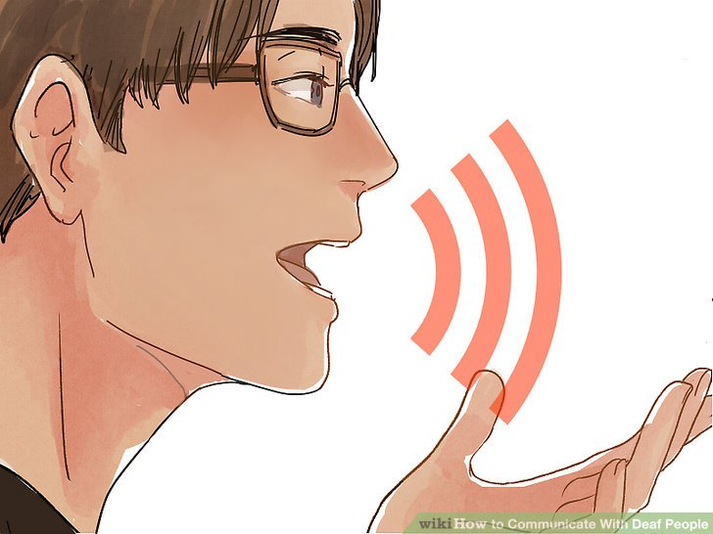
Why ?

Slide 6

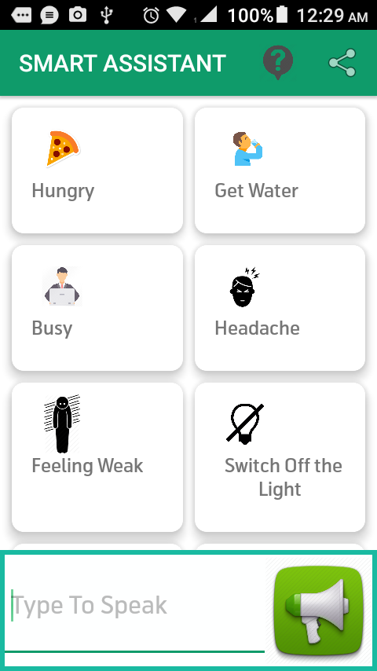
Smart Assistant

Slide 7
Afsana Ahsan Jeny : 151-15-5278

Slide 8
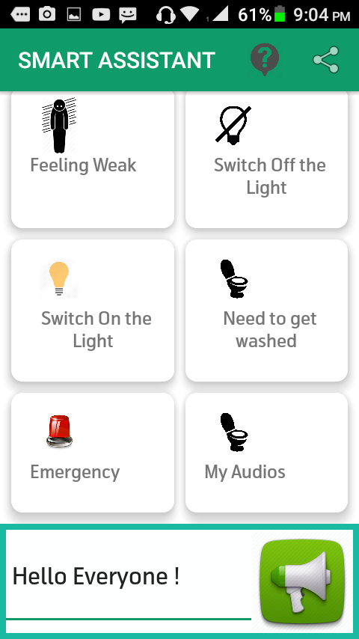
Features :
Getting audio from typed text

Slide 9
Features :
Basic offline audios On Button
Click

Slide 10
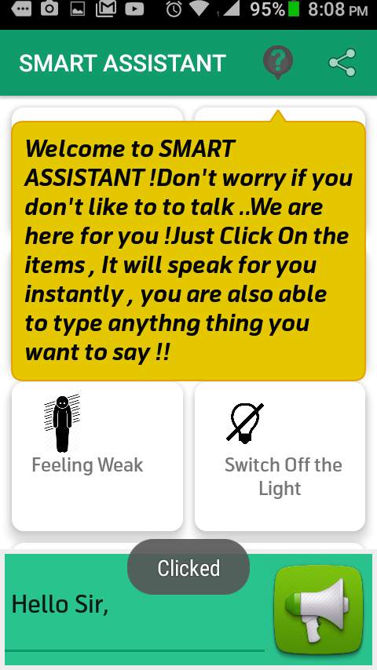
Features :
Tips dialog , for app uses query

Slide 11
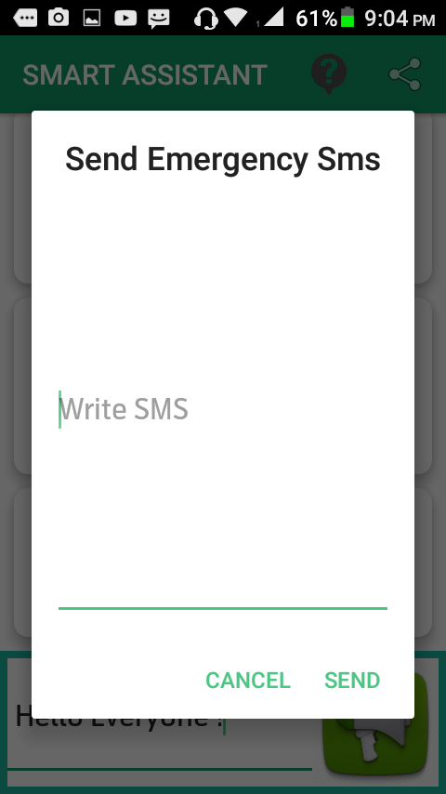
Features :
Emergency automated
SMS onclick in addition to audio

Slide 12
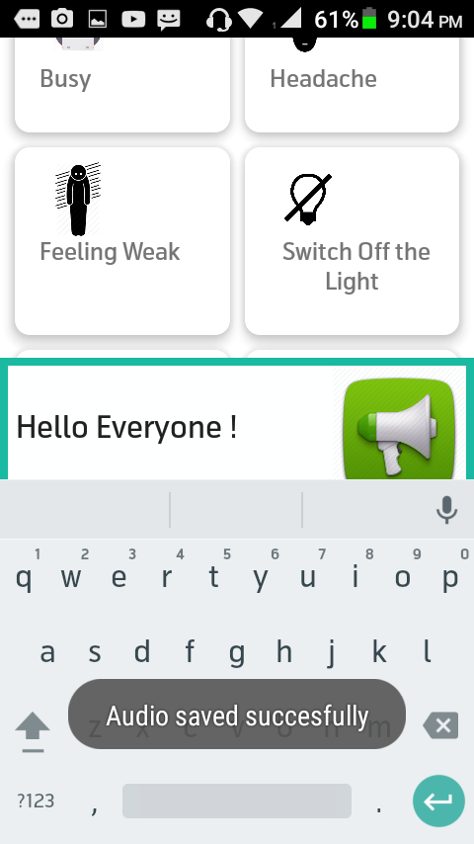
Features :
Save the typed audio on long
Press directly to the memory card

Slide 13
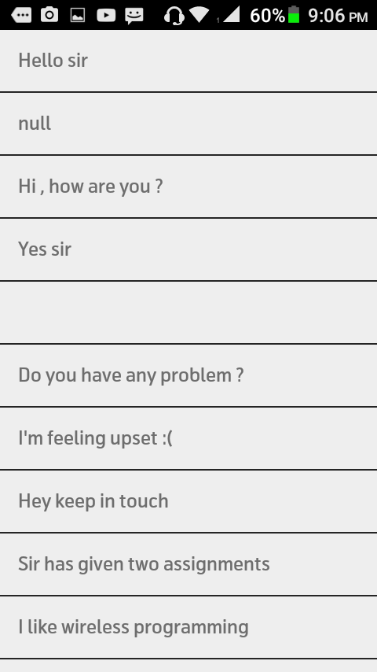
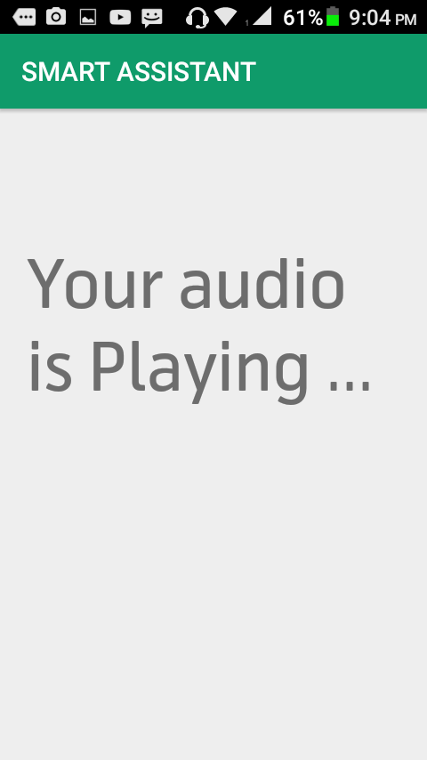
Features :
Get the typed audio list and
Play

Slide 14
Md. Rafsan Biswas : 151-15-4846

Slide 15
Tools
IDE : Android Studio 3.0.0

Slide 16
Tools
Recycler View
Card View
Grid View

Slide 17
Tools
Text to Audio
Engine

Slide 18
Tools
Tooltip
Share button
on action bar

Slide 19
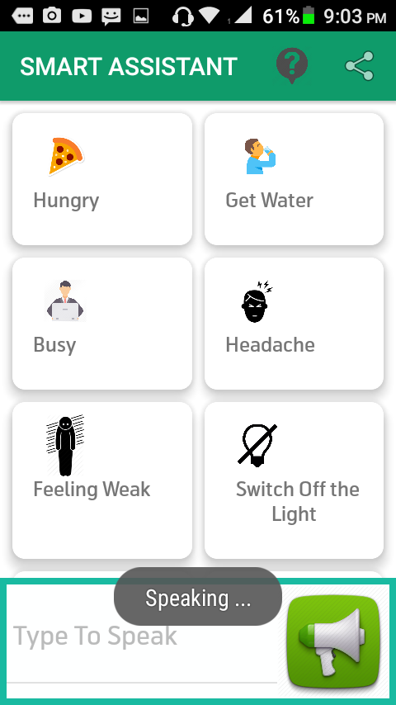
Tools
MediaPlayer

Slide 20
Tools
Listview
Intent
Explicit +
implicit

Slide 21
Tools
File Synchronization
with Hashmap

Slide 22
Tools
Get the files
from sdcard directly to
the listview
with algorithms

Slide 23
Tools
AlertDialog
SmsManager

Slide 24
Tools
Permissions:
Send sms
Read sdcard

Slide 25
Masum Shah Junayed : 151-15-5008

Slide 26

Future Development & Challenges
Adding A.I

Slide 27

Future Development & Challenges
Adding emergency calls in the next version

Slide 28

Future Development & Challenges
Knowing current
Location of the user at emergency in the
Next version

Slide 29

Future Development & Challenges
Integrating Bangla language
and getting natural output

Slide 30

Future Development & Challenges
Making a social
Network of the
Users

