Slide 1
Welcome to the presentation
TAX & TIP

Slide 2
Group members
ABU SHAIF KHAN (151-15-5207)
ABDULLAH-AL-MASUM (151-15-4952)
IKHTIAR AHMED (151-15-5257)
RAFIUL ISLAM(151-15-4702)
ANISUL ISLAM (143-15-4602)
SAZZAD MAHAMUD (151-15-4980)

Slide 3
index
Motivation
Features
Application demonstration
Code review
Future work

Slide 4
Tax & TIP
Tax is money that people have to pay to the government. The government uses the money it gets from taxes to pay for things.
Restaurants only pay a small portion of their employee's salaries; customers' tips provide the rest. The server's income is then supplemented with the service they provide – tips

Slide 5
motivation
In restaurants often sees that bargaining with the waiter for extra charge of tips and tax.
In some super shops when someone buy some product. cashier provide receipt, there have the tax for the product to check the actual tax of the product.

Slide 6
features
Percentage wise calculation
Tax
Tips
Tip calculation for divided entries

Slide 7
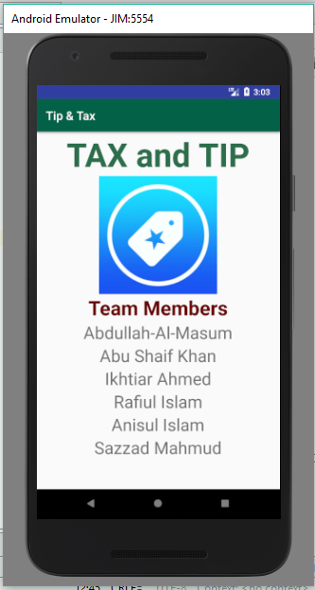
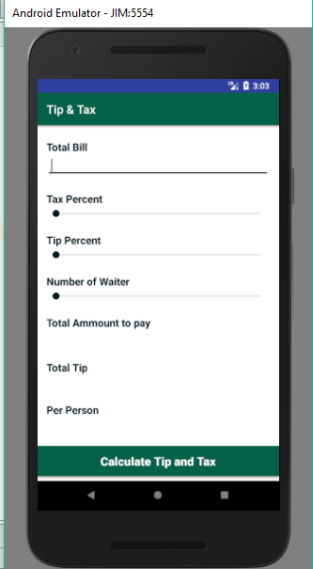
App demonstration

Slide 8
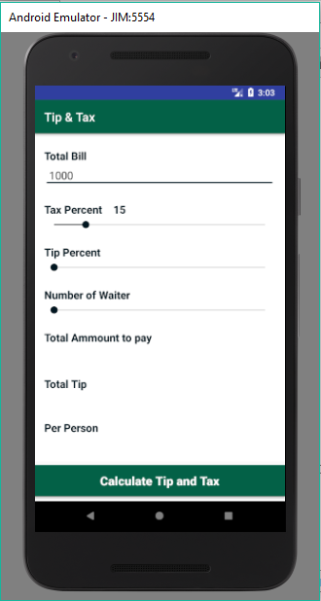
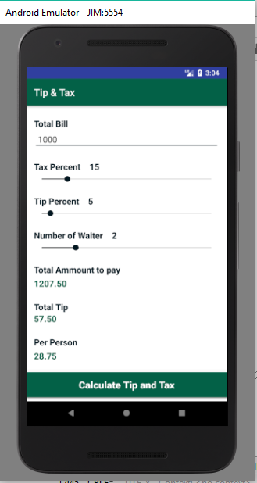

Slide 9
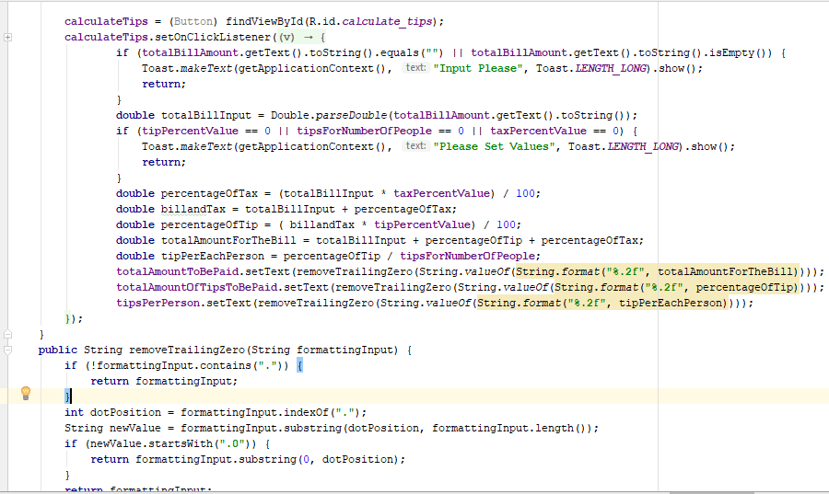
Code review

Slide 10
Future work
Basic day by day calculation graph
Previous history
Monthly total cost and visualize graph
Quarter month and yearly visualize graph
Categorization of the spend and also calculation
Creating a database for using a user account in different device

Slide 11
THANK YOU

