Slide 1
CoachFinders UX Suggestions

Slide 2
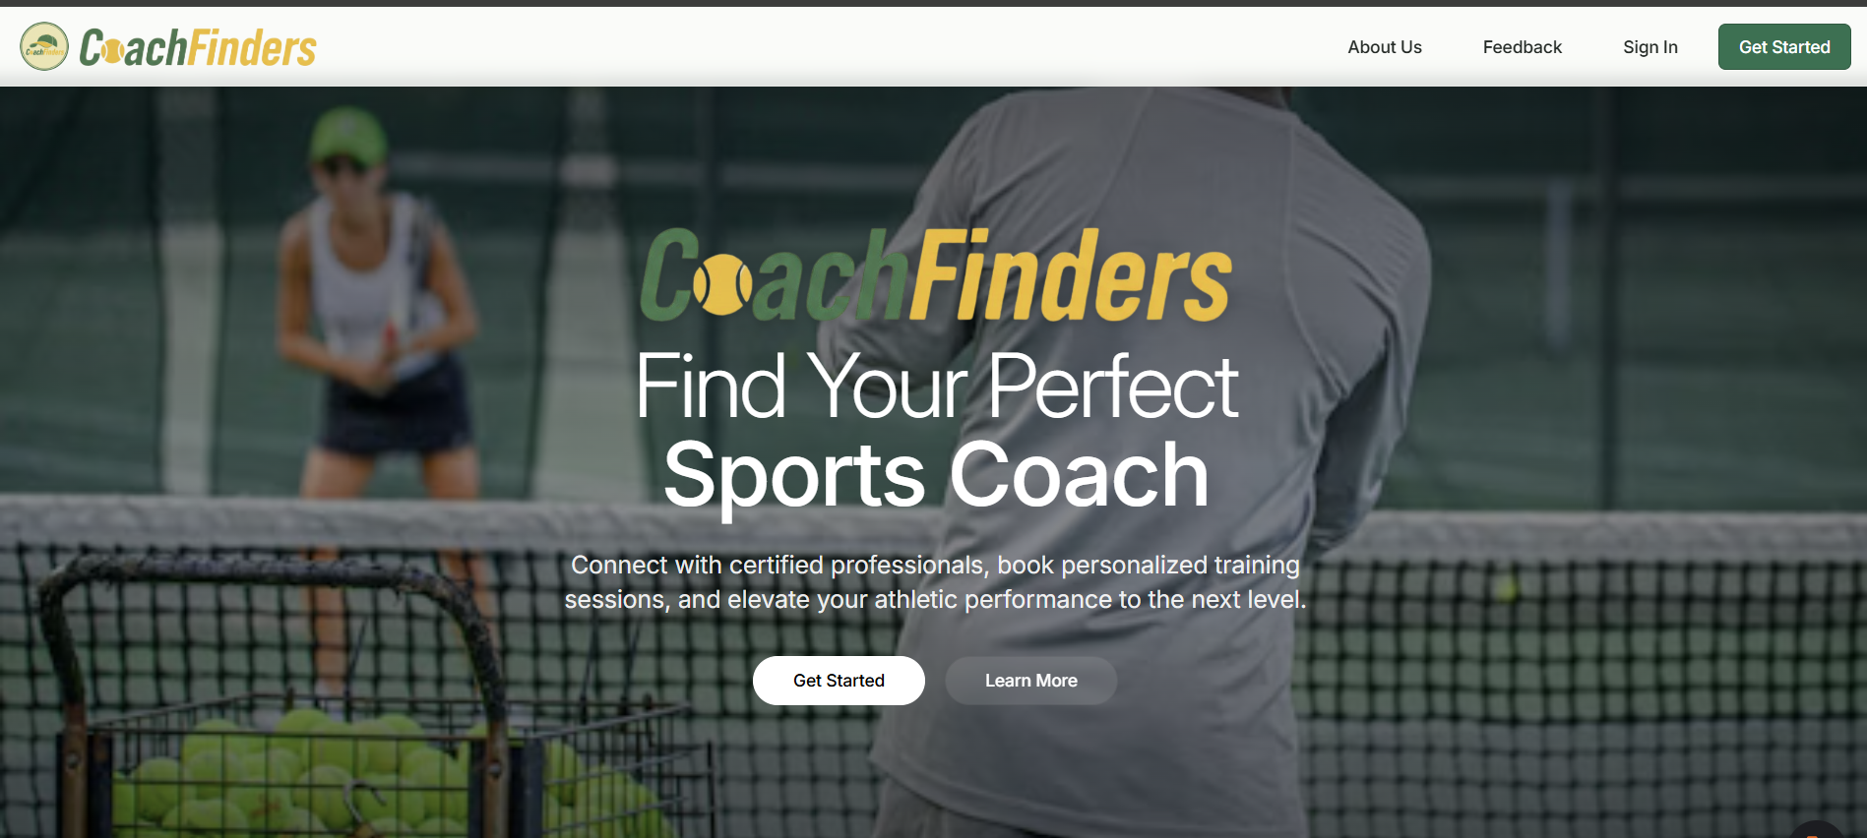
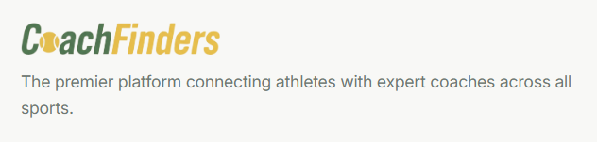

Change “premier” to “leading” and remove the dot at the end
…and take your athletic performance to the next level

Slide 3
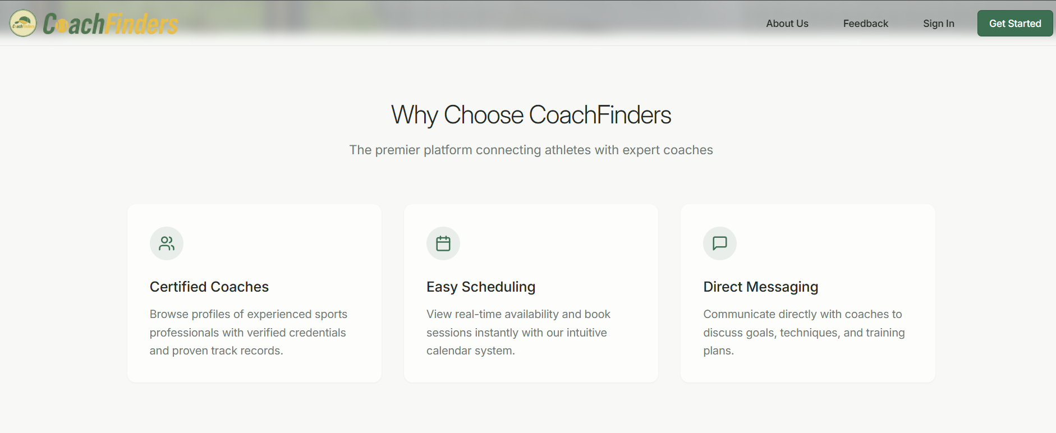

Should we add something about which sports are offered on this page?
Leading platform
…With out live calendar system
…With out live calendar system

Slide 4
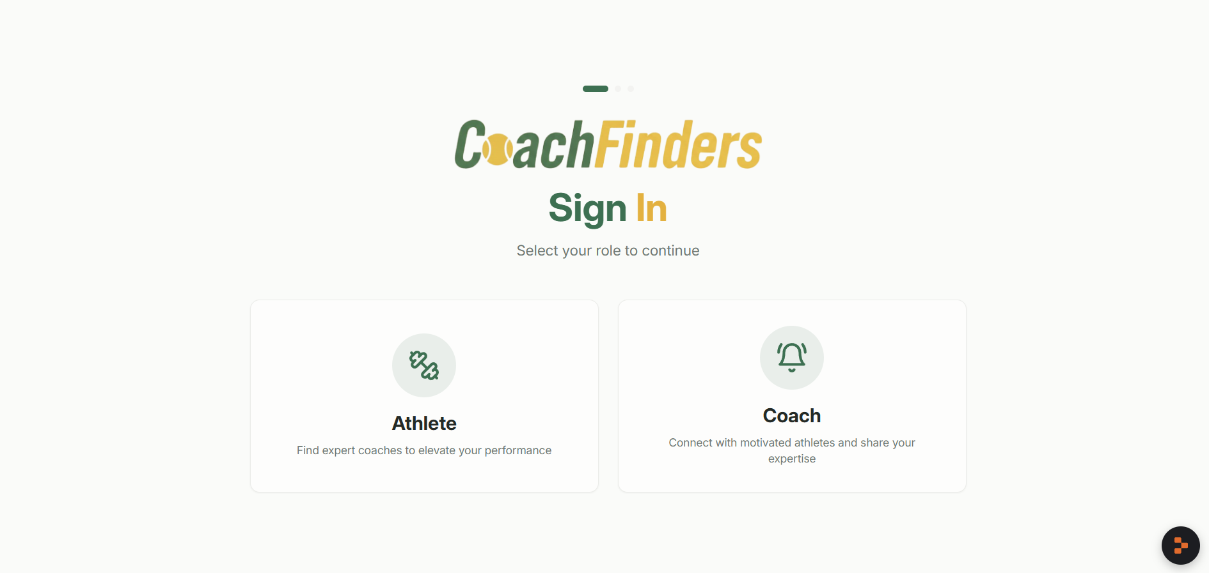
Add semi transparent sports image / graphic to the background?

Slide 5
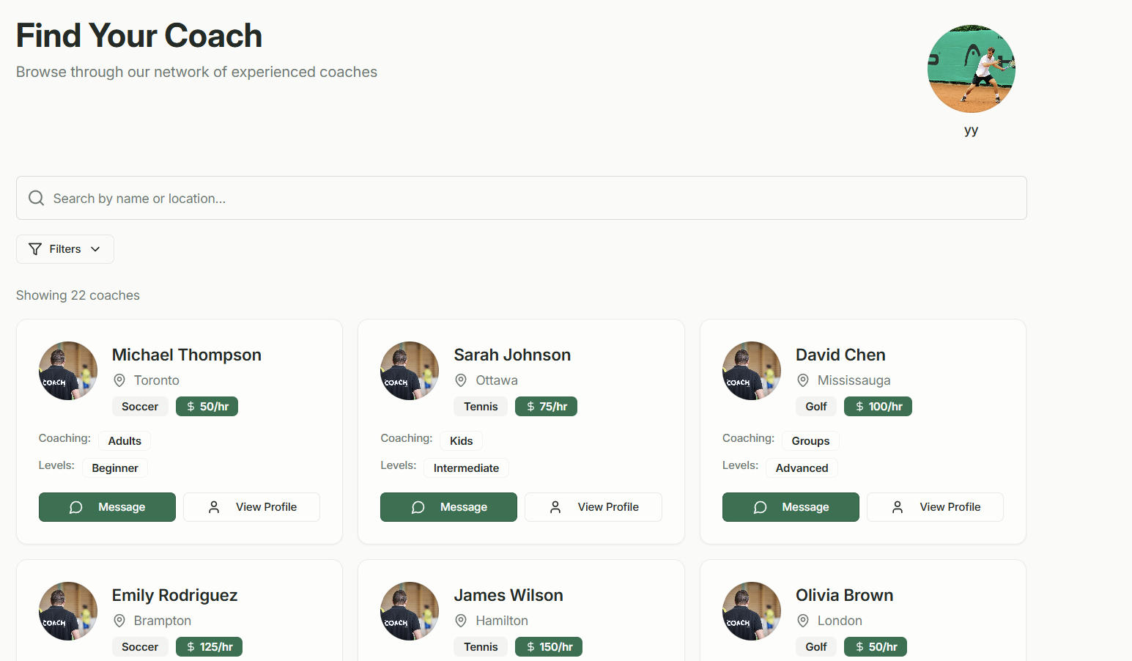
After logging in, the athlete should be greeted with the screen that prompts him to select the sport and click on “Find your coach”, before directing to the results page.
The results page should contain filters and sort

Slide 6
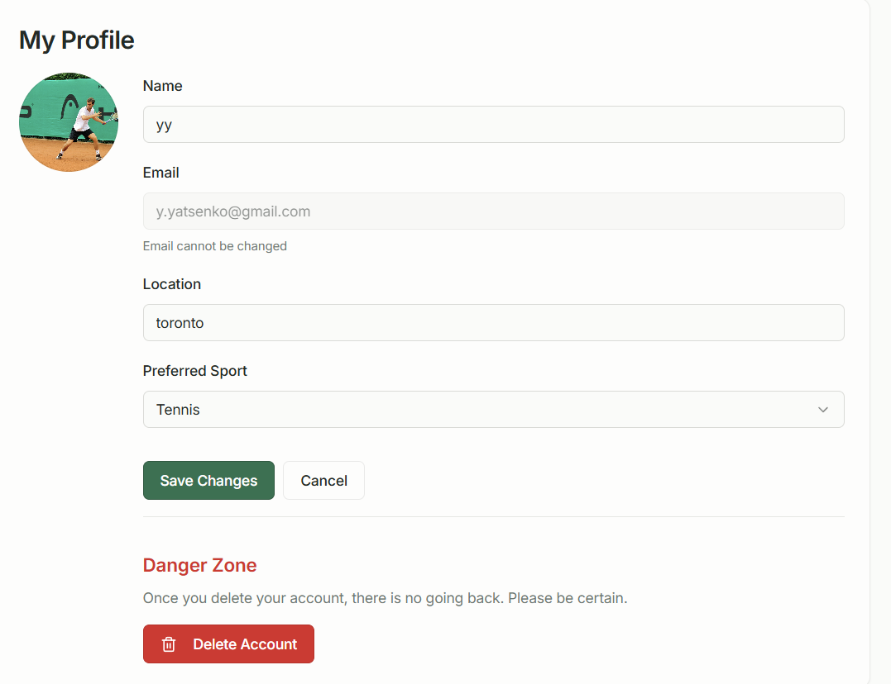

Maybe an option to add a quick bio?
Add a background graphic
Can a player have more than one preferred sport

Slide 7
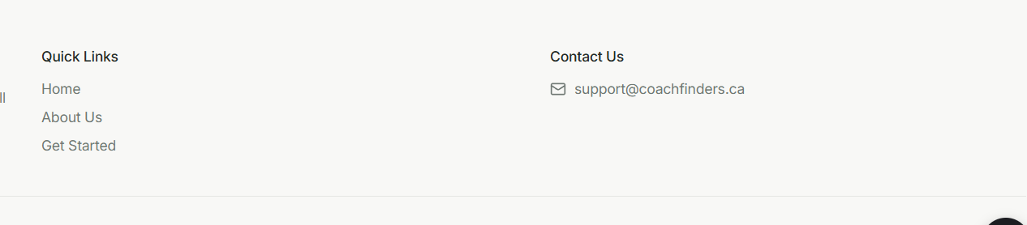
Should we have a terms of service at the bottom?
Add FAQ page (I’ll come up with copy)

