Slide 1
Detailed Sourcing Process — Buying Agency Model

Slide 2
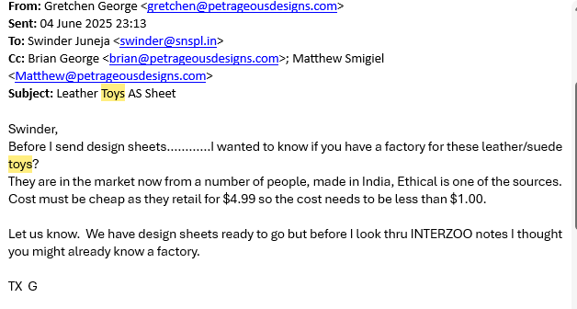
1. Buyer Shares Initial Product Requirement
2 / 48

Slide 3
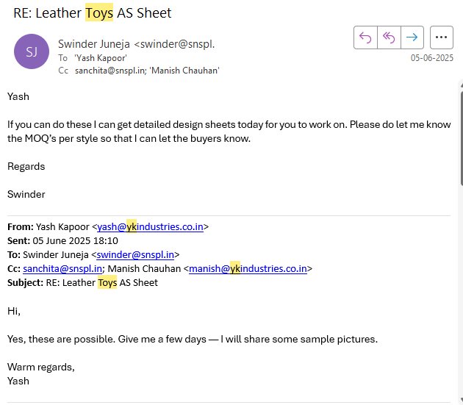
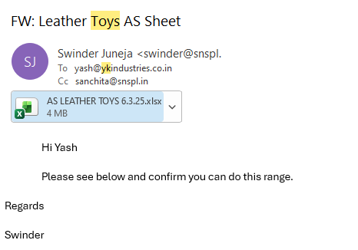
2. Buying Agency Approaches Suitable Factories
3 / 48

Slide 4
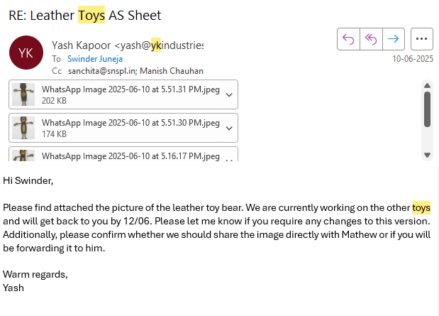
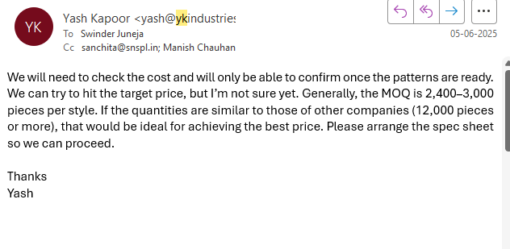
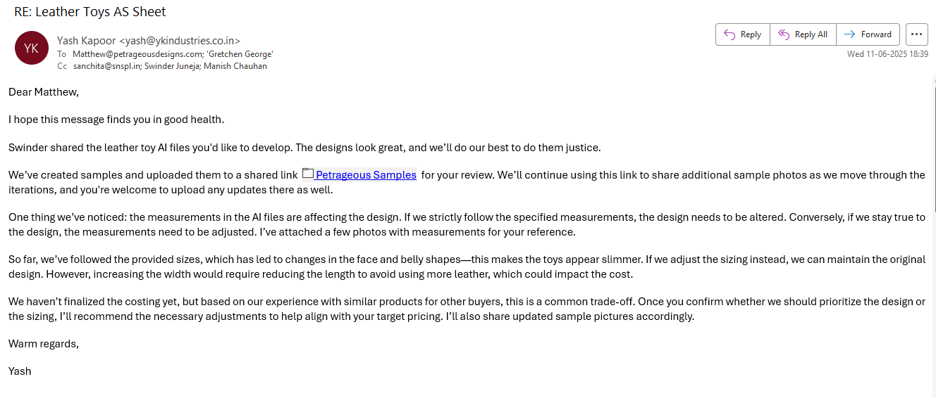
3. Factory Provides Initial Quote Sheet
4 / 48

Slide 5
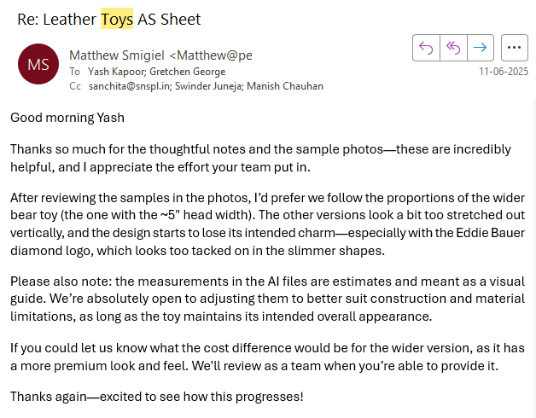
4. Buyer Reviews and Selects Products
5 / 48

Slide 6
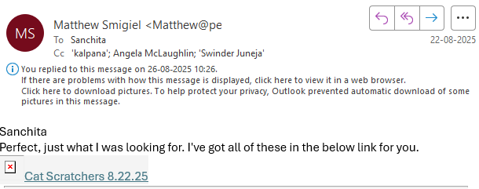
5. Buyer Shares AI Artwork/Design Files
6 / 48

Slide 7
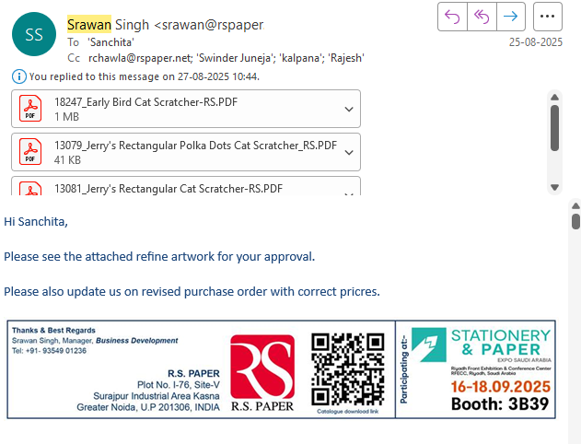
6. Factory Shares AI Artwork/Design with Agency for Buyer's Approval
7 / 48

Slide 8
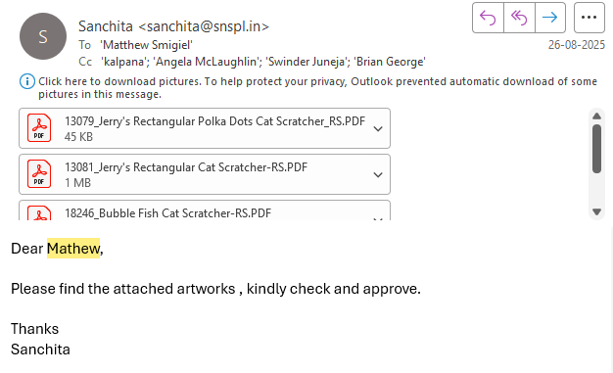
7. Agency Forwards AI Artwork/Design Files for Buyer's Final Approval
8 / 48

Slide 9
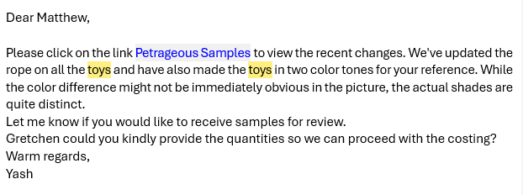
8. Factory Develops Initial Samples to Finalize the Costing
9 / 48

Slide 10
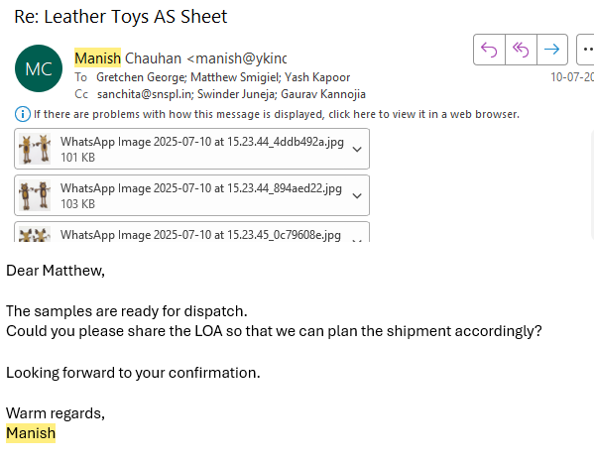
9. Agency Requests Physical Samples from Factory to Send to Buyer
10. Factory Dispatches the Samples to Buyer and Shares Pictures for Reference
10 / 48

Slide 11
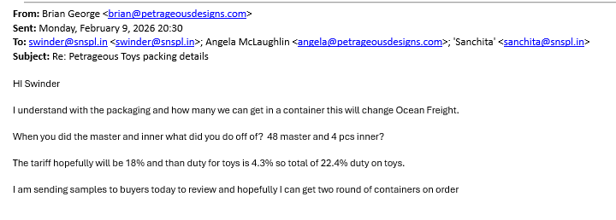
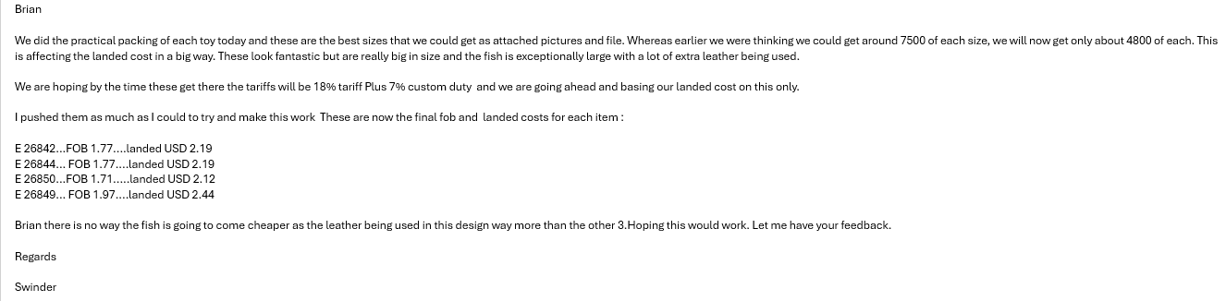
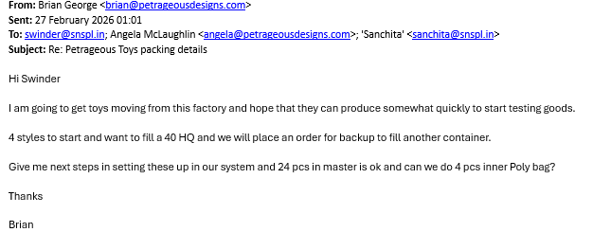
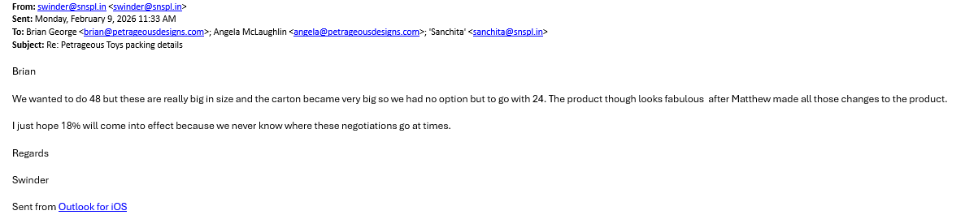
11. Factory Confirms Final Cost / Packaging Details After Initial Development
11 / 48

Slide 12
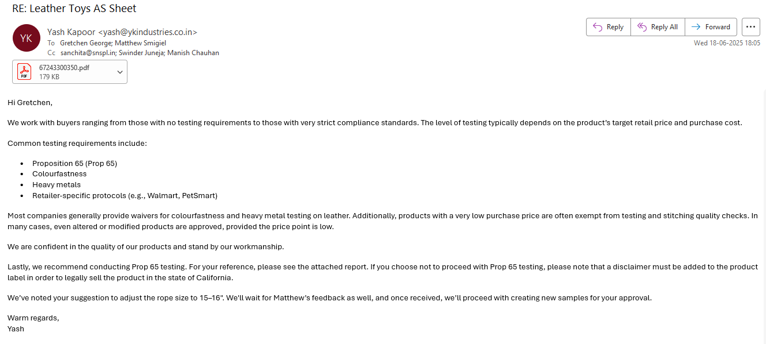
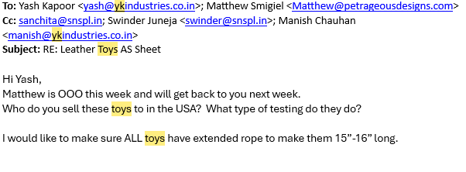
12. Testing & Compliance Requirement Confirmation
12 / 48

Slide 13
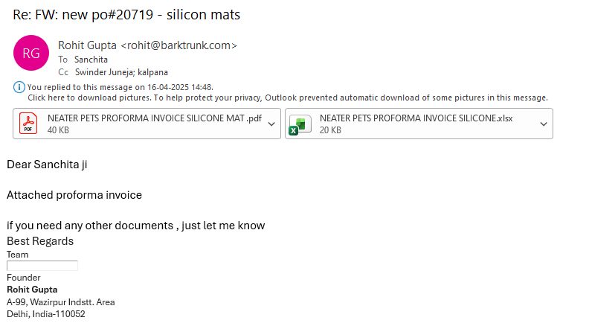
13. Factory Prepares Final PI and Confirms Quantity & Packing Requirements
13 / 48

Slide 14
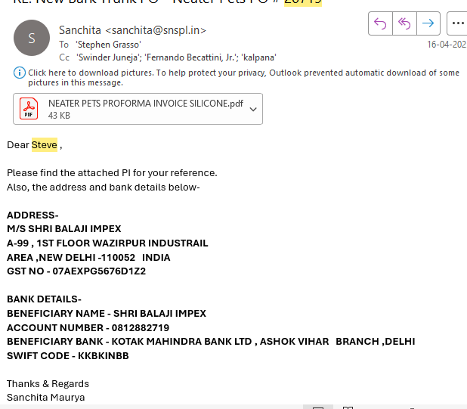
14. Agency Shares Factory PI with Buyer
14 / 48

Slide 15
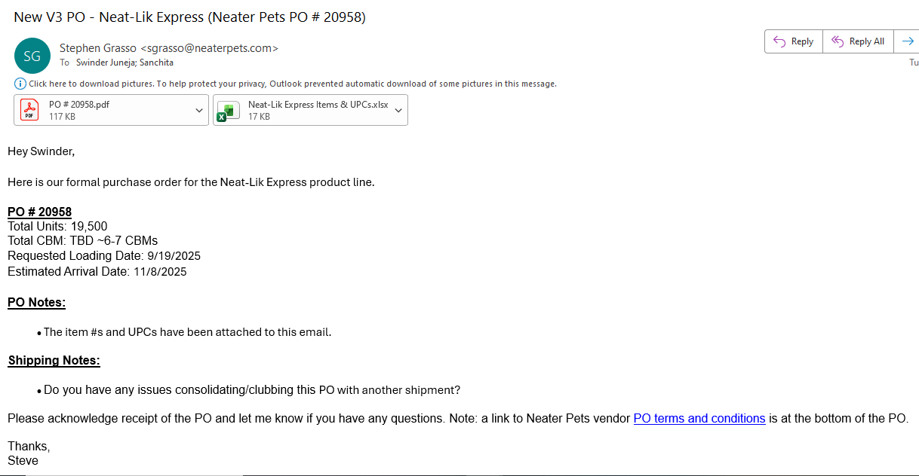
15. Buyer Issues PO
15 / 48

Slide 16
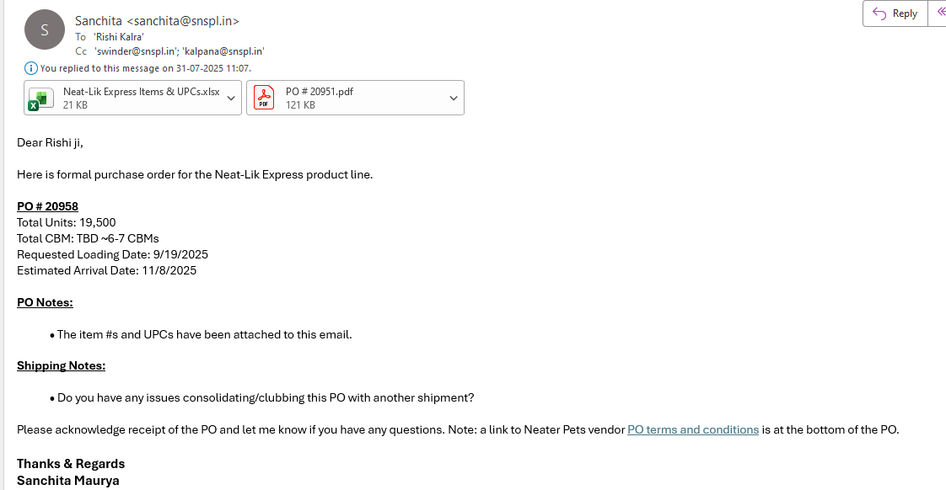
16. Agency Shares PO with Factory
16 / 48

Slide 17
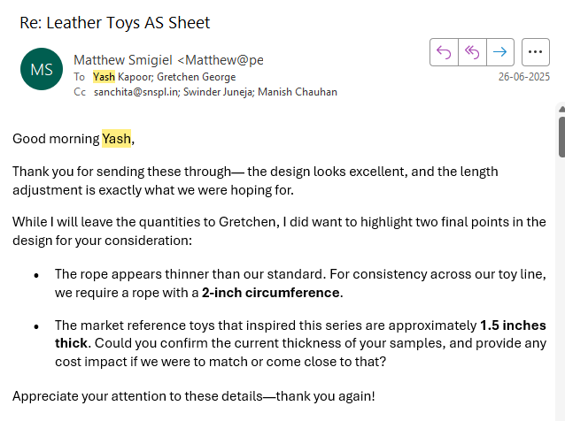
17. Buyer Reviews the Sent Initial Physical Samples
17 / 48

Slide 18
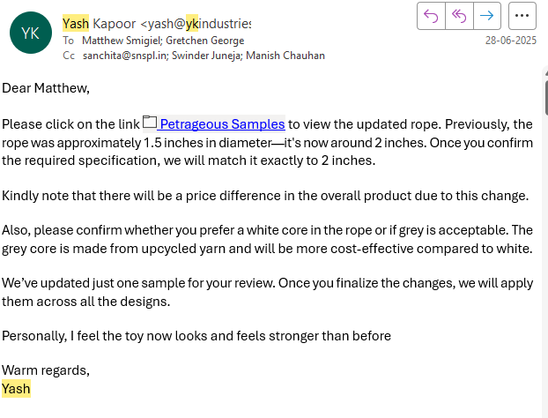
18. Factory Reverts to Buyer on Sent Initial Physical Samples
18 / 48

Slide 19
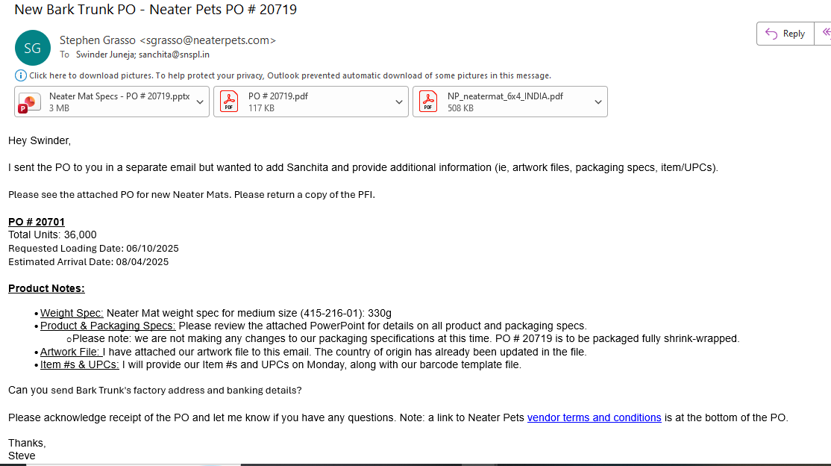
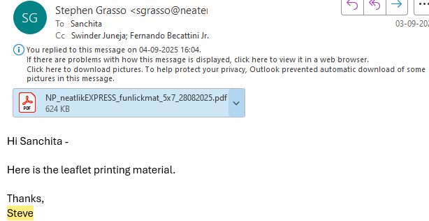
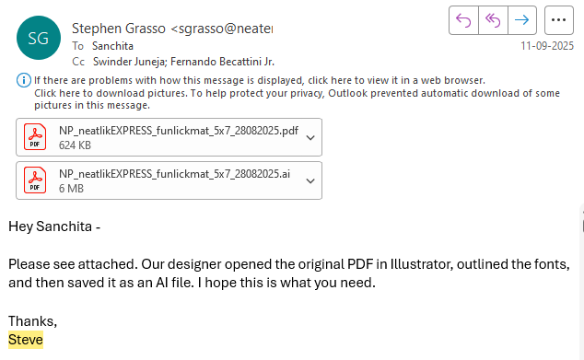
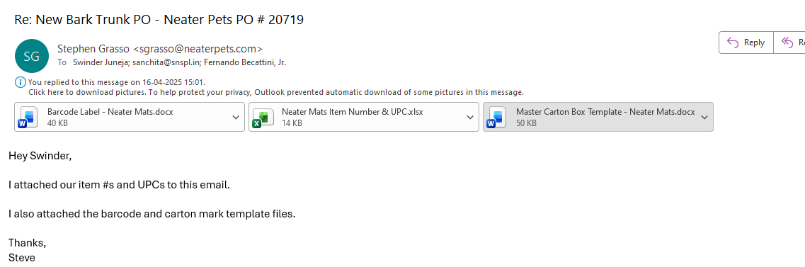
19. Buyer Shares Product Specification, Packaging, and Artwork Details
19 / 48

Slide 20
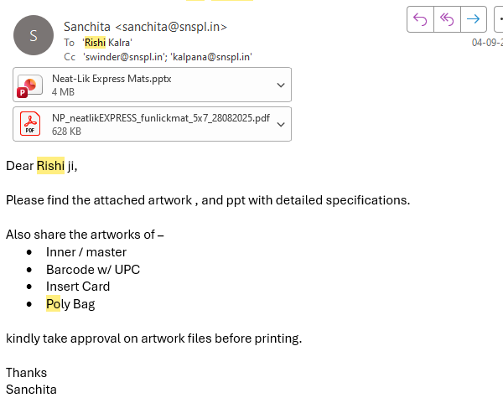
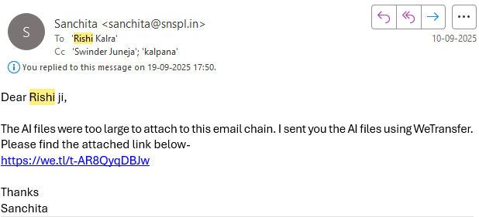
20. Agency Shares Product Specification, Packaging, and Artwork Details with Factory
20 / 48

Slide 21
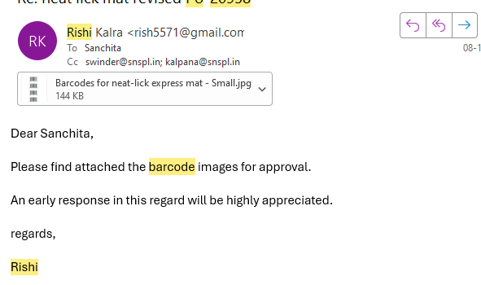
21. Factory Shares the Barcode Artwork with Agency for Final Production Approval
21 / 48

Slide 22
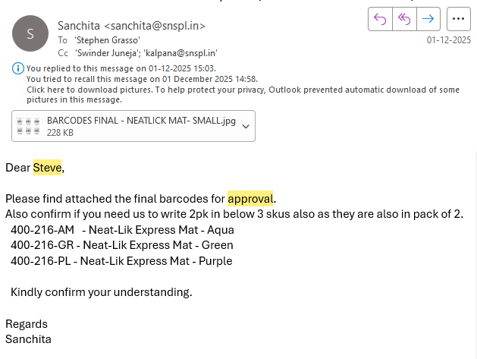
22. Agency Takes Final Approval on Barcodes
22 / 48

Slide 23
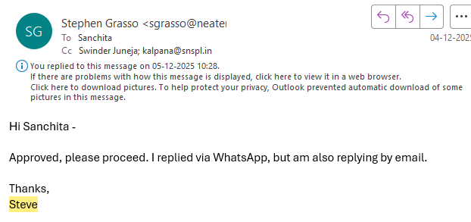
23. Buyer Gives Final Approval on Barcodes
23 / 48

Slide 24
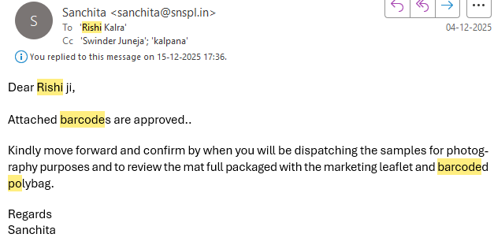
24. Agency Gives Final Approval on Barcodes to Factory
24 / 48

Slide 25
25. Factory Confirms Change in Final Packaging with Agency while sharing pictures on WhatsApp; Agency Shares Final Packaging Pictures Prepares a PPT for Buyer's Final Packaging Approval on mail
25 / 48

Slide 26
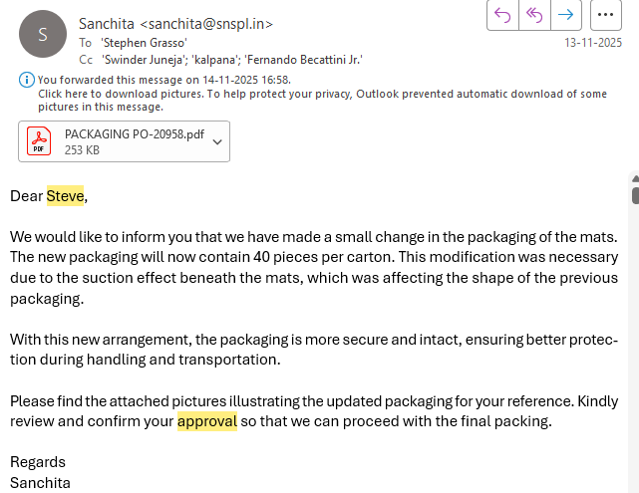
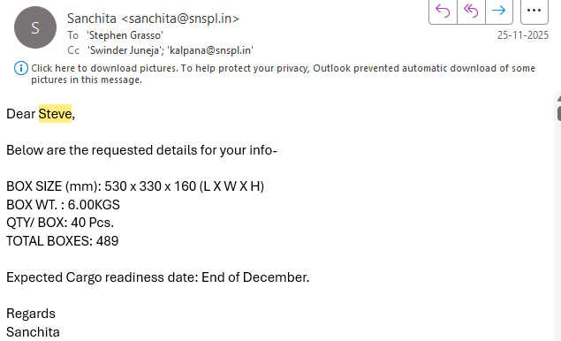
26. Agency Takes Confirmation on Change in Final Packaging from Buyer
26 / 48

Slide 27
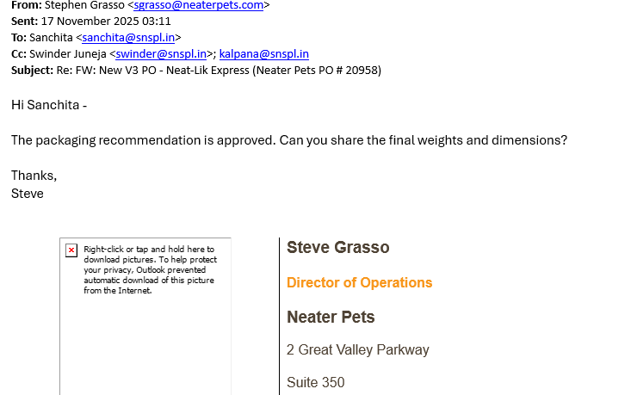
27. Buyer Confirms Change in Final Packaging
27 / 48

Slide 28
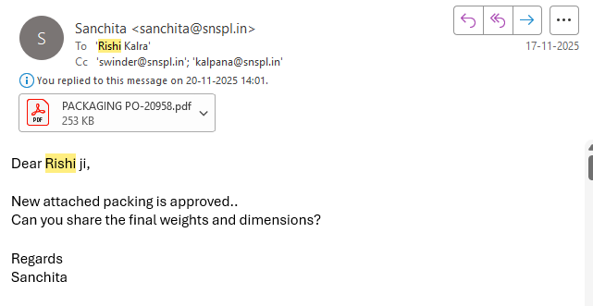
28. Agency Confirms Change in Final Packaging to Factory
28 / 48

Slide 29
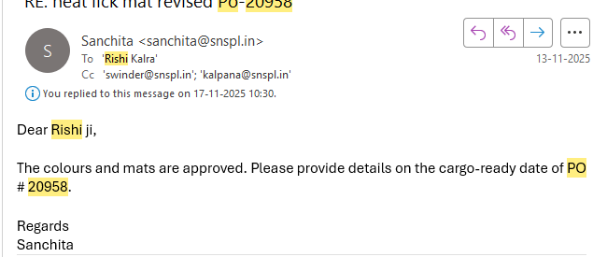
29. Agency Follows Up on Production with Factory Regularly via Email, Phone Calls, and WhatsApp
29 / 48

Slide 30
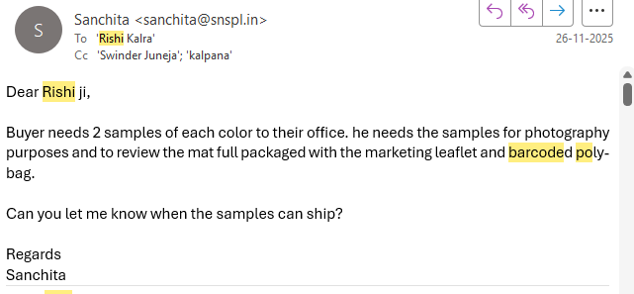
30. Agency Requests Final Preproduction Samples from Factory for Buyer's Review and Photography
30 / 48

Slide 31
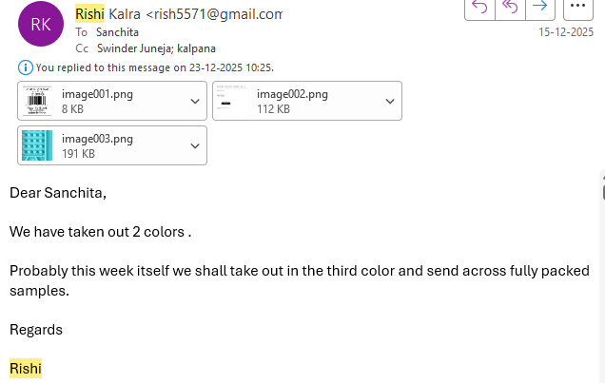
31. Factory Dispatches the PP Sample to Buyer's Address
31 / 48

Slide 32
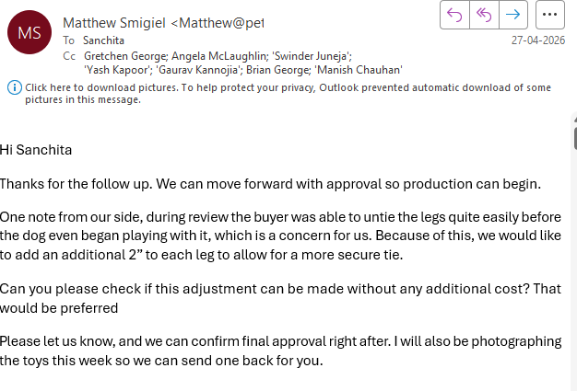
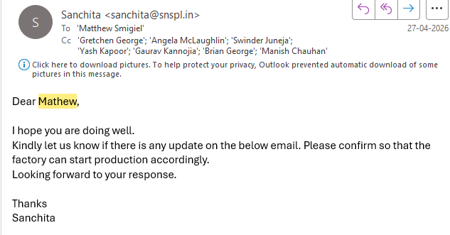
32. Buyer Reverts on the Sent PP Samples
32 / 48

Slide 33
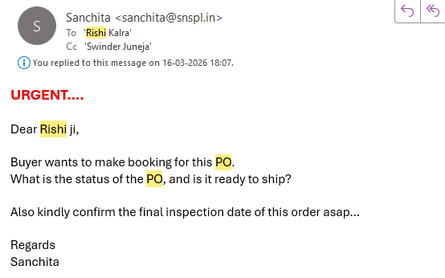
33. Agency Follows Up with Factory on Final Dispatch and Inspection Plan
33 / 48

Slide 34
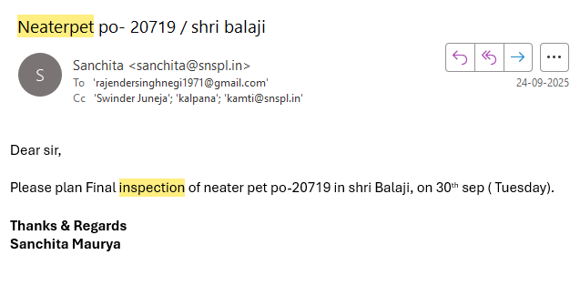
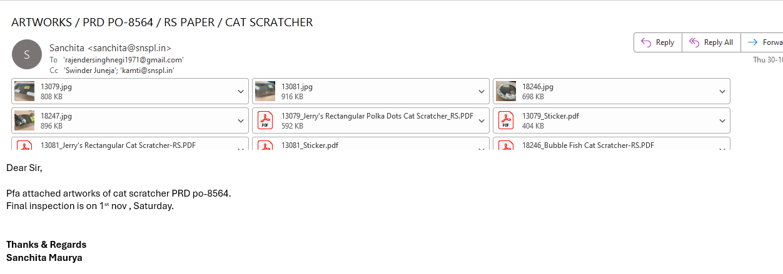
34. Factory Confirms Final Dispatch and Inspection Plan by Call; Agency Plans Dispatch and Inspection Accordingly with there QC team and share approved artworks , packaging details.
34 / 48

Slide 35
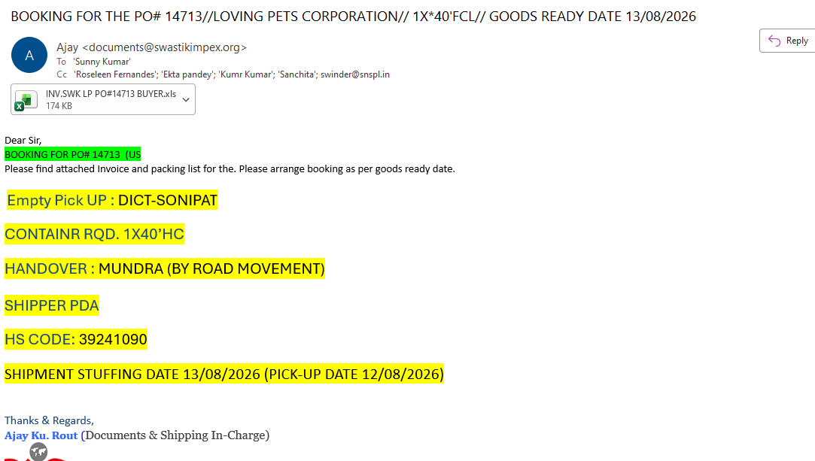
35. Factory Initiates the Booking Process Through the Forwarder for Final Dispatch and Delivery
35 / 48

Slide 36
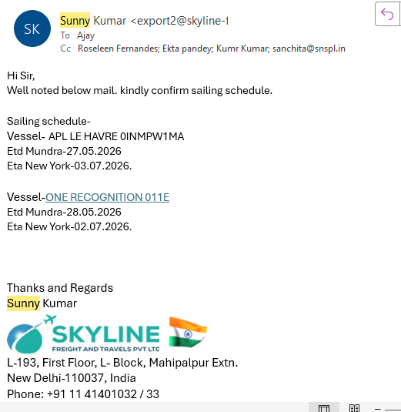
36. Forwarder Confirms the Booking as per the Available Vessel
36 / 48

Slide 37
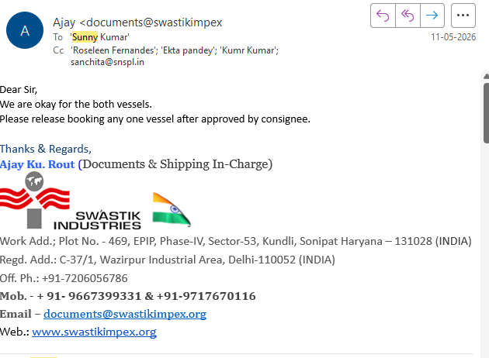
37. Factory Accepts the Vessel Schedule
37 / 48

Slide 38
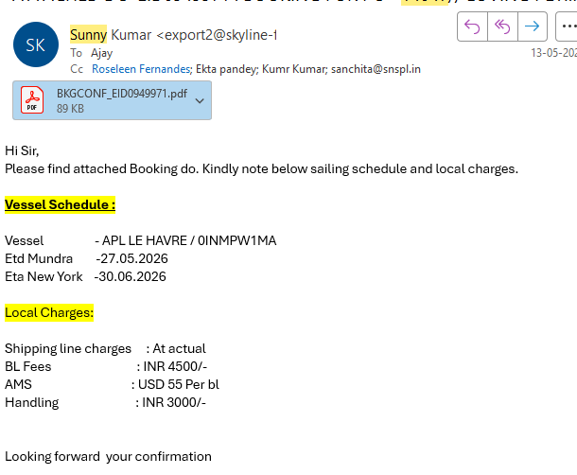


38. Forwarder Shares Final Booking, Sailing Schedule, and Charges as per Factory Confirmation / Forwarder shares draft BL to factory for approval of final OBL / Factory approves the draft BL on behalf of which forwarder shares the final OBL to factory
38 / 48

Slide 39

39. Factory Shares the Final Documents with Agency – Invoice, Packing List, OBL, Sailing and ETA Schedule
39 / 48

Slide 40

40. Agency Shares the Final Documents with Buyer – Invoice, Packing List, OBL, Sailing and ETA Schedule
40 / 48

Slide 41


41. Buyer Confirms Payment with Receipt for Container Release; Payment Is Made 30 Days After Sharing the BL
41 / 48

Slide 42


42. Agency Informs Factory of the Payment Made by Buyer and Container Release
42 / 48

Slide 43

43. Factory Shares the Release BL with Agency
43 / 48

Slide 44

44. Agency Shares the Release BL with Buyer
44 / 48

Slide 45

45. Agency Internally Shares Updated Payment Tracking with Accounts
45 / 48

Slide 46


46. Once Factory Receives Payment from Buyer, Accounts Sends the Exchange Rate to Factory to Prepare the Commission Invoice
46 / 48

Slide 47

47. Factory Shares the Payment Advice
47 / 48

Slide 48

48. After Receiving Payment Advice from Factory, Agency Verifies the Credit with the Bank and Confirms Back to Factory Once Accounts Confirms
48 / 48

Slide 49
Final Outcome
REQUIREMENT → DEVELOPMENT → SAMPLE APPROVAL → PO → PRODUCTION → INSPECTION → PACKING → BOOKING → LOADING → GATE-IN → VESSEL DEPARTURE → DOCUMENTATION → PAYMENT → COMMISSION → FINAL CLOSURE

