Slide 1
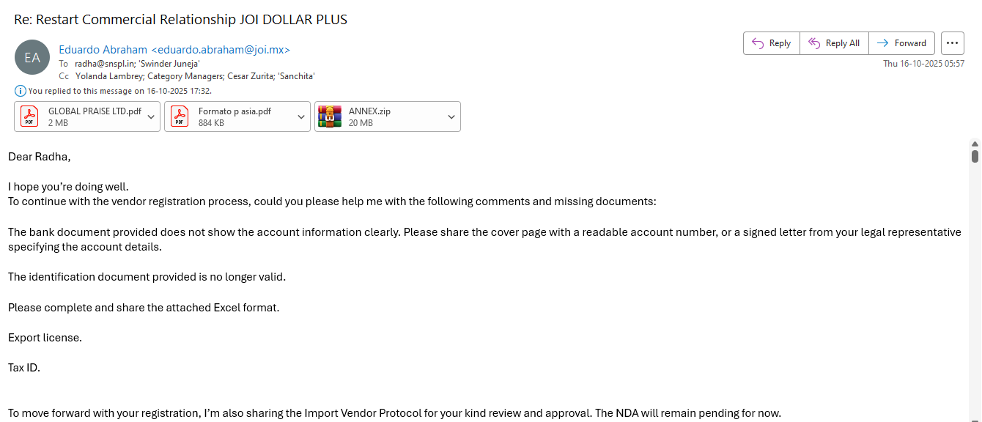
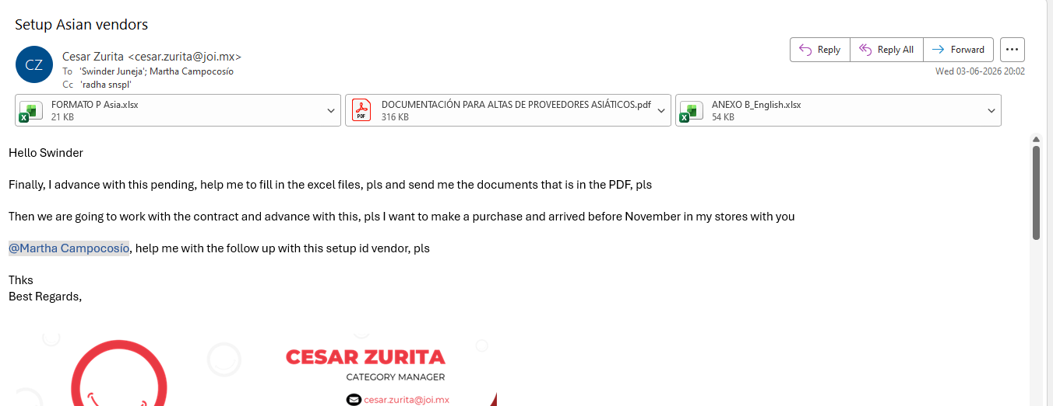
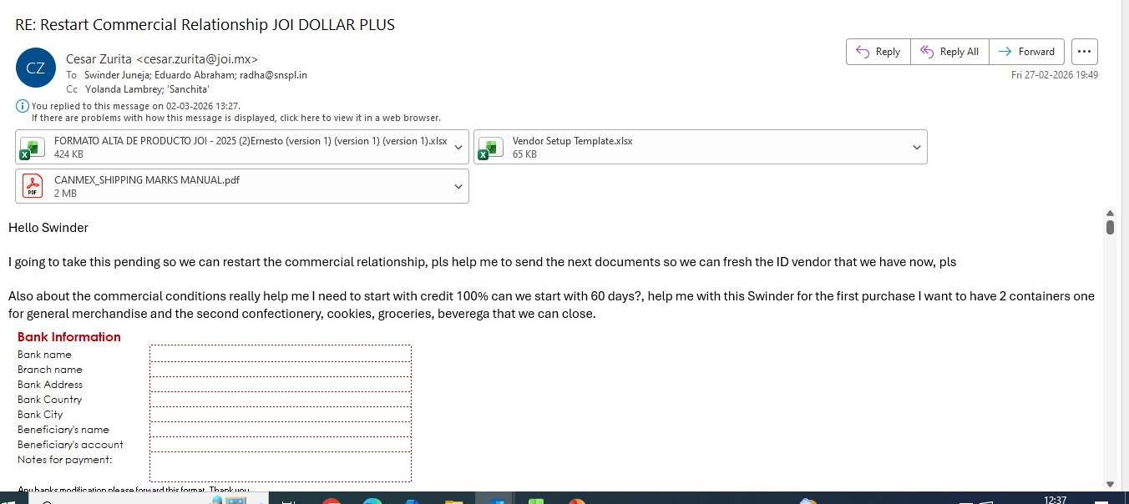
1ST STEP: (VENDOR SETUP)
As per the buyer’s requirement, we request the factory to provide the product quotation sheet

Slide 2
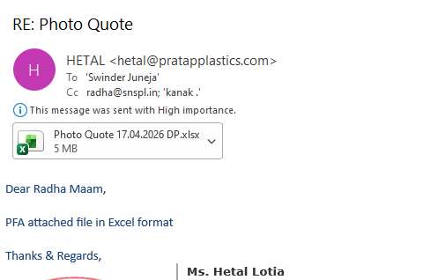
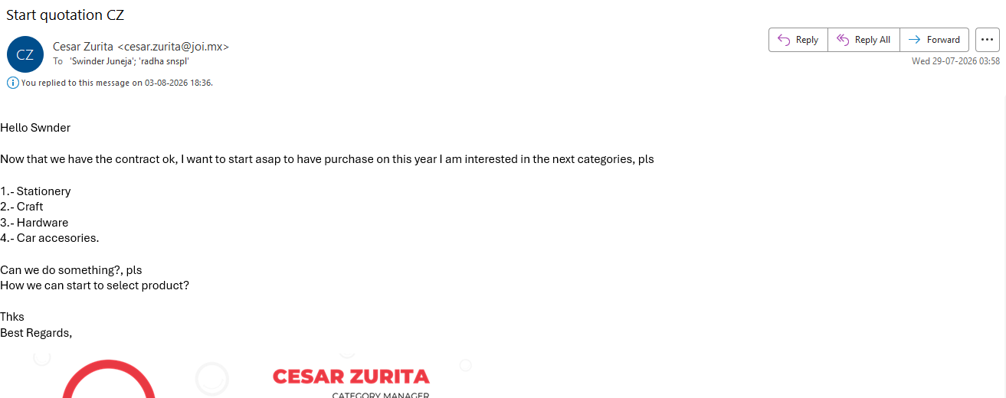
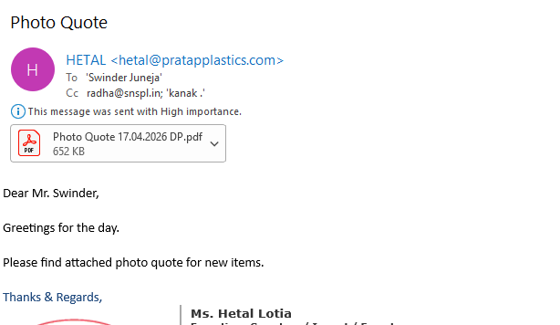
1ST STEP:
As per the buyer’s requirement, we request the factory to provide the product quotation sheet

Slide 3
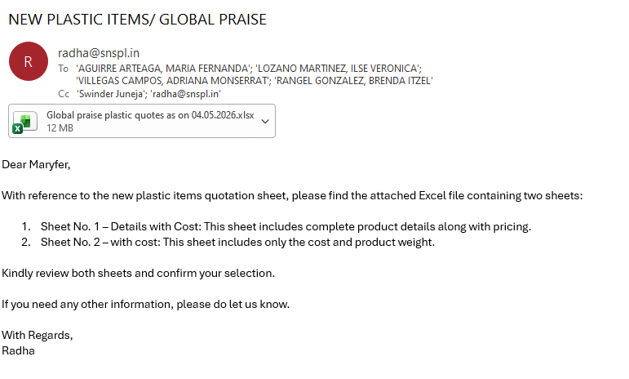
2ND STEP:
We send the product quotation sheet to the buyer and wait for their selection..

Slide 4
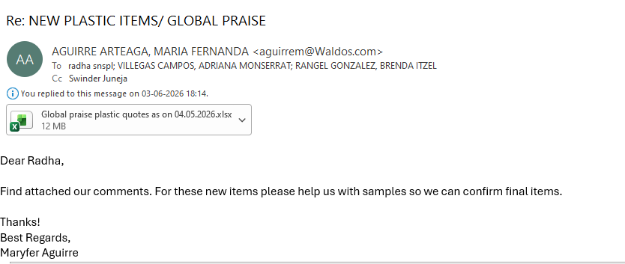
3RD STEP:
We receive the buyer’s selection and sample requirements, and then request the factory to arrange the samples.

Slide 5
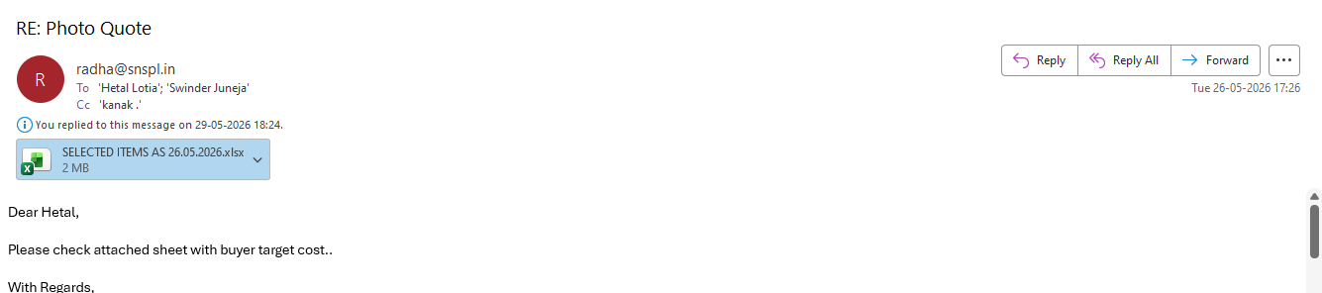
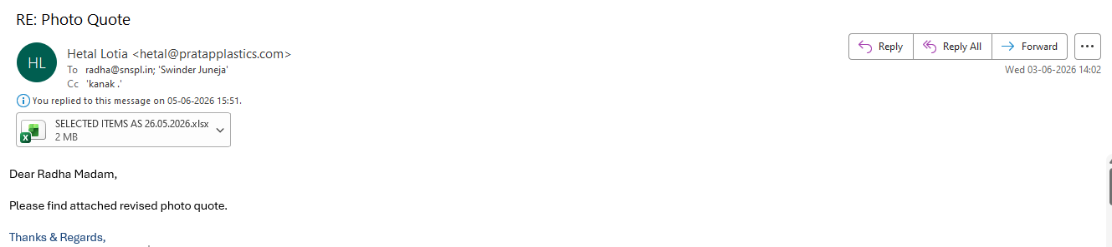
4th Step:
We send the Selected items to factory with target cost.
We also send the samples to buyer.
Selected( Factory sent revised cost)

Slide 6
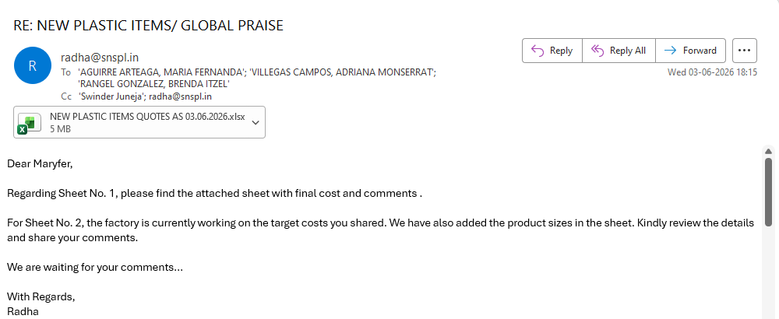
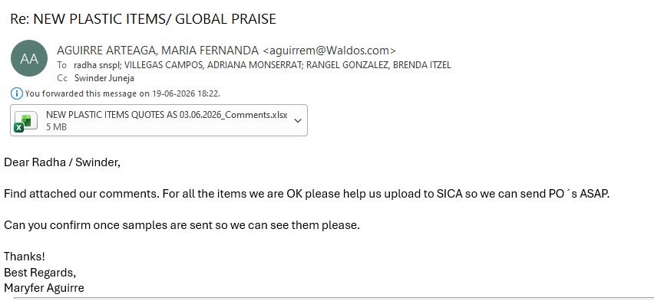
5th Step :SICA( BUYER PORTAL)
The buyer shares the comments on selected items and request to upload the items on SICA

Slide 7
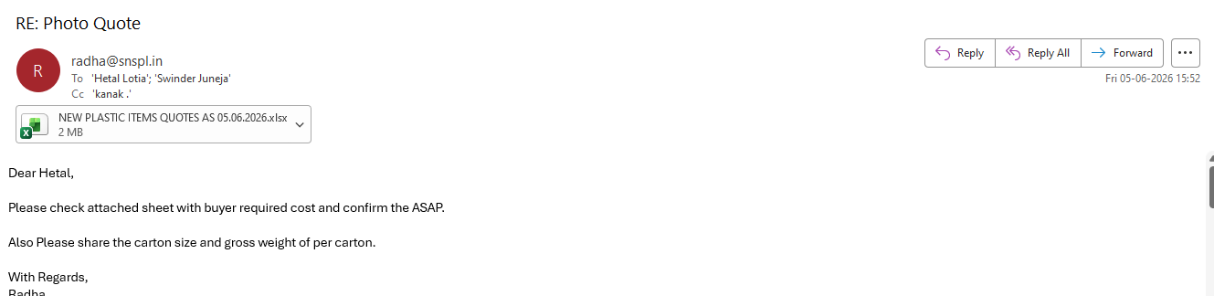
we need some information from the factory to upload the items on SICA( weight / CBM / MOQ/ production time)

Slide 8
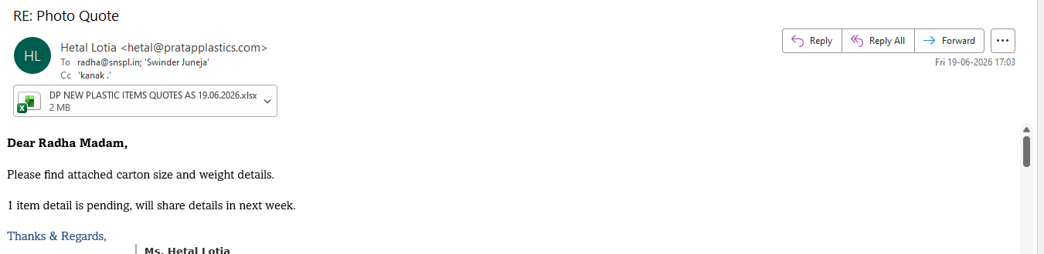
Factory: required product information for SICA

Slide 9
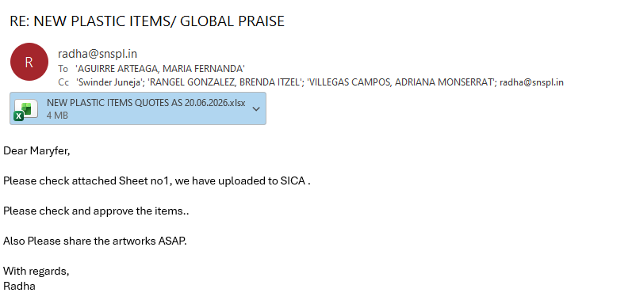
ITEMS UPLOADED ON SICA ( BUYER PORTAL)
Now we need approval on SICA from buyer .

Slide 10
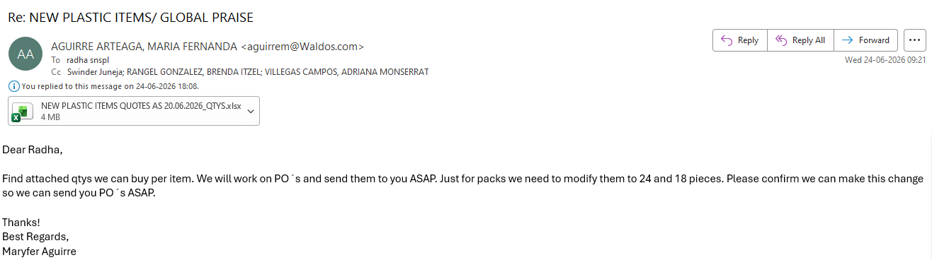
6th STEP:
Once the items are approved on SICA then buyer send qtys in excel sheet for checking CBM and weight. Then releases the POS.
In the mean time we start the process for artworks and mockups.

Slide 11
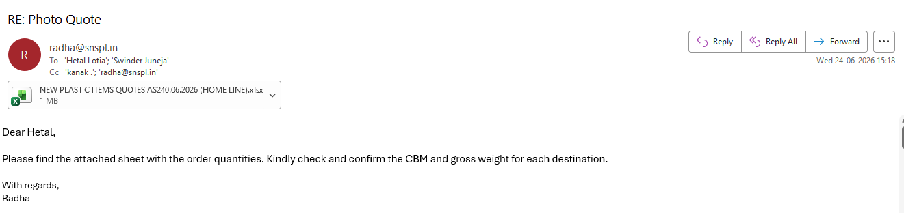
CBM SHEET: We make the CBM /containerization sheet and send to factory for cross checking.. Match the cbm and then send to Buyer with final comments.

Slide 12
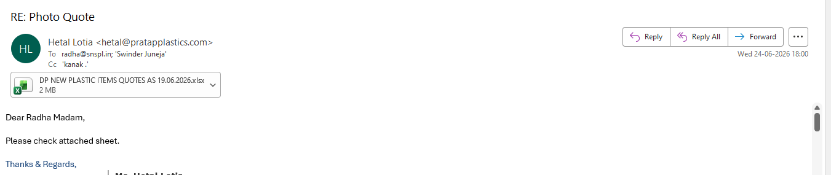
Factory:-CBM & Weight

Slide 13
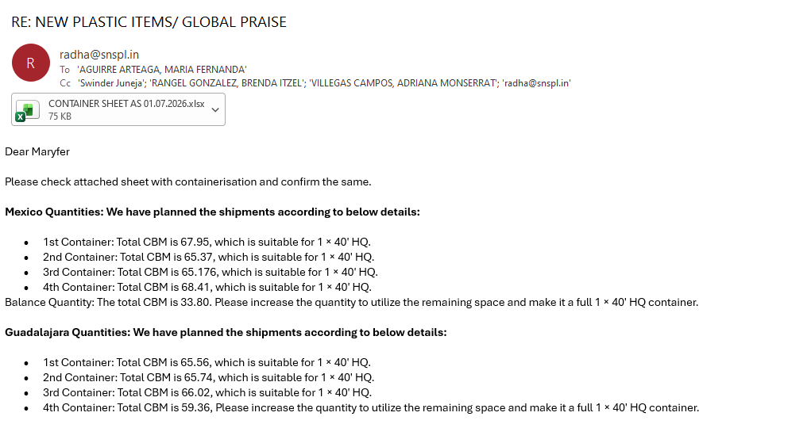
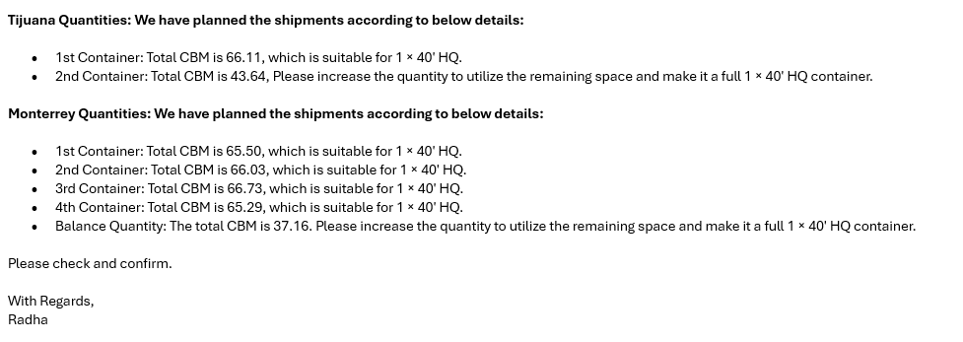
Make the sheet container wise for buyer.

Slide 14
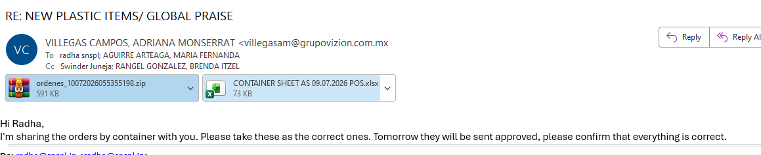
7th Step:
We have received the Pos from buyer , we crossed check all details and confirm to buyer.

Slide 15
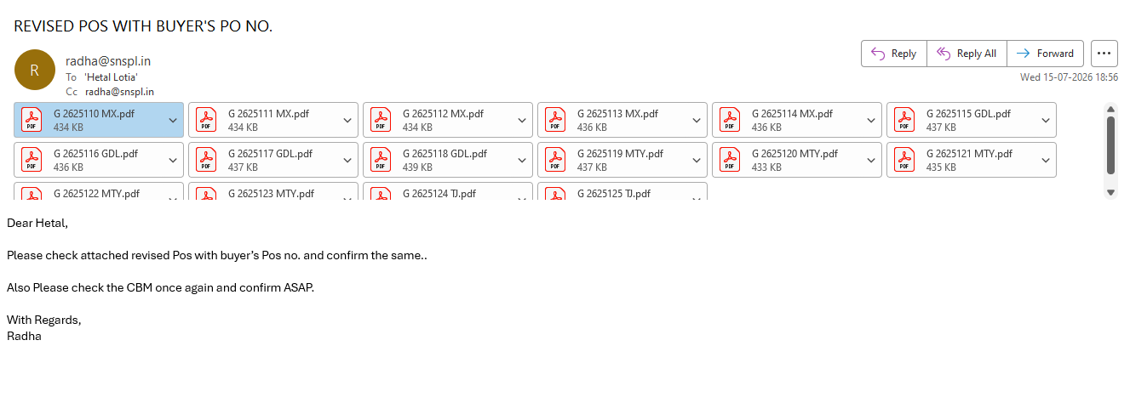
8th Step:
In regard of Buyer po we make Global Po and share with factory.

Slide 16
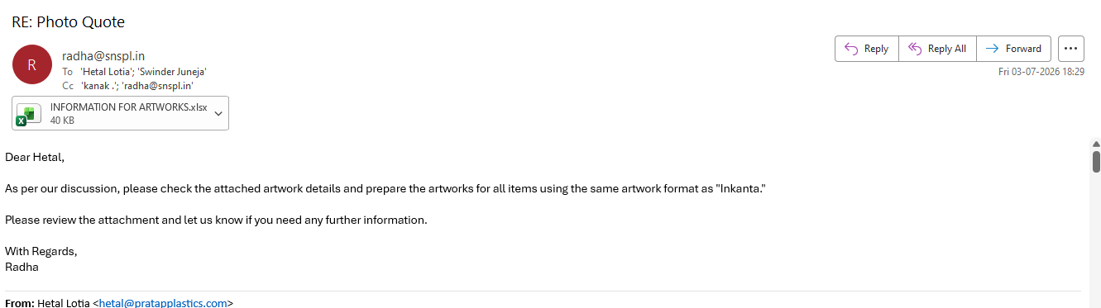
^{9th} STEP:
Artwork process: Detailed Artworks information send to Factory.

Slide 17
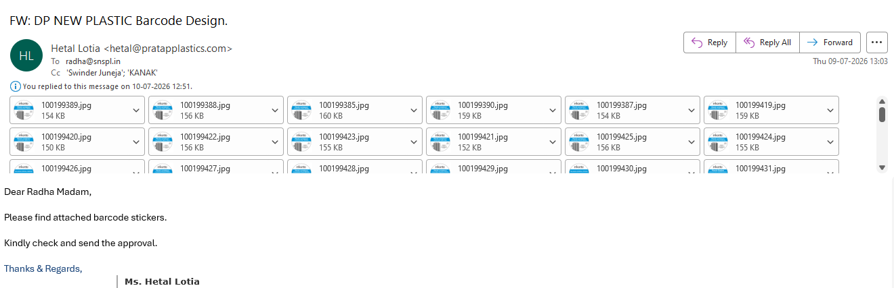
Factory: Artworks Received from Factory for buyer approval.

Slide 18
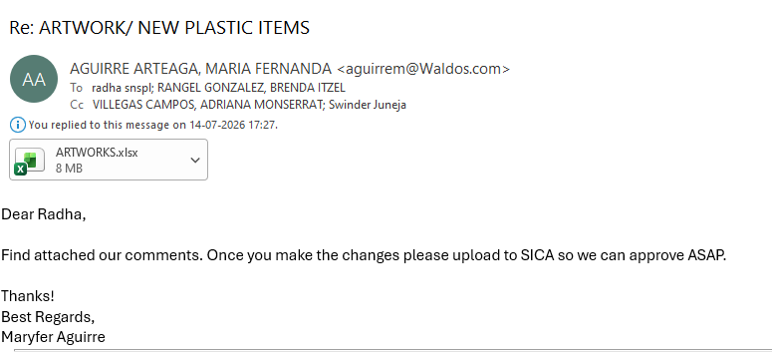
Buyer comments on shared Artwork

Slide 19
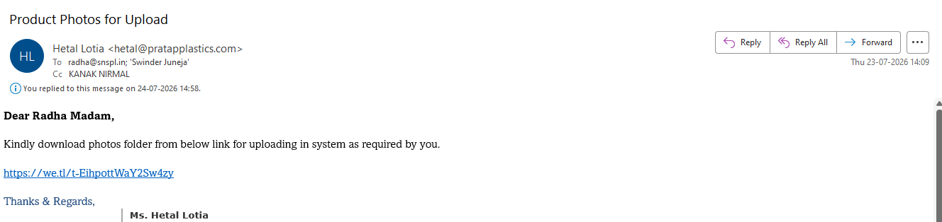
After approving the artworks, we uploaded mockups on SICA for final approval.
Mockups provided by Factory.

Slide 20
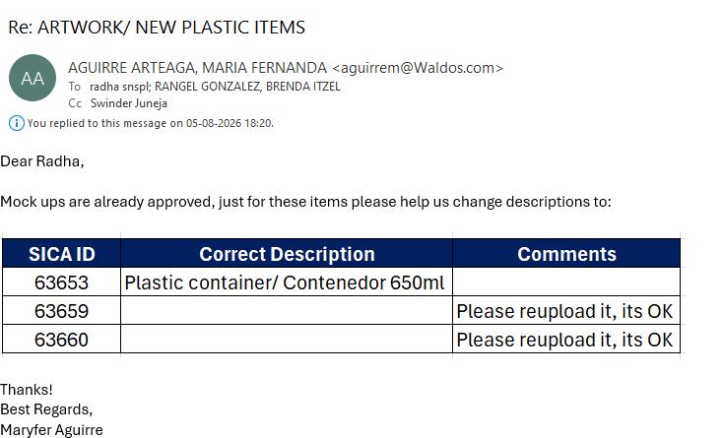
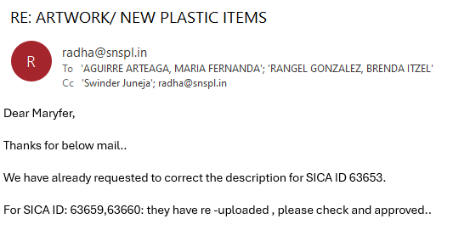
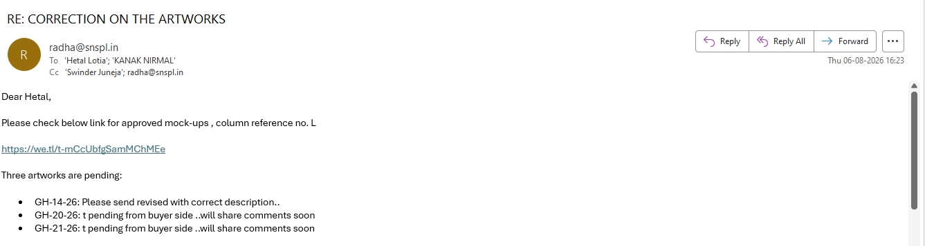
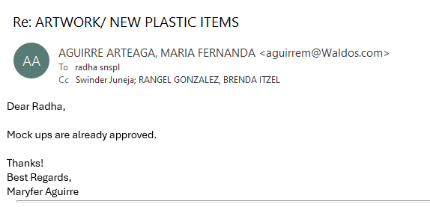
Buyer approval on Mockups

Slide 21
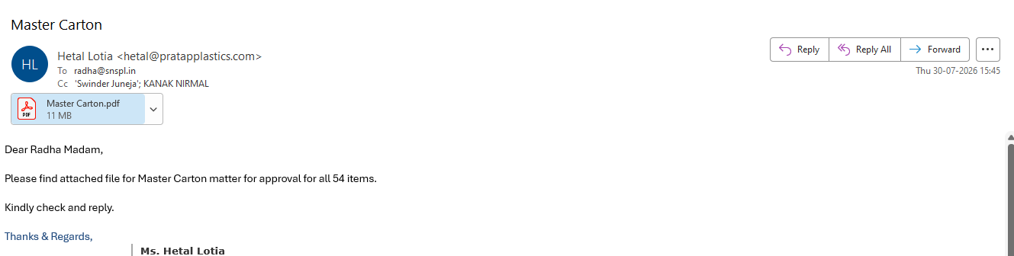
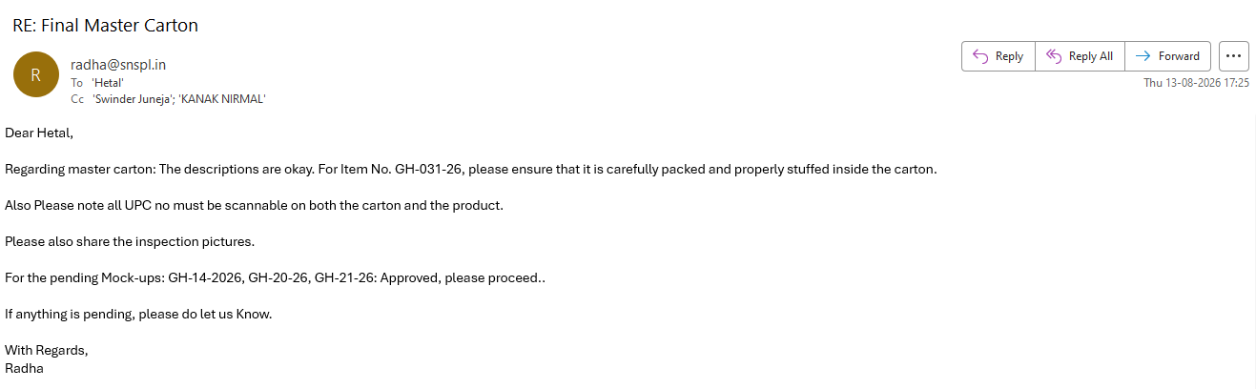
^{10th} STEP:
CARTON MARKING: The factory send us carton marking for approval.
Our QC team checks and keeps in record for inspection all the approved artwork and carton markings

Slide 22
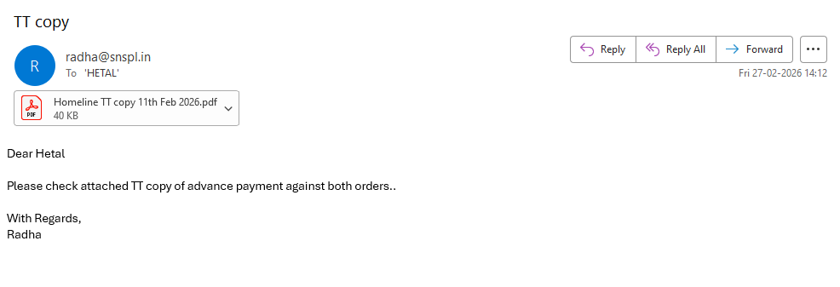
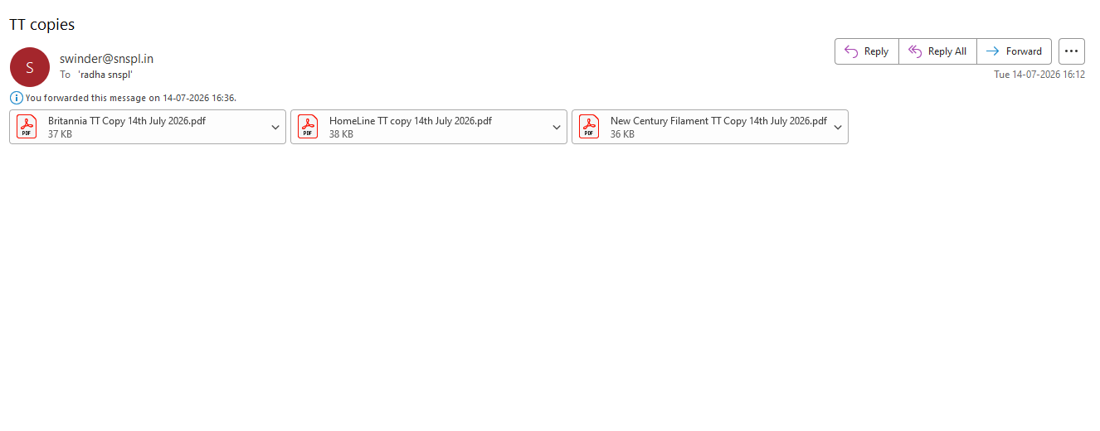
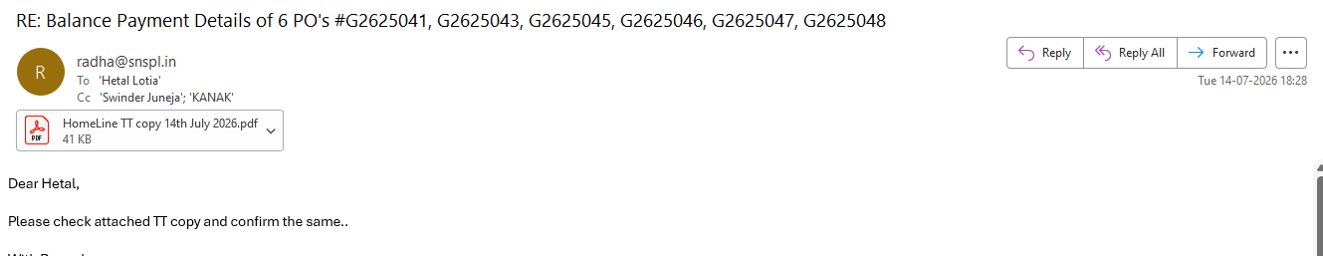
^{11th} STEP:
We make the 30% advance payment

Slide 23
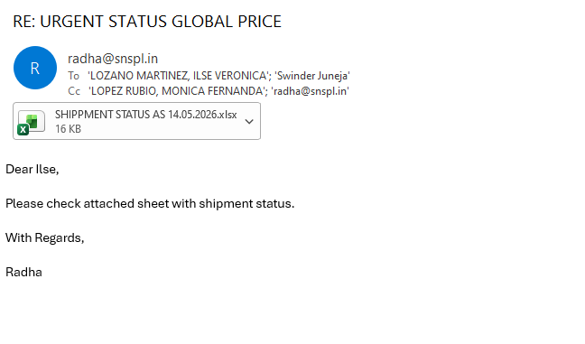
Shipment status send to buyer

Slide 24
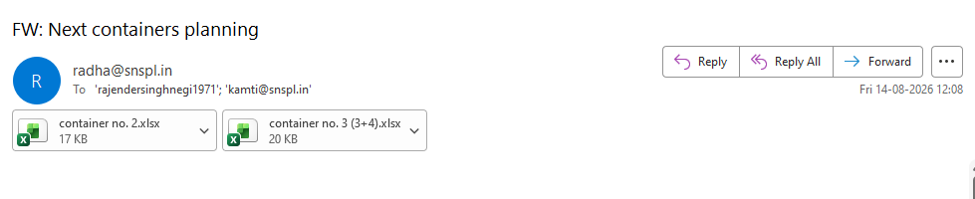
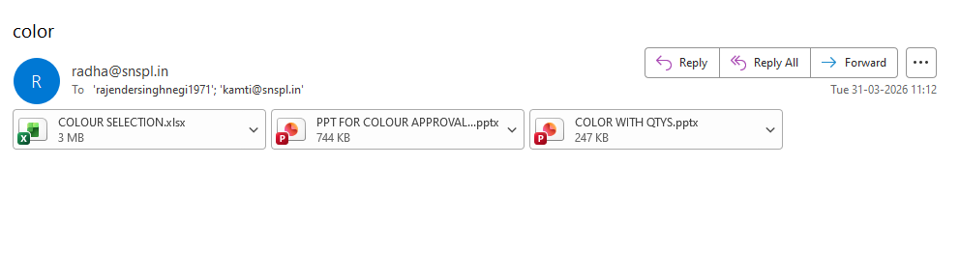
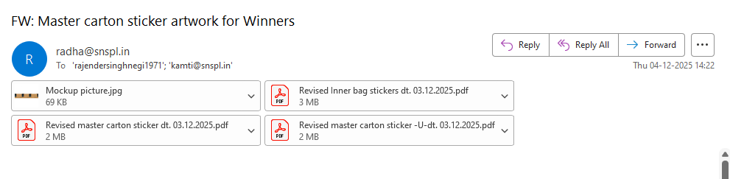
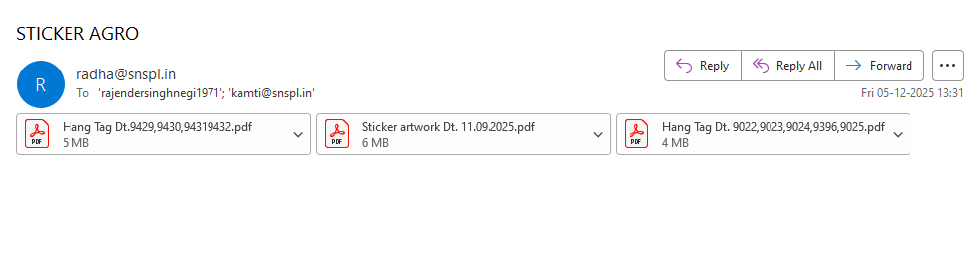
12th step: QC DEPARTMENT: Once buyer approve the all mock-ups then we provide the all details/ information regarding the shipments to QC department.

Slide 25
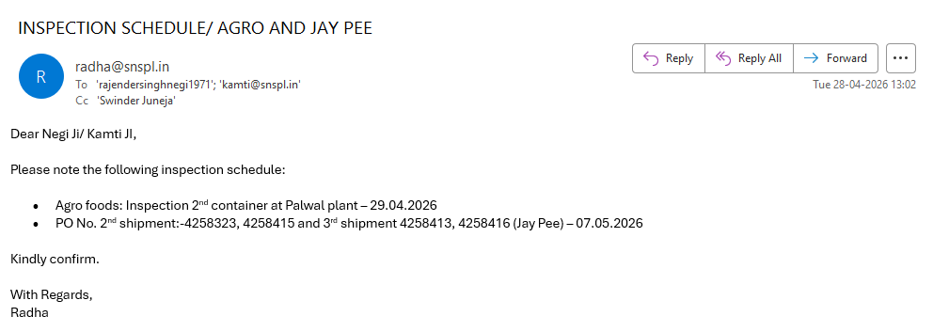
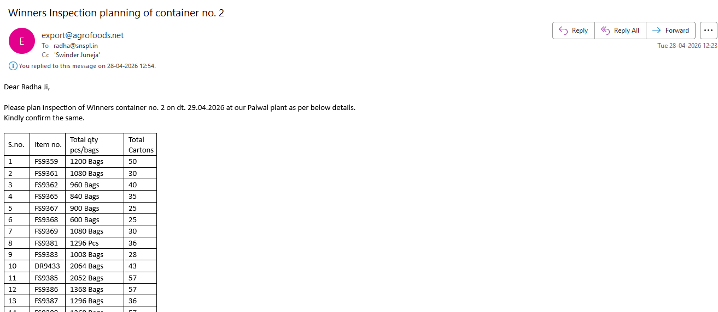
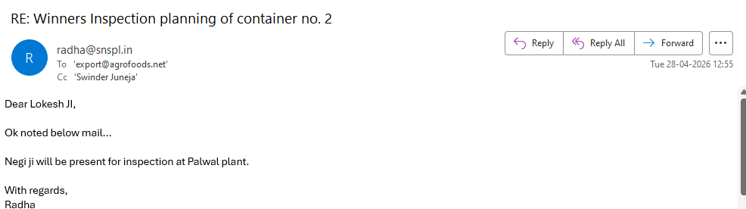
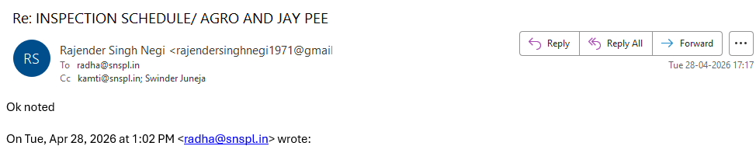
For inspections : Once the shipment ready 80% then we plan the inspection. Some inspection done by Negi Sir/ Kamti sir and sometime, we require the pictures and samples and check everything at our end.

Slide 26
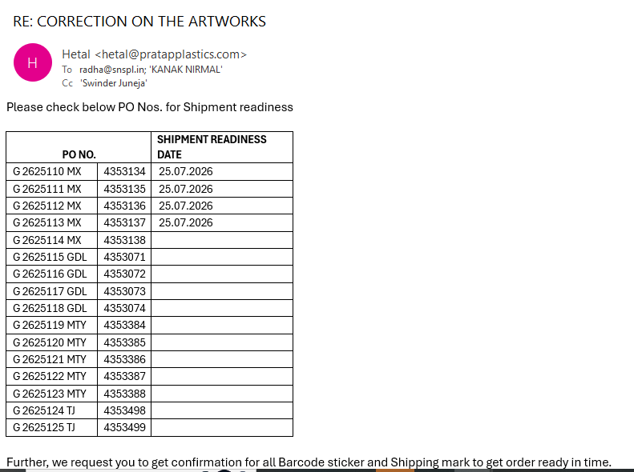
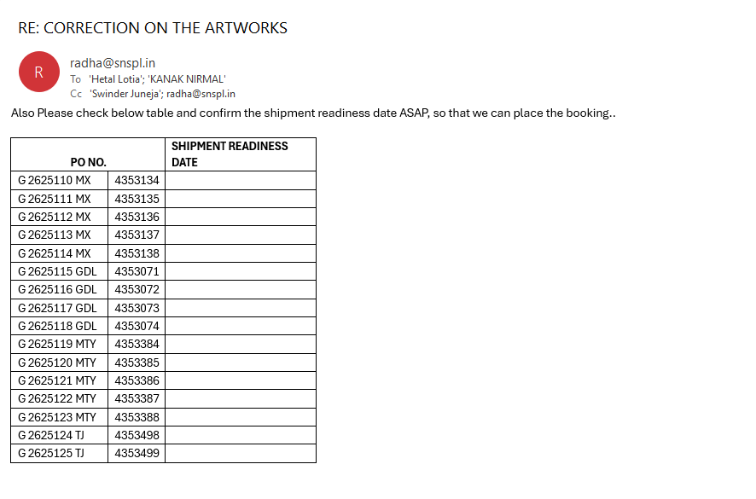
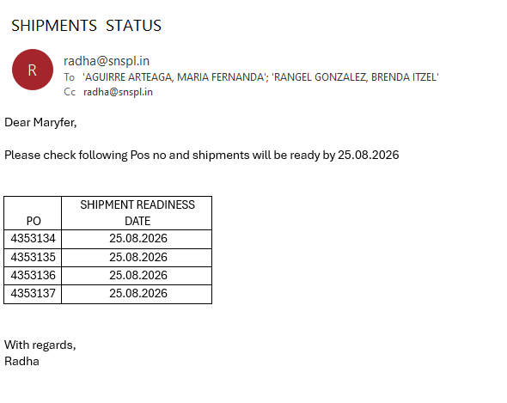
13th STEP
After advance payment & approval all artwork & carton marking then we ask the factory about the Shipment readiness date. Production time is 60-70 days..

Slide 27
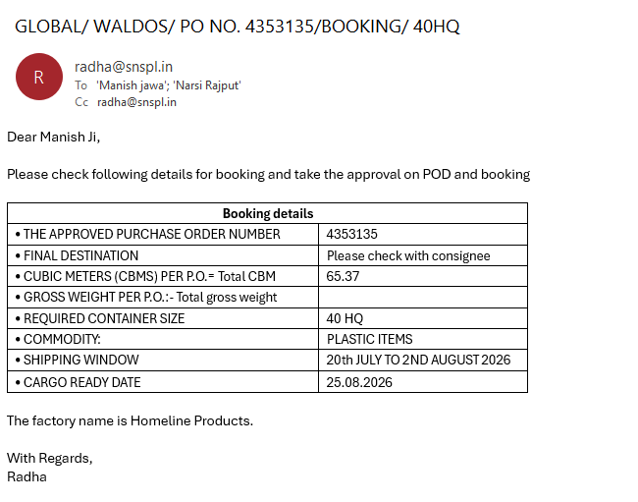
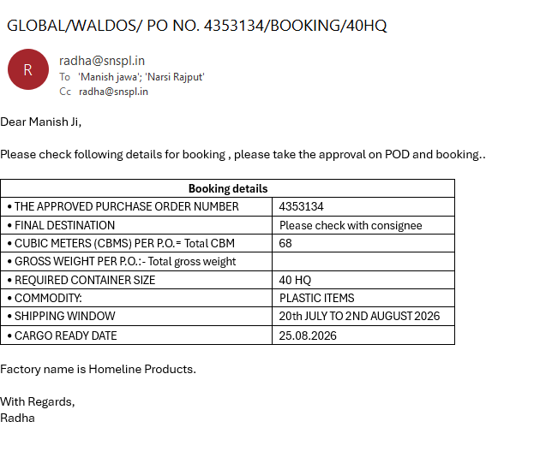
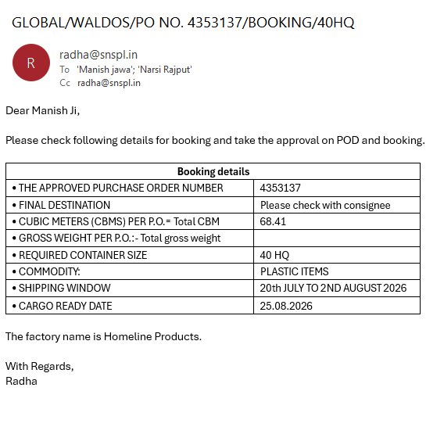

14th Step:
Booking process: we place the booking to Indian forwarder before 15-20 days from readiness date.

Slide 28

Booking process( mail sent to Mexico forwarder counterpart

Slide 29




Booking process ( India agent confirmed booking approval & POD)
Once the booking release to factory and container dispatched from the factory, then start the process for documents.
Sometimes, we request the vessel schedule from the shipping agent

Slide 30
Booking process ( India agent confirmed booking approval & POD)
Once the booking release to factory and container dispatched from the factory, then start the process for documents.

Slide 31




Check the Both B/L –factory and Global and give the approval to Shipping agent.
FCR(Forwarder's Cargo Receipt) 1ST LEG B/L : Release for factory.
( Homeline product to Global)

Slide 32




HBL(House Bill of Lading) 2ND LEG B/L : This B/L is for Buyer.( Global to Waldos)

Slide 33


15th Step : Documents: we ask for the document from the factory, once we receive then we make the Global documents ( invoice & packing list)
Factory documents

Slide 34


Global final document set: we make the final documents and send it to the buyer with inspection pictures.

Slide 35



16th Step : Full Payment : once we received the final documents from the factory, then we make the balance payment to factory..

Slide 36



17th Step: Bank : we submit the final Global documents in the bank for the Payment term which is 90days.

Slide 37

18th Step. Final payment is credited in global account confirmed by the Swinder sir..

Slide 38

19th step: we share the sale and purchase to accounts team.

Slide 39




20th Step: Waldos Commission: we make the commission invoice and share with buyer

Slide 40




21th Step: Waldos Commission: we make the commission invoice and share with buyer

