Slide 1
⚕
MedRescue AI
Predicting medicine expiry. Matching real need. Preventing waste before it happens.
IBM Bob AI Innovation Hackathon | Team MedRescue
Sakshi Parmar (Lead) • Rajvi Khunt • Ayushi Raval • Hir Ramani

Slide 2
THE PROBLEM
Medicine expires unused while nearby facilities run short
20-40%
₹1000cr+
Zero
of hospital medicine waste comes from
unused stock reaching expiry
estimated annual pharma wastage
across Indian healthcare facilities
real-time visibility between nearby
pharmacies and hospitals today
Hospital A has 150 units of Insulin expiring in 12 days it will never use.
Hospital B is 4km away, actively short on Insulin, and has no way of knowing.
2

Slide 3
OUR SOLUTION
One platform. Predict, match, and rescue expiring medicine.
MedRescue AI lets hospitals and pharmacies register their own medicine stock, then continuously predicts which items are approaching expiry, finds another registered facility that actually needs that exact medicine, and recommends a transfer — before the stock is wasted and before the patient goes without.
Register
Stock
→
Predict
Expiry Risk
→
AI-Ranked
Matching
→
Human
Approval
→
Waste
Prevented
Deterministic rules and required human approval keep every physical transfer under authorized control — the AI recommends, it never decides alone.
3

Slide 4
KEY FEATURES
Built for how hospitals and pharmacies actually work
🔐
⏳
🔗
Role-Based Login
Type-Aware Urgency
AI-Ranked Matching
Separate Hospital and Pharmacy accounts, each with its own dashboard and stock.
Injectables are flagged sooner than tablets or capsules — urgency matches real shelf-life risk.
Ranks candidate facilities by need, quantity fit, proximity, and urgency — not a simple list.
💰
🔍
🔔
Transparent Pricing
Medicine Search
Live Notifications
Every match shows a full price breakdown: base price, markup, and transportation.
Search any medicine to see who has it, where, and how to contact them directly.
Simulated SMS/email alerts on urgency and payment events, with an in-app bell.
4

Slide 5
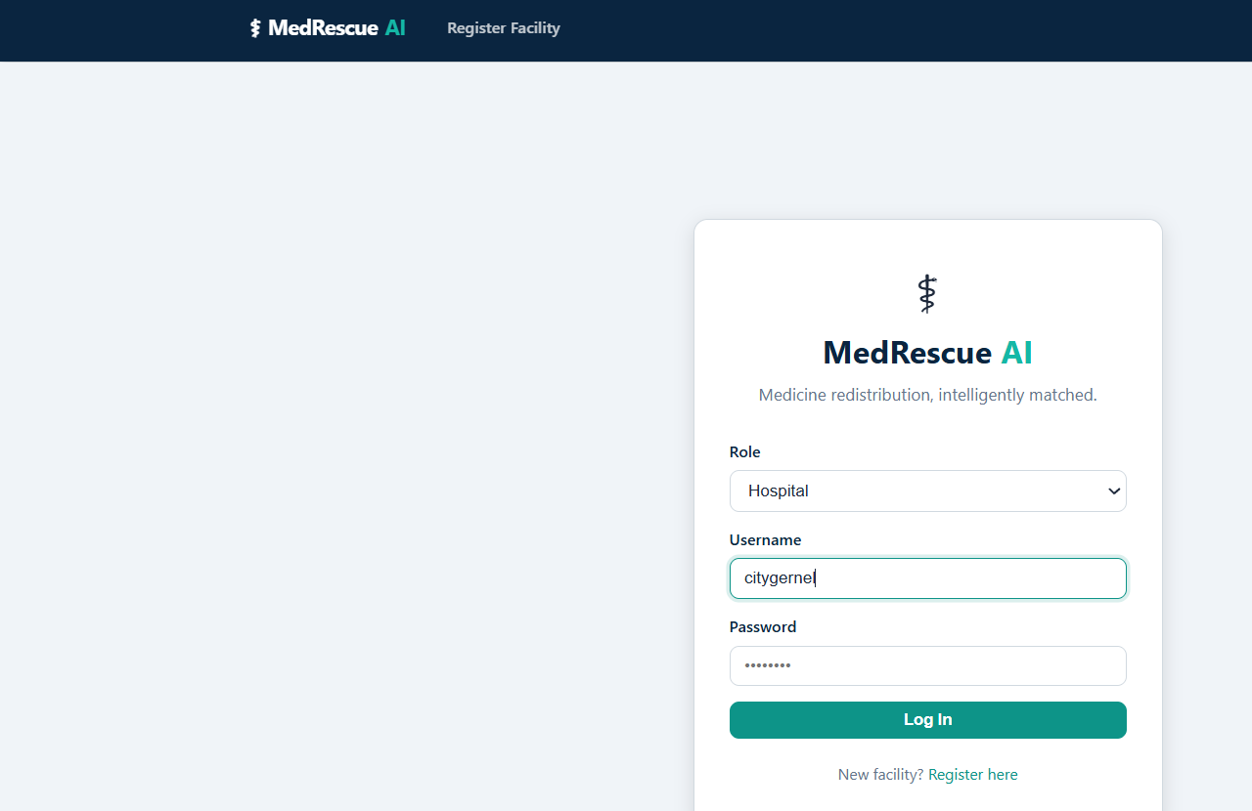
LIVE PRODUCT
Role-based login — Hospital or Pharmacy
Facility selects its role — Hospital or Pharmacy — at login
Each account only sees and manages its own registered stock
New facilities self-register directly from the login screen
Session-based access control protects every internal route
5

Slide 6
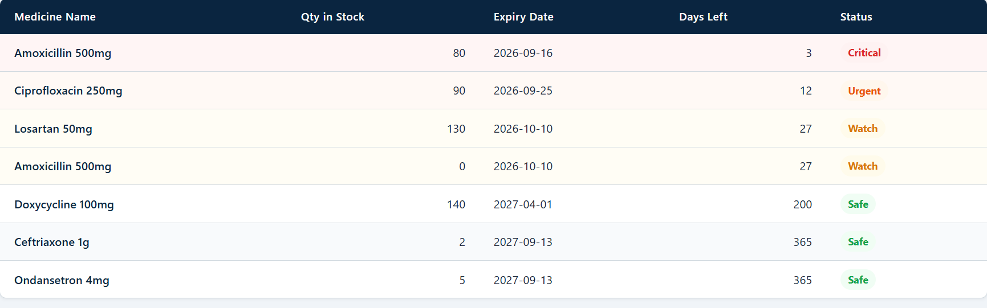
LIVE PRODUCT
Dashboard — urgency at a glance
Critical ≤ 7 days Urgent ≤ 15 days Watch ≤ 30 days Safe 30+ days
6

Slide 7
WHAT MAKES THIS AI
Urgency thresholds adapt to the medicine type
Not all medicines carry the same risk when they expire. MedRescue AI applies different urgency windows depending on the medicine type, so the system flags what actually needs attention first.
Medicine Type
Critical
Urgent
Watch
Why
Injectable
≤ 3 days
≤ 7 days
≤ 15 days
Highest sensitivity — flagged earliest
Tablet / Capsule
≤ 10 days
≤ 20 days
≤ 30 days
Longer safe buffer, stable shelf life
Syrup / Other
≤ 7 days
≤ 15 days
≤ 30 days
Standard default thresholds
7

Slide 8
ARCHITECTURE
How data flows end to end
Facility
(Hospital / Pharmacy)
→
Flask
Web App
→
Matching
Engine
→
SQLite
Database
→
Notification
Log (SMS/Email)
Built with IBM Bob
1. Facility registers medicine stock (name, quantity, manufacture and expiry date, type).
2. The Expiry Risk Engine scans stock and flags items nearing expiry using type-specific thresholds.
3. The Matching Engine ranks other facilities by need, quantity fit, proximity, and urgency.
4. A reasoned recommendation and price breakdown is generated and shown to both facilities.
5. Staff review and approve the transfer — stock and audit records update automatically.
8

Slide 9
TECH STACK
Simple, reliable, and genuinely built with IBM Bob
Languages
Python, HTML, CSS, JavaScript
Framework
Flask
Database
SQLite
Auth
Flask sessions, role-based access
IBM Technology
IBM Bob — scaffolding, feature extension, and debugging
Hosting
PythonAnywhere (live deployment)
9

Slide 10
KNOWN LIMITATIONS
What this prototype is — and isn't — yet
Simulated data
Simulated notifications
Runs on realistic sample data, not live pharmacy or hospital records.
SMS/email alerts are logged in-app; not yet wired to a real messaging API.
Plaintext auth
Scoped medicine types
Login is functional for demo purposes but not production-hardened.
Cold-chain and controlled substances are excluded from this version.
Transparency over overclaiming — this is what a focused hackathon build honestly covers today.
10

Slide 11
IMPACT & WHAT'S NEXT
From hackathon prototype to real healthcare infrastructure
1
2
3
Now
Next
Later
Expiry prediction + AI matching within a single cooperative network, using IBM Bob.
Real messaging integration (SMS/email), plus live pharmacy inventory connections.
Multi-region redistribution, watsonx.ai-powered demand forecasting, regulatory compliance layer.
The core insight: waste and shortage are usually the same event, seen from two sides. Solve the visibility gap, and you solve both at once.
11

Slide 12
⚕
Thank You
MedRescue AI — Reducing medicine waste, saving lives.
Live demo: shakshi17.pythonanywhere.com
Team MedRescue — Sakshi Parmar • Rajvi Khunt • Ayushi Raval • Hir Ramani

