Slide 1
Virtual Classroom And Conferensing

Slide 2
Introduction Despite terrifying covid-19 situation in 2020, the learning process in schools and universities stayed mostly uninterrupted. That’s because of virtual classroom software
VIRTUAL CLASS ROOM is a modern educational concept. The Virtual class room concept binds together the Educational experts and the Students all over the world, who are online, into a classroom, which is purely virtual in nature.
The experts and the students who are learning from them may be living at different Geographical zones. But a feeling is sustained that everybody is together with in a hand reach.

Slide 3
Advantages of Project:
Enhancing student-to-student and faculty-to student communication.
Enabling student centered teaching approaches.
Providing 24/7 accessibility to course materials.
To support live on-line classes for distance learning and remote education.
To pool academic resources thereby improving access to advanced educational experiences.
To increase and improve the accessibility of educational resources to the persons with disabilities

Slide 4
Literature Review

Slide 5
Paper 1
International Journal of Advanced Research in Computer Engineering & Technology (IJARCET) Volume 4 Issue 4, April 2015 1296 ISSN: 2278 – 1323
Virtual Classroom in PHP
By Mayuri Mohod, Farah Iqbal, Juhi Katariya, Shruti Katkar Computer Science And Engineering, COET, ,Akola

Slide 6
Analysis Of Papers
The project in the above paper is virtual classroom, it consists of three types of users:-
Admin can accept and validate the new registering student.
Faculty can upload any question in discussion forum and able to solve that query also. Faculty can create a poll question and also can mail any notice to any student.
student is able to view his ready profile on his own home page with their photos and put question over discussion forum , see the status of the poll , mail its query, do video conference for online discussion .
.

Slide 7
Technology Used
User Interface : Html/CSS
Client Side Scripting : Java Script
Programming Language : php
Database: Mysql 5.3.5

Slide 8
Conclusion from analysis
great shareware and a common SharePoint tool.
act as a great knowledge resource implementing the concept of knowledge management system.
new way to think Smarter, Learn Smarter Do Smarter.

Slide 9
Paper 2
Research and Implementation of WebRTC Signaling via WebSocket-based for Real-time Multimedia Communications

Slide 10
Analysis Of Papers
gives an introduction to WebRTC (Web Real-Time Communication)
technology used for peer-to-peer audio, video and data sharing without the need for third-party plugin or proprietary software.
shows the way WebRTC is built and the various protocols used to allow communication.
communication system was implemented using HTML5 and JavaScript to test the working and support for various devices, PCs and mobiles.

Slide 11
Conclusion from analysis
WebRTC is one of the most commonly used technologies for peer-to-peer communication used by WhatsApp, Discord, Facebook, Google Hangouts, etc .
supported by many browsers
ideal to use for any applications having peer-to-peer communication as a feature

Slide 12
Proposed Idea

Slide 13
Proposed Solutions
First and foremost goes the virtual classroom - a central hub that combines all the controls and features in one place.
include video and audio conferencing, a list of students that are present in the class, interactive whiteboard, and all the controls for teachers and students, and many others.

Slide 14
The project consists of three types of users: Administrator, student and faculty members.
Admin can accept and validate the new registering student. Admin can discard any student or any faculty member.

Slide 15
student
communicate with the faculty
put question over discussion forum
Receive whatsapp notifications
do video conference for online discussion
Access whiteboard
Access learning material

Slide 16
faculty
window will include the list of students enrolled in class which he/she can use to send personal invite or invite to entire class for discussion.
Can start a video conferencing with the video conferencing feature provided. All the rights will be with the teacher.

Slide 17
Proposed Algorithm
The project consist of following module
Virtual Classroom
Broadcast and Discussion Forum
Video Conferencing
Collaborative Whiteboard
Learning material sharing
Email Integration

Slide 18
Virtual classroom
project focuses on integrating the currently present features along with additional features like video conferencing, one to one chat system and collaborative white board into one central hub. .

Slide 19

Broadcast and Discussion Forum

Slide 20
Video Conferencing
online lessons with quality audio and video solutions
The teacher stays in charge of the class and has all the tools to engage student

Slide 21
Collaborative whiteboard
shared feature where both teachers and students can type, draw, delete, and blank the whiteboard.
enables realistic whiteboard experience, encourages collaboration, and visualizes the discussing ideas.

Slide 22
Learning materials sharing
easily accessible learning materials
Only the assigned participants can access, view, edit, upload, or download learning materials.

Slide 23
email integrations
To inform the participants, and send automatic reminders via email.

Slide 24
Whatsapp message automation
Selenium is a free (open-source) automated testing
framework used to validate web applications across
different browsers and platforms.
This tool can be used to send messages from
WhatsApp web automatically at specified time
without user input.

Slide 25
Requirement Specifications

Slide 26
Software Requirements
• scripting Language: PHP
• User Interface: Html/CSS
• Client Side Scripting: Java Script
• Database: MySQL
• XAMPP
WebRTC (for video conferencing)
• Whiteboardteam API (for whiteboard)

Slide 27
Hardware Requirements
Computer/laptop with working webcam and active Internet Connection

Slide 28
Design

Slide 29
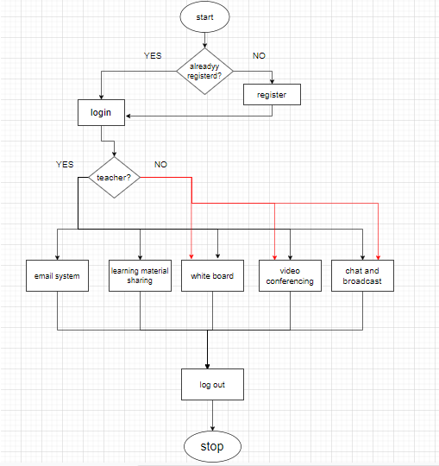
Data Flow
Diagram

Slide 30
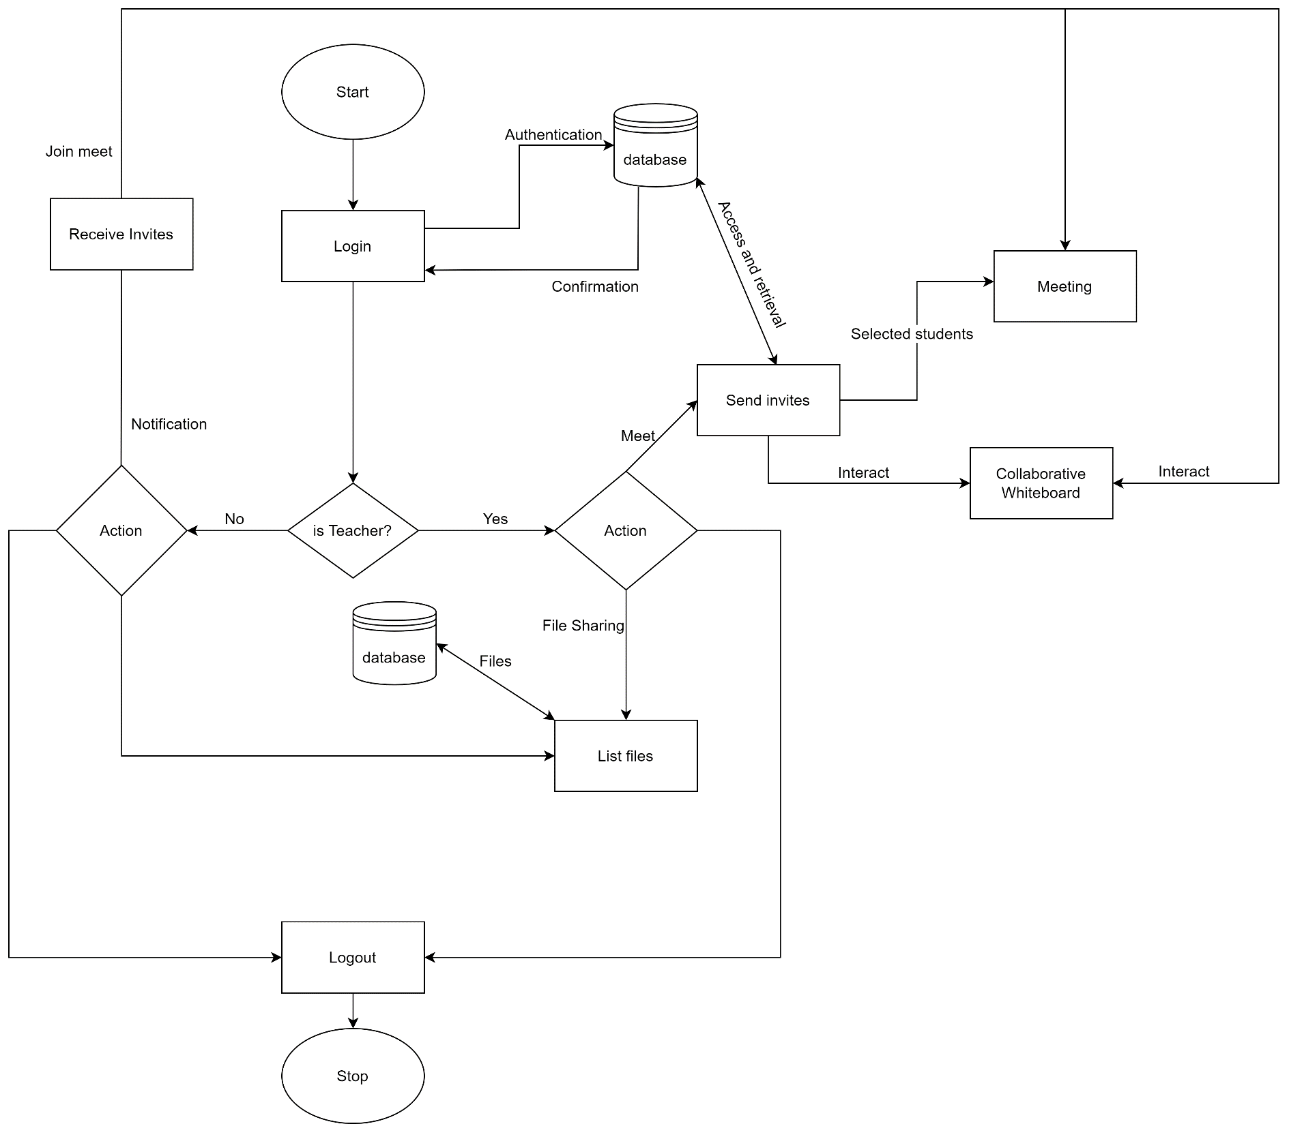
Detail Process Flow

Slide 31
User Interface
https://www.figma.com/proto/AwKRBpZ1eSGIEzsW9Gntqj/Ui-project?node-id=1%3A4&scaling=scale-down&page-id=0%3A1&starting-point-node-id=1%3A4&show-proto-sidebar=1
https://www.figma.com/proto/AwKRBpZ1eSGIEzsW9Gntqj/Ui-project?node-id=18%3A9532&scaling=scale-down&page-id=0%3A1&starting-point-node-id=1%3A4&show-proto-sidebar=1

Slide 32
Conclusion
The educational system is open to new learning approaches and wide adoption of technology.
virtual classroom software supports adaptability and flexibility to conduct actual lessons for anyone, anywhere, and anytime advancing the learning process

Slide 33

THANK YOU!!!
Team
Shakshi Amonkar (181106002)
Dattaraj Shetye (181106055)
Ashnil Naik (171106034)

