Slide 1

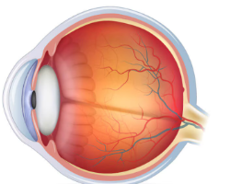
Diabetic-Retinopathy Detection
24EEE431 - AI & EDGE COMPUTING
AMAL KRISHNA S (CB.EN.U4EEE22003)
SHAKTHI (CB.EN.U4EEE22042)
ASHNI S (CB.EN.U4EEE22060)
PRIYASHREE (CB.EN.U4EE22125)

Slide 2
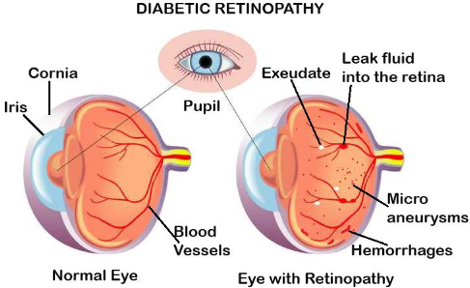
Introduction
Diabetic Retinopathy (DR) is a diabetes-related eye disease that damages the retina due to high blood sugar, leading to vision loss. It progresses from mild vessel swelling to severe complications like bleeding and retinal detachment. Early detection is crucial, as symptoms often appear late.
Traditional diagnosis is time-consuming and subjective. This project uses Convolutional Neural Network (CNN) trained on retinal images to automate DR detection and classification. Performance is evaluated using Cohen’s Kappa Score, ensuring accuracy. AI-driven solutions
enhance early diagnosis, enabling timely treatment
and reducing blindness risk.

Slide 3
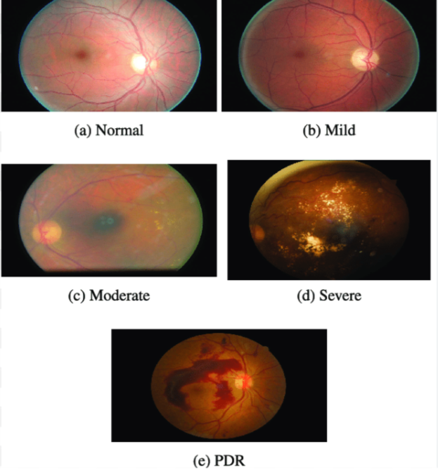
Stages of Diabetic Retinopathy
No DR (0): Healthy retina, no abnormalities.
Mild DR (1): Small swelling in retinal blood vessels.
Moderate DR (2): Blocked blood vessels, affecting blood flow.
Severe DR (3): Many blocked vessels, retina becomes deprived of oxygen.
Proliferative DR (4): New abnormal blood vessels form, leading to severe vision loss.

Slide 4
Dataset Description
The dataset contains Gaussian-filtered retinal images classified into five DR severity levels (No DR to Proliferative DR), with labels from 0 to 4.
The dataset is accompanied by a train.csv file, which contains image IDs and corresponding diagnosis labels, mapping each image to its respective DR subclass.
This structured dataset enables deep learning models to learn patterns in retinal abnormalities, facilitating early and accurate detection of DR.
The dataset consists of retinal fundus images, with corresponding severity labels stored in train.csv.

Slide 5
Data Preprocessing & Augmentation
The data processing pipeline begins with loading and analyzing the dataset using pandas, where the class distribution is visualized to understand potential imbalances. The images, stored in a ZIP archive, are extracted and organized into relevant folders.
Each image undergoes preprocessing, including resizing to a fixed dimension suitable for CNN input, and normalization to scale pixel values within a standard range, enhancing model stability.
These preprocessing steps ensure the dataset is structured and optimized for deep learning training
Improve model generalization and reduce overfitting, data augmentation is applied using TensorFlow's ImageDataGenerator. Augmentation techniques such as rescaling are implemented to introduce variations in the training images.
These transformations help the model learn invariant features, making it more robust to variations in real-world medical images. By enhancing the diversity of training data, augmentation improves classification accuracy and ensures the model performs well on unseen images.

Slide 6
Deep Learning Approach
Uses Convolutional Neural Networks (CNNs) for Diabetic Retinopathy detection.
Implements MobileNetV2 as a pretrained feature extractor for efficient classification.
Fine-tuned with additional layers to classify DR severity levels.
Uses Adam optimizer for efficient learning and Cohen’s Kappa Score for performance evaluation.

Slide 7
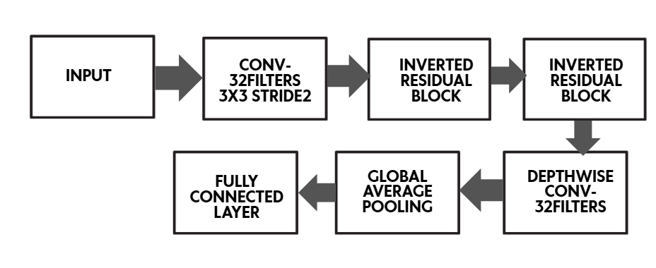
MobileNetV2 Architecture

Slide 8
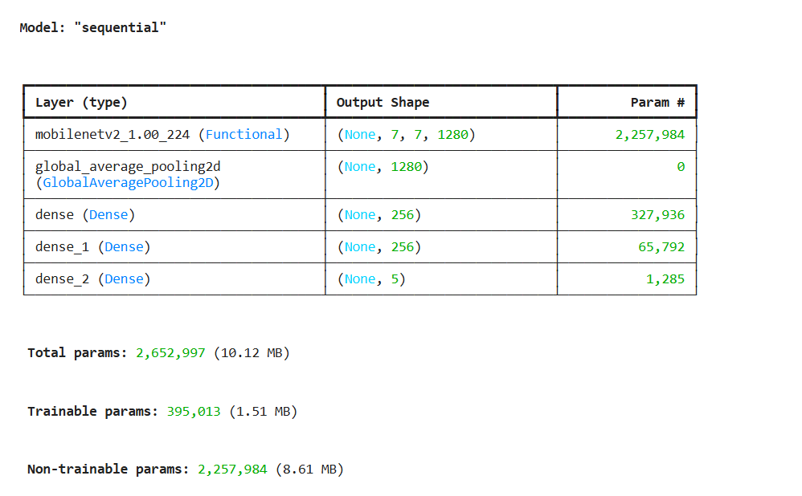
Model Architecture

Slide 9
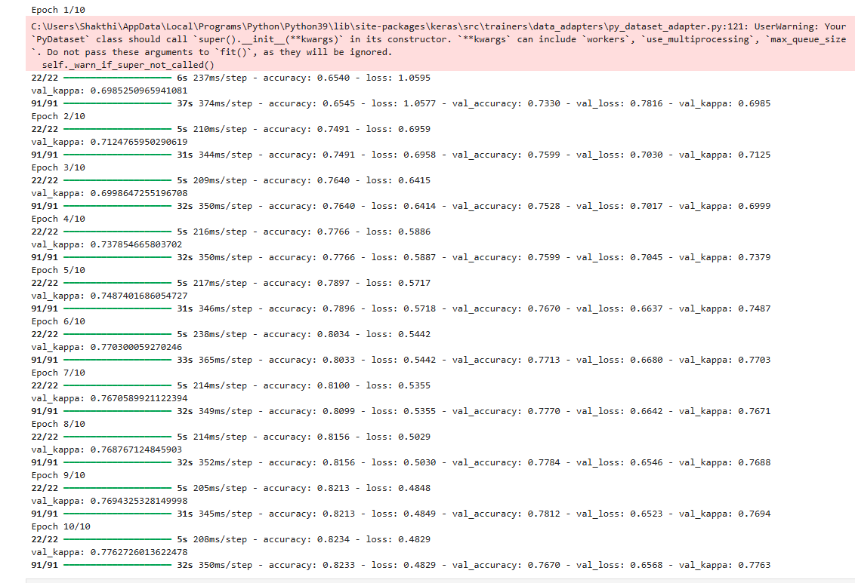
Training model
Judging metrics used: Accuracy, Sparse Categorical Loss, Kappa Score

Slide 10
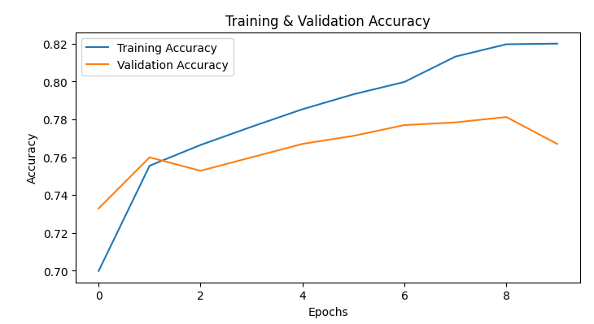
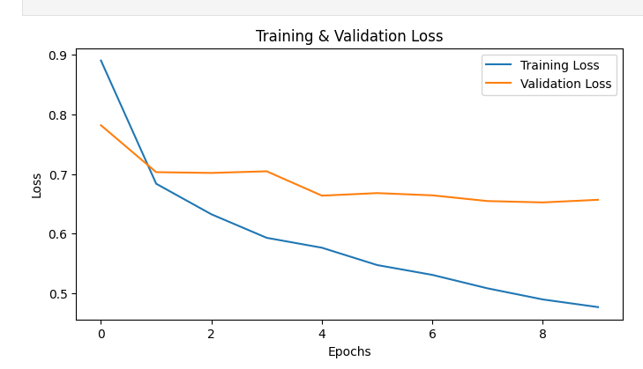
Graphs for visualisation
Plot between Training and Validation Accuracy
Plot between Training and Validation Loss

Slide 11
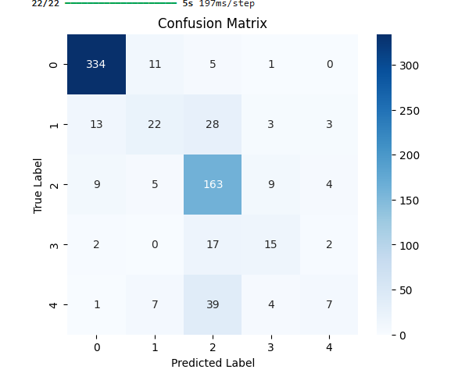
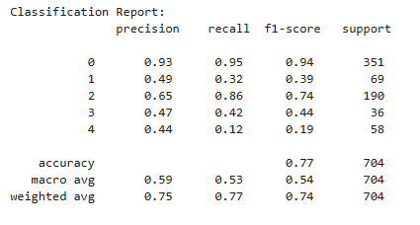
Classification Report & Confusion Matrix

Slide 12
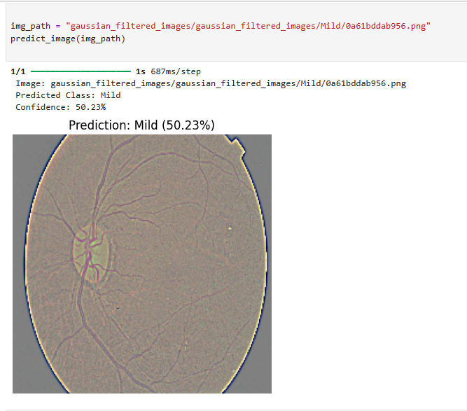
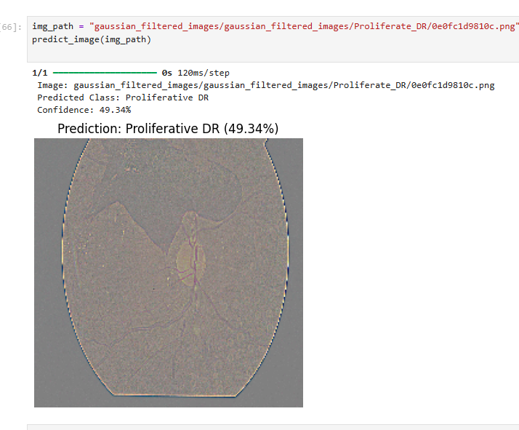
Model Prediction Result

Slide 13
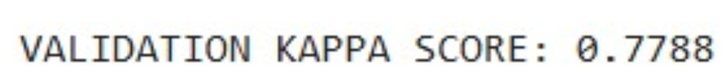
Results & Performance Metrics
The model’s performance is evaluated using Cohen’s Kappa Score, accuracy, and a confusion matrix to assess classification effectiveness.
The validation Kappa Score (val_kappa) is tracked throughout training, ensuring improvements in model performance. Accuracy is used as a key metric to measure correct classifications, while the Sparse categoricalcrossentropy serves as the loss function, helping fine-tune predictions.
The model automatically saves its best version whenever an improvement in the Validation Kappa Score is detected. Additionally, the confusion matrix provides insight into misclassifications across different severity levels, enabling better model refinement.
These metrics collectively ensure reliable and accurate detection of Diabetic Retinopathy (DR) severity.

Slide 14
Conclusion & Future work
This project successfully leverages Convolutional Neural Networks (CNNs) to detect and classify Diabetic Retinopathy (DR) using retinal images. By automating DR diagnosis, the model provides a fast, scalable, and objective solution, reducing reliance on manual screening.
Performance evaluation using Cohen’s Kappa Score ensures accuracy and reliability in classification. Early detection through AI-driven methods can significantly improve timely intervention, prevent vision loss, and reduce the global burden of DR.
Future improvements can focus on enhancing model accuracy by integrating attention mechanisms and transfer learning. Expanding the dataset with multi-source retinal images and incorporating real-time clinical testing can further improve robustness.
Additionally, deploying the model as a cloud-based or mobile application will enable accessible and cost-effective DR screening for wider use in healthcare settings.

Slide 15
THANK YOU

