Slide 1


Chapter 2 Application Layer
A note on the use of these ppt slides:
We’re making these slides freely available to all (faculty, students, readers). They’re in PowerPoint form so you see the animations; and can add, modify, and delete slides (including this one) and slide content to suit your needs. They obviously represent a lot of work on our part. In return for use, we only ask the following:
Computer Networking: A Top Down Approach
If you use these slides (e.g., in a class) that you mention their source (after all, we’d like people to use our book!)
If you post any slides on a www site, that you note that they are adapted from (or perhaps identical to) our slides, and note our copyright of this material.
Thanks and enjoy! JFK/KWR
All material copyright 1996-2012
J.F Kurose and K.W. Ross, All Rights Reserved

Slide 2
Reading assignment: Chapter 2

Slide 3
Chapter 2: outline
2.1 principles of network applications
2.2 Web and HTTP
2.4 electronic mail
SMTP, POP3, IMAP
2.5 DNS
2.6 P2P applications
2.7 socket programming with UDP and TCP

Slide 4
Some network apps
e-mail
web
text messaging
remote login
P2P file sharing
multi-user network games
streaming stored video (YouTube, Hulu, Netflix)
voice over IP (e.g., Skype)
real-time video conferencing
social networking
search
…
…

Slide 5

















Creating a network app
application
transport
network
data link
physical
write programs that:
run on (different) end systems
communicate over network
e.g., web server software communicates with browser software
no need to write software for network-core devices
network-core devices do not run user applications
applications on end systems allows for rapid app development, propagation
application
transport
network
data link
physical
application
transport
network
data link
physical

Slide 6
Application architectures
possible structure of applications:
client-server
peer-to-peer (P2P)

Slide 7
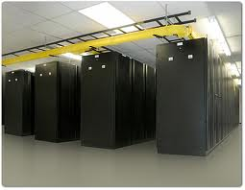
Client-server architecture
server:
always-on host
permanent IP address
data centers for scaling
clients:
communicate with server
may be intermittently connected
may have dynamic IP addresses
do not communicate directly with each other
client/server

Slide 8
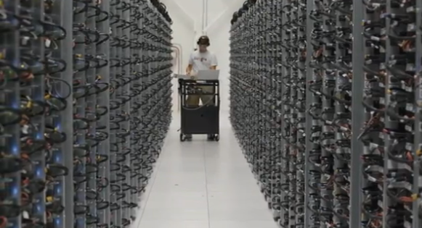
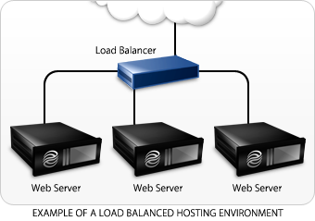
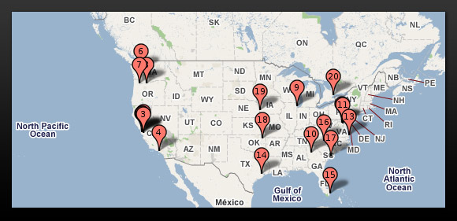
Server’s load balance

Slide 9
P2P architecture
no always-on server
arbitrary end systems directly communicate
peers request service from other peers, provide service in return to other peers
self scalability – new peers bring new service capacity, as well as new service demands
peers are intermittently connected and change IP addresses
complex management
peer-peer

Slide 10
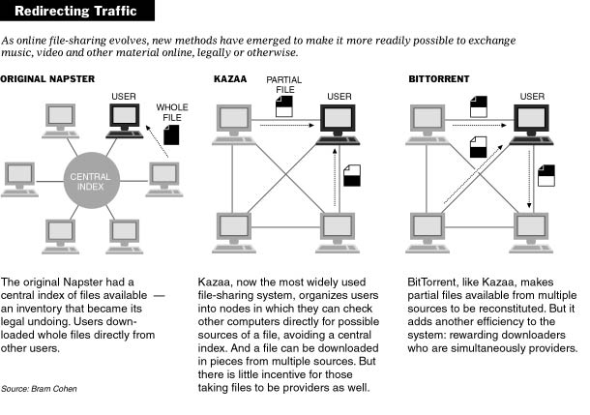
File Sharing

Slide 11
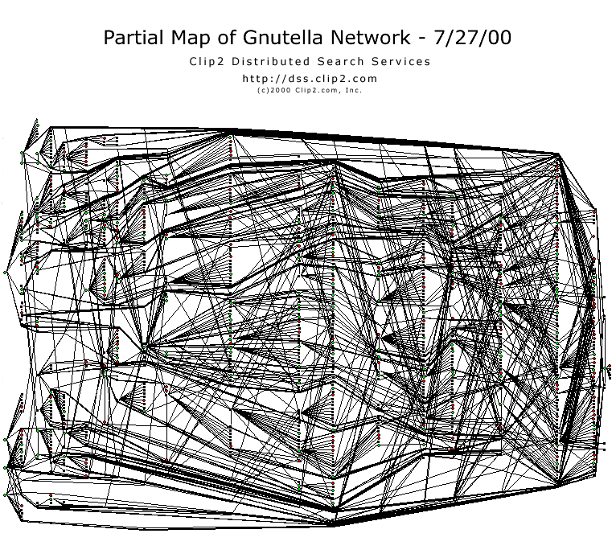
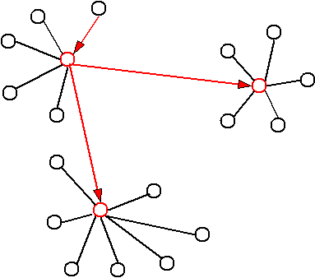
P2P Structure

Slide 12
Processes communicating
process: program running within a host
within same host, two processes communicate using inter-process communication (defined by OS)
processes in different hosts communicate by exchanging messages
clients, servers
client process: process that initiates communication
server process: process that waits to be contacted
aside: applications with P2P architectures have client processes & server processes

Slide 13

Sockets
process sends/receives messages to/from its socket
socket analogous to door
sending process shoves message out door
sending process relies on transport infrastructure on other side of door to deliver message to socket at receiving process
application
socket
application
controlled by
app developer
process
process
transport
transport
network
network
controlled
by OS
link
Internet
link
physical
physical

Slide 14
Addressing processes
to receive messages, process must have identifier
host device has unique 32-bit IP address
Q: does IP address of host on which process runs suffice for identifying the process?
identifier includes both IP address and port numbers associated with process on host.
example port numbers:
HTTP server: 80
mail server: 25
to send HTTP message to gaia.cs.umass.edu web server:
IP address: 128.119.245.12
port number: 80
more shortly…
A: no, many processes can be running on same host

Slide 15
App-layer protocol defines
types of messages exchanged,
e.g., request, response
message syntax:
what fields in messages & how fields are delineated
message semantics
meaning of information in fields
rules for when and how processes send & respond to messages
open protocols:
defined in RFCs
allows for interoperability
e.g., HTTP, SMTP
proprietary protocols:
e.g., Skype

Slide 16
What transport service does an app need?
data integrity
some apps (e.g., file transfer, web transactions) require 100% reliable data transfer
other apps (e.g., audio) can tolerate some loss
throughput
some apps (e.g., multimedia) require minimum amount of throughput to be “effective”
other apps (“elastic apps”) make use of whatever throughput they get
timing
some apps (e.g., Internet telephony, interactive games) require low delay to be “effective”
security
encryption, data integrity, …
application
application
process
process
transport
transport
network
network
link
Internet
link
physical
physical

Slide 17
Transport service requirements: common apps
application
file transfer
e-mail
Web documents
real-time audio/video
stored audio/video
interactive games
text messaging
data loss
no loss
no loss
no loss
loss-tolerant
loss-tolerant
loss-tolerant
no loss
throughput
elastic
elastic
elastic
audio: 5kbps-1Mbps
video:10kbps-5Mbps
same as above
few kbps up
elastic
time sensitive
no
no
no
yes, 100’s msec
yes, few secs
yes, 100’s msec
yes and no

Slide 18
Internet transport protocols services
TCP service:
reliable transport between sending and receiving process
flow control: sender won’t overwhelm receiver
congestion control: throttle sender when network overloaded
does not provide: timing, minimum throughput guarantee, security
UDP service:
unreliable data transfer between sending and receiving process
does not provide: reliability, flow control, congestion control, timing, throughput guarantee, security, orconnection setup,
Q: why bother? Why is there a UDP?

Slide 19
Internet apps: application, transport protocols
application
layer protocol
SMTP [RFC 2821]
Telnet [RFC 854]
HTTP [RFC 2616]
FTP [RFC 959]
HTTP (e.g., YouTube), RTP [RFC 1889]
SIP, RTP, proprietary
(e.g., Skype)
underlying
transport protocol
TCP
TCP
TCP
TCP
TCP or UDP
TCP or UDP
application
e-mail
remote terminal access
Web
file transfer
streaming multimedia
Internet telephony

Slide 20
Chapter 2: outline
2.1 principles of network applications
app architectures
app requirements
2.2 Web and HTTP
2.4 electronic mail
SMTP, POP3, IMAP
2.5 DNS
2.6 P2P applications
2.7 socket programming with UDP and TCP

Slide 21
Web and HTTP
First, a review…
web page consists of objects
object can be HTML file, JPEG image, Java applet, audio file,…
web page consists of base HTML-file which includes several referenced objects
each object is addressable by a URL, e.g.,
www.someschool.edu/someDept/pic.gif
host name
path name

Slide 22

HTTP overview
HTTP: hypertext transfer protocol
Web’s application layer protocol
client/server model
client: browser that requests, receives, (using HTTP protocol) and “displays” Web objects
server: Web server sends (using HTTP protocol) objects in response to requests
HTTP request
PC running
Firefox browser
HTTP response
HTTP request
server
running
Apache Web
server
HTTP response
iphone running
Safari browser

Slide 23
HTTP overview (continued)
uses TCP:
client initiates TCP connection (creates socket) to server, port 80

Slide 24
HTTP connections
non-persistent HTTP
at most one object sent over TCP connection
connection then closed
downloading multiple objects required multiple connections
persistent HTTP
multiple objects can be sent over single TCP connection between client, server

Slide 25
Non-persistent HTTP
suppose user enters URL:
(contains text,
references to 10
jpeg images)
www.someSchool.edu/someDepartment/home.index
1a. HTTP client initiates TCP connection to HTTP server (process) at www.someSchool.edu on port 80
1b. HTTP server at host www.someSchool.edu waiting for TCP connection at port 80. “accepts” connection, notifying client
2. HTTP client sends HTTP request message (containing URL) into TCP connection socket. Message indicates that client wants object someDepartment/home.index
3. HTTP server receives request message, forms response message containing requested object, and sends message into its socket
time

Slide 26
Non-persistent HTTP (cont.)
4. HTTP server closes TCP connection.
5. HTTP client receives response message containing html file, displays html. Parsing html file, finds 10 referenced jpeg objects
time
6. Steps 1-5 repeated for each of 10 jpeg objects

Slide 27
Non-persistent HTTP: response time
RTT (definition): time for a small packet to travel from client to server and back
HTTP response time:
one RTT to initiate TCP connection
one RTT for HTTP request and first few bytes of HTTP response to return
file transmission time
non-persistent HTTP response time =
2RTT+ file transmission time
initiate TCP
connection
RTT
request
file
RTT
time to
transmit
file
file
received
time
time

Slide 28
Persistent HTTP
non-persistent HTTP issues:
requires 2 RTTs per object
OS overhead for each TCP connection
browsers often open parallel TCP connections to fetch referenced objects
persistent HTTP:
server leaves connection open after sending response
subsequent HTTP messages between same client/server sent over open connection
client sends requests as soon as it encounters a referenced object
as little as one RTT for all the referenced objects

Slide 29
HTTP request message
two types of HTTP messages: request, response
HTTP request message:
ASCII (human-readable format)
carriage return character
request line
(GET, POST,
HEAD commands)
line-feed character
GET /index.html HTTP/1.1\r\n
Host: www-net.cs.umass.edu\r\n
User-Agent: Firefox/3.6.10\r\n
Accept: text/html,application/xhtml+xml\r\n
Accept-Language: en-us,en;q=0.5\r\n
Accept-Encoding: gzip,deflate\r\n
Accept-Charset: ISO-8859-1,utf-8;q=0.7\r\n
Keep-Alive: 115\r\n
Connection: keep-alive\r\n
\r\n
header
lines
carriage return,
line feed at start
of line indicates
end of header lines

Slide 30
HTTP request message: general format
method
sp
URL
sp
version
cr
lf
request
line
header field name
value
cr
lf
~
~
header
lines
~
~
header field name
value
cr
lf
cr
lf
~
entity body
~
body
~
~

Slide 31
Uploading form input
POST method:
web page often includes form input
input is uploaded to server in entity body
URL method:
uses GET method
input is uploaded in URL field of request line:
www.somesite.com/animalsearch?monkeys&banana

Slide 32
Method types
HTTP/1.0:
GET
POST
HEAD
asks server to leave requested object out of response
HTTP/1.1:
GET, POST, HEAD
PUT
uploads file in entity body to path specified in URL field
DELETE
deletes file specified in the URL field

Slide 33
HTTP response message
status line
(protocol
status code
status phrase)
HTTP/1.1 200 OK\r\n
Date: Sun, 26 Sep 2010 20:09:20 GMT\r\n
Server: Apache/2.0.52 (CentOS)\r\n
Last-Modified: Tue, 30 Oct 2007 17:00:02 GMT\r\n
ETag: "17dc6-a5c-bf716880"\r\n
Accept-Ranges: bytes\r\n
Content-Length: 2652\r\n
Keep-Alive: timeout=10, max=100\r\n
Connection: Keep-Alive\r\n
Content-Type: text/html; charset=ISO-8859-1\r\n
\r\n
data data data data data ...
header
lines
data, e.g.,
requested
HTML file

Slide 34
HTTP response status codes
status code appears in 1st line in server-to-client response message.
some sample codes:
200 OK
request succeeded, requested object later in this msg
301 Moved Permanently
requested object moved, new location specified later in this msg (Location:)
400 Bad Request
request msg not understood by server
404 Not Found
requested document not found on this server
505 HTTP Version Not Supported

Slide 35
Trying out HTTP (client side) for yourself
use Wireshark to look at captured HTTP request/response

Slide 36
User-server state: cookies
many Web sites use cookies
four components:
1) cookie header line of HTTP response message
2) cookie header line in next HTTP request message
3) cookie file kept on user’s host, managed by user’s browser
4) back-end database at Web site

Slide 37
Cookies: keeping “state” (cont.)
client
server
ebay 8734
usual http request msg
Amazon server
creates ID
1678 for user
cookie file
usual http response
set-cookie: 1678
backend
database
create
entry
ebay 8734
amazon 1678
usual http request msg
cookie: 1678
cookie-
specific
action
access
usual http response msg
one week later:
access
ebay 8734
amazon 1678
usual http request msg
cookie: 1678
cookie-
specific
action
usual http response msg

Slide 38
Cookies (continued)
aside
what cookies can be used for:
shopping carts
recommendations
user session state (Web e-mail)
cookies and privacy:
cookies permit sites to learn a lot about you
how to keep “state”:
cookies: http messages carry state

Slide 39

Web caches (proxy server)
goal: satisfy client request without involving origin server
user sets browser: Web accesses via cache
browser sends all HTTP requests to cache
object in cache: cache returns object
else cache requests object from origin server, then returns object to client
proxy
server
HTTP request
HTTP request
client
origin
server
HTTP response
HTTP response
HTTP request
HTTP response
client
origin
server

Slide 40
More about Web caching
cache acts as both client and server
server for original requesting client
client to origin server
typically cache is installed by ISP (university, company, residential ISP)
why Web caching?
reduce response time for client request
reduce traffic on an institution’s access link
Internet dense with caches: enables “poor” content providers to effectively deliver content

Slide 41

Caching example:
assumptions:
avg object size: 100K bits
avg request rate from browsers to origin servers:15/sec
avg data rate to browsers: 1.50 Mbps
RTT from institutional router to any origin server: 2 sec
access link rate: 1.54 Mbps
consequences:
LAN utilization: 15%
access link utilization = 99%
total delay = Internet delay + access delay + LAN delay
= 2 sec + minutes + usecs
origin
servers
public
Internet
1.54 Mbps
access link
problem!
institutional
network
1 Gbps LAN

Slide 42
Caching example: fatter access link
assumptions:
avg object size: 100K bits
avg request rate from browsers to origin servers:15/sec
avg data rate to browsers: 1.50 Mbps
RTT from institutional router to any origin server: 2 sec
access link rate: 1.54 Mbps
consequences:
LAN utilization: 15%
access link utilization = 99%
total delay = Internet delay + access delay + LAN delay
= 2 sec + minutes + usecs
origin
servers
public
Internet
154 Mbps
1.54 Mbps
access link
154 Mbps
institutional
network
9.9%
1 Gbps LAN
msecs
Cost: increased access link speed (not cheap!)

Slide 43
Caching example: install local cache
assumptions:
avg object size: 100K bits
avg request rate from browsers to origin servers:15/sec
avg data rate to browsers: 1.50 Mbps
RTT from institutional router to any origin server: 2 sec
access link rate: 1.54 Mbps
consequences:
LAN utilization: 15%
access link utilization = 100%
total delay = Internet delay + access delay + LAN delay
= 2 sec + minutes + usecs
origin
servers
public
Internet
1.54 Mbps
access link
institutional
network
?
1 Gbps LAN
?
local web
cache
How to compute link
utilization, delay?
Cost: web cache (cheap!)

Slide 44
Caching example: install local cache
Calculating access link utilization, delay with cache:
suppose cache hit rate is 0.4
40% requests satisfied at cache, 60% requests satisfied at origin
origin
servers
public
Internet
access link utilization:
60% of requests use access link
data rate to browsers over access link = 0.6*1.50 Mbps = .9 Mbps
utilization = 0.9/1.54 = .58
1.54 Mbps
access link
institutional
network
total delay
= 0.6 * (delay from origin servers) +0.4 * (delay when satisfied at cache)
= 0.6 (2.01) + 0.4 (~msecs)
= ~ 1.2 secs
less than with 154 Mbps link (and cheaper too!)
1 Gbps LAN
local web
cache

Slide 45
Conditional GET
client
server
Goal: don’t send object if cache has up-to-date cached version
no object transmission delay
lower link utilization
cache: specify date of cached copy in HTTP request
If-modified-since: <date>
server: response contains no object if cached copy is up-to-date:
HTTP/1.0 304 Not Modified
HTTP request msg
If-modified-since: <date>
object
not
modified
before
<date>
HTTP response
HTTP/1.0
304 Not Modified
HTTP request msg
If-modified-since: <date>
object
modified
after
<date>
HTTP response
HTTP/1.0 200 OK
<data>

Slide 46
Chapter 2: outline
2.1 principles of network applications
app architectures
app requirements
2.2 Web and HTTP
2.4 electronic mail
SMTP, POP3, IMAP
2.5 DNS
2.6 P2P applications
2.7 socket programming with UDP and TCP

Slide 47
Electronic mail
outgoing
message queue
user mailbox
Three major components:
user agents
mail servers
simple mail transfer protocol (SMTP) and mail access protocols (POP, IMAP)
User Agent
Outlook, iPhone mail client, browser, etc.
user
agent
mail
server
user
agent
SMTP
mail
server
user
agent
SMTP
SMTP
user
agent
mail
server
user
agent
user
agent

Slide 48
Electronic mail: mail servers
mail servers:
mailbox contains incoming messages for user
message queue of outgoing (to be sent) mail messages
SMTP protocol between mail servers to send email messages
client: sending mail server
“server”: receiving mail server
user
agent
mail
server
user
agent
SMTP
mail
server
user
agent
SMTP
SMTP
user
agent
mail
server
user
agent
user
agent

Slide 49
Electronic Mail: SMTP [RFC 2821]
uses TCP to reliably transfer email message from client to server, port 25

Slide 50


Scenario: Alice sends message to Bob
1) Alice uses UA to compose message “to” bob@cs.mit.edu
2) Alice’s UA sends message to her mail server; message placed in message queue
3) client side of SMTP opens TCP connection with Bob’s mail server
4) SMTP client sends Alice’s message over the TCP connection
5) Bob’s mail server places the message in Bob’s mailbox
6) Bob invokes his user agent to read message
user
agent
mail
server
user
agent
1
mail
server
2
3
6
4
Alice’s mail server
5
Bob’s mail server

Slide 51
Sample SMTP interaction
S: 220 hamburger.edu
C: HELO crepes.fr
S: 250 Hello crepes.fr, pleased to meet you
C: MAIL FROM: <alice@crepes.fr>
S: 250 alice@crepes.fr... Sender ok
C: RCPT TO: <bob@hamburger.edu>
S: 250 bob@hamburger.edu ... Recipient ok
C: DATA
S: 354 Enter mail, end with "." on a line by itself
C: Do you like ketchup?
C: How about pickles?
C: .
S: 250 Message accepted for delivery
C: QUIT
S: 221 hamburger.edu closing connection

Slide 52
Mail access protocols
user
agent
mail access
protocol
user
agent
SMTP
SMTP
(e.g., POP,
IMAP)
sender’s mail
server
receiver’s mail
server
SMTP: delivery/storage to receiver’s server
mail access protocol: retrieval from server
POP: Post Office Protocol [RFC 1939]: authorization, download
IMAP: Internet Mail Access Protocol [RFC 1730]: more features, including manipulation of stored msgs on server
HTTP: gmail, Hotmail, Yahoo! Mail, etc.

Slide 53
POP3 protocol
S: +OK POP3 server ready
C: user bob
S: +OK
C: pass hungry
S: +OK user successfully logged on
authorization phase
client commands:
user: declare username
pass: password
server responses
+OK
-ERR
transaction phase, client:
list: list message numbers
retr: retrieve message by number
dele: delete
quit
C: list
S: 1 498
S: 2 912
S: .
C: retr 1
S: <message 1 contents>
S: .
C: dele 1
C: retr 2
S: <message 1 contents>
S: .
C: dele 2
C: quit
S: +OK POP3 server signing off

Slide 54
ports
POP3 - port 110
IMAP - port 143
SMTP - port 25
HTTP - port 80
Secure SMTP (SSMTP) - port 465
Secure IMAP (IMAP4-SSL) - port 585
IMAP4 over SSL (IMAPS) - port 993
Secure POP3 (SSL-POP) - port 995
telnet www.google.com 80
telnet mail.cise.ufl.edu 465
telnet imap.ufl.edu 143

Slide 55
Chapter 2: outline
2.1 principles of network applications
app architectures
app requirements
2.2 Web and HTTP
2.3 FTP
2.4 electronic mail
SMTP, POP3, IMAP
2.5 DNS
2.6 P2P applications
2.7 socket programming with UDP and TCP

Slide 56
DNS: services, structure
DNS services
hostname to IP address translation
host aliasing
canonical, alias names
mail server aliasing
load distribution
replicated Web servers: many IP addresses correspond to one name
why not centralize DNS?
single point of failure
traffic volume
distant centralized database
maintenance
A: doesn’t scale!

Slide 57
DNS: a distributed, hierarchical database
Root DNS Servers
…
…
com DNS servers
org DNS servers
edu DNS servers
yahoo.com
DNS servers
pbs.org
DNS servers
poly.edu
DNS servers
umass.edu
DNS servers
amazon.com
DNS servers
client wants IP for www.amazon.com; 1st approx:
client queries root server to find com DNS server
client queries .com DNS server to get amazon.com DNS server
client queries amazon.com DNS server to get IP address for www.amazon.com

Slide 58
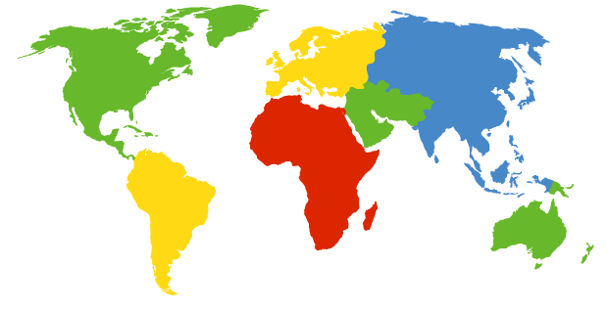
DNS: root name servers
contacted by local name server that can not resolve name
root name server:
contacts authoritative name server if name mapping not known
gets mapping
returns mapping to local name server
c. Cogent, Herndon, VA (5 other sites)
d. U Maryland College Park, MD
h. ARL Aberdeen, MD
j. Verisign, Dulles VA (69 other sites )
k. RIPE London (17 other sites)
i. Netnod, Stockholm (37 other sites)
e. NASA Mt View, CA
f. Internet Software C.
Palo Alto, CA (and 48 other sites)
m. WIDE Tokyo
(5 other sites)
13 root name “servers” worldwide
a. Verisign, Los Angeles CA
(5 other sites)
b. USC-ISI Marina del Rey, CA
l. ICANN Los Angeles, CA
(41 other sites)
g. US DoD Columbus, OH (5 other sites)

Slide 59
TLD, authoritative servers
top-level domain (TLD) servers:
responsible for com, org, net, edu, aero, jobs, museums, and all top-level country domains, e.g.: uk, fr, ca, jp
Network Solutions maintains servers for .com TLD
Educause for .edu TLD
authoritative DNS servers:
organization’s own DNS server(s), providing authoritative hostname to IP mappings for organization’s named hosts
can be maintained by organization or service provider

Slide 60
Local DNS name server
does not strictly belong to hierarchy
each ISP (residential ISP, company, university) has one
also called “default name server”
when host makes DNS query, query is sent to its local DNS server
has local cache of recent name-to-address translation pairs (but may be out of date!)
acts as proxy, forwards query into hierarchy

Slide 61
DNS name resolution example
root DNS server
2
host at cis.poly.edu wants IP address for gaia.cs.umass.edu
3
TLD DNS server
4
5
iterated query:
contacted server replies with name of server to contact
“I don’t know this name, but ask this server”
local DNS server
dns.poly.edu
7
6
1
8
authoritative DNS server
dns.cs.umass.edu
requesting host
cis.poly.edu
gaia.cs.umass.edu

Slide 62
DNS name resolution example
root DNS server
2
3
recursive query:
puts burden of name resolution on contacted name server
heavy load at upper levels of hierarchy?
7
6
TLD DNS
server
local DNS server
dns.poly.edu
5
4
1
8
authoritative DNS server
dns.cs.umass.edu
requesting host
cis.poly.edu
gaia.cs.umass.edu

Slide 63
DNS: caching, updating records
once (any) name server learns mapping, it caches mapping
cache entries timeout (disappear) after some time (TTL)
TLD servers typically cached in local name servers
thus root name servers not often visited
cached entries may be out-of-date (best effort name-to-address translation!)
if name host changes IP address, may not be known Internet-wide until all TTLs expire
update/notify mechanisms proposed IETF standard
RFC 2136

Slide 64
DNS records
DNS: distributed db storing resource records (RR)
RR format: (name, value, type, ttl)
type=A
name is hostname
value is IP address
type=CNAME
name is alias name for some “canonical” (the real) name
www.ibm.com is really
servereast.backup2.ibm.com
value is canonical name
type=NS
name is domain (e.g., foo.com)
value is hostname of authoritative name server for this domain
type=MX
value is name of mailserver associated with name

Slide 65
DNS protocol, messages
query and reply messages, both with same message format
2 bytes
2 bytes
msg header
identification: 16 bit # for query, reply to query uses same #
flags:
query or reply
recursion desired
recursion available
reply is authoritative
identification
flags
# questions
# answer RRs
# authority RRs
# additional RRs
questions (variable # of questions)
answers (variable # of RRs)
authority (variable # of RRs)
additional info (variable # of RRs)

Slide 66
DNS protocol, messages
2 bytes
2 bytes
identification
flags
# questions
# answer RRs
# authority RRs
# additional RRs
name, type fields
for a query
questions (variable # of questions)
RRs in response
to query
answers (variable # of RRs)
records for
authoritative servers
authority (variable # of RRs)
additional “helpful”
info that may be used
additional info (variable # of RRs)

Slide 67
Inserting records into DNS
example: new startup “Network Utopia”
register name networkuptopia.com at DNS registrar (e.g., Network Solutions)
provide names, IP addresses of authoritative name server (primary and secondary)
registrar inserts two RRs into .com TLD server: (networkutopia.com, dns1.networkutopia.com, NS)
(dns1.networkutopia.com, 212.212.212.1, A)
create authoritative server type A record for www.networkuptopia.com; type MX record for networkutopia.com

Slide 68
Attacking DNS
DDoS attacks
Bombard root servers with traffic
Not successful to date
Traffic Filtering
Local DNS servers cache IPs of TLD servers, allowing root server bypass
Bombard TLD servers
Potentially more dangerous
Redirect attacks
Man-in-middle
Intercept queries
DNS poisoning
Send bogus relies to DNS server, which caches
Exploit DNS for DDoS
Send queries with spoofed source address: target IP
Requires amplification

Slide 69
Chapter 2: outline
2.1 principles of network applications
app architectures
app requirements
2.2 Web and HTTP
2.3 FTP
2.4 electronic mail
SMTP, POP3, IMAP
2.5 DNS
2.6 P2P applications
2.7 socket programming with UDP and TCP

Slide 70
Pure P2P architecture
no always-on server
arbitrary end systems directly communicate
peers are intermittently connected and change IP addresses
examples:
file distribution (BitTorrent)
Streaming (KanKan)
VoIP (Skype)

Slide 71
File distribution: client-server vs P2P
Question: how much time to distribute file (size F) from one server to N peers?
peer upload/download capacity is limited resource
u_{s}: server upload capacity
u₁
d_{i}: peer i download capacity
file, size F
u_{s}
d₁
u₂
d₂
server
d_{i}
u_{N}
network (with abundant
bandwidth)
u_{i}
d_{N}
u_{i}: peer i upload capacity

Slide 72
File distribution time: client-server
server transmission: must sequentially send (upload) N file copies:
time to send one copy: F/u_{s}
time to send N copies: NF/u_{s}
F
u_{s}
d_{i}
network
u_{i}
client: each client must download file copy
d_{min} = min client download rate
min client download time: F/d_{min}
time to distribute F
to N clients using
client-server approach
D_{c-s} > max{NF/u_{s,},F/d_{min}}
increases linearly in N

Slide 73
File distribution time: P2P
server transmission: must upload at least one copy
time to send one copy: F/u_{s}
F
u_{s}
d_{i}
client: each client must download file copy
min client download time: F/d_{min}
network
u_{i}
clients: as aggregate must download NF bits
max upload rate (limting max download rate) is u_{s} + Σu_{i}
time to distribute F
to N clients using
P2P approach
D_{P2P} > max{F/u_{s,},F/d_{min,},NF/(u_{s} + Σu_{i})}
increases linearly in N …
… but so does this, as each peer brings service capacity

Slide 74
Client-server vs. P2P: example
client upload rate = u, F/u = 1 hour, u_{s} = 10u, d_{min} ≥ u_{s}

Slide 75

P2P file distribution: BitTorrent
file divided into 256Kb chunks
peers in torrent send/receive file chunks
tracker: tracks peers
participating in torrent
torrent: group of peers exchanging chunks of a file
Alice arrives …
… obtains list
of peers from tracker
… and begins exchanging
file chunks with peers in torrent

Slide 76


P2P file distribution: BitTorrent
peer joining torrent:
has no chunks, but will accumulate them over time from other peers
registers with tracker to get list of peers, connects to subset of peers (“neighbors”)
while downloading, peer uploads chunks to other peers
peer may change peers with whom it exchanges chunks
churn: peers may come and go
once peer has entire file, it may (selfishly) leave or (altruistically) remain in torrent

Slide 77
BitTorrent: requesting, sending file chunks
requesting chunks:
at any given time, different peers have different subsets of file chunks
periodically, Alice asks each peer for list of chunks that they have
Alice requests missing chunks from peers, rarest first
sending chunks: tit-for-tat
Alice sends chunks to those four peers currently sending her chunks at highest rate
other peers are choked by Alice (do not receive chunks from her)
re-evaluate top 4 every10 secs
every 30 secs: randomly select another peer, starts sending chunks
“optimistically unchoke” this peer
newly chosen peer may join top 4

Slide 78
BitTorrent: tit-for-tat
(1) Alice “optimistically unchokes” Bob
(2) Alice becomes one of Bob’s top-four providers; Bob reciprocates
(3) Bob becomes one of Alice’s top-four providers
higher upload rate: find better trading partners, get file faster !

Slide 79
Distributed Hash Table (DHT)
DHT: a distributed P2P database
database has (key, value) pairs; examples:
key: ss number; value: human name
key: movie title; value: IP address
Distribute the (key, value) pairs over the (millions of peers)
a peer queries DHT with key
DHT returns values that match the key
peers can also insert (key, value) pairs
Application 2-79

Slide 80
Q: how to assign keys to peers?
central issue:
assigning (key, value) pairs to peers.
basic idea:
convert each key to an integer
Assign integer to each peer
put (key,value) pair in the peer that is closest to the key
Application 2-80

Slide 81
DHT identifiers
assign integer identifier to each peer in range [0,2^{n}-1] for some n.
each identifier represented by n bits.
require each key to be an integer in same range
to get integer key, hash original key
e.g., key = hash(“Led Zeppelin IV”)
this is why its is referred to as a distributed “hash” table
Application 2-81

Slide 82
Assign keys to peers
rule: assign key to the peer that has the closest ID.
convention in lecture: closest is the immediate successor of the key.
e.g., n=4; peers: 1,3,4,5,8,10,12,14;
key = 13, then successor peer = 14
key = 15, then successor peer = 1
Application 2-82

Slide 83
Circular DHT (1)
1
3
15
4
12
5
10
8
each peer only aware of immediate successor and predecessor.
“overlay network”
Application 2-83

Slide 84
Circular DHT (1)
O(N) messages
on avgerage to resolve
query, when there
are N peers
0001
Who’s responsible
for key 1110 ?
I am
0011
1111
1110
1110
0100
1110
1100
1110
0101
1110
Define closest as closest successor
1110
1010
1000
Application 2-84

Slide 85
Circular DHT with shortcuts
1
Who’s responsible
for key 1110?
3
15
4
12
5
10
8
each peer keeps track of IP addresses of predecessor, successor, short cuts.
reduced from 6 to 2 messages.
possible to design shortcuts so O(log N) neighbors, O(log N) messages in query
Application 2-85

Slide 86
Peer churn
handling peer churn:
peers may come and go (churn)
each peer knows address of its two successors
each peer periodically pings its two successors to check aliveness
if immediate successor leaves, choose next successor as new immediate successor
1
3
15
4
12
5
10
8
example: peer 5 abruptly leaves
peer 4 detects peer 5 departure; makes 8 its immediate successor; asks 8 who its immediate successor is; makes 8’s immediate successor its second successor.
what if peer 13 wants to join?
Application 2-86

Slide 87
Chapter 2: outline
2.1 principles of network applications
app architectures
app requirements
2.2 Web and HTTP
2.3 FTP
2.4 electronic mail
SMTP, POP3, IMAP
2.5 DNS
2.6 P2P applications
2.7 socket programming with UDP and TCP

Slide 88
Socket programming
goal: learn how to build client/server applications that communicate using sockets
socket: door between application process and end-end-transport protocol
application
socket
application
controlled by
app developer
process
process
transport
transport
network
network
controlled
by OS
link
Internet
link
physical
physical

Slide 89
Socket programming
Two socket types for two transport services:
UDP: unreliable datagram
TCP: reliable, byte stream-oriented
Application Example:
Client reads a line of characters (data) from its keyboard and sends the data to the server.
The server receives the data and converts characters to uppercase.
The server sends the modified data to the client.
The client receives the modified data and displays the line on its screen.

Slide 90
Socket programming with UDP
UDP: no “connection” between client & server
no handshaking before sending data
sender explicitly attaches IP destination address and port # to each packet
rcvr extracts sender IP address and port# from received packet
UDP: transmitted data may be lost or received out-of-order
Application viewpoint:
UDP provides unreliable transfer of groups of bytes (“datagrams”) between client and server

Slide 91
Client/server socket interaction: UDP
server (running on serverIP)
client
create socket:
create socket, port= x:
clientSocket =
socket(AF_INET,SOCK_DGRAM)
serverSocket =
socket(AF_INET,SOCK_DGRAM)
Create datagram with server IP and
port=x; send datagram via clientSocket
read datagram from
serverSocket
write reply to
serverSocket
specifying client address,
port number
read datagram from
clientSocket
close
clientSocket
Application 2-91

Slide 92
Example app: UDP client
Python UDPClient
include Python’s socket
library
from socket import *
serverName = ‘hostname’
serverPort = 12000
clientSocket = socket(socket.AF_INET,
socket.SOCK_DGRAM)
message = raw_input(’Input lowercase sentence:’)
clientSocket.sendto(message,(serverName, serverPort))
modifiedMessage, serverAddress =
clientSocket.recvfrom(2048)
print modifiedMessage
clientSocket.close()
create UDP socket for server
get user keyboard
input
Attach server name, port to message; send into socket
read reply characters from
socket into string
print out received string and close socket

Slide 93
Example app: UDP server
Python UDPServer
from socket import *
serverPort = 12000
serverSocket = socket(AF_INET, SOCK_DGRAM)
serverSocket.bind(('', serverPort))
print “The server is ready to receive”
while 1:
message, clientAddress = serverSocket.recvfrom(2048)
modifiedMessage = message.upper()
serverSocket.sendto(modifiedMessage, clientAddress)
create UDP socket
bind socket to local port number 12000
loop forever
Read from UDP socket into message, getting client’s address (client IP and port)
send upper case string back to this client

Slide 94
Socket programming with TCP
client must contact server
server process must first be running
server must have created socket (door) that welcomes client’s contact
client contacts server by:
Creating TCP socket, specifying IP address, port number of server process
when client creates socket: client TCP establishes connection to server TCP
when contacted by client, server TCP creates new socket for server process to communicate with that particular client
allows server to talk with multiple clients
source port numbers used to distinguish clients (more in Chap 3)
application viewpoint:
TCP provides reliable, in-order
byte-stream transfer (“pipe”)
between client and server

Slide 95
Client/server socket interaction: TCP
server (running on hostid)
client
create socket,
port=x, for incoming request:
serverSocket = socket()
wait for incoming
connection request
TCP
connection setup
create socket,
connect to hostid, port=x
connectionSocket =
serverSocket.accept()
clientSocket = socket()
send request using
clientSocket
read request from
connectionSocket
write reply to
connectionSocket
read reply from
clientSocket
close
connectionSocket
close
clientSocket

Slide 96
Example app: TCP client
Python TCPClient
from socket import *
serverName = ’servername’
serverPort = 12000
clientSocket = socket(AF_INET, SOCK_STREAM)
clientSocket.connect((serverName,serverPort))
sentence = raw_input(‘Input lowercase sentence:’)
clientSocket.send(sentence)
modifiedSentence = clientSocket.recv(1024)
print ‘From Server:’, modifiedSentence
clientSocket.close()
create TCP socket for server, remote port 12000
No need to attach server name, port

Slide 97
Example app: TCP server
Python TCPServer
from socket import *
serverPort = 12000
serverSocket = socket(AF_INET,SOCK_STREAM)
serverSocket.bind((‘’,serverPort))
serverSocket.listen(1)
print ‘The server is ready to receive’
while 1:
connectionSocket, addr = serverSocket.accept()
sentence = connectionSocket.recv(1024)
capitalizedSentence = sentence.upper()
connectionSocket.send(capitalizedSentence)
connectionSocket.close()
create TCP welcoming
socket
server begins listening for incoming TCP requests
loop forever
server waits on accept()
for incoming requests, new socket created on return
read bytes from socket (but not address as in UDP)
close connection to this client (but not welcoming socket)

Slide 98
Chapter 2: summary
our study of network apps now complete!
application architectures
client-server
P2P
application service requirements:
reliability, bandwidth, delay
Internet transport service model
connection-oriented, reliable: TCP
unreliable, datagrams: UDP
specific protocols:
HTTP
FTP
SMTP, POP, IMAP
DNS
P2P: BitTorrent, DHT
socket programming: TCP, UDP sockets

Slide 99
Chapter 2: summary
most importantly: learned about protocols!
typical request/reply message exchange:
client requests info or service
server responds with data, status code
message formats:
headers: fields giving info about data
data: info being communicated
important themes:
control vs. data msgs
in-band, out-of-band
centralized vs. decentralized
stateless vs. stateful
reliable vs. unreliable msg transfer
“complexity at network edge”

