Slide 1

AI-POWERED INTELLIGENT AGENT
for Personalized Human–Computer Interaction
Designing Adaptive, Context-Aware Interfaces Through AI-Driven Personalization
Presented by:
M SHAKTHI(192312538)
ECE

Slide 2




Introduction & Motivation
Modern users interact with technology across countless apps, devices, and contexts every day — yet most systems still treat every user the same way.
An intelligent agent that learns individual preferences, habits, and context can make interactions faster, more intuitive, and more satisfying.
This project explores an AI-powered agent that continuously adapts the human–computer interaction experience to each user.
Human ⇄ Agent
A continuous feedback loop where the agent observes, learns, and adapts to every user interaction in real time.
73%
2x
24/7
of users expect
personalized experiences
higher engagement with
adaptive interfaces
continuous learning
from user behavior
Observe
Learn
Adapt
AI-Powered Intelligent Agent for Personalized HCI
2

Slide 3



Problem Statement
Existing human–computer interfaces largely rely on static, one-size-fits-all designs — leading to friction and disengagement.
Generic Interfaces
No Contextual Awareness
Repetitive Manual Effort
Weak Personalization
Same layout and responses for every user, regardless of skill level or intent.
Systems ignore situational factors like time, location, or task urgency.
Users repeat the same settings and preferences across sessions and devices.
Limited or shallow user modeling fails to capture evolving preferences.
AI-Powered Intelligent Agent for Personalized HCI
3

Slide 4


Project Objectives
Build an Adaptive Agent
Design an AI agent capable of learning individual user behavior and preferences over time.
Model User Context
Capture context such as intent, history, device, and environment to personalize responses.
Enable Dynamic UI Adaptation
Adjust interface layout, content, and recommendations based on the learned user model.
Support Continuous Learning
Incorporate real-time feedback loops so the agent improves with every interaction.
AI-Powered Intelligent Agent for Personalized HCI
4

Slide 5


Proposed System Architecture
User
Interaction
Data
Collection
AI / ML
Engine
Personalization
Engine
Adaptive
Interface
Voice, text, gesture, touch
Behavior, context, history
NLU, modeling, inference
Adaptive rules & ranking
Personalized output
Continuous Feedback Loop — the agent refines its user model with every interaction
AI-Powered Intelligent Agent for Personalized HCI
5

Slide 6

Key Components of the Intelligent Agent
Natural Language Understanding
User Modeling Module
Interprets user intent from speech and text to enable conversational interaction.
Builds and updates a dynamic profile of preferences, habits, and skill level.
Recommendation Engine
Adaptive Interface Controller
Ranks content, actions, and suggestions tailored to the current user context.
Reconfigures layout, tone, and content density to match user needs in real time.
AI-Powered Intelligent Agent for Personalized HCI
6

Slide 7
Personalization Techniques
Behavioral Analysis
Context Awareness
Preference Learning
Reinforcement Feedback
Tracks clicks, navigation paths, and usage patterns to infer preferences.
Uses time, location, and device signals to tailor responses to the situation.
Applies collaborative and content-based filtering to refine recommendations.
Rewards actions that improve satisfaction, reinforcing better agent behavior.
AI-Powered Intelligent Agent for Personalized HCI
7

Slide 8
Methodology & Workflow
01
1
02
2
03
3
04
4
Data Collection
Model Training
Personalized Interaction
Feedback & Refinement
Gather interaction logs, preferences, and contextual signals from users.
Train NLU and user-modeling components on collected behavioral data.
Agent responds and adapts the interface using the learned user model.
User feedback and outcomes are fed back to continuously improve the model.
AI-Powered Intelligent Agent for Personalized HCI
8

Slide 9

Technology Stack
NLU / NLP Layer
Language models for intent detection, entity extraction, and dialogue management.
Machine Learning Layer
Supervised & reinforcement learning models for user modeling and ranking.
Data & Storage Layer
User profiles, interaction logs, and preference stores for fast retrieval.
Cloud & Deployment Layer
Scalable APIs and services delivering real-time personalized responses.
AI-Powered Intelligent Agent for Personalized HCI
9

Slide 10




Real-World Applications
Virtual Assistants
E-Learning Platforms
Healthcare Support
Smart Home Systems
Customer Service
Conversational agents that adapt tone and suggestions to the user.
Personalized pacing and content based on learner progress.
Adaptive patient interfaces tuned to individual needs and literacy.
Interfaces that adjust to household routines and preferences.
Context-aware support that personalizes resolutions and tone.
AI-Powered Intelligent Agent for Personalized HCI
10

Slide 11

Advantages & Challenges
Advantages
Challenges
Faster, more intuitive interactions tailored to each user
Ensuring user privacy while collecting behavioral data
Higher engagement and user satisfaction over time
Avoiding bias in learned preferences and recommendations
Reduced repetitive configuration and manual input
Maintaining transparency in adaptive decision-making
Scales personalization across many users automatically
Balancing personalization with system performance
AI-Powered Intelligent Agent for Personalized HCI
11

Slide 12

Conclusion & Future Scope
An AI-powered intelligent agent that learns from user behavior and context can transform static interfaces into responsive, personalized experiences — improving usability, satisfaction, and efficiency across domains.
Multimodal Interaction
Federated Learning
Cross-Device Continuity
Combine voice, gesture, and gaze for richer personalization.
Personalize models while preserving user data privacy.
Carry a single adaptive profile seamlessly across devices.
AI-Powered Intelligent Agent for Personalized HCI
12

Slide 13
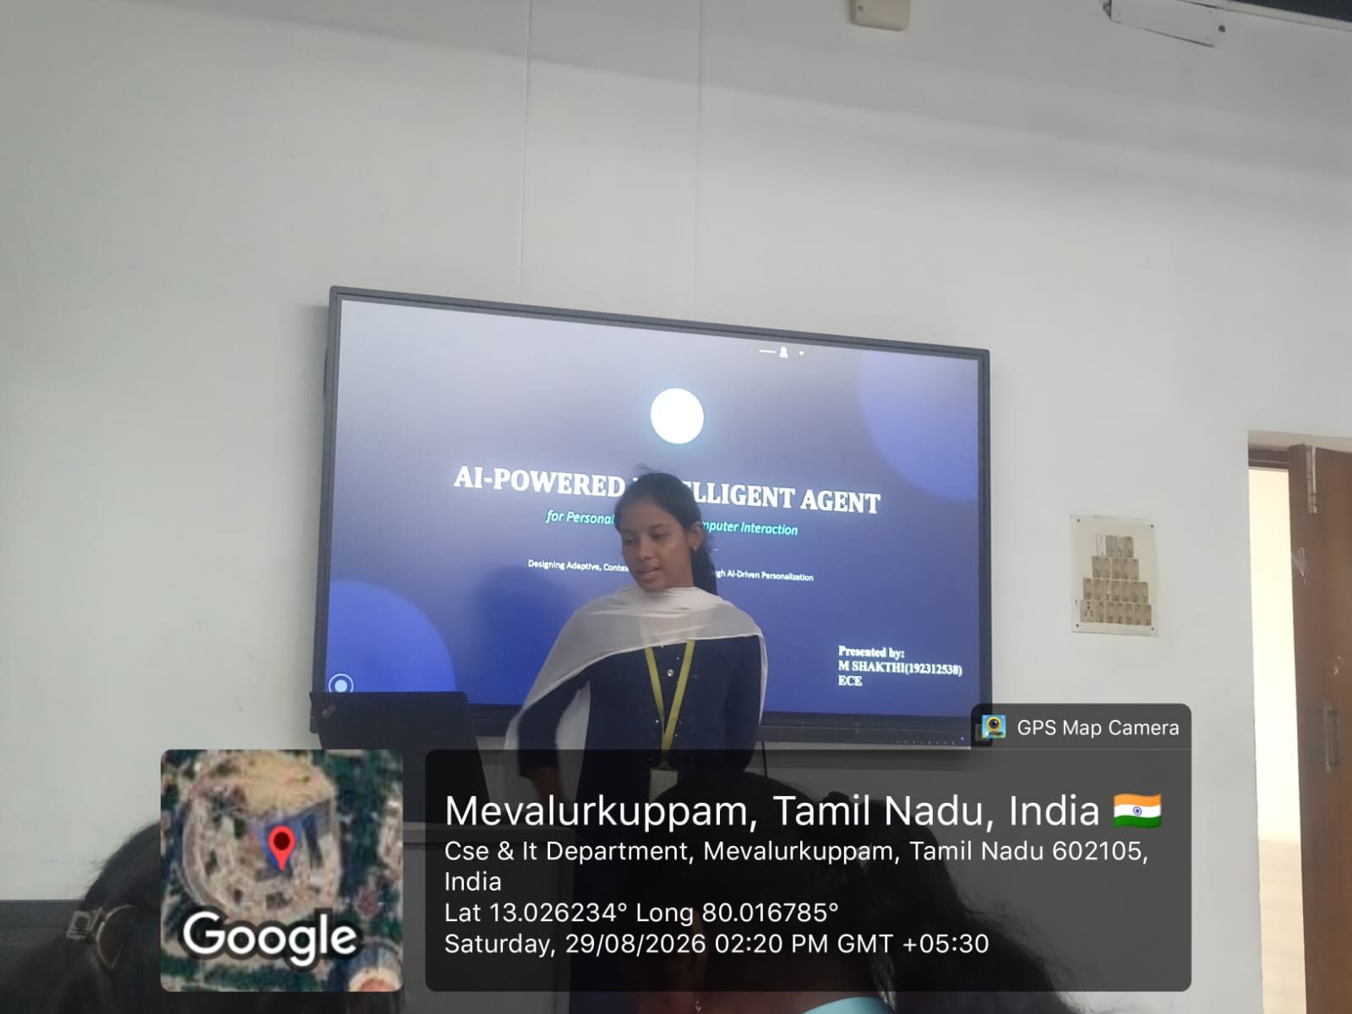
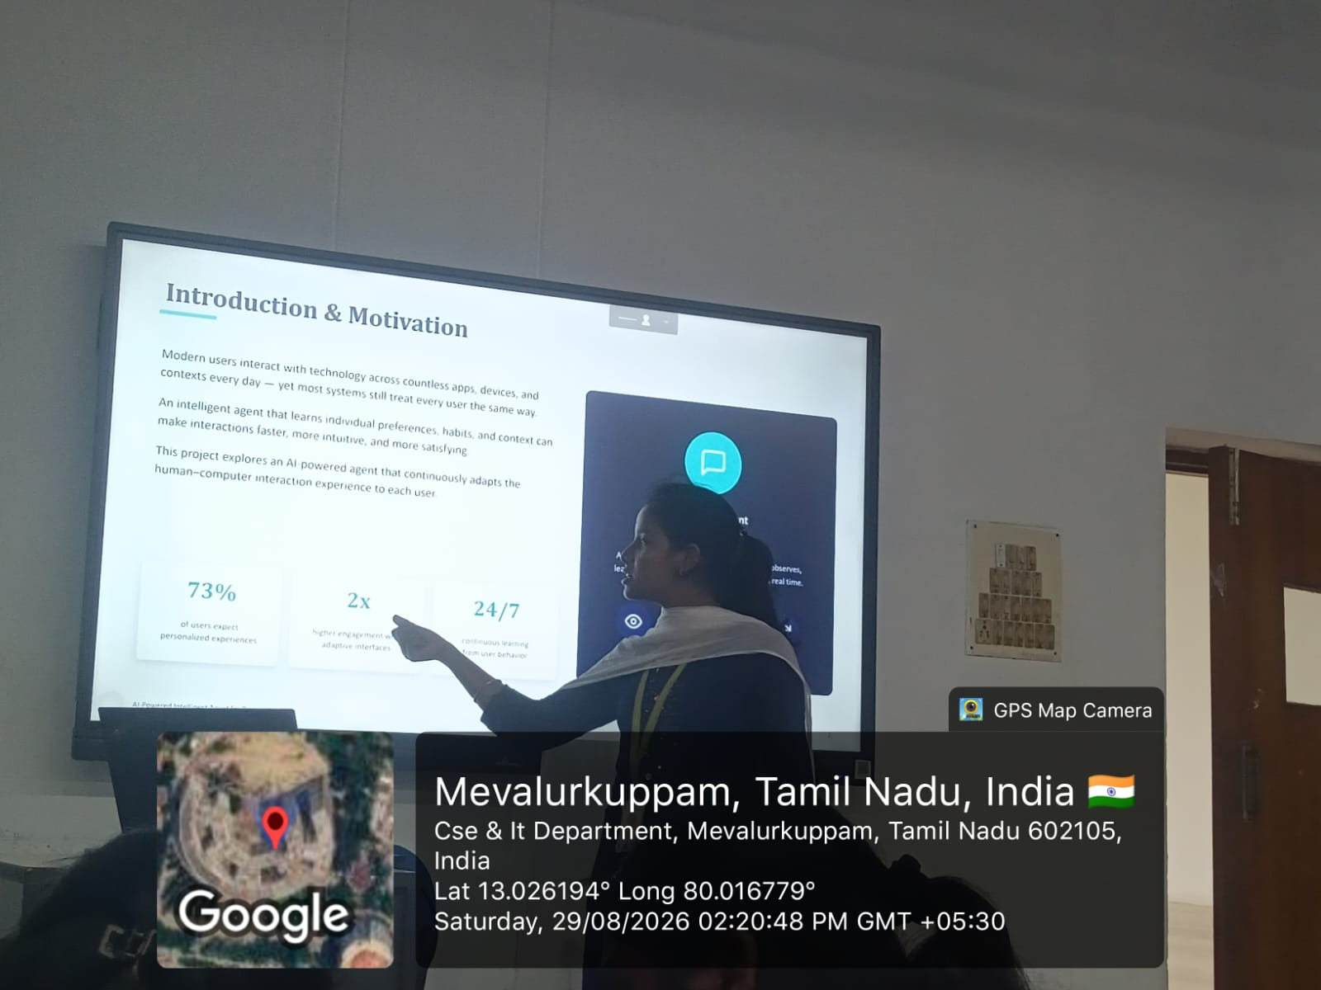

Slide 14

Thank You
Questions & Discussion

