Slide 1

DEPARTMENT OF CSE (ARTIFICIAL INTELLIGENCE AND MACHINE LEARNING) ACADEMIC YEAR 2025 - 2026 SEMESTER III ARTIFICIAL INTELLIGENCE LABORATORY MINI PROJECT REVIEW AI-Based Smart Home Energy Saver
REGISTER NUMBER | 2117240030139
NAME | SHAKTHI DHARSHNI C R
YEAR | II
SECTION | C
FACULTY IN-CHARGE | Mrs.M. BHAVANI

Slide 2
PROBLEM STATEMENT
Increasing energy consumption in homes leads to high electricity bills and resource wastage.
Manual control of appliances often causes lights or fans to remain ON unnecessarily.
Lack of intelligent monitoring systems results in inefficient energy usage.
Users have limited awareness or time to manage appliances effectively.
There is a need for an AI-based automated system to optimize energy use and reduce human effort.

Slide 3
THEORETICAL BACKGROUND
Theoretical background:
The system uses AI and sensors to automate appliance control.
It applies rule-based logic for real-time energy management.
AI enables efficient decision-making to reduce power wastage.
Literature Survey:
Studies show IoT and AI improve smart home energy efficiency.
Rule-based algorithms are simple and effective for real-time control.
Justification:
Rule-based logic is easy to implement and reliable for automation.
It works efficiently without needing complex data training.
Algorithm Explanation (with Example):
The system collects sensor data like temperature, light, and motion.
It applies rules such as turning ON lights when motion is detected.
Control signals are sent to appliances based on decisions.
Example: If room is hot and occupied → fan ON; empty → all OFF.

Slide 4
IMPLEMENTATION AND CODE
Link to code in Git-hub Repository
List | Git-hub Repository Links
Implementation of Code Link | https://github.com/shakthidharshni/AI-MINIPROJECT/blob/main/AI_CODE
Word Document Report Link | https://github.com/shakthidharshni/AI-MINIPROJECT/blob/main/AI_MINIPROJECT_REPORT.pdf
PPT Link | https://1drv.ms/p/c/E7234B53F91C622A/EQJcQtVGi4BDtntDBqH702EBd94zpHvZ8zoV1IW83taIsw?e=kjpqlh

Slide 5
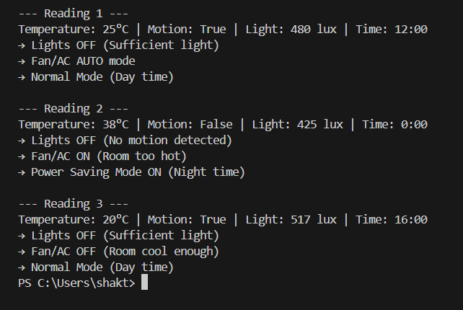
OUTPUT AND RESULTS
OUTPUT :
EXPLANATION:
The system displays real-time sensor readings and appliance status on the screen.It shows actions like “Motion detected – Lights ON” or “No motion – Lights OFF.”This helps users easily understand how energy is being managed automatically.

Slide 6
OUTPUT AND RESULTS
RESULTS:
The system successfully automates appliance control based on sensor data.
Energy consumption is reduced through intelligent decision-making.
Appliances respond instantly to environmental and occupancy changes.
Overall, the system improves efficiency and promotes smart energy use.
FUTURE ENHANCEMENT:
Integrate machine learning to predict user behavior for smarter control.
Add voice assistant compatibility for hands-free operation.
Include mobile app connectivity for remote monitoring and control.
Use renewable energy sources like solar panels for sustainable power.
Implement data analytics to track long-term energy consumption patterns.
Introduce cloud storage for saving system data and generating detailed reports.

Slide 7
REFERENCES
Russell, S. & Norvig, P. (2021). Artificial Intelligence: A Modern Approach. Pearson Education.
Kaushik, A. (2022). “Smart Home Automation Using AI and IoT,” International Journal of Advanced Research in Computer Science, Vol. 13, Issue 4.
Sharma, R. & Gupta, P. (2023). “Energy-Efficient Smart Home Systems Using Rule-Based Algorithms,” IEEE Access, 11(2), 1456–1463.
Khan, M. et al. (2021). “AI-Based Energy Optimization in Smart Homes,” Journal of Electrical and Electronics Engineering Research, Vol. 9, Issue 3.
Singh, D. & Mehta, R. (2022). “IoT-Driven Home Energy Management System,” International Conference on Smart Technologies.
Research articles and case studies from IEEE Xplore and ScienceDirect on AI-based energy management.

