Slide 1

SMART SURVEILLANCE
Team Members
SHAKTHI KIRAN.R
TEJASHWIN.S
SURJITH RAJA.A
NAVEEN KUMAR.
Guided By
Ms. Gowri S

Slide 2
Outline
ABSTRACT
INTRODUCTION
OBJECTIVE OF THE SYSTEM
EXISTING SCENARIO
PROPOSED SOLUTION
BLOCK DIAGRAM
WORK PROGRESS
REFERENCES
22

Slide 3
ABSTRACT
Smart surveillance, is the use of automatic video analysis technologies in video surveillance applications.

Slide 4
INTRODUCTION
In this 21st century, new technologies are emerging to make our life easier.
Security plays an major aspect in each and every field nowadays.
Anywhere from small personal space to a huge commercial area, security plays an essential role.

Slide 5
OBJECTIVE OF THE SYSTEM
In a standard security monitoring system, at least one guard must keep an eye on the monitors for any suspicious activity or any breach in a restricted space.
And that too is not 100% efficient.
So we make the system to take decision and send alert to the customer incase of any threat.

Slide 6
EXISTING SCENARIO
Today’s CCTV’s:
Simply put, they are dumb
Whatever happen they just sit and watch.
Require human interaction to work properly.

Slide 7
PROPOSED SOLUTION
We can move to some advanced technologies which has sense to respond.
A system that can think on its own to predict the unwanted events and send a intimation to the user via mail or message or alert, etc…
It uses image processing and automatic video analysis techniques to predict.

Slide 8
BLOCK DIAGRAM
Start:
Camera Input
Image Processing
No
Is threats detected?
Yes
Take Action: Raise Alert
End

Slide 9
Requirements:
Modules:
OpenCV is a huge open-source library for computer vision, machine learning, and image processing. It can process images and videos to identify objects, faces, or even the handwriting of a human.
Numpy is a general-purpose array-processing package. It provides a high-performance multidimensional array object, and tools for working with these arrays. It is the fundamental package for scientific computing with Python.

Slide 10
scikit-image is an image processing Python package that works with NumPy arrays which is a collection of algorithms for image processing.
Python GUI – tkinter - Python offers multiple options for developing GUI. Out of all the GUI methods, tkinter is the most commonly used method. It is a standard Python interface to the Tk GUI toolkit shipped with Python. Python with tkinter is the fastest and easiest way to create the GUI applications. Creating a GUI using tkinter is an easy task.

Slide 11
Features:
Monitor Feature :
This feature is used to find what is the thing which is stolen from the frame which is visible to webcam. Meaning It constantly monitors the frames and checks which object or thing from the frame has been taken away by the thief.
This uses Structural Similarity to find the differences in the two frames. The two frames are captured first when noise was not happened and second when noise stopped happening in the frame.

Slide 12
Record feature:
This is a most common feature of all existing CCTVs.
With OpenCV, we can capture a video from the camera. It lets us to create a video capture object which is helpful to capture videos through webcam and then we may use that video for future uses.

Slide 13
Detect for Noises in the frame:
This feature is used to find the noises in the frames well this is something you would find in most of the cctv’s.
In simple way all the frames are continously analysed and checked for noises. Noise is checked in the consecutive frames. Simply we find the absolute difference between two frames and in this way the difference of two images are analysed.

Slide 14
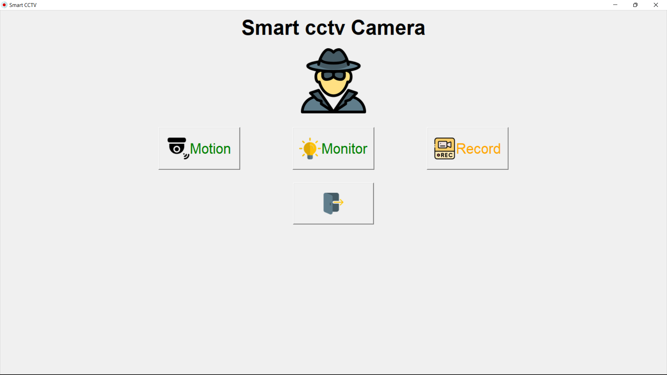

Slide 15
REFERENCES
"What is the difference between 2.4 GHz and 5 GHz?". Stuff Fibre. Retrieved 2020-02-11.
"Digital Wireless Cameras: Frequently Asked Questions | Lorex". www.lorextechnology.com. Retrieved 2020-02-11.
"Choosing a Recording System for Your Security Cameras • NSSF". NSSF. 2017-03-01. Retrieved 2020-02-11.
Thiel, Bill (31 January 2002). "Online Dairy". New York Times. The New York Times.
Hays, Tom (16 April 2006). "NYPD deploys first of 500 security cameras". USA Today. The Associated Press. Retrieved 7 June 2014.

Slide 16
THANK YOU

