Slide 1
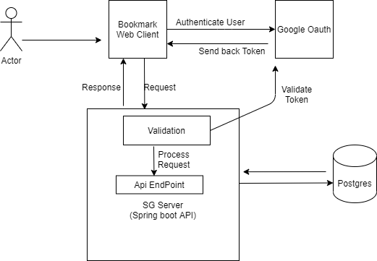

Slide 2
Authentication
Google Oauth2
CICD
SG Bookmark Server
Datastore
Postgres
Google Cloud Build
Spring Boot
Build Tool
Platform
Maven
GCP

