Slide 1
MS Ocean Cruise
Trip of your Lifetime

Slide 2

Overview
What it is?
Our project is a travel application to book cruise ship vacations.
The purpose of this app is for customers to navigate through our application and go through a booking process which lets them decide their destination, cruise model, accommodation class and duration of the trip.

Slide 3
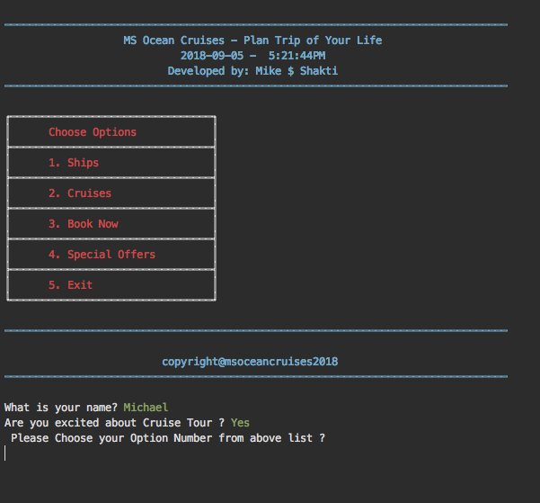
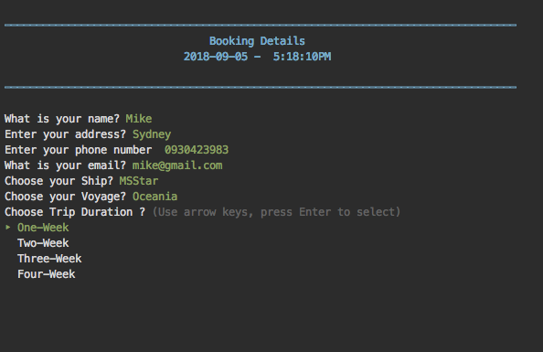
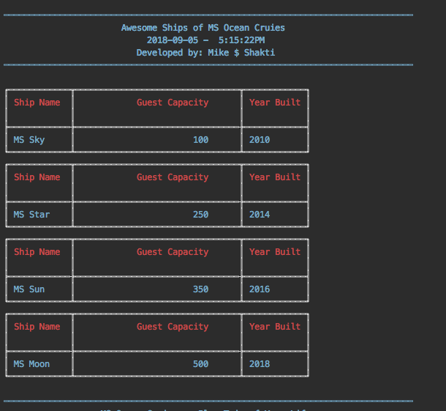
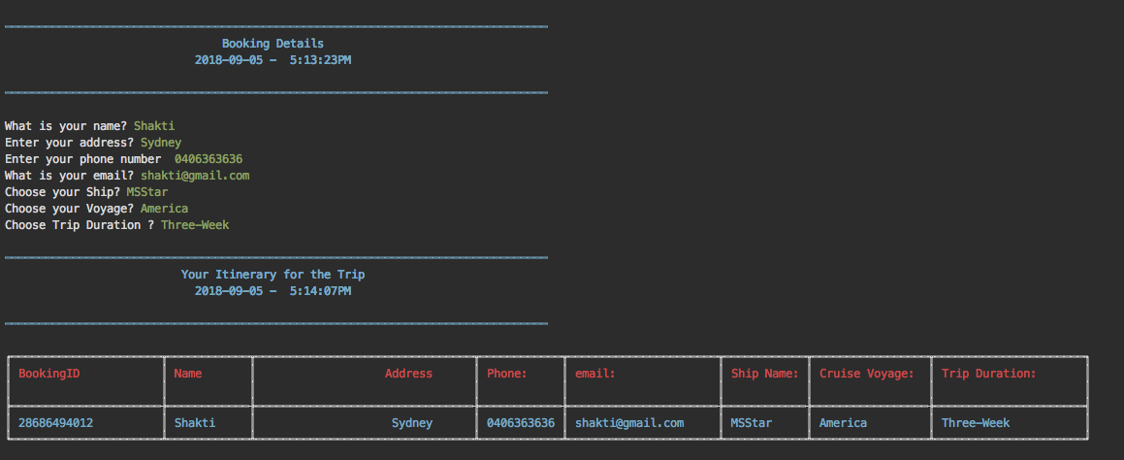
Live Demo

Slide 4
Secret Ingredients
Command-line-reporter
Tty-table
Command- prompt
Tty-progressbar

Slide 5
Challenges
Data Validation
Displaying Data in Table format
Session Creation

Slide 6
Thank you
Any Feedback ?????
Any Question ?????

