Slide 1
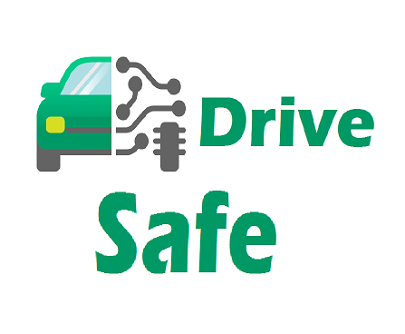
DriveSafety Mobile Application
Submitted To,
Prof. Niloy Ganguli.
Project Guide
Suman Kalyan Maity.
IIT kharagpur, CSE Dept.
Group Partners
Nitish Kumar
Shakti Papdeja
Sushovan Mandal
Swati Patil

Slide 2
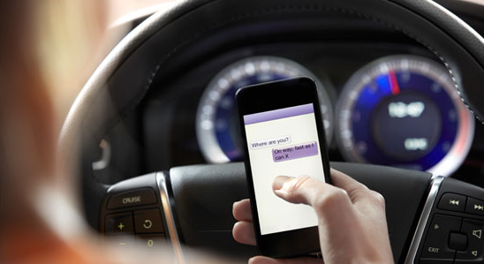
Overview Of The Problem
Smartphones have made it easy for us to stay connected at all times. But that can pose serious safety risks if someone decides to check his or her text messages, emails, phone calls, or any other mobile applications while driving.
Cell phone distraction rates are alarmingly high.

Slide 3
Overview Of The Problem
Statistic Says, at any given time throughout the day, approximately 660,000 drivers are attempting to use their phones while behind the wheel of an automobile.
Texting while driving is 6x more likely to cause an accident than driving drunk.

Slide 4
Challenges
We require to cover 2 Challenges :
Detecting Speed of the person carrying Mobile.
If the speed crosses the threshold of vehicle, then to detect whether the person is driving or not.

Slide 5

Solutions
First Challenge:
Detecting Speed of the person carrying Mobile.
Android proposes 2 Solutions to find Speed:
Accelerometer
GPS
Due to some limitations of application of Accelerometer, we have used GPS to detect speed of vehicle.

Slide 6
Solutions
Second Challenge:
Detecting whether person using mobile is driving or Not
We have used Machine learning concept.
The readings of
a. Accelerometer
b. Gyrometer
c. Magnetic Field.
d. Gesture listener
are recorded using Android Application.

Slide 7

Solutions
Second Challenge continued:
Weka Software
It is android application, used for training the model with the dataset.
And gives feature to use the model for testing on the real time feature-set.
It supports different classifiers, like:
BaysianNetwork
Logistic Regression

Slide 8
Solutions
Second Challenge continued:
Data Set on Weka
dataset discription one hand 13745 (label 1) two hand 13077 (label 0)
Classification accuracy
BayesianLogisticRegression accuracy 69.5474% DMNBtext 66.8407%
NaiveBayes 67.7504%
MultilayerPerceptron 85.2248%

Slide 9
Solutions
Second Challenge continued:
Android gives feature of using weka-library
Where we can classify the real time featureset
into weka classification model.
And we can get the prediction values.

Slide 10
Future Scope
Since we have used the technique of detecting one hand, or two hand while operating the phone by the user of mobile, which does not give much accuracy by the sensors which are used. So it can be extended by using other sensors to collect the data, and preparing the model.

Slide 11
Thank You

