Slide 1
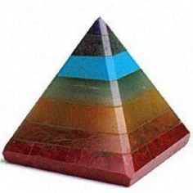
Analysis of CIFAR 10
Pyramid Group
Submitted To,
Prof. Pabitra Mitra.
Project Guide
Anirban Santara.
IIT kharagpur, CSE Dept.
Pyramid Group – Autum 2016
Group Partners
Prafulla Shelke
Nitish Kumar
Swati Patil
Ajay Banshkar
Omkar Sharan
Arijit Nag
Ashwani Kumar
Satish Kumar Jalon
Shakti Papdeja

Slide 2
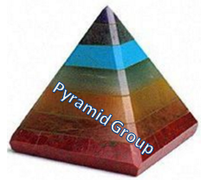
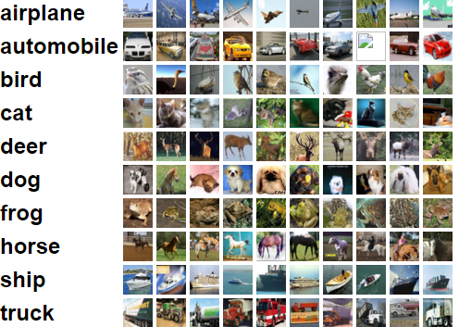
Overview Of The Problem
CIFAR 10 - Canadian Institute For Advanced Research
The CIFAR-10 Dataset
The CIFAR-10 dataset consists of 60000 32x32 color images.
10 classes, with 6000 images per class
50000 training images and 10000 test images.
Problem Definition:
To Test CIFAR 10 on Different Classifiers
and Make the analysis of their Accuracy

Slide 3
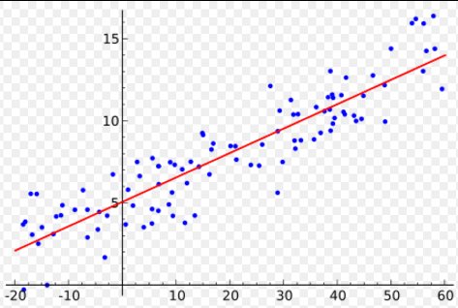

Classifiers of CIFAR 10
Logistic Regression:
CIFAR 10 is multiclass problem.
Multinomial logistic regression is used when the dependent variable in question is nominal, and for which there are more than two categories

Slide 4
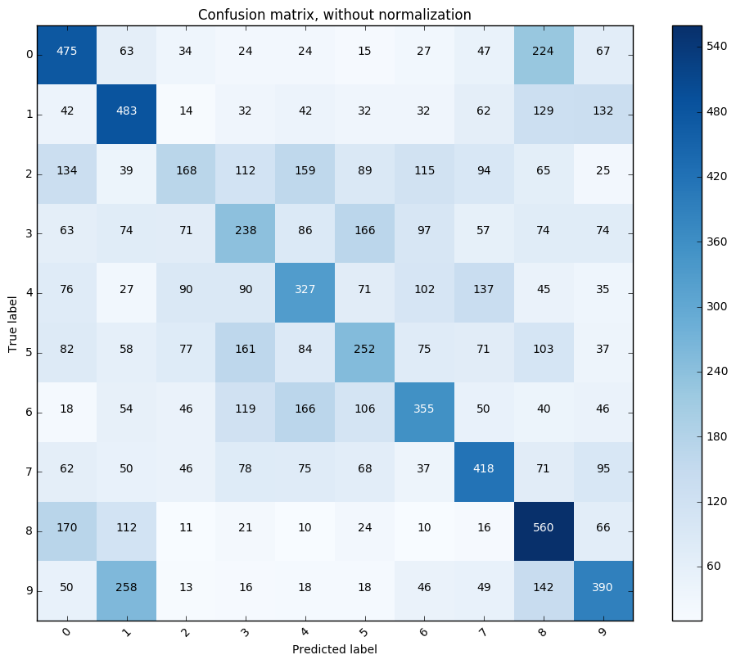
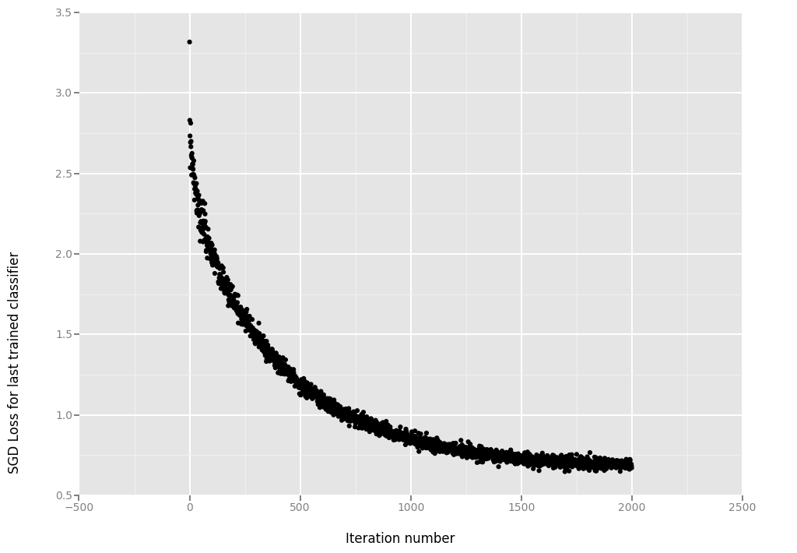
Logistic Regression Confusion Matrix for Cifar10
Logistic Regression Loss Plot for Cifar10

Slide 5
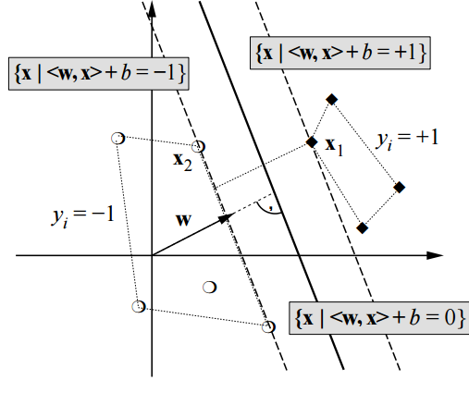
Classifiers of CIFAR 10 continued
SVM
“Support Vector Machine” (SVM) is a supervised machine learning algorithm which can be used for classification.
In this algorithm, we plot each data item as a point in n-dimensional space (where n is number of features you have) with the value of each feature being the value of a particular coordinate.
And, perform classification by finding the hyper-plane that differentiate the classes very well.

Slide 6
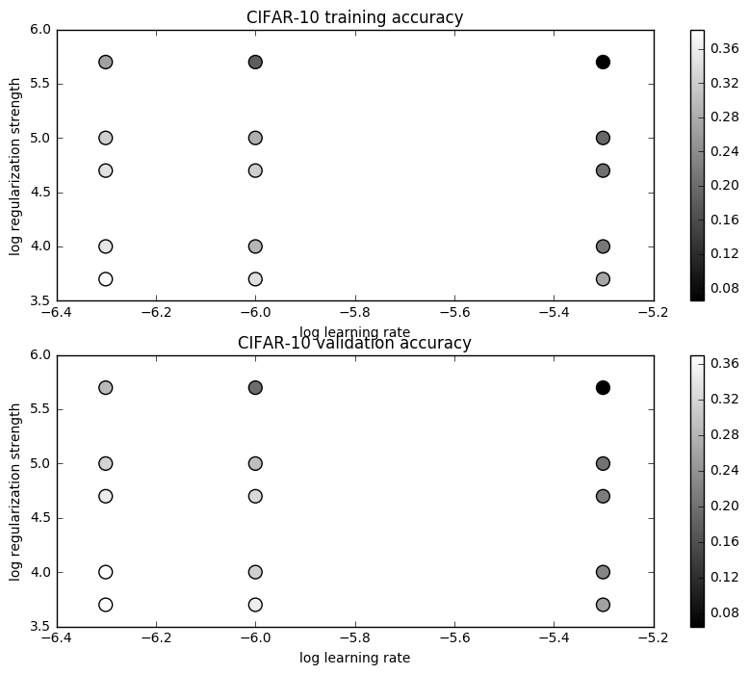
SVM cross validation accuracy

Slide 7
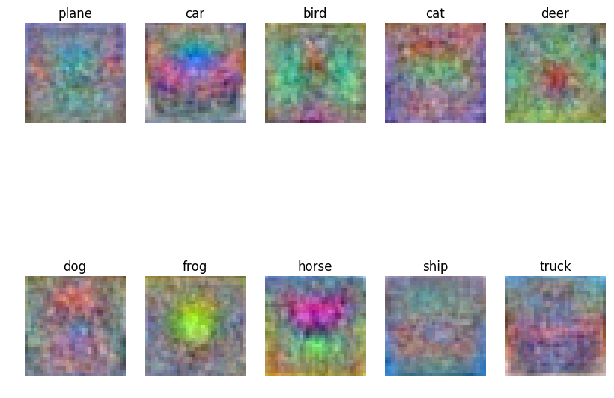
Svm weight vector

Slide 8
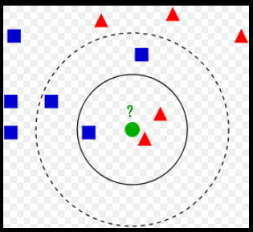
Classifiers of CIFAR 10 continued
k-NN classification
In k-NN classification, the output is a class membership.
An object is classified by a majority vote of its neighbors, with the object being assigned to the class most common among its k nearest neighbors .
A commonly used distance metric for continuous variables is Euclidean distance

Slide 9
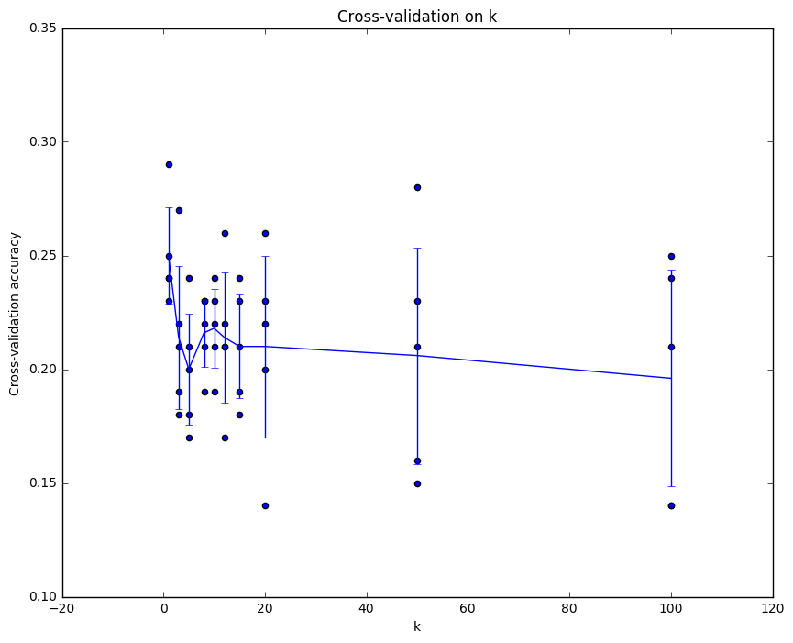
k-NN Cross Validation K v/s Accuracy

Slide 10
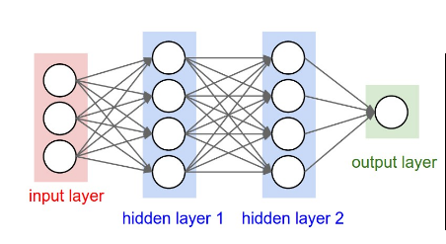
Classifiers of CIFAR 10 continued
Convolutional neural network
Convolutional neural networks (CNNs) consist of multiple layers of receptive fields.
These are small neuron collections which process portions of the input image.
The outputs of these collections are then tiled so that their input regions overlap, to obtain a better representation of the original image; this is repeated for every such layer.
Tiling allows CNNs to tolerate translation of the input image.

Slide 11
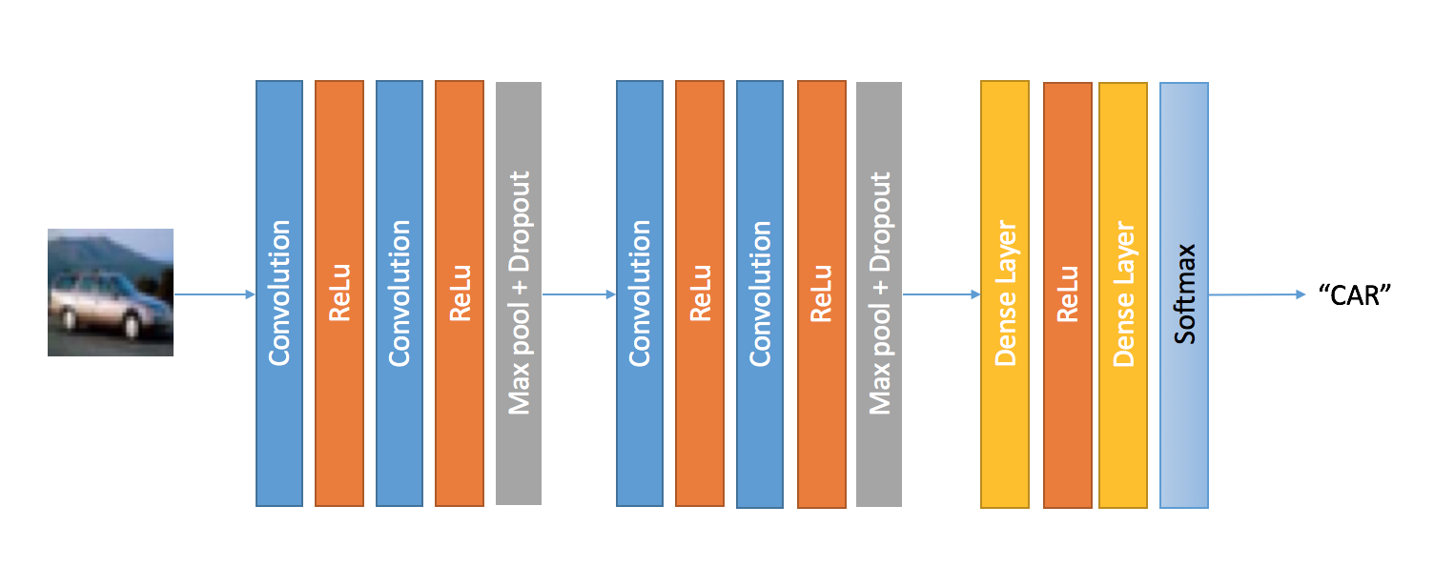
Convolutional neural network Cifar10 Algorithm

Slide 12
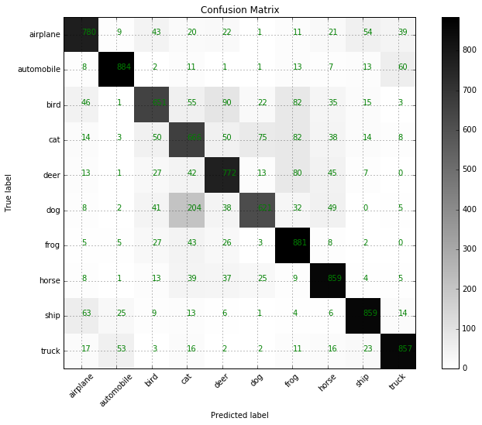
Convolutional neural network Cifar10 Confusion Matrix

Slide 13
Convolutional neural network Cifar10 Performance

Slide 14
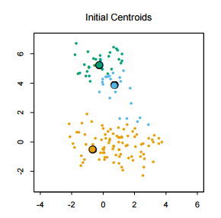
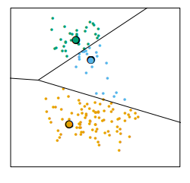
Classifiers of CIFAR 10 continued
K Means
For each data point, the closest cluster (in Euclidean distance) is identified;
Each cluster center is replaced by the coordinate-wise average of all data points that are closest to it.
Steps 1 and 2 are repeated until convergence. Algorithm converges to a local minimum of the within-cluster.

Slide 15
Classifiers of CIFAR 10 continued
SIFT Image Feature Extraction for Bus
SURF Image Feature Extraction for CAR

Slide 16
Cifar 10 Performance Analysis
Method | Accuracy
KNN GMM Logistic regression SVM 2 Layer Fully Connected Neural Network | 28.0 (for k=50) 36.0 36.67 36.9 43.0 (for 10000 iterations)
Convolutional Neural Network | 85.0

Slide 17
Thank You

