Slide 1
Master of Technology Project Presentation Static Analysis of Comments and Dynamic Analysis of Execution Behaviour to Build Semantic Graph of Codebases using Machine Learning
Under the Supervision of - Prof. Partha Pratim Das.
Shakti S. Papdeja
16CS60R54.
Mtech-2nd Year.
Department of Computer Science and Engineering.
Indian Institute of Technology, Kharagpur.
Notes:
0

Slide 2
Background
Codebases – C/C++
Program Comprehension
1. Semantic Analysis of Source Codes
Static analysis .
Dynamic analysis.
2. Read Documentation
3. Use Test Cases and try to find out the behavior of code from output.

Slide 3
Motivation
Program comprehension is one of the first and most frequently performed activities during software maintenance and evolution.
Comments in a program is one of the main sources of information for program comprehension.
Program Comprehension is a major issue for developers for following reasons
Code and Documentation are often not in Sync.
Architectures are not upto date when the codes are changed.
No proper documentation is available for the codes.
Understanding someone else’s code.
Loosing context because of interrupt, or switching of task.
All of these challenges in program comprehension adds extra overhead to understand the code.

Slide 4
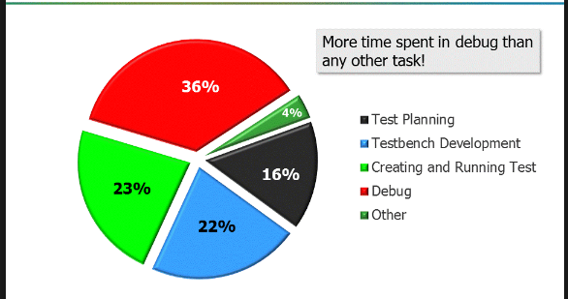
Gap Analysis
Comments have been analyzed for different area of interest
Analyzing comments to detect software bugs and bad comments for improving software development methodology[4]
Action Oriented Graph Representation (AOGR) & NLPA-Natural Language Processing Analysis, correlates verbs in the method name and corresponding action in OOPS[5]
iComment combines Natural Language Processing (NLP), Machine Learning, Statistics and Program Analysis techniques to detect inconsistencies between comments and source code.[7] etc.
These all research help to analyze the quality of comment, to correlate the method names with their action, to analyze the source code for bug findings, to construct flow graphs and syntax tree

Slide 5
Objective
The Objective is to build a tool to analyze the source code using static and dynamic analysis.
It envolves Comprehending the source Code and building query processing engine for providing ease to the programmers/users of source Code.
It envolves 3 steps of Implementation
Information Extraction
Constructing Knowledge Graph
Implemention of Query Engine.
Further extending the model for Dynamic Analysis of code using PIN tool and analysing the code using Machine Learning Algorithms.

Slide 6
Objective Continued…
#include<iostream.h> //This code is for Windows Operating System. #include<graphics.h> /*The code requires graphics.h header file to be available in include directory.*/ int main() { int gd = DETECT, gm; initgraph(&gd,&gm, "C:\\tc\\bgi"); circle(300,300,50); closegraph(); return 0; }
Comment Analysis Can Extract the need of graphics.h header file and add into documentation.

Slide 7
/* CPP Code for Quick Sort Using Divide and Conquer Approach */ #include<iostream> /* Partition function considering last element as pivot, arranges all elements less than pivot to left and greater than pivot to right of it */ int partitionForQuickSort ( int arr[] , int left , int right ) //here left is lower bound and right is upper bound of array { int x = arr[right]; int i = left; for(int j = left ; j < right ; j++) { ………. } …… return i; }
Objective Continued…
Comment Analysis can Extract the program definition, the underlying Algorithm and data structures used in the code.
The purpose of variable left and right can be extracted from comment.
void QuickSort(int arr[] , int left , int right) { ……….. int pivote = partitionForQuickSort(arr , left , right); ….……. }
int main() { ……………. QuickSort(arr , 0 , n-1); ………. return 0; }

Slide 8
Objective Continued…
//This program computes final salary of all employees, including House Rent Allowance. #include<iostream> int main() { ……………. Int n; // n represents number of employees cin>>n; float hr = 3.5; //This variable is constant. float arr[n]; //arr represents salary of n employees. ………. return 0; }
Along with semantic Analysis, our tool can also map the information with the variables like
Variable n represents number of employees
Variable hr is constant
Variable arr represents salary of n employees.
Existing static Analysis can determine
1. Variable n of type integer – size 4 bytes.
2. Variable hr of type float – size 4 bytes
3. An array arr of size n of type float.

Slide 9

Objective Continued…
iostream.h
int arr[]
Software Knowledge Graph –
We would like to build the Software Knowledge graph from static and dynamic analysis of code.
It is the graph for representing relevant knowledge in software domain, projects and systems.
It is represented using
Nodes – Software knowledge entities.
Edges – Relationship between entities (Method invocation, tracability links)
void QuickSort(…)
int main(…)
stdlib.h
int paritition(…)
int n

Slide 10
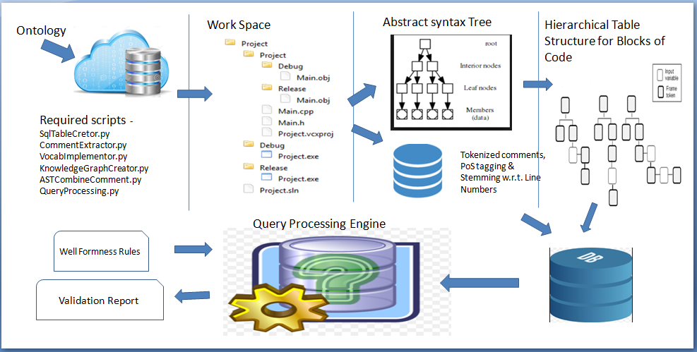
Methodology
Architecture Design of Static Analysis of Source Code
Notes:
9

Slide 11
Methodology (Continued...)
Ontology –
Ontology is set of vocabulary for the categorization of all tokens of the comment, It is handcrafted using previous observations of source codes like a part of Ontology is :
Algorithm - Dynamic Programming, Divide and Conquer, Branch and Bound, Searching, Sorting, Quick Sort , Merge Sort etc.
Data Structure – Array, Linked List, Tree, Trie, Hash Tables, Map, Set, list, vector, red black tree etc.
Visibility Scopes – global, local, external, auto, static, register, private, public, protected etc.
Constructing Ontology is incremental process, and there is provision to add new tokens into the appropriate category at the time of testing new examples on tool for unseen vocabulary.

Slide 12
Methodology (Continued...)
Using NLP Tools –
Structure extraction
Identify and mark sentence, phrase, and paragraph boundaries
Tokenization
Stemming
POS tagging
Matching Unigram/Bigram/Trigram for recognizing appropriate vocabulary set.
The information extracted from parsing, tokenizing, applying ontology and NLP tools is stored in database for mapping with AST and query processing.

Slide 13
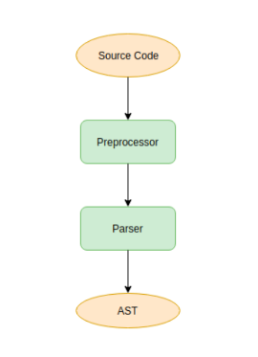
Methodology (Continued...)
Using Clang and LLVM Tools to extract information from AST –
Clang
Clang is compiler front end for various languages
It is the part of LLVM (Low Level Virtual Machine)
AST
Tree representation of Abstract Syntactic structure of preprocessed code.
Recursive AST Visitor
Algorithm encoded in clang to traverse various AST Nodes.

Slide 14
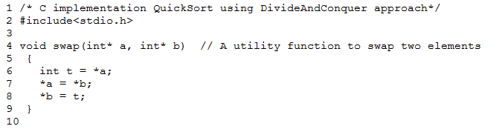
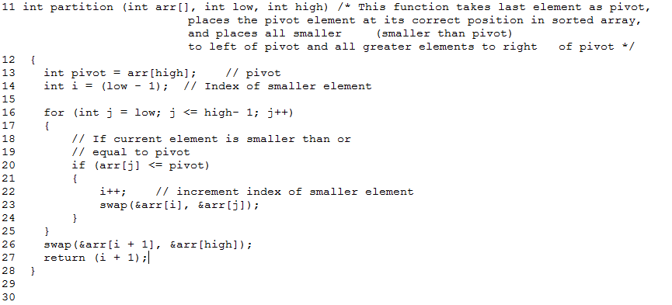
Work Done
Example – For Comment Analysis – A C code for Quick Sort using Divide and Conquer algorithm with associated comments.

Slide 15
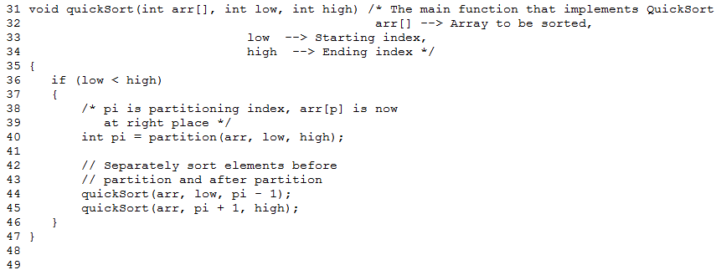
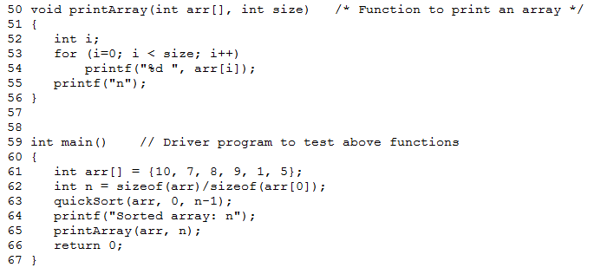
Example – of Quick Sort Continued….

Slide 16
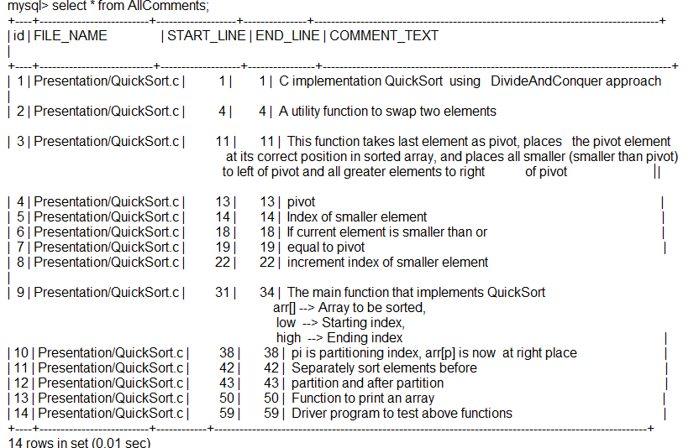
Extracted Comments with Line Numbers
A python script processes the project file provided as input, and analyses each file for comments of single and multiple lines. Like
//
And
/*
....
*/
The corresponding File name , start line of comment ,end line and comment text is stored in the database.

Slide 17
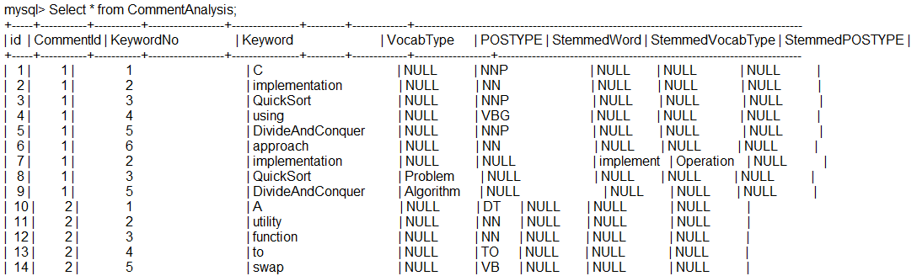
Ontology Mapping on Extracted Comments (a small portion is shown below)
Mapping of every token of the comment with its respective Vocabulary-type, Part Of Speech type.
If it cannot be mapped with anyone of these, then its Stemmed word is mapped with respective to its Vocabulary Type or POS type
DivideAndConquer is identified in Algorithm set.
And
QuickSort in Problem set.

Slide 18
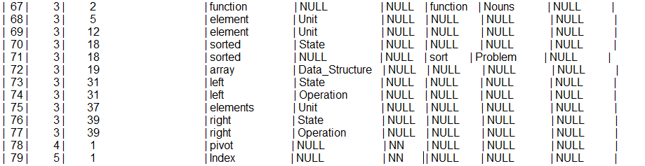
Ontology Mapping on Extracted Comments Continued…(a small portion is shown below)
Sorted has got stemmed to Sort – and is identified into “Problem”set of Ontology.
array – is identified as a data structure

Slide 19
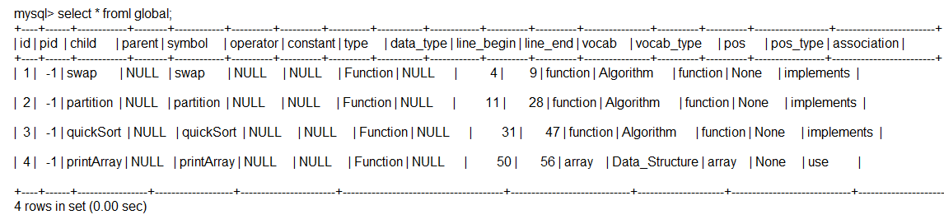
Mapping of AST analysis and Comment Analysis to implement Association
The AST analysis on the same source code implements hierarchical tables, for storing information about each and every block level code along with line number.
The Python script maps the line number from comment analysis and AST analysis to implement the association between them, and it is stored in the database.

Slide 20
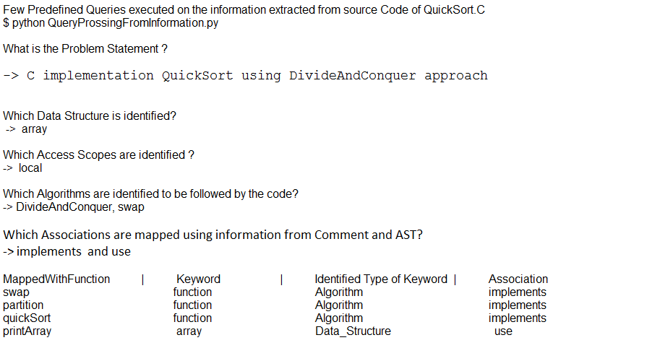
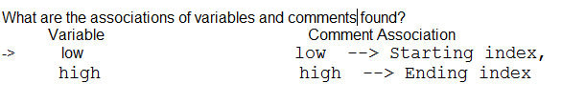
Few static Queries and their Outcomes from the information extracted from Comment and AST analysis.
Few static queries like – Identified Problem statement, Data Structures , Access scopes, Algorithms and associations are extracted from the stored database, as shown above.

Slide 21
Plan for Next Semester
Till now only the static analysis of code has been done, this work will be extended for dynamic analysis of code with following goals –
Using Dynamic Analysis for extracting Flow of the code execution using PIN – tool.
Using predefined codes, to extract the features and generating model from machine learning algorithms (Neural Network).
Executing few test cases on the given project, and extracting its features, which will be supplied to prepared model to understand its behaviour.
Implementing Query Processing Engine to answer some static and user defined queries about the source code.
Notes:
20

Slide 22
References
https://www.cqse.eu/publications/2013-quality-analysis-of-source-code-comments.pdf
T. Tenny, “Program Readability: Procedures Versus Comments,” IEEETrans. Softw. Eng., vol. 14, no. 9, 1988.
Recommending Insightful Comments for Source Code using Crowdsourced Knowledge
Natural language is a programming language: Applying natural language processing to software development
HotComments: How to Make Program Comments More Useful? Lin Tan, Ding Yuan and Yuanyuan Zhou, Department of
Computer Science, University of Illinois at Urbana-Champaign, {lintan2, dyuan3, yyzhou@cs.uiuc.edu
/* iComment: Bugs or Bad Comments? */Lin Tan†, Ding Yuan†, Gopal Krishna†, and Yuanyuan Zhou†‡ †University of Illinois at Urbana-Champaign, Urbana, Illinois, USA ‡CleanMake Co., Urbana, Illinois, USA {lintan2, dyuan3, gkrishn2, yzhou}@cs.uiuc.edu
18th IEEE International Conference on Program Comprehension, Natural Language Parsing of Program Element Names for Concept Extraction, Surafel Lemma Abebe and Paolo Tonella, Software Engineering research unit, Fondazione Bruno Kessler, Trento, Italy, fsurafel,tonellag@fbk.eu.
Notes:
21

Slide 23

Thank you!

