Slide 1
Hashtag Prediction using Attention Based Convolutional Neural Networks
Submitted To -
Prof. Animesh Mukherjee.
Prof. Pawan Goyal.
Guided By –
Suman Kalyan Maity
Department of CSE
IIT Kharagpur.
Submitted By –
Anirban Ghose – 16CS91R12
Ashwani Kr. Verma – 16CS60R62
Nitish Kumar – 16CS60R71
Prem N. Yadav – 16CS60R68
Saurabh Singh – 16CS60D03
Shakti Papdeja - 16CS60R54
Department of CSE
IIT Kharagpur.
Notes:
1

Slide 2
Agenda
Word2Vec
Convolution Neural Network - CNN
Attention Based CNN
Network Topology
Experimental Results

Slide 3
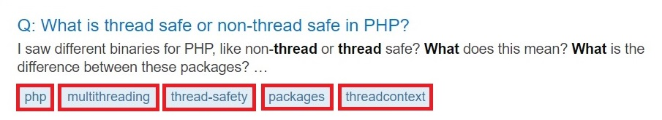
Basic Problem
Input
f(Stackoverflow Question)
Hashtag
Notes:
3

Slide 4
Model Flow
Stack Overflow Sentences
Word2Vec
CNN
HASHTAG
3
Notes:
4

Slide 5
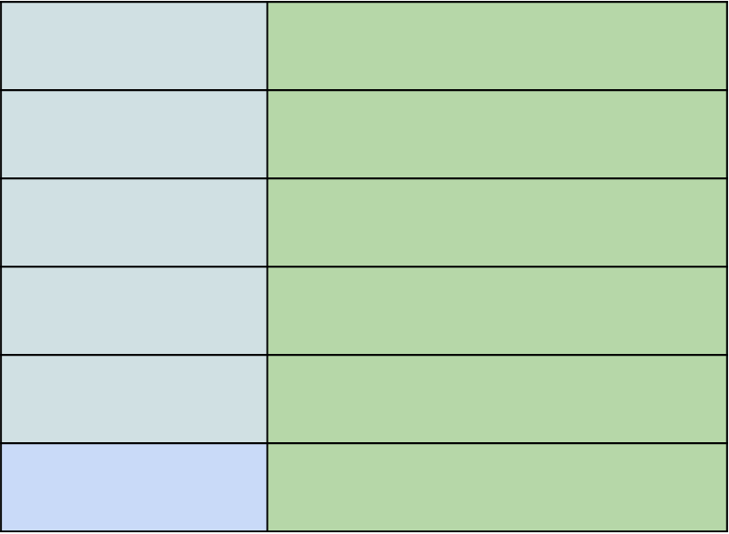
Word2Vec
WORDS
FEATURE VECTOR
Corpus
Text
WORD2VEC
W
Notes:
5

Slide 6
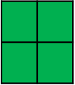
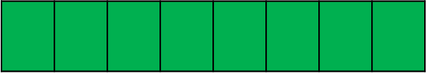
Convolutional Layer
MG
Question
Convolution
Scores For Each output
Pooling Operation
Zi = g(M^{g} .wi:i+l-1 + b)
Feature Map (Fglobal)
Notes:
6

Slide 7
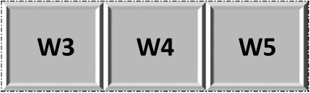
Local Attention Layer
Input: Microblog
Word Vector
MLocal
Compute Score
If Score > Ƭ
Wh
Mark Trigger Words
S(2i+h-1)/2 = g(M^{l} * wi:i+h + b)
K – Trigger Words
FLocal
Notes:
7

Slide 8

Folding
 | f1 | f2 | f3 | f4 | … | … | … | … | fn
W1
W2
W3
… | … | … | … | … | … | … | … | … | …
… | … | … | … | … | … | … | … | … | …
Wk
f1
f2
f3
f4
…
…
…
…
f100

Slide 9

Network Topology
Flocal
Fglobal
Convolution
Softmax
Layer
Hash-Tag Probability Vector
Rank Set of Hash-Tags
Notes:
9

Slide 10
WORD2VEC: STACKOVERFLOW DATADUMP
The given dataset contains a total of 12922917 samples.
Word2Vec Model Contains 499547 unique words.
Notes:
10

Slide 11
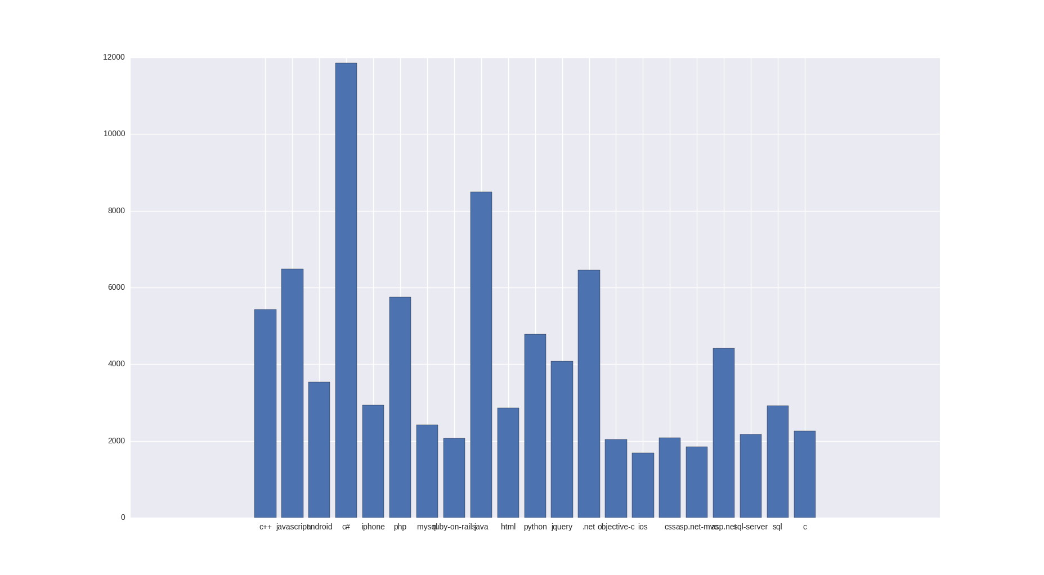

Slide 12
TARGET
110,000 microblogs in the dataset (Sina Weibo)
The vocabulary of words is 106,323
The vocabulary of hashtags is 37,224,
Avg no of words in each microblog is 20.45
Avg no of hashtags in each microblog 1.20
Precision: 0.406
Recall: 0.332
Hashtag Recommendation using Attention-based Convolutional Neural Network – Gong et al

Slide 13
ACHIEVED
A sample of 2484 questions
5 Epochs of training
Total of 10 hashtags
109886 samples
The vocabulary of words is 16681143
The vocabulary of hashtags is 38197,
Avg no of words in each microblog is 170
Avg no of hashtags in each microblog 4
Precision: 0.242
Recall: 0.212

Slide 14
Thank you!
Notes:
14

