Slide 1
Developing Web App For Detecting Malaria With Microscopic Blood Images Using Yolo Model
Guide – Krishna Kumar Singh
N190700 – P.C.Avinash kumar Reddy
N190684 – Mandem Shakunthala
N190660 – Padala Sai Bhavani
N190641 – Bollineni Sirisha
N190686 – Kasimsetti Mahesh

Slide 2
Table of Contents
Abstract
Objective
Introduction
- What is Malaria?
YOLO
Model Architecture
Dataset
- Dataset and Results File Structure
Python Implementation
Results and Performances
Streamlit Application
Challenges and Solutions
Conclusion Future Work
References

Slide 3
Abstract
Malaria is a deadly syndrome formed by the Plasmodium parasite that spreads through the bite of infected Anopheles mosquitoes. There are several drugs to cure malaria but its diagnosis is still tedious, time-consuming and costly. Although the existing equipment for detecting malaria gives high accuracy, those are costlier.
Keeping this issue in view we used Pretrained YOLO model where the blood smear images are used for training which could be incorporated in an web app. The outcome reveals that the proposed model gives 94% accuracy.
Our results show the YOLO model effectively identifies malaria infected and uninfected blood cells in microscopic images.

Slide 4
Objective
The goal of this project is to detect the malaria in microscopic blood smear images distinguishing between two classes:
Uninfected Cells: Healthy red blood cells without malaria infection.
Infected Cells: Red blood cells infected with Plasmodium parasites.
Developing a portable web app for ease of availability for the comman poeple.

Slide 5
Introduction
YOLO (You Only Look Once) is a object detector that uses a convolutional neural network (CNN) to predict the bounding boxes and class probabilities of objects in input images [2] .
This project focuses on the detecting of malaria for the microscopic blood cell images. Malaria, a life-threatening disease caused by Plasmodium parasites, is a major global health concern[4].

Slide 6
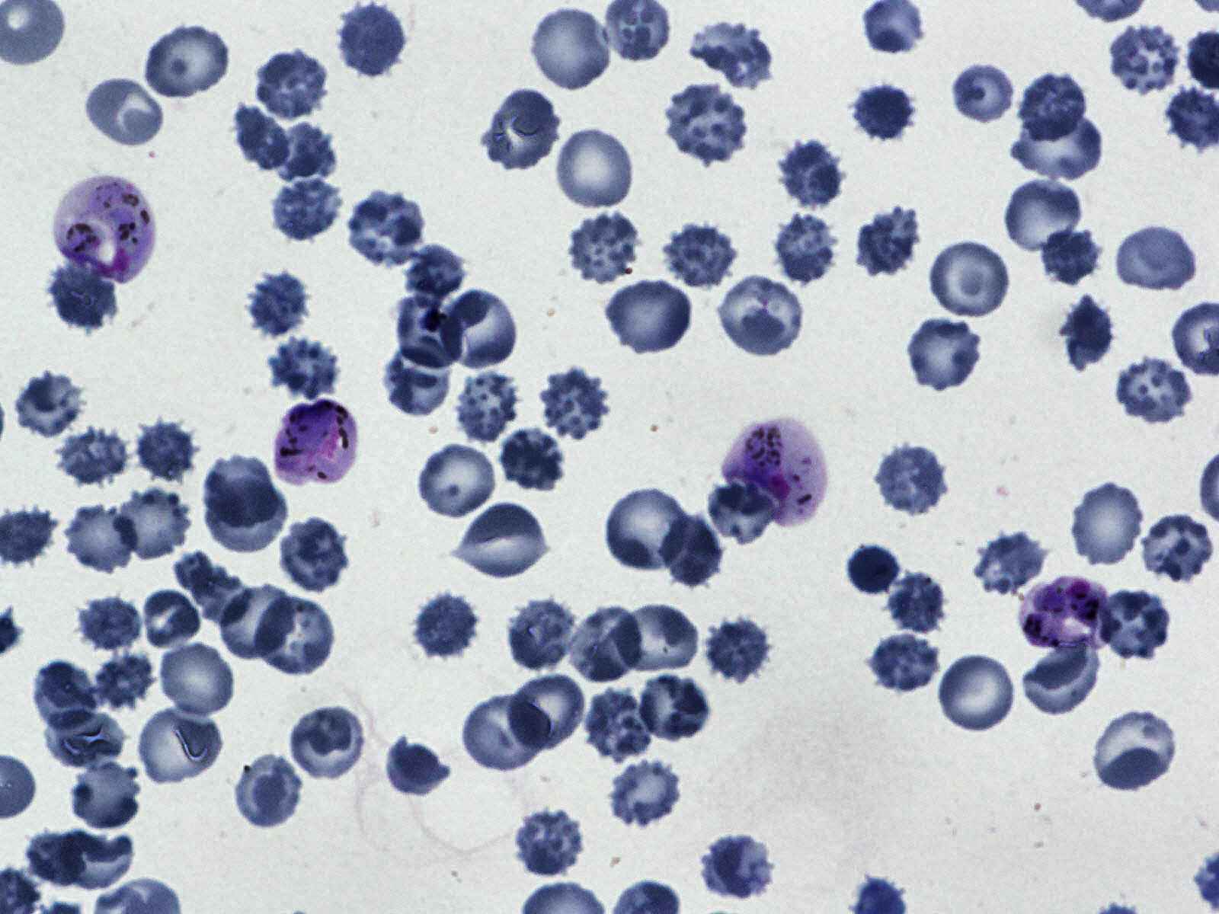
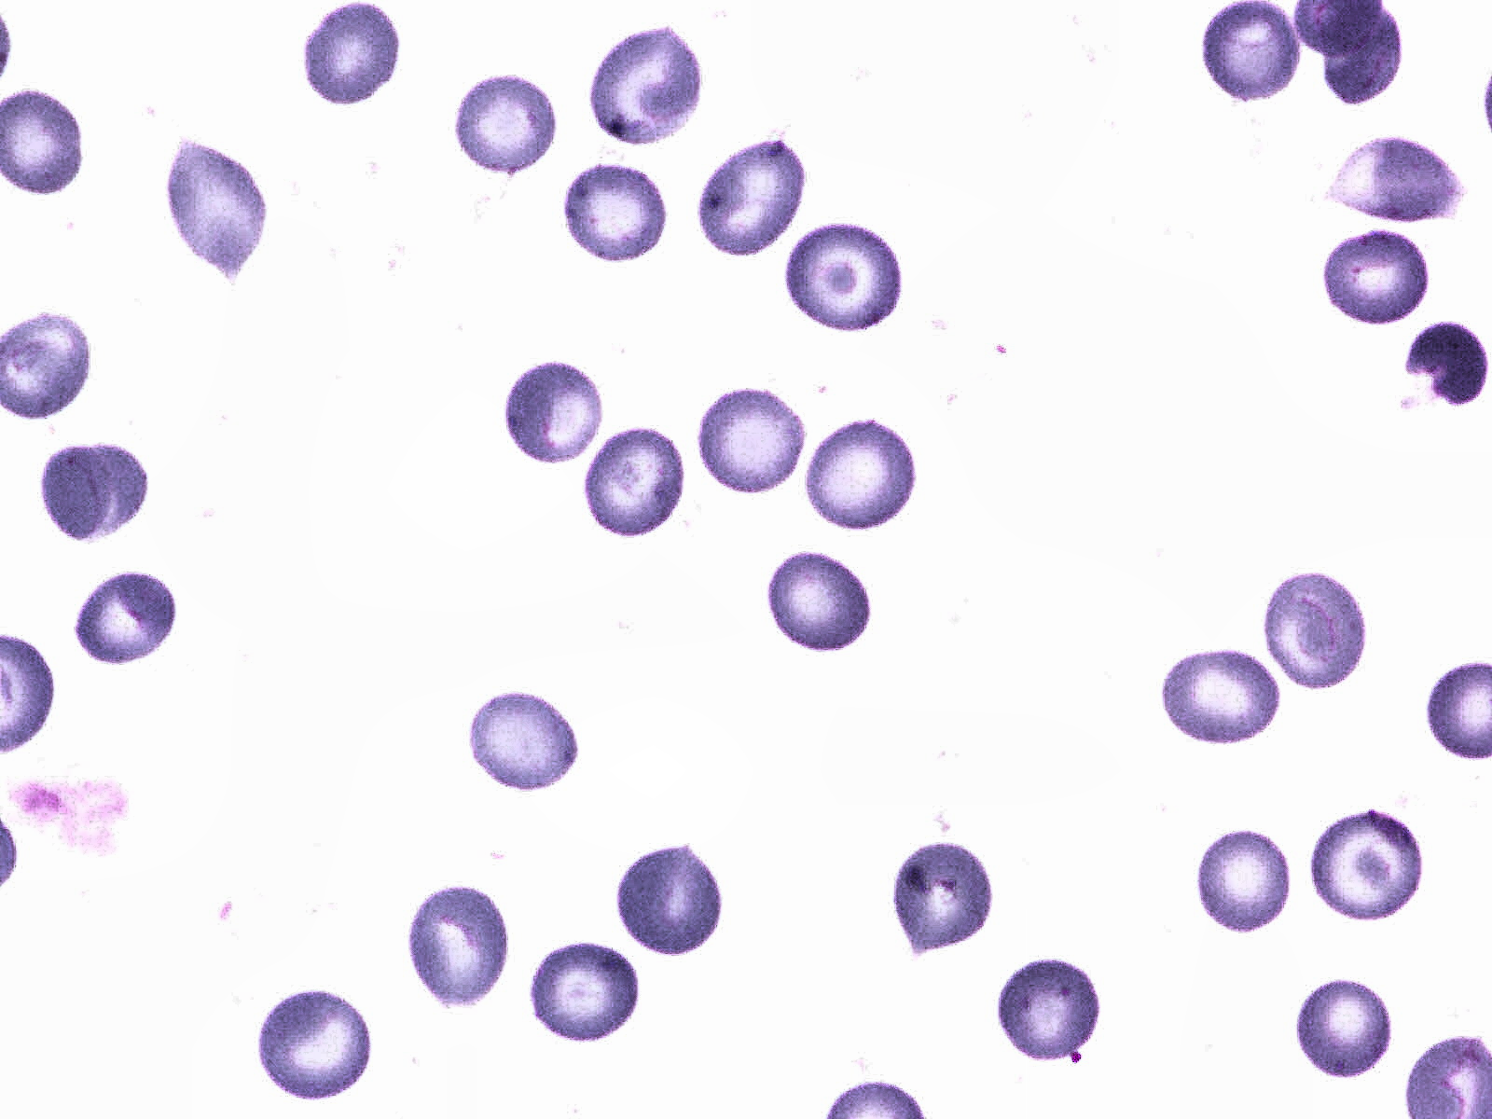
What is Malaria :
Malaria:
Malaria is a potentially life-threatening disease caused by Plasmodium parasites, which are transmitted to humans through the bites of infected female Anopheles mosquitoes [4].
Causes:
Parasites: Malaria is caused by Plasmodium parasites. The most deadly species is Plasmodium falciparum.
Transmission: The primary mode of transmission is through the bite of an infected Anopheles mosquito.
Symptoms:
Fever, headache, sweats, fatigue, nausea, and vomiting. These symptoms typically appear 10–15 days after the mosquito bite.
Infected Image
Uninfected Image

Slide 7
YOLO (You Only Look Once)[2]
For the object detection in deep learning applications, we can employ the YOLO (You Only Look Once) algorithm.
It refers to a class of algorithms based on artificial neural networks that are optimized to work with unstructured data such as images, voice, videos, and text.
It provides accurate results and we can easily train and test the model and it also provide various matrix like confusion matrix defaultly.
We use Yolov8 version in this project and it accepts the data in .yaml form.
Yolov8 has defaultly detect the 80 different objects.

Slide 8
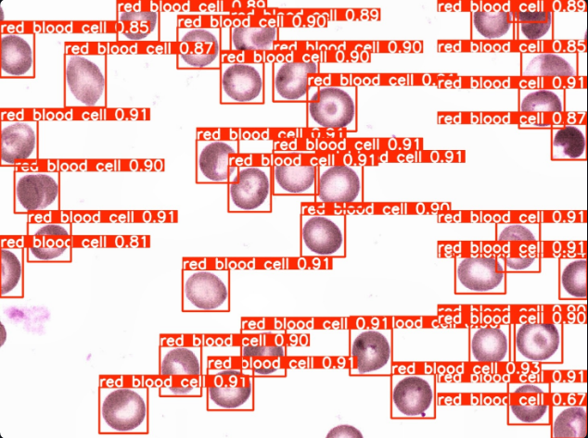
To detect Malaria using the YOLO model, collect and annotate a large dataset of blood cell images, marking the locations and types uninfected cells (RBCs and leukocytes),four classes of infected cells (rings, trophozoites,gametocyte and schizonts) andsome cells as difficult if not clearly in one of the cell classes.
We replace the our dataset and train the model for detection of 6 classes (i.e, RBCs,leukocytes,rings, trophozoites,schizonts and gametocyte cells).
Microscopic blood image
Before detection by YOLO model
Microscopic blood image
after detection byYOLO model

Slide 9
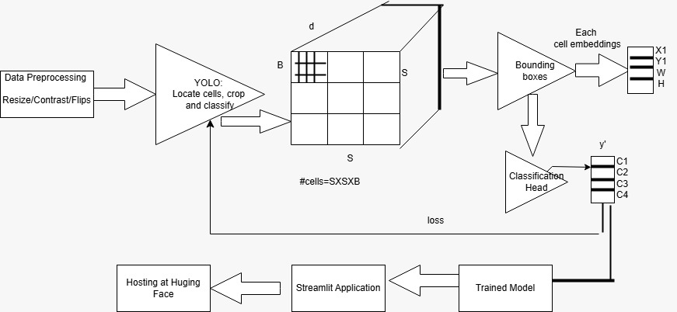
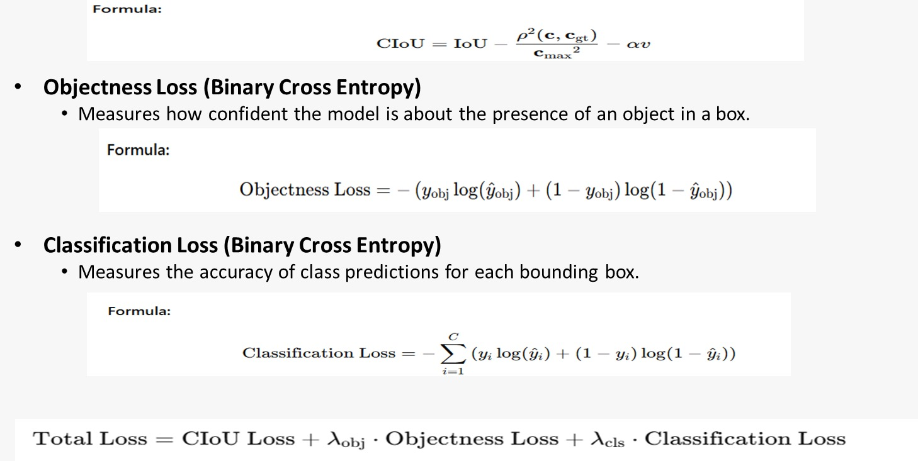
Model Architecture

Slide 10
Dataset
For this project we found the dataset from the following link:
https://www.kaggle.com/datasets/kmader/malaria-bounding-boxes
The dataset comprises a collection of labeled images depicting both uninfected and infected cells. Sourced from kagile Datasets, it contains a total of 1208 images.
The dataset contain 1600X1200 pixels size of microscopic blood images.
Dataset is divided into 80% of images(966) for train and 20% of images(242) for test.
For each image in train and valid, we have annotation text file containing bounding box info and respective class (i.e, RBCs,leukocytes,rings, trophozoites,schizonts and gametocyte cells) in yaml format.
In yaml the data in the form key-value pairs.

Slide 11
Drive
My Drive
YOLO(Folder Name)
Train
images
labels
labels.cache
Valid
images
labels
labels.cache
data.yaml
runs
detect
malaria_yoloi
Weights
best.pt
Last.pt
When dataset is downloaded, the file structure is like this.
After training of dataset, YOLO model creates above file structure.

Slide 12
Python Implementation
https://colab.research.google.com/drive/1-fwF52QgI9HfNRBZCe5Cq-hgZMnLzVpZ?usp=sharing
The code mounts Google Drive to access the training data and installs the ultralytics package for using YOLOv8 to detect malaria. It trains a YOLOv8 model on a dataset specified in data.
.yaml for 50 epochs and utilizes the trained model to detect malaria in test images. Subsequently, it processes the prediction results to extract bounding boxes, masks, keypoints and probabilities.

Slide 13
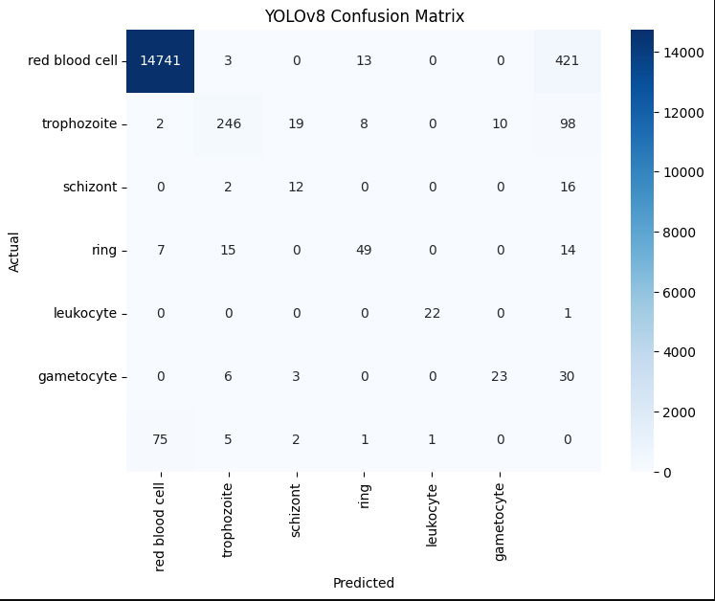
Performances
A confusion matrix is a table used to evaluate the performance of a classification model by comparing the predicted labels with the actual labels.
It consists of four key metrics: True Positives (TP), False Positives (FP), True Negatives (TN), and False Negatives (FN).
These metrics help in calculating important performance measures like accuracy, precision, recall, and F1-score.

Slide 14
Loss Functions of YOLO
1. Bounding Box Regression Loss (CIoU Loss)
Measures the overlap and distance between predicted and ground-truth bounding boxes.
2. Objectness Loss (Binary Cross Entropy)
Measures how confident the model is about the presence of an object in a box.
3. Classification Loss (Binary Cross Entropy)
Measures the accuracy of class predictions for each bounding box.

Slide 15
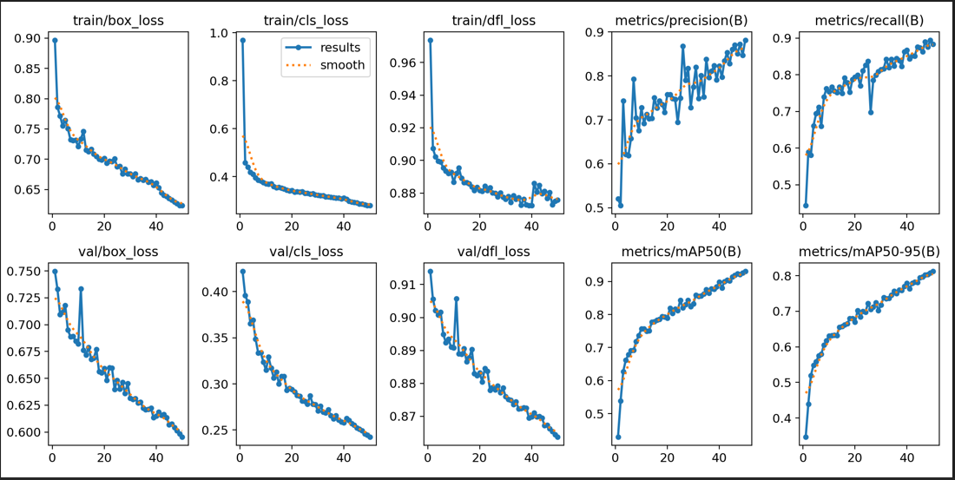
Graph metirc

Slide 16
STREAMLIT Application
Streamlit is a Python library designed for creating fast, interactive web apps for machine learning and data science projects with minimal effort.
It provides features like file upload, buttons, image display, and real-time outputs.
In the context of malaria detection, Streamlit provided an easy-to-use platform where users (doctors, healthcare workers) could interact with the model by simply uploading a blood smear image and getting instant results.

Slide 17
How Streamlit is Used in Our Malaria Detection App?
We designed a Streamlit web app that accepts microscopic blood images from the user through a file uploader widget (st.file_uploader).
Image is sent to the YOLO model for detecting malaria-infected cells.
Based on detection:
- Infected cells highlighted with bounding boxes.
- Final result shown using st.success() or st.error().
Streamlit handles the entire flow in real-time, giving quick and accurate results to the user.

Slide 18
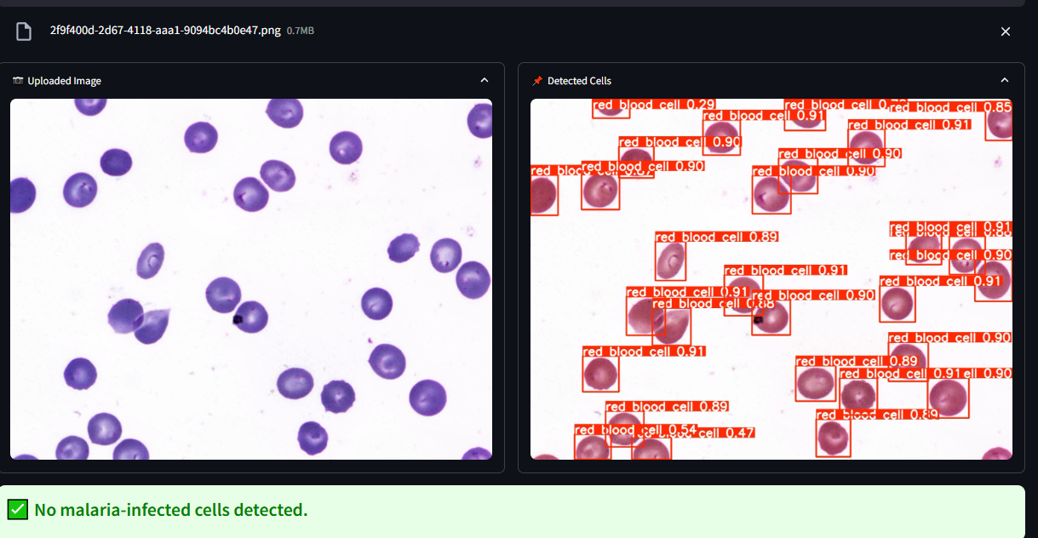
🦠 Malaria Detection with YOLOv8

Slide 19
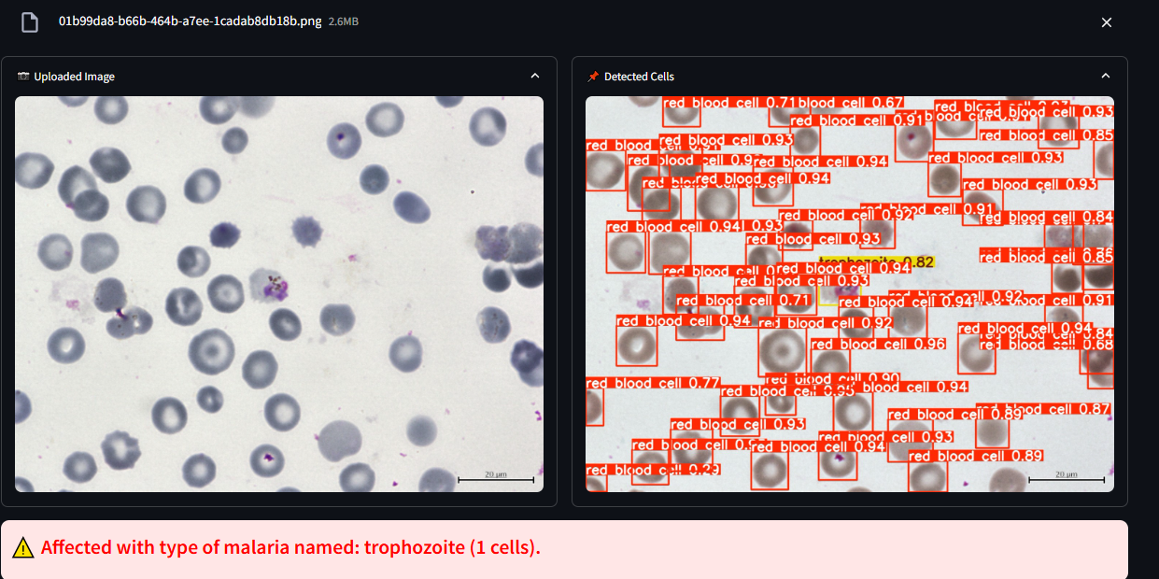
Output : Affected with type of malaria named: trophozite(1cells)
Uploaded Image

Slide 20
Challenges and Solution
Challenge: Red and white blood cells often overlap or cluster together in blood smears, making it difficult for the YOLO model to distinguish individual cells accurately .
Solution: Incorporate advanced preprocessing steps to separate clustered cells. Train the model on a diverse dataset that includes examples of overlapping cells to improve its ability to handle such scenarios.
Limited Training Data Challenge : High-quality, annotated datasets for training the YOLO model are often scarce, limiting its performance and generalizability.
Solution: Generating more datasets using generative models.

Slide 21
Conclusion
In conclusion, employing the YOLO model for detecting malaria via deep learning proves to be a highly effective approach, offering accurate and rapid analysis of blood samples.
This method streamlines laboratory processes, reducing manual effort, cost , requirement of Blood and potential errors while enabling real-time analysis for timely medical decision-making.
The integration of YOLO model showcases the potential of deep learning in revolutionizing medical diagnostics, promising improved efficiency and accuracy in malaria detection tasks.

Slide 22
Future Scope
Deploying this application in an Android app will enable easy access to detect malaria, reducing the cost of doing blood tests for malaria detection, minimizing blood wastage, and enhancing the accuracy and efficiency of malaria detection through deep learning.

Slide 23
References
https://www.kaggle.com/datasets/kmader/malaria-bounding-boxes
https://yolov8.com/
https://www.geeksforgeeks.org/introduction-deep-learning/
https://medlineplus.gov/malaria.html#
https://kili-technology.com/data-labeling/machine-learning/yolo-algorithm-real-time-object-detection-from-a-to-z

Slide 24


Slide 25
Thank you

