Slide 1
Android App for Malaria Detection with Microscopic Blood Image Using Deep Learning Model
Guide-Mr.K.K.Singh Sir
N190700 P C.Avinash Kumar Reddy
N190684 M.Shakunthala
N190660 P.Sai Bhavani
N190686 K.Mahesh
N190641 B.Sirisha
N190142 G.Srividya

Slide 2
Table of Contents:
Abstract
Introduction
Objective
What is Malaria?
Related Works and Limitations
Algorithm for malaria classification
Results
Conclusion
References
Q&A

Slide 3
Abstract:
Malaria is a deadly syndrome formed by the Plasmodium parasite that spreads through the bite of infected Anopheles mosquitoes. There are several drugs to cure malaria but its diagnosis is still tedious, time-consuming and costly. Although the existing equipment for detecting malaria gives high accuracy, those are costlier.
Keeping this issue in view we develop a deep learning classification model where the blood smear images are used for training which could be incorporated in an android app. The outcome reveals that the proposed model gives 82% accuracy.

Slide 4
Introduction
This project focuses on the development of a deep learning model for the classification of malaria for the microscopic blood cell images. Malaria, a life-threatening disease caused by Plasmodium parasites, is a major global health concern.

Slide 5
Objective
The goal of this project is to create a model capable of distinguishing between two classes:
Uninfected Cells: Healthy red blood cells without malaria infection.
Infected Cells: Red blood cells infected with Plasmodium parasites.
Developing a portable app for ease of availability for the comman poeple.

Slide 6
What is Malaria?
Malaria is a potentially life-threatening disease caused by Plasmodium parasites, which are transmitted to humans through the bites of infected female Anopheles mosquitoes.
Causes:
Parasites: Malaria is caused by Plasmodium parasites. The most deadly species is Plasmodium falciparum.
Transmission: The primary mode of transmission is through the bite of an infected Anopheles mosquito.
Symptoms:
Fever, headache, sweats, fatigue, nausea, and vomiting. These symptoms typically appear 10–15 days after the mosquito bite.

Slide 7
Related Works and Limitations:
Title | Authors | Publisher(Year) | Key Concept | Cons
Detection of Malaria Parasite Infected Blood Cells Using Image Processing | NU RANI | IEEE (2012) | Utilizing image processing for detecting infected blood cells in microscopic images | Performance degrades with image artifacts and poor quality images
A Machine Learning Approach for Automated Diagnosis of Malaria | C Chakraborty | MICRON (2013) | Machine learning algorithms for automating malaria diagnosis using image data | Dependency on large labeled datasets for training
Malaria Cell Image Dataset Classification Using Convolutional Neural Network | W.David Pan | PeerJ (2018) | Classification of malaria cell images using CNNs | Dataset imbalance affecting model performance
Malaria Detection by Deep Learning Using Mobile Microscopy | M Mittal | Journal of King Saud University-Computer and information Scince (2022) | Mobile microscopy integration with deep learning for malaria detection | Performance affected by variability in mobile image quality
Convolutional Neural Network for Malaria Diagnosis and Quantitiation | M Jaiswal | Computational and Mathematical Methods in Medicine (2017) | Application of CNNs for malaria parasite detection in blood smear images | Limited evaluation on diverse datasets
Deep Learning and Data Augmentation for Malaria Parasite Detection | W Hoyos | BMC Bioinformatics (2024) | Combining deep learning and data augmentation to enhance malaria parasite detection | Model performance highly dependent on quality of augmented data
A Hybrid Deep Learning Model for Malaria Detection Using Microscopic Blood Smears | Mostafa M.Fouda | IEEE Transactions on Biomedical Engineering (2024) | Hybrid model combining CNNs and RNNs for robust malaria detection | High resource requirements for training and inference

Slide 8
Algorithm for Malaria Classification using CNN and TFLite Conversion
1.Data Loading:
Mount Google Drive.
Load dataset from the specified directory.
Split the dataset into training and testing sets.
2.Data Preprocessing:
Rescale images to a standard size (e.g., 224x224 pixels).
Apply data augmentation techniques such as rotation, zoom, horizontal flip, etc., to increase dataset variability.

Slide 9
3.Model Architecture:
where,
C1=conv2D layer(32 filters, kernel size(3,3), activation function(relu), and input shape(224,224,3))
C2=maxpooling2D layer(with pool size(2,2))
F=flatten layer(to convert 2D matrix to 1D vector)
D=dense layer(fully connected, with 512 units and activation function(relu))
Dr=dropoutlayer
Do/p=Dense output layer (with 2 classes and softmax activation function)
C1
C2
C1
C2
C1
C2
D
Do/p
F
Dr

Slide 10
4.Compile Model:
Compile the model using the Adam optimizer with Learning Rate 0.001.
Set the loss function to categorical cross-entropy.
Specify the metrics to track, such as accuracy.
5.Train Model:
Fit the model using the training data.
Implement early stopping to monitor validation loss and stop training when the loss stops improving.
6.Evaluate Model:
Generate predictions on the test data.
Calculate and print the classification report (including precision, recall, F1-score).

Slide 11
7.Plot Training and Validation Metrics:
Plot the training and validation accuracy and loss over the epochs.
8.Convert Model to TFLite:
Load the trained Keras model.
Convert the model to TFLite format using the TensorFlow Lite Converter.
Save the TFLite model to a specified directory.
9.Inference on New Images:
Load and preprocess new images to match the input requirements of the model.
Load the TFLite model.
Use the TFLite interpreter to make predictions on the new images.
Display the predictions.

Slide 12
10.Add TFLite Model to Android Studio:
Import the TFLite model into an Android Studio project.
Integrate the TFLite Interpreter to perform inference.
11.Inference on Mobile App:
Load and preprocess new images within the mobile app.
Use the TFLite model for predictions.
Display predictions on the mobile app.

Slide 13
Python Implementation
https://github.com/SaiBhavani1916/Mini_Project/blob/main/mini_project.ipynb
Tools: Google Colab TP4 GPU
RAM: 1.08 GB/12.67 GB
Disk: 27.42 GB/107.72 GB,python
FrameWorks:TensorFlow,keras
Libraries:Numpy,opencv,matplotlib
Andriod app:
Tools:andriodstudio,andriod phone

Slide 14
Dataset:
https://www.kaggle.com/datasets/kmader/malaria-bounding-boxes
The dataset comprises a collection of labeled images depicting both uninfected and infected cells. Sourced from kagile Datasets, it contains a total of 1328 images.
Preprocessing:
Image Resizing:
Resize all images from 1600X1200 to 224X224
Normalization:
Pixel Value Scaling: Normalize pixel values to a range of 0 to 1 by dividing by 255. This helps in faster convergence during training.

Slide 15
Class Balancing:
Handling Imbalance:
As we have class imbalance problem that is , infected class is greater than uninfected.That’s why we are reducing no.of infected images with respect to count(>3) infected cells in an image.
Now total images are 383 (uninfected-161,infected-182).
Splitting the Data:
Training and Test Sets: Split the dataset into training and test sets (commonly in a 80-20 ratio). The training set is used to train the model and the test set is used to evaluate model performance.
Methodology:
We will use deep learning techniques, specifically Convolutional Neural Networks (CNNs), to train a model that can automatically learn and differentiate between features associated with infected and uninfected cells. The model will be trained on a labeled dataset and evaluated on a separate test set to assess its classification performance.

Slide 16
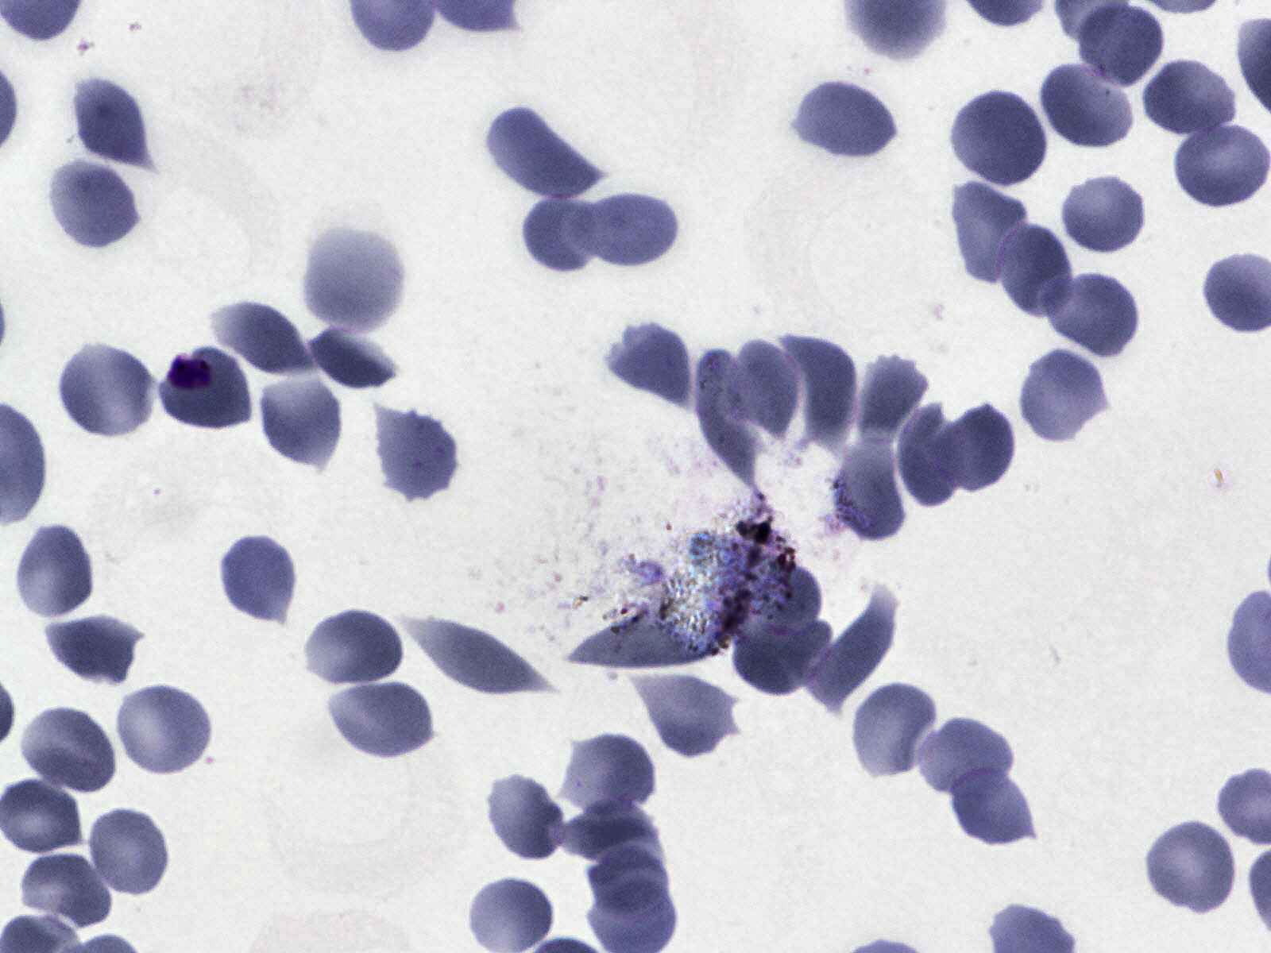
Model Architecture:
L(Θ,x,y)=-Σy_{i}log f(x_{i})
Θ’=min_{Θ} E_{(x,y)∈D} L(Θ,x,y)
Input
x∈R^{pxq}
Ground truth
classifier
f(x)
0
1
f_{Θ}
Loss

Slide 17
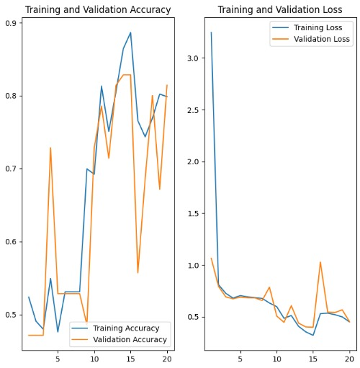
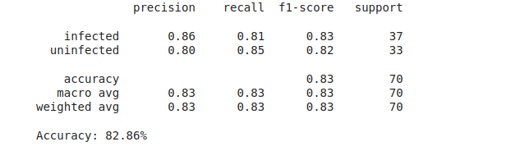
Results:
Present Accuracy:82%

Slide 18
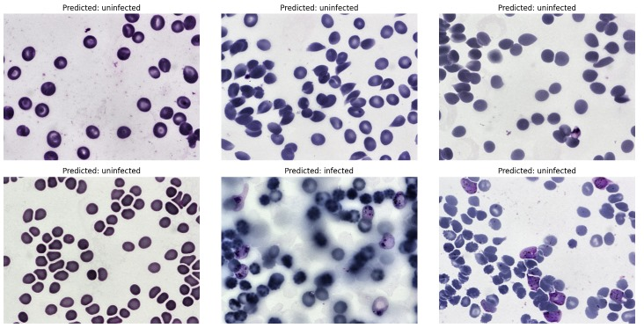
Predicted Labeled Images:

Slide 19
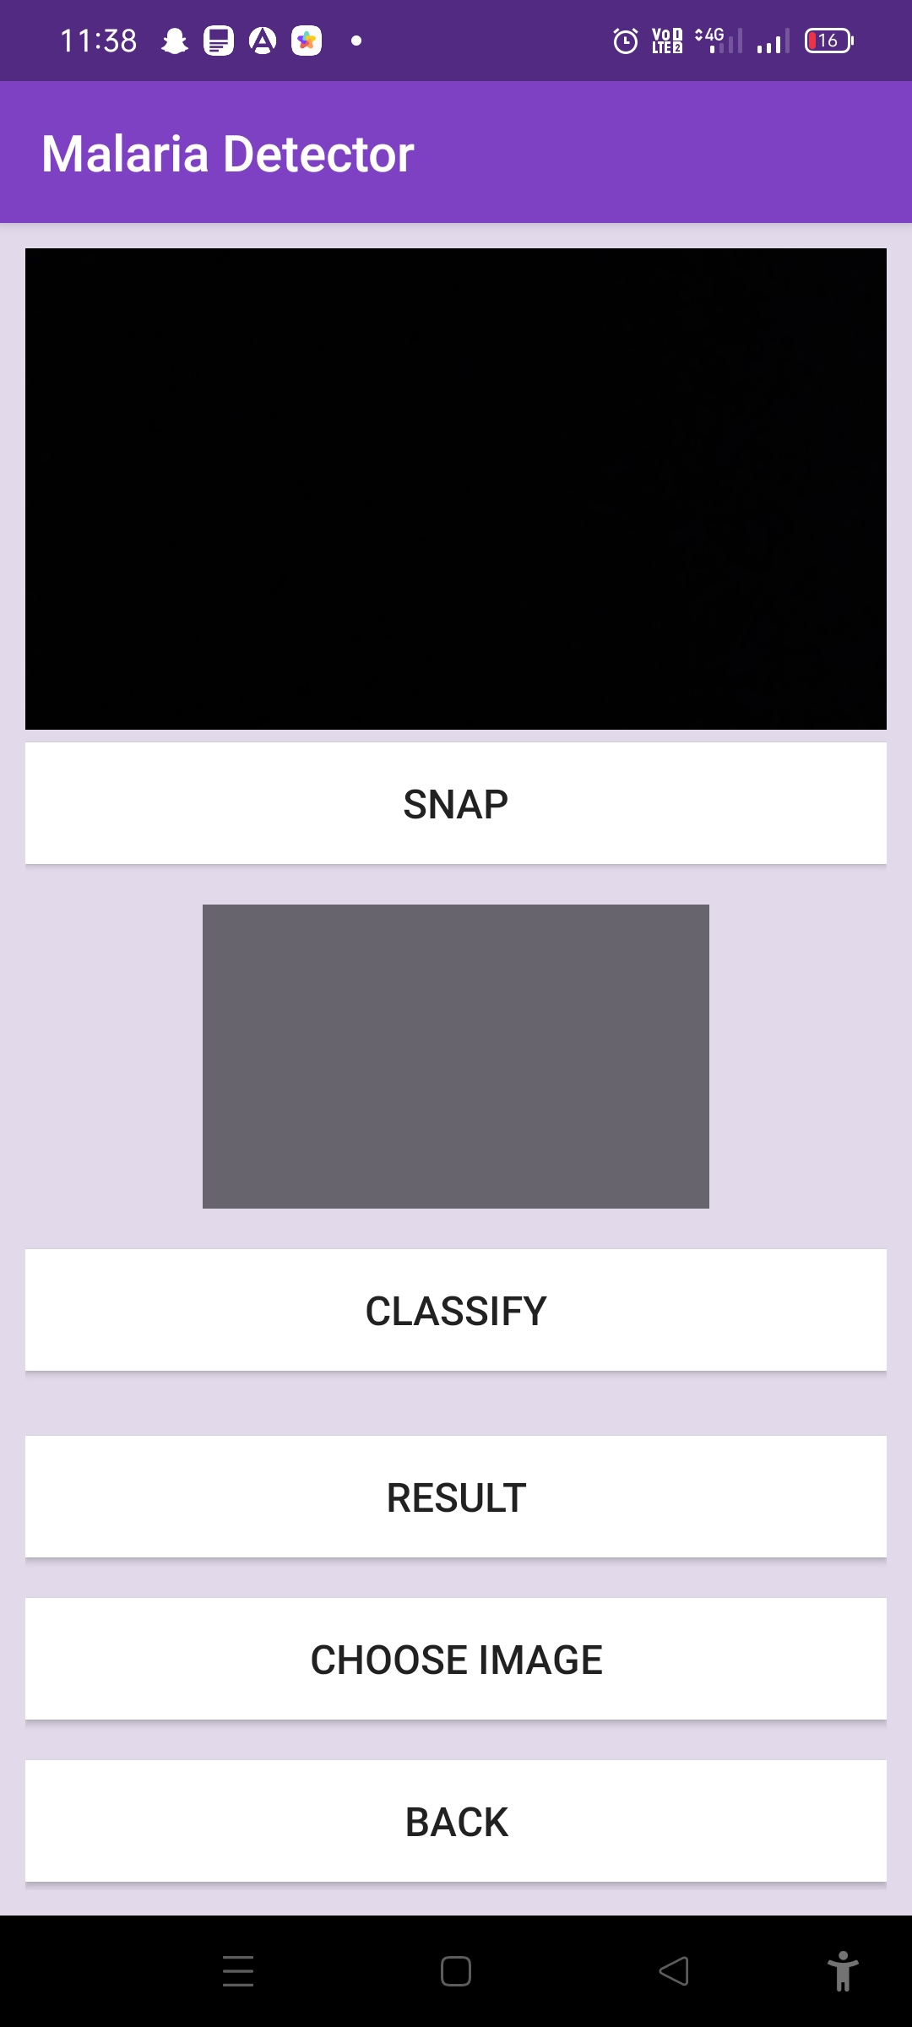
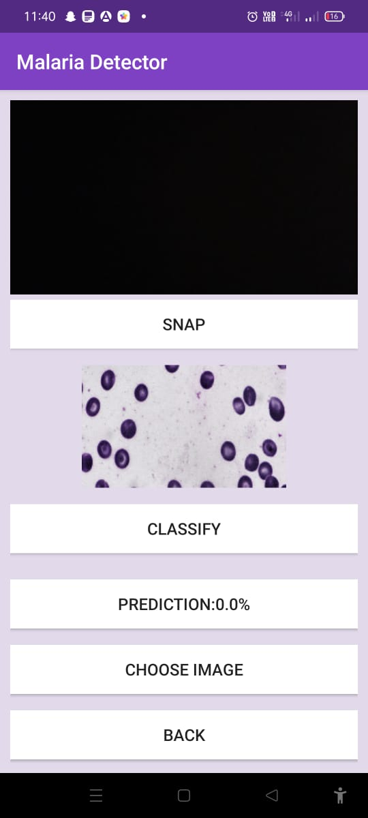
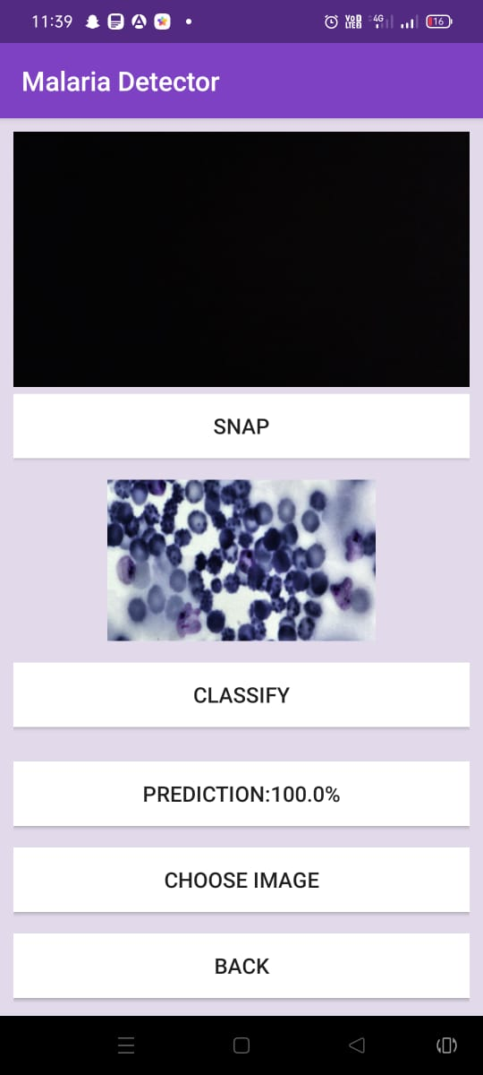
Andrioid App Results:

Slide 20
Conclusion
In this project, we successfully developed a deep learning model to classify malaria-infected and uninfected cells.
This model effectively uses a CNN for accurate malaria detection from blood smear images, enhanced by data augmentation and preprocessing.
Converting to TensorFlow Lite (TFLite) enables efficient deployment on mobile and edge devices, facilitating real-time diagnosis in remote areas.
Integrating the TFLite model into an Android project and a mobile app demonstrates practical applicability and user accessibility.

Slide 21
Future Scope
Real-world Deployment and Integration:
Mobile App Development: Develop mobile applications that integrate the TFLite model, providing healthcare workers with a user-friendly tool for on-site malaria diagnosis.
Integration with Healthcare Systems: Collaborate with healthcare providers to integrate the diagnostic tool into existing medical systems, ensuring seamless and widespread adoption.

Slide 22
References:
Ghate, D. A., Jadhav, C., & Rani, N. U. (2012). Automatic detection of malaria parasite from blood images. Int J Comput Sci Appl, 1.
Das, Dev Kumar, et al. "Machine learning approach for automated screening of malaria parasite using light microscopic images." Micron 45 (2013): 97-106.
Pan, W. David, Yuhang Dong, and Dongsheng Wu. "Classification of malaria-infected cells using deep convolutional neural networks." Machine learning: advanced techniques and emerging applications 159 (2018).
Pattanaik, Priyadarshini Adyasha, et al. "Malaria detection using deep residual networks with mobile microscopy." Journal of King Saud University-Computer and Information Sciences 34.5 (2022): 1700-1705.
Mehanian, Courosh, et al. "Computer-automated malaria diagnosis and quantitation using convolutional neural networks." Proceedings of the IEEE international conference on computer vision workshops. 2017.
Hoyos, Kenia, and William Hoyos. "Supporting Malaria Diagnosis Using Deep Learning and Data Augmentation." Diagnostics 14.7 (2024): 690.
Dev, Antora, et al. "Advancing Malaria Identification from Microscopic Blood Smears Using Hybrid Deep Learning Frameworks." IEEE Access (2024).

Slide 23
Any Questions?

Slide 24
Thank You...!!

