Slide 1

NEXTHIKES SOLUTIONS | ML PROJECT
Feature Extraction &
Price Prediction for Mobile Phones
Identifying the device specifications that most influence mobile phone pricing, and building a predictive model the business can trust.
Presented by Ashish Kumar
Dataset: Processed_Flipdata.xlsx • 541 Flipkart mobile phone listings

Slide 2








ROADMAP
What We'll Cover
Project Scenario & Objective
Dataset & Data Quality
Why the business needs this model
541 listings, 11 raw features, zero gaps
Feature Engineering
Exploratory Data Analysis
Turning raw text specs into usable numbers
Univariate, bivariate & multivariate patterns
Feature Extraction
Preprocessing
Correlation-based ranking of price drivers
Label encoding, standardization, normalization
Model Building & Evaluation
Feature Importance & Recommendations
Linear Regression, Decision Tree, Random Forest
What actually drives price, and what to do about it
Feature Extraction & Price Prediction | Ashish Kumar
2

Slide 3

PROJECT BRIEF
Scenario & Objective
The Scenario
KEY DELIVERABLES
A mobile phone retailer wants to sharpen its pricing strategy by understanding which device specifications genuinely drive price in today's competitive market — and to build a model that estimates price directly from those specifications.
End-to-end project report: exploration → extraction → modeling
Full, reproducible code and notebook
Project Objective
Build a predictive model that accurately estimates mobile phone price from its features, and run a feature extraction analysis to pinpoint the most influential specs — turning that insight into concrete pricing and marketing recommendations.
Visualizations of feature importance & price impact
Actionable pricing & marketing recommendations
Feature Extraction & Price Prediction | Ashish Kumar
3

Slide 4



SECTION 1 · DATA EXPLORATION
Dataset Snapshot
541
11
₹920 – ₹80,999
0
Mobile Phones
Features
Price Range
Missing Values
Feature Types
Numerical
Categorical
Binary
Memory, RAM, Battery, Mobile Height
Model, Colour, Processor, Camera specs
AI Lens (0 / 1)
No missing values and no duplicate rows were found — the dataset was complete and clean from the start, needing no imputation.
Feature Extraction & Price Prediction | Ashish Kumar
4

Slide 5

SECTION 2 · FEATURE ENGINEERING
Making Raw Specs Usable
Brand Extraction
Camera MP Conversion
Processor Family
Extracted from the first word of the 187-value Model field (e.g. "MOTOROLA G62 5G" → MOTOROLA), cutting cardinality while preserving pricing signal. Brand names normalized for consistency (I KALL, MICROMAX).
Rear Camera and Front Camera arrived as text ("50MP"). Stripped the unit and cast to numeric megapixels — Rear_Camera_MP and Front_Camera_MP — so they can be plotted, correlated, and modeled.
123 raw processor strings grouped into 7 families — Snapdragon, Dimensity, Helio, Unisoc, Exynos, Apple Bionic, Google Tensor — a far more model-friendly categorical feature.
Result: three noisy, high-cardinality text columns become clean, model-ready numeric and categorical features.
Feature Extraction & Price Prediction | Ashish Kumar
5

Slide 6
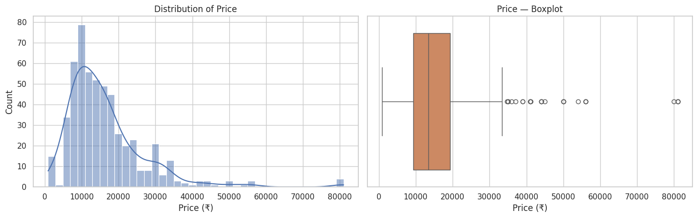
SECTION 3 · EXPLORATORY DATA ANALYSIS
Price Is Right-Skewed
Reading the Distribution
Skewness ≈ 2.4
Kurtosis ≈ 9.6
Most phones cluster in the budget/mid-range ₹5,000–₹20,000 band.
A long tail of flagship devices (iPhones, Galaxy S-series, Pixel) pulls the mean above the median.
This non-normal shape favors tree-based models, which don't assume linearity or normality.
Feature Extraction & Price Prediction | Ashish Kumar
6

Slide 7
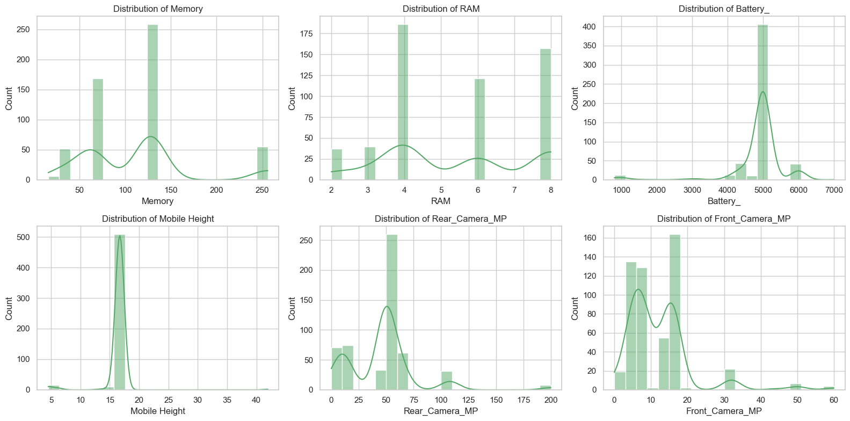
SECTION 3 · EXPLORATORY DATA ANALYSIS
Specs Cluster at Common Tiers
Memory and RAM show step-wise clustering at industry-standard tiers (32/64/128/256GB, 2/4/6/8GB). Battery concentrates heavily around 5,000mAh. Mobile Height clusters tightly ~16–17cm, apart from a small group of basic/feature phones.
Feature Extraction & Price Prediction | Ashish Kumar
7

Slide 8
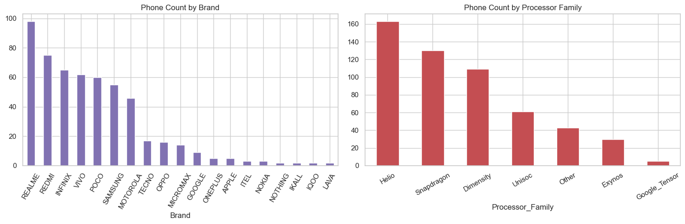
SECTION 3 · EXPLORATORY DATA ANALYSIS
Brand & Processor Landscape
REALME, REDMI, INFINIX, VIVO and POCO dominate the listing count — this dataset skews toward budget/mid-range Android brands, with only a handful of Apple/Google/OnePlus flagships. Helio and Snapdragon are the most common processor families. Only ~6% of phones carry an AI Lens.
Feature Extraction & Price Prediction | Ashish Kumar
8

Slide 9
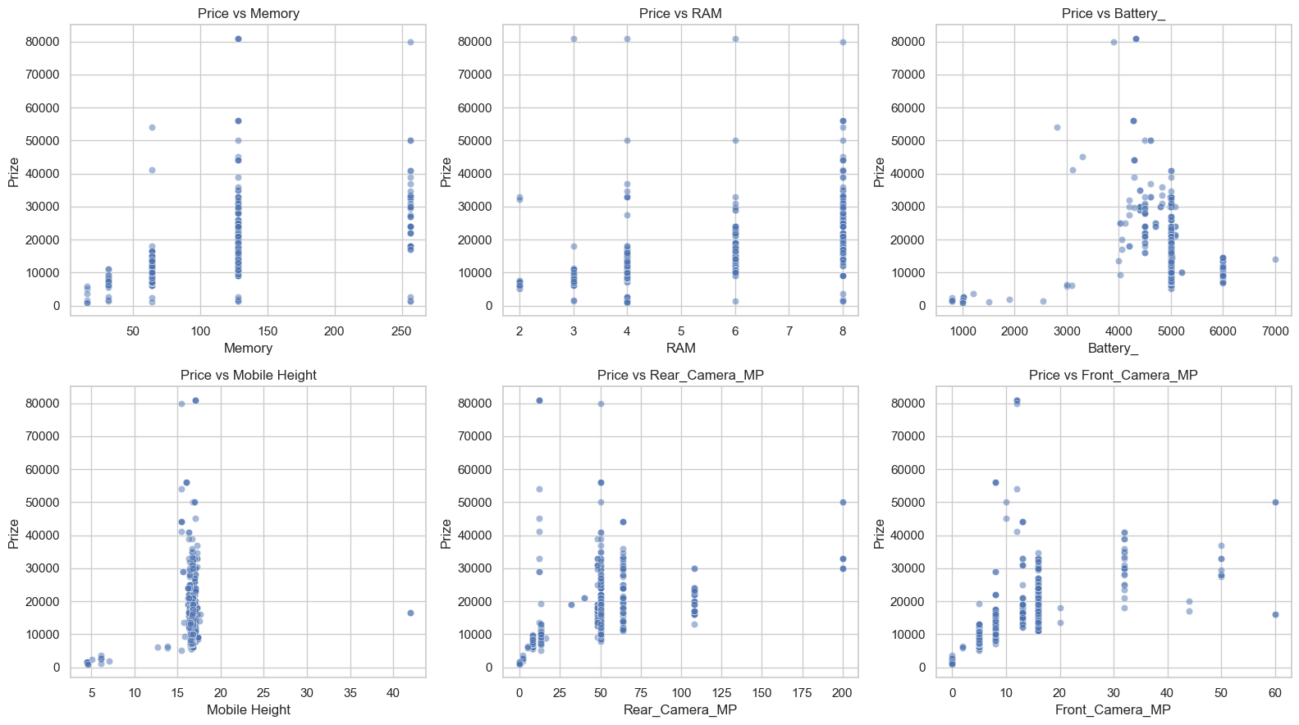
SECTION 3 · EXPLORATORY DATA ANALYSIS
Price vs. Specifications
Memory, RAM, and both camera specs show a clear upward trend with price. Battery shows almost no visible trend — most phones sit at 5,000mAh regardless of price tier. Mobile Height shows only a weak, noisy relationship.
Feature Extraction & Price Prediction | Ashish Kumar
9

Slide 10
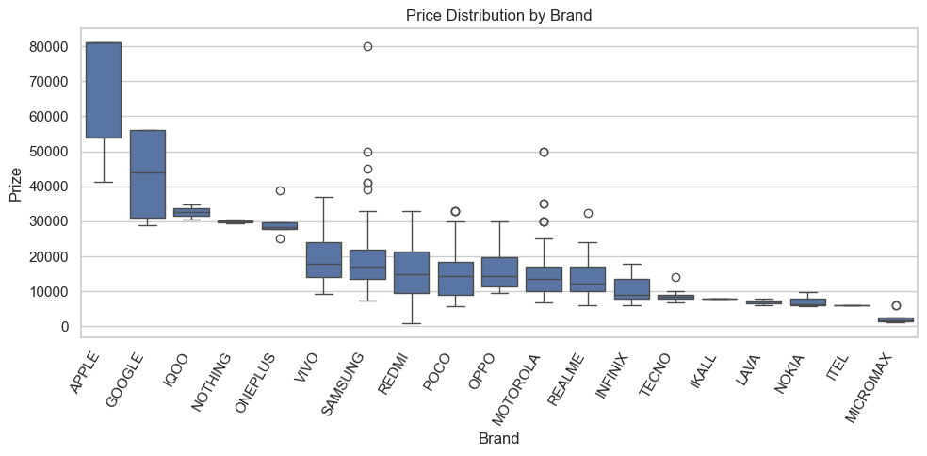
SECTION 3 · EXPLORATORY DATA ANALYSIS
Brand Carries Its Own Premium
What This Shows
Apple and Google command far higher median prices than budget brands like Micromax, Itel, and Lava.
For the same RAM tier, premium brands sit visibly higher than budget brands.
This is why Brand is retained as a modeled categorical feature rather than dropped after correlation analysis.
Feature Extraction & Price Prediction | Ashish Kumar
10

Slide 11
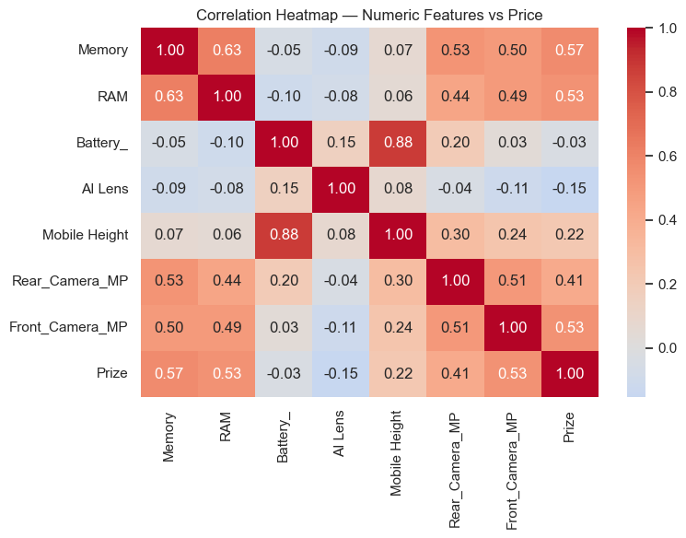
SECTION 4 · FEATURE EXTRACTION
Correlation With Price
Feature | Corr. with Price
Memory | 0.567
Front Camera (MP) | 0.532
RAM | 0.532
Rear Camera (MP) | 0.410
Mobile Height | 0.222
Battery | −0.034
AI Lens | −0.154
Memory, camera MP, and RAM show the strongest positive correlation with price. Battery and AI Lens show almost no linear correlation — but that doesn't rule out non-linear importance, confirmed later by the Random Forest.
Feature Extraction & Price Prediction | Ashish Kumar
11

Slide 12


SECTION 5 · PREPROCESSING
Encoding & Feature Scaling
5.1
5.2
5.3
Label Encoding
Standardization
Normalization
Brand and Processor Family converted to integer codes rather than one-hot dummies — compact, and well-suited to the tree-based models used here.
Numeric features (Memory, RAM, Battery, Height, Camera MP) rescaled to mean 0 / std 1, so no single spec's raw scale dominates a coefficient-based model.
The same numeric features rescaled to a 0–1 range via Min-Max scaling, computed and compared alongside standardization.
The standardized numeric features are combined with label-encoded categoricals and the binary AI Lens flag to build the final model-ready feature matrix.
Feature Extraction & Price Prediction | Ashish Kumar
12

Slide 13



SECTION 6 · MODEL BUILDING
Three Algorithms, Increasing Complexity
Linear Regression
Decision Tree
Random Forest
A simple linear baseline — assumes price moves proportionally with each spec.
Splits on feature thresholds (max depth 8) — captures non-linear jumps, e.g. mid-range to flagship.
An ensemble of 300 trees (max depth 12) — averages out overfitting for the most robust predictions.
80 / 20 train / test split • 432 training rows • 109 held-out test rows
Feature Extraction & Price Prediction | Ashish Kumar
13

Slide 14
SECTION 7 · MODEL EVALUATION
Random Forest Wins on Every Metric
Random Forest achieves the lowest error and highest R² (≈0.88) — its predictions are, on average, within roughly ₹1,600 of the actual price. It comfortably outperforms a single Decision Tree and plain Linear Regression, which struggles with price's non-linear jump from mid-range to flagship.
Feature Extraction & Price Prediction | Ashish Kumar
14

Slide 15
SECTION 8 · FEATURE IMPORTANCE
What Actually Drives Price
Top Takeaways
Front Camera MP dominates — by far the strongest single predictor.
Brand (Google, Samsung) adds a premium independent of raw specs.
Battery ranks in the top 5 despite near-zero linear correlation — its effect is threshold-based, not linear.
Memory, RAM and Rear Camera round out the core price drivers.
Feature Extraction & Price Prediction | Ashish Kumar
15

Slide 16
SECTION 9 · RECOMMENDATIONS
For the Organization
1
2
3
Anchor pricing on Memory, RAM & Front Camera
Lead marketing with camera specs
Treat battery as a tier marker, not a dial
The strongest, most consistent drivers across every method used — EDA, correlation, and Random Forest.
Front camera MP is the single highest-importance feature — buyers pay a premium for it, so it deserves top billing in listings and ads.
Little linear correlation with price, yet top-5 importance — most phones cluster at 5,000mAh, so use it to segment, not to price continuously.
4
5
6
Price in a brand premium explicitly
Deprioritize Colour & processor sub-model
Ship Random Forest to production
Google and Samsung command higher prices even after accounting for specs — factor brand equity into competitive pricing.
Colour was too sparse to encode reliably; specific processor identity mattered far less than expected once grouped into families.
MAE ≈ ₹1,600, R² ≈ 0.88 — the most accurate of the three while staying interpretable via feature importances.
Feature Extraction & Price Prediction | Ashish Kumar
16

Slide 17

CONCLUSION
Specs Explain Price — And Random Forest Proves It
Storage, RAM, and camera specifications are the clearest, most defensible drivers of mobile phone pricing in this dataset, with brand contributing a meaningful premium on top of specs. A Random Forest model trained on these engineered features predicts price with an average error of roughly ₹1,600, explaining ~88% of price variance — a solid foundation for a data-driven pricing strategy tool.
₹1,598
0.88
3
Avg. Error (MAE)
R² Score
Models Compared
Thank you — Ashish Kumar

