Slide 1

Disaster Tweet Classification
End-to-end NLP project report: exploration, modelling and live deployment
Ashish Kumar
Data Scientist, Next Hikes | 15 October 2026
Live app: https://disastertweetclassification-n.streamlit.app/
Notes:
Project report for the NLP disaster tweet classification challenge. Covers data exploration, feature engineering, model selection, evaluation and the live Streamlit deployment.

Slide 2
Executive summary
7,613
0.736
0.844
Live
labelled tweets analysed, 43% real disasters
F1-score on 1,497 held-out tweets
ROC-AUC of the final Linear SVM
Streamlit app deployed on the cloud
Key insights
What we built
Next steps
The keyword is the strongest single signal, yet the same word is used literally and figuratively
Disaster tweets read like news: links, numbers, longer words
Noisy labels cap accuracy near 80%
EDA, cleaning, TF-IDF plus meta-features
Five models compared with cross-validation and grid search
Flask and Streamlit apps with batch scoring
Add digit and URL-pattern features
Try GloVe or BERTweet embeddings
Review noisy labels and tune the threshold
Notes:
Headline: a tuned Linear SVM reaches F1 0.736 and ROC-AUC 0.844 on held-out tweets and is deployed as a live app. The EDA shows where the signal is (keyword, news-style text) and why accuracy plateaus (label noise).

Slide 3




Why disaster tweets are hard to classify
The same word means different things
Classification model
Relief agencies and newsrooms want real-time alerts from Twitter, but words like “fire” or “flood” are often used as metaphors.
Predict whether a tweet is about a real disaster
Accuracy and precision
“Forest fire near La Ronge Sask. Canada”
Keep false alarms low for timely, trustworthy alerts
Real disaster
Robustness
Handle slang, abbreviations and cultural nuance
“This new album is the bomb lol”
Not a disaster
Scalability
Score large volumes of tweets; deploy as a web app
Notes:
The core difficulty is intent: literal versus figurative use of disaster vocabulary. The four objectives come from the project brief.

Slide 4





Our approach: five steps, one pipeline
1
2
3
4
5
Explore
Clean
Engineer
Model
Deploy
Structure, balance, keywords, text patterns, noise
Strip URLs, mentions, entities; tokenise; de-duplicate
TF-IDF 1-2 grams, keyword token, 10 meta-features
Five classifiers, 5-fold CV, grid search
One pickled pipeline behind Flask and Streamlit
17 EDA charts
7,485 clean rows
Sparse feature matrix
Tuned Linear SVM
Live web app
One scikit-learn Pipeline: raw tweet in, disaster probability out. Training and both apps share the same code.
Notes:
The same cleaning and feature code is imported by training and by both apps, which avoids training/serving skew.

Slide 5

The data: 7,613 hand-labelled tweets
Column | Type | What it holds | Missing
id | int | Tweet identifier | 0%
keyword | text | Search keyword, 221 unique values | 0.8%
location | text | Free text, 3,278 unique values | 33.3%
text | text | The raw tweet, often with a link | 0%
target | 0 / 1 | 1 = real disaster, 0 = not | 0%
7,613
tweets, five columns
221
distinct keywords (e.g. wildfire, flood)
Modelling uses text and keyword; location is too noisy to help
The brief mentions about 10,000 tweets; the file supplied has 7,613
4,342 : 3,271
non-disaster vs disaster tweets
Notes:
Five columns. keyword is nearly complete, location is a third missing and free text. The brief quotes roughly 10,000 tweets but the supplied file has 7,613.

Slide 6
Classes are mildly imbalanced (43% disaster)
1.33 : 1
imbalance ratio: mild, no resampling needed
Class weights are enough to balance the loss
Accuracy alone can mislead, so we report precision, recall and F1
A stratified 80/20 split keeps the 43% share in both train and test
Notes:
4,342 non-disaster versus 3,271 disaster tweets. The imbalance is mild, so we use class weights and stratified splitting rather than resampling.

Slide 7
Keyword is the strongest single signal
221
keywords, only 0.8% of tweets lack one
23 of 216 frequent keywords are 80%+ disaster; 59 are 20% or less
Association with the label is highly significant (chi-square p near 0)
Necessary, not sufficient: “blazing”, “ruin” and “body bag” are almost always figurative
Notes:
Frequent keywords (n >= 20): 216 of 221. Red bars are near-certain disasters, blue bars are almost always non-disasters. The keyword is kept as a feature but cannot decide alone.

Slide 8
Disaster tweets read like news
109 vs 96
mean characters: disaster vs non-disaster
Links and numbers point to reports (correlation with label: URL 0.25, digit 0.23)
Questions, exclamations and @mentions point to chat (mention correlation -0.10)
Disaster words are longer: 6.5 vs 5.9 characters on average
Notes:
Differences in length and word length are significant (Mann-Whitney p below 1e-45). URL presence is already a model feature; digit presence is a candidate to add.

Slide 9
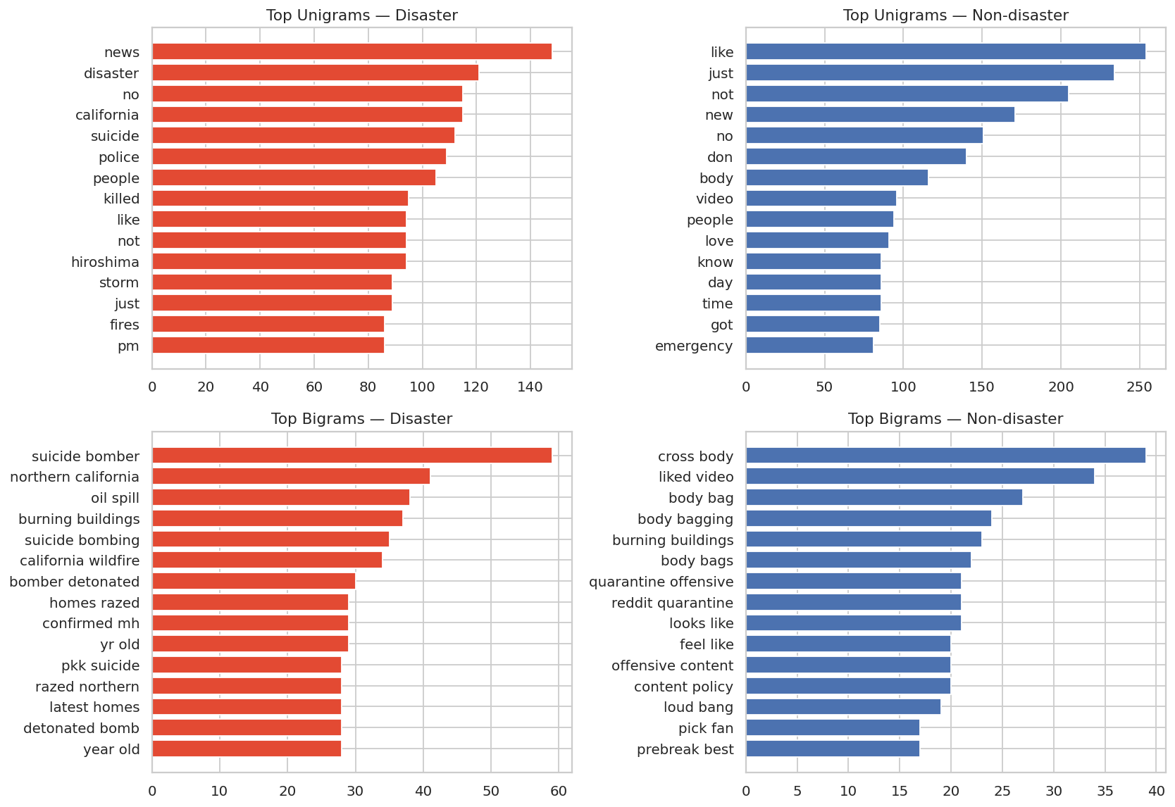
Vocabulary is sparse but telling
13,734
56%
unique tokens after cleaning
of tokens appear only once
Bigrams disambiguate: “suicide bomber” and “oil spill” signal disaster, “body bag” and “cross body” do not
Some phrases such as “burning buildings” appear in both classes
Sparsity calls for min_df, sublinear TF-IDF and regularisation
Notes:
About 62k tokens after cleaning, 38% of raw tokens are stop-words. Bigrams are why we use 1-2 gram TF-IDF.

Slide 10



Data quality issues we found and fixed
How we handled it
Dropped the 18 conflicting texts and kept one copy of each duplicate: 7,613 rows became 7,485, so identical tweets never straddle train and test
Removed HTML entities and garbled characters in cleaning
Excluded location from the model
Accepted the remaining label noise and measured its impact in the error analysis
179
18
rows share duplicate text
texts carry conflicting labels
~13%
33%
tweets contain encoding junk or HTML entities
locations missing; 29 cells auto-converted by Excel
Notes:
Identical tweet text appears with both labels, for example a Hellfire reflection tweet labelled 0 and 1. This sets a ceiling on achievable accuracy.

Slide 11
Cleaning and feature engineering
Text preparation
Features
Lowercase; strip URLs, @mentions, HTML entities, digits and punctuation
Keep hashtag words (#flood becomes flood)
Tokenise and drop stop-words, but keep “not”, “no” and “never”
Stratified 80/20 split: 5,988 train, 1,497 test
TF-IDF on 1-2 grams with sublinear term frequency
The tweet’s keyword appended as an extra token
Ten meta-features: length, words, hashtags, mentions, URL flag, caps ratio, ! and ? counts, keyword flag
Class weights to balance the loss
TF-IDF (sparse text) + scaled meta-features = FeatureUnion → classifier
Notes:
Keeping negations matters in tweets. Meta-features are min-max scaled so Naive Bayes can use them. Word embeddings (Word2Vec/GloVe) were not used because no embedding library was available in the build environment; they are listed as a next step.

Slide 12
Cross-validation: top models are tied
± 0.013
typical fold-to-fold std of F1, wider than the 0.011 gap among the top four
Logistic Regression, Linear SVM, MLP and Naive Bayes are statistically close
Random Forest is clearly weakest: sparse text suits linear models
Grid search tuned C, n-gram range and min_df; the SVM won with C = 1, 1-2 grams
Notes:
Five-fold stratified CV on 5,988 training tweets. Because the top models differ by less than the fold-to-fold spread, the final choice rests on test performance, recall and the ability to output calibrated probabilities.

Slide 13
Test results: precision vs recall trade-off
Linear SVM and Logistic Regression tie on F1 (0.736) with the best recall
Naive Bayes and MLP reach 0.84 precision but miss about 38% of disasters
For alerts, missing a real disaster is costlier than a false alarm, so we chose the SVM
ROC-AUC is about 0.84 for all but Random Forest (0.82)
Notes:
Accuracy ranges from 0.758 (Random Forest) to 0.790 (MLP). The app's threshold slider lets an operator trade recall against precision.

Slide 14
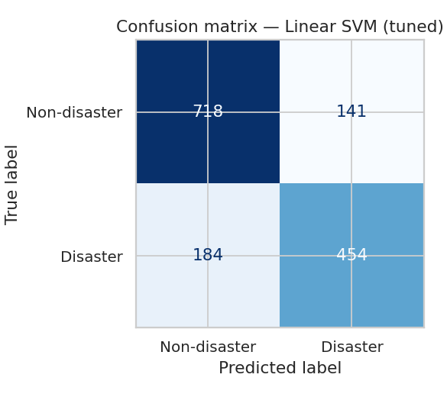
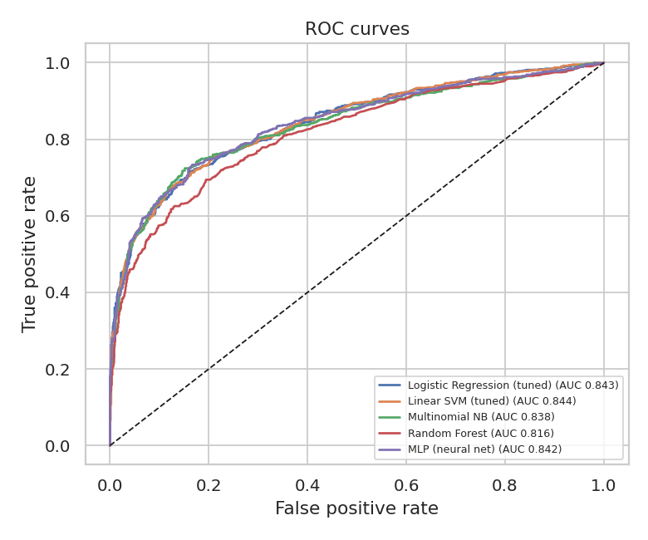
Final model: Linear SVM (tuned)
Probabilities come from calibrated SVM scores, so the app can show confidence
ROC curves of all models nearly overlap: the ceiling is the data, not the algorithm
Train F1 is about 0.98 vs 0.74 on test: the model overfits
0.783
0.763
0.712
0.736
0.844
Accuracy
Precision
Recall
F1-score
ROC-AUC
Notes:
Final test metrics for the tuned Linear SVM. The train/test gap is a known limitation; stronger regularisation, more data or pre-trained embeddings are the main levers.

Slide 15




Where the model fails
Tweet (excerpt) | True | P(disaster) | Likely reason
all that panicking made me tired ;__; i want to sleep in my bed | 1 | 0.01 | Label looks wrong
@allen_enbot If you mess up it’s gonna explode... | 1 | 0.03 | Figurative; label doubtful
White family … gets blown up in a horrible CGI nuclear strike | 1 | 0.03 | Film commentary
Santa Fe Springs Studebaker Rd / South St Trfc Collision-No Inj | 0 | 0.96 | News-style alert labelled 0
Metaphor and sarcasm
Bag-of-words cannot read intent
Noisy labels
Identical tweets with opposite labels cap accuracy
Overfitting
Train F1 0.98 vs test 0.74
Dated data
2015-era tweets; new slang may be missed
Most confident mistakes on the test set: several look like label noise rather than model error.
Notes:
Error analysis: the highest-confidence errors are often questionable labels. Fixing labels and adding contextual embeddings are the most promising improvements.

Slide 16
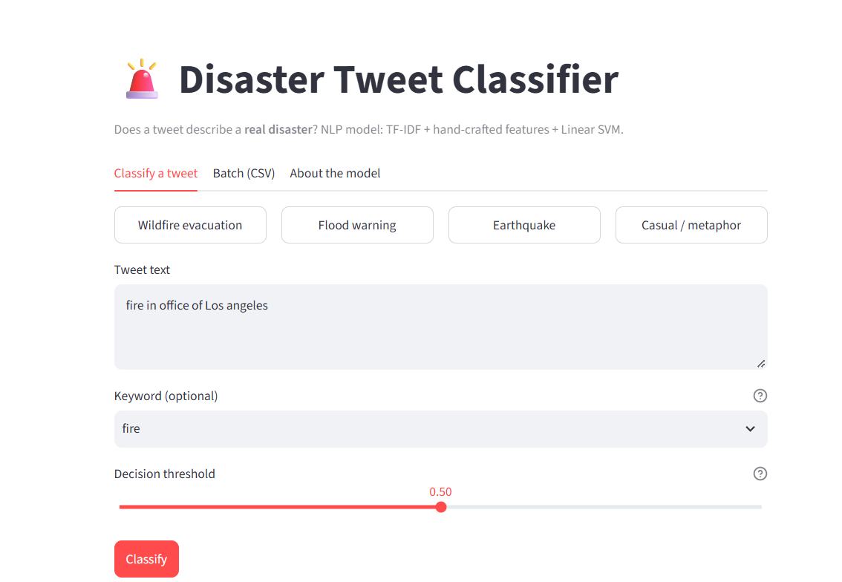
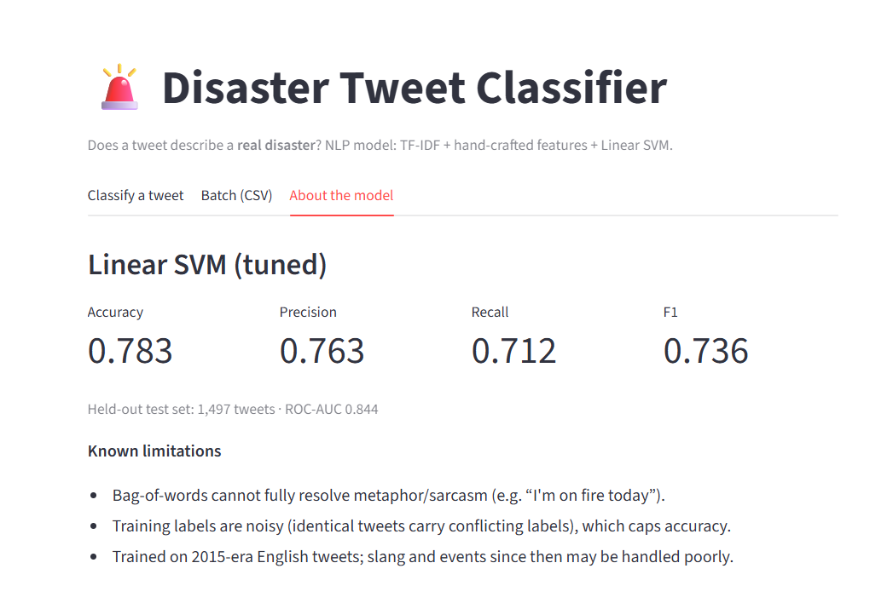
Live app on Streamlit Cloud
Classify a tweet: text, optional keyword, adjustable decision threshold
About the model: test metrics and known limitations (plus Batch CSV tab)
Live app: https://disastertweetclassification-n.streamlit.app/
Streamlit Cloud | GitHub | scikit-learn pipeline
Notes:
The deployed app loads the same pickled pipeline used in training. Tabs: classify a single tweet, score a CSV/Excel file in batch, and a model card. A Flask version is also included in the repository.

Slide 17


Conclusions and next steps
What we delivered
Next steps
Full EDA with 17 charts and a documented set of insights
Add digit presence and URL-pattern features found in the EDA
Tuned Linear SVM: F1 0.736, ROC-AUC 0.844 on held-out tweets
Test GloVe features or fine-tune BERTweet for context
Streamlit and Flask apps with single and batch scoring
Review conflicting labels and re-measure the ceiling
Reproducible GitHub repo, notebooks and pinned dependencies
Tune the alert threshold with the relief-agency cost of misses
Try it live: https://disastertweetclassification-n.streamlit.app/
Notes:
Wrap-up. The model is deployed and usable today; the EDA points to concrete, low-cost feature improvements, and embeddings or a transformer are the larger upgrade.

