Slide 1
ML PROJECT · FORECASTING
Rossmann Store
Sales Forecasting
1.017M
1,115
TRAINING ROWS
STORES
0.104
0.131
Overall Project Analysis Report
LSTM RMSPE
LIGHTGBM RMSPE
EDA · Machine Learning · Deep Learning · Deployment
Prepared by: Ashish Kumar
NextHikes IT Solutions

Slide 2
EXECUTIVE SUMMARY
2
One Project, Three Modeling Layers
The project moves from behavioural evidence to deployable store-level forecasting, with deep learning used as a dedicated time-series experiment.
1
Understand
2
Predict
3
Learn Sequences
4
Serve
EDA identifies promotion, customer,
calendar, store and competition effects.
Random Forest → LightGBM improves store-day forecast accuracy.
A 2-layer LSTM captures weekly structure from a 14-day window.
Streamlit exposes predictions, metrics, plots and CSV download.
KEY RESULT
LSTM = 0.1041 RMSPE on aggregate six-week validation; LightGBM = 0.1313 RMSPE for per-store daily forecasting.
2

Slide 3
BUSINESS PROBLEM
3
What Are We Forecasting?
Rossmann needs reliable daily sales forecasts across a large multi-store network. The challenge combines demand seasonality with store-specific behaviour and operational context.
1
Forecast
2
Explain
Estimate daily sales for each store and date.
Identify the drivers behind sales and customer traffic.
3
Compare
4
Deploy
Benchmark classical time-series, ML and deep-learning approaches.
Turn the strongest operational model into a manager-facing application.
Primary evaluation metric: RMSPE · Supporting metrics: MAE and R² · Validation: final six weeks
3

Slide 4
DATA OVERVIEW
4
From Raw Transactions to a Modeling Base
1.017M
41,088
1,115
18
TRAINING ROWS
TEST ROWS
STORES
MERGED COLUMNS
DATA SOURCES
ANALYSIS GRAIN
• Rossmann store-level daily sales history
• Store metadata: type, assortment and competition
• Promotion, holiday and calendar information
• Customer counts used as a behavioural signal
Two complementary grains were used:
STORE-DAY
Production LightGBM
AGGREGATE-DAY
ARIMA / SARIMA / LSTM
4

Slide 5
DATA PREPARATION
5
Cleaning, Leakage Control & Feature Engineering
1
Clean
2
Calendarize
3
Context
Closed-store rows are handled separately; missing store attributes are treated explicitly.
Year, month, day, week-of-year, weekend and month-period features.
Holiday proximity, competition-open duration and promotion tenure.
LEAK-SAFE STORE TARGET ENCODING
StoreTargetEnc replaces the raw integer store ID with a smoothed historical sales level calculated from the training split only.
• Training-only statistics prevent future information from entering validation.
• Global mean fallback handles unseen stores safely.
• The resulting encoding becomes one of the strongest LightGBM features.
5

Slide 6
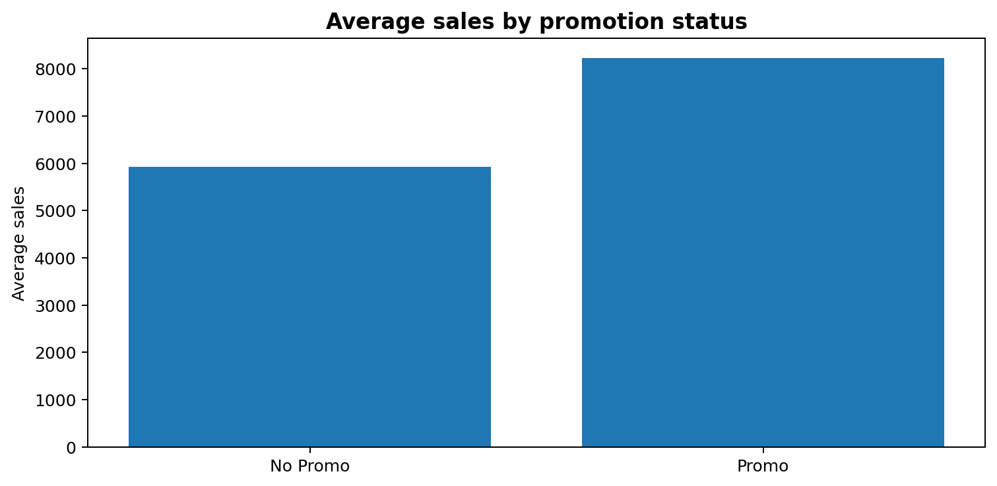
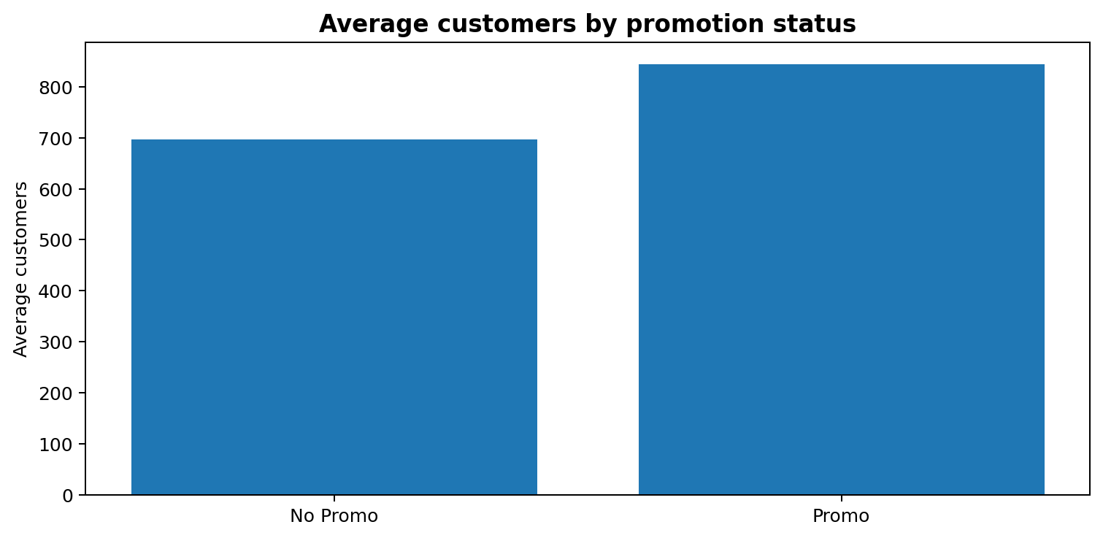
EDA · DEMAND DRIVERS
6
Promotion and Customer Traffic Move Together
0.824
+38.6%
+21.2%
144.9%
SALES–CUSTOMERS CORRELATION
SALES: PROMO VS NO PROMO
CUSTOMERS: PROMO VS NO PROMO
TOP STORE PROMO UPLIFT
Insight: promotion is associated with higher traffic and higher sales, but the magnitude varies substantially by store.
6

Slide 7
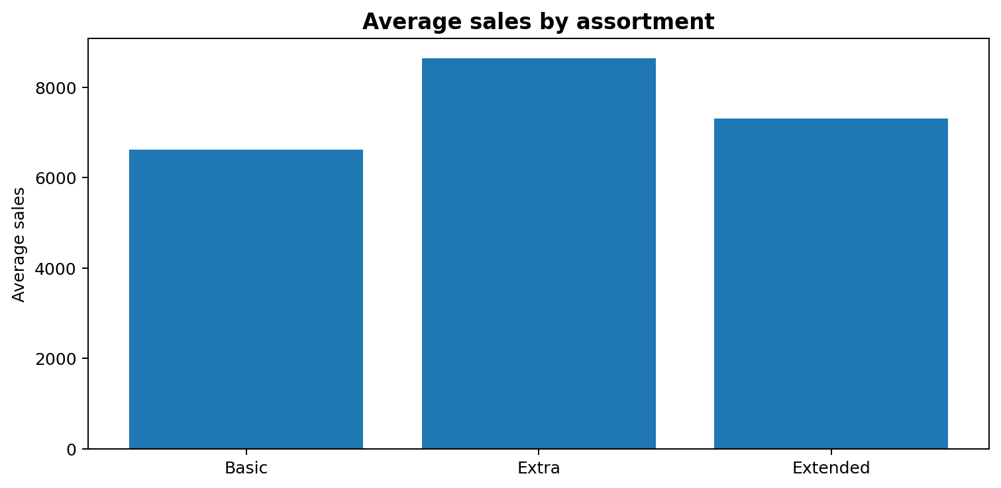
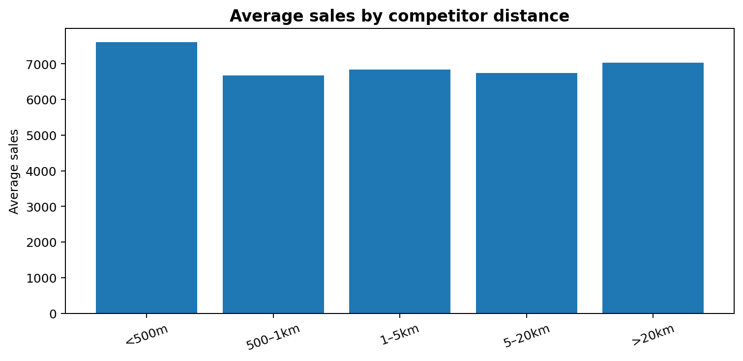
EDA · STORE CONTEXT
7
Assortment and Competition Are Contextual Signals
ASSORTMENT
Extra stores average the highest sales (8,639), but the group is small — treat as directional.
COMPETITION
Distance is non-monotonic; locality and footfall likely interact with competition.
Commercial implication: avoid one-variable rules. Combine store format, historical demand, promotions and local context.
7

Slide 8
EDA · TIME STRUCTURE
8
Weekly Seasonality Is the Dominant Temporal Signal
AGGREGATE TIME SERIES
WHY THIS MATTERS FOR MODELING
942
ARIMA
1
daily observations
Baseline linear dynamics; no explicit weekly seasonal term.
ADF
2
SARIMA
−5.4154
Adds a weekly seasonal component (period 7).
p = 0.0000 → stationary raw series
3
LSTM
ACF / PACF
Learns sequence structure directly from the previous 14 days.
Strong lag-7 pattern → weekly seasonality
8

Slide 9
MACHINE LEARNING
9
Baseline Random Forest → LightGBM v2
V1 · RANDOM FOREST
V2 · LIGHTGBM
0.343
1,523
0.131
614
RMSPE
MAE
RMSPE
MAE
• Pipeline-based preprocessing
• Tree ensemble baseline
• Time-based six-week validation
• Useful benchmark, but limited store representation
• Leak-safe smoothed StoreTargetEnc
• Calendar + promo + holiday + competition features
• R² = 0.915
• 62% RMSPE reduction vs Random Forest
Takeaway: feature representation mattered as much as model complexity.
9

Slide 10
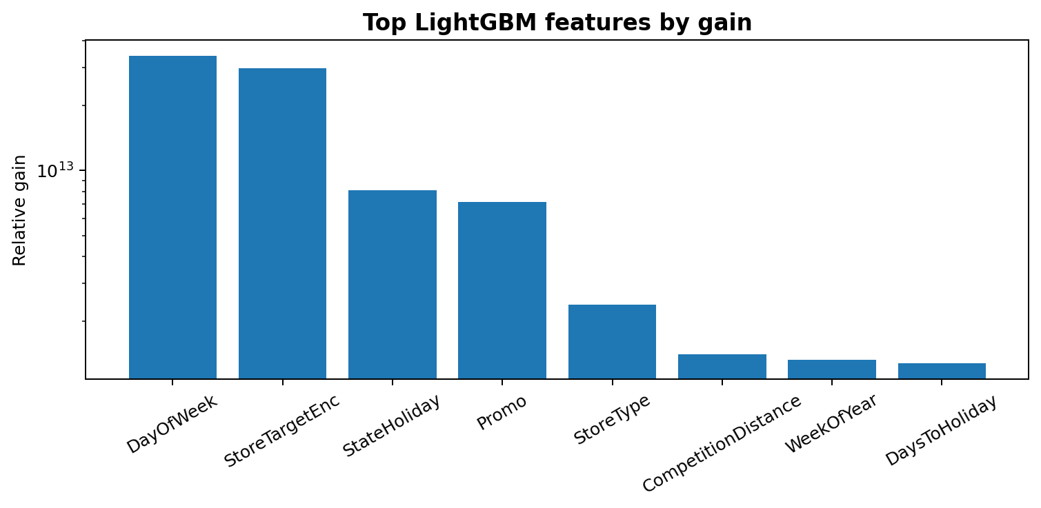
a
LIGHTGBM · EXPLAINABILITY
10
What the Production Model Learns
TOP SIGNALS
The model confirms the EDA: historical store behaviour + weekly timing are the strongest predictive signals.
10

Slide 11
DEEP LEARNING
11
Why an LSTM Was Added
The LSTM experiment isolates aggregate daily sales per open store so that sequence learning can be compared fairly with ARIMA and SARIMA on the same six-week validation horizon.
1
Sequence Input
2
Scale
3
Learn
Previous 14 daily values become one supervised input window.
Min–max scaling to (−1, 1), fitted on training data.
Two recurrent layers learn temporal dependencies and weekly structure.
DEEP LEARNING HYPOTHESIS
A 14-day memory should contain enough information to learn the dominant 7-day retail cycle without manually specifying a seasonal term.
11

Slide 12
DEEP LEARNING · ARCHITECTURE
12
2-Layer LSTM Model
14-DAY
WINDOW
LSTM
32 UNITS
LSTM
32 UNITS
DENSE
1
Input
Recurrent
Recurrent
Output
12,705
Adam
MSE
79
TRAINABLE PARAMETERS
OPTIMIZER
LOSS
RECORDED EPOCHS
Early stopping: patience = 8 · maximum 80 epochs · batch size = 16
12

Slide 13
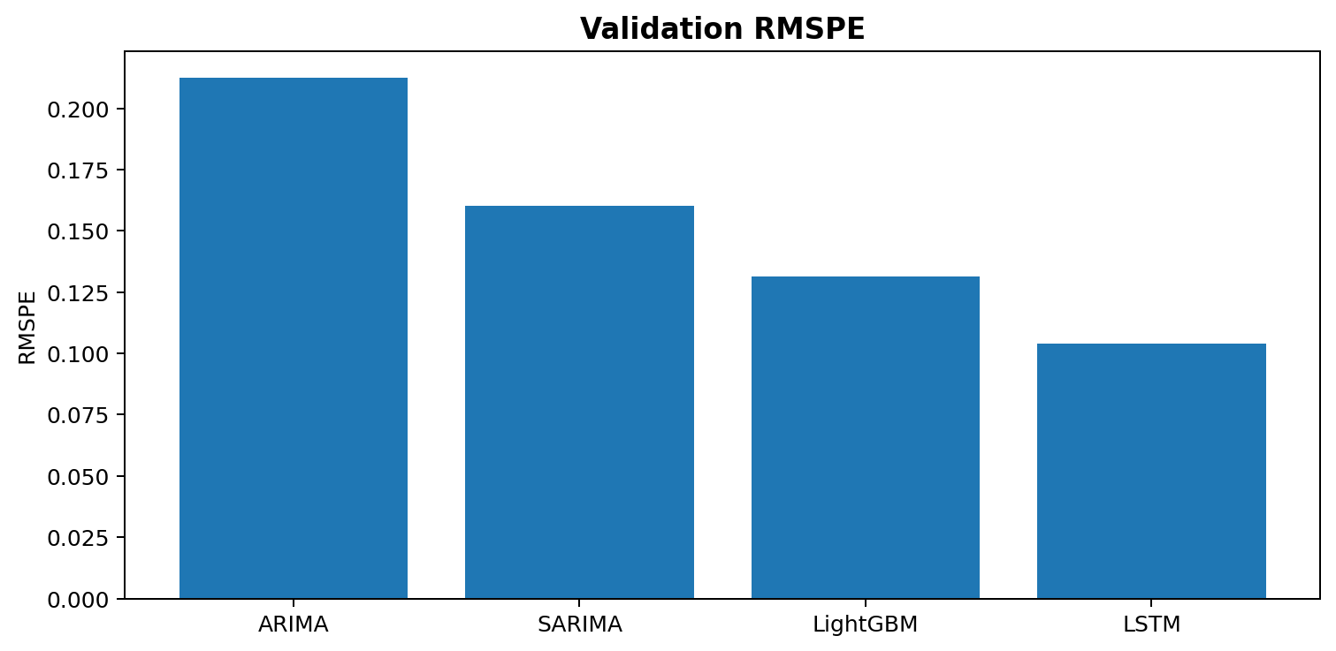
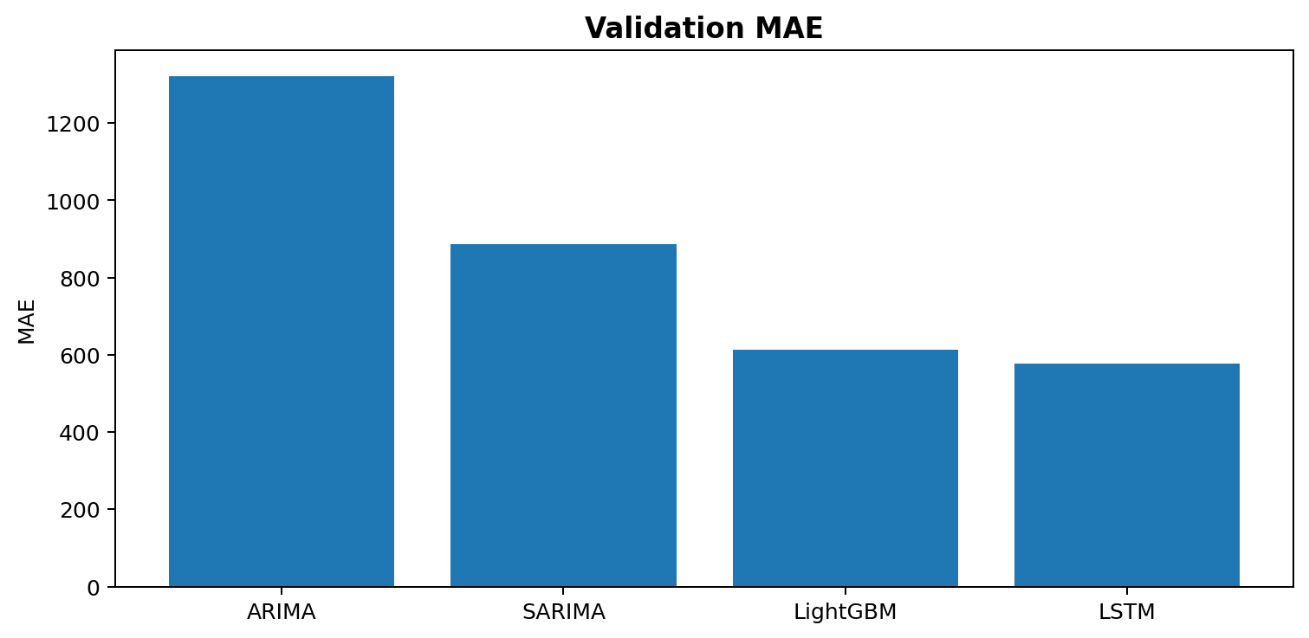
MODEL COMPARISON
13
Deep Learning Wins the Aggregate Time-Series Benchmark
LSTM: 0.1041 RMSPE / 577.3 MAE → best aggregate result. SARIMA: 0.1600 / 885.8 · ARIMA: 0.2125 / 1322.0
13

Slide 14
MODEL DECISION
14
LSTM Is the Best Aggregate Model; LightGBM Is the Production Model
LSTM
LIGHTGBM
Best for aggregate demand dynamics
Recommended for production serving
• Lowest aggregate RMSPE
• Learns weekly pattern from raw sequence windows
• Useful for macro demand, capacity and inventory planning
• Not a direct per-store operational forecast
• Per-store, per-day prediction
• Uses store history + promo + holiday + competition context
• RMSPE 0.1313, MAE 614, R² 0.915
• Matches the manager-facing dashboard use case
The correct decision is based on operational granularity, not only the lowest metric.
14

Slide 15
PREDICTION UNCERTAINTY
15
From Point Forecasts to Prediction Bands
PRODUCTION BUNDLE
VALIDATION EXAMPLE
90% prediction interval
Actual sales
13,995
Point prediction
12,222
P05 — P95
9,413 — 14,946
Why it matters
Planning teams can size inventory, staffing and financial expectations against a plausible range rather than a single point estimate.
15

Slide 16
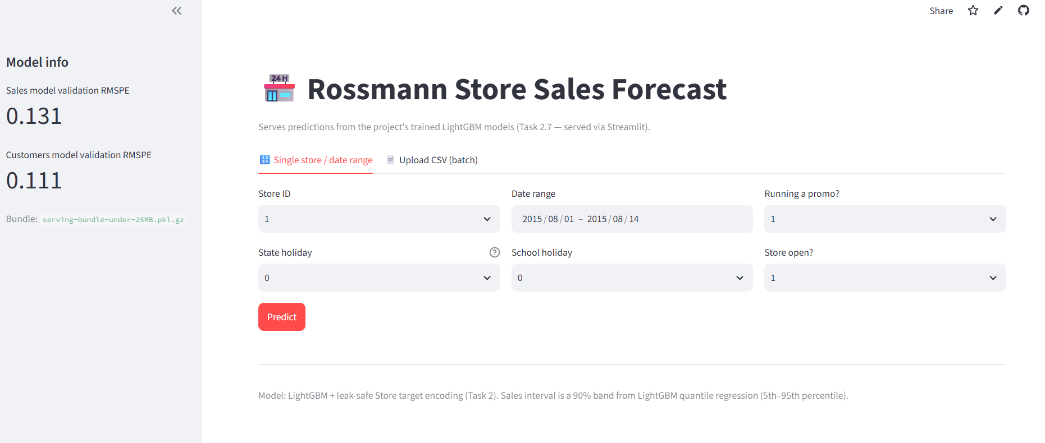
DEPLOYMENT
16
Streamlit Turns the Model Into a Business Tool
DASHBOARD WORKFLOW
• Select store and forecast date range
• Set promo / holiday / opening inputs
• Generate sales and customer forecasts
• Visualize predicted values
• Download CSV predictions
• Display validation RMSPE metrics
GitHub
github.com/shakya362/
rossmann_store_sales
Live app
rossmann-store-sales-forecast.
streamlit.app
16

Slide 17
CONCLUSION
17
What the Project Demonstrates
01
EDA → Evidence
03
Deep Learning → Sequence
04
Production → Action
• Promo and customers matter
• Weekly seasonality is strong
• Store context is heterogeneous
• LightGBM serves store-day forecasts
• Quantile models add uncertainty
• Streamlit enables business use
2-layer LSTM
14-day memory
0.1041 RMSPE
Best aggregate time-series benchmark
02
Modeling → Improvement
NEXT STEPS
RF 0.343 → LightGBM 0.131
Add lag/rolling store features · dedicated Customers model · hybrid LightGBM + LSTM
FINAL MESSAGE · The project is strongest when deep learning and production ML are treated as complementary tools for different forecasting grains.
17

Slide 18
