Slide 1
Rossmann Sales Forecasting — Customer Purchasing Behaviour
Executive first-pass EDA | Decision question: is deeper investigation worth the effort?
1.017M
training rows
41,088
test rows
1,115
stores
0
remaining nulls after cleaning
Promotions, holidays, seasonality, store format and competition all show meaningful relationships with purchasing behaviour.
Sales and Customers are strongly positively correlated (~0.82–0.85), making customer traffic a key business signal.
Promo response varies materially by store, suggesting targeted promotions can outperform blanket promotion strategies.
Recommendation: continue investigation — especially store-level promo uplift, holiday effects and locality/competition interactions.
Rossmann Store Sales | Task 1 — Customer Purchasing Behaviour

Slide 2
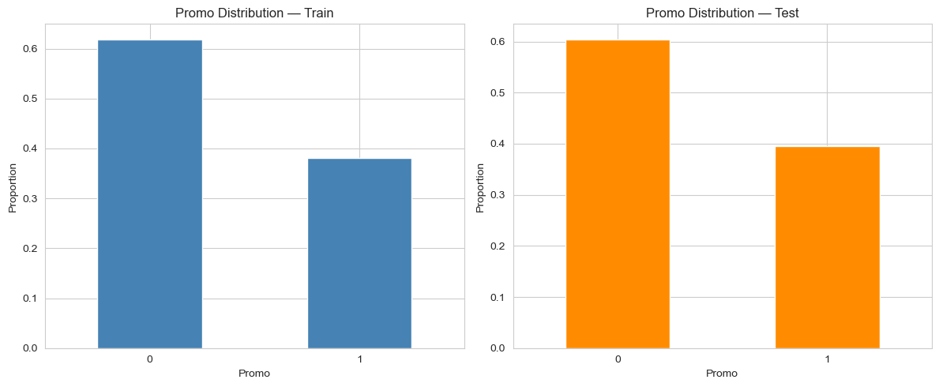
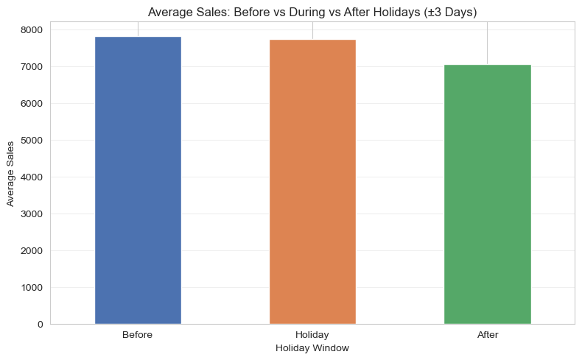
Data quality, promotions & holiday behaviour
The first-pass EDA shows stable train/test promo exposure but strong calendar effects.
38.15%
train promo days
39.58%
test promo days
7,818.8
avg sales: 3 days before holiday
7,050.0
avg sales: 3 days after holiday
Promo split is very similar between train and test → no meaningful sampling bias.
Holiday demand shows a pre-holiday stock-up effect; Christmas and Easter produce the strongest seasonal lift.
Rossmann Store Sales | Task 1 — Customer Purchasing Behaviour

Slide 3
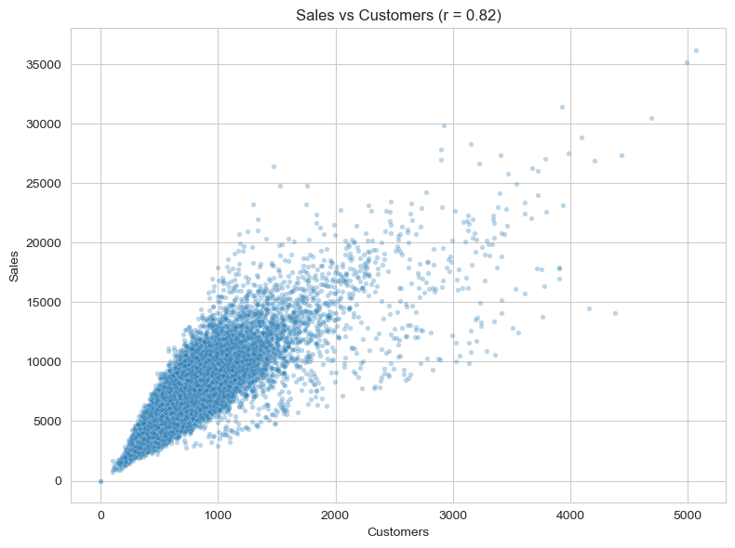
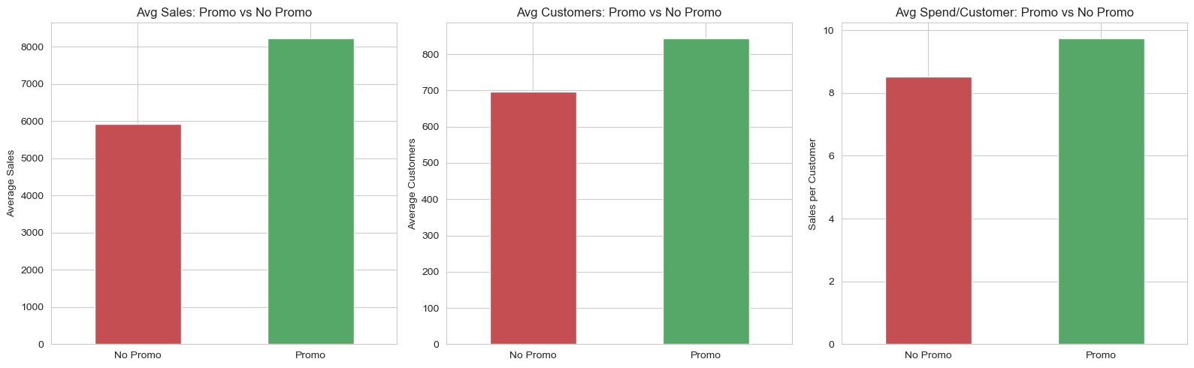
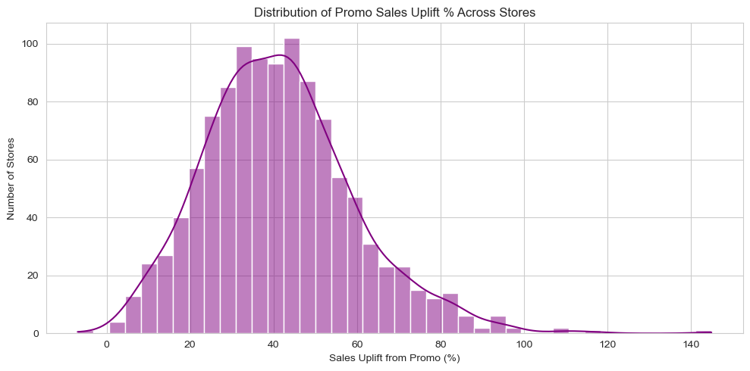
Customers and promotions are commercially actionable
Foot traffic explains much of sales variation, while promo response differs by store.
Sales ↔ Customers correlation is ~0.82–0.85: more footfall generally means more revenue.
Promo days lift both average sales and customer counts, with slightly higher spend/customer; store-level uplift has a long tail.
Rossmann Store Sales | Task 1 — Customer Purchasing Behaviour

Slide 4
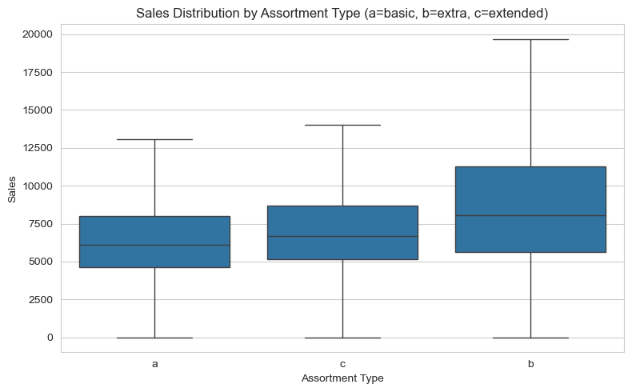
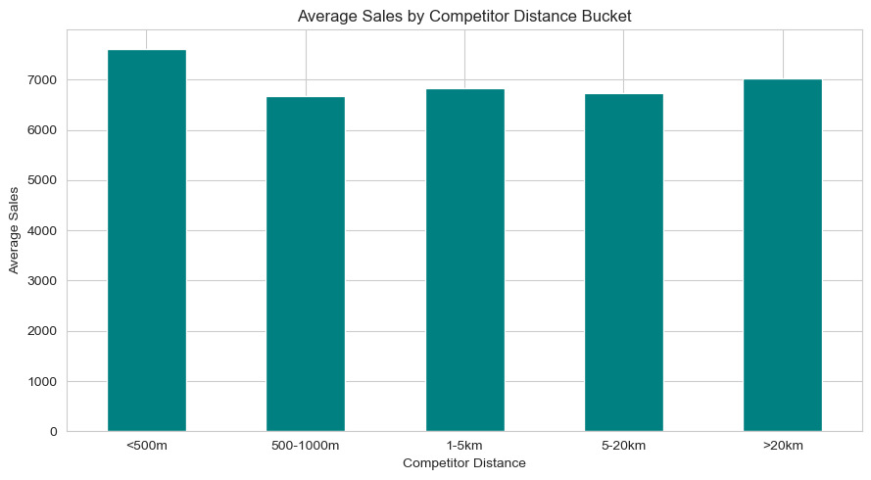
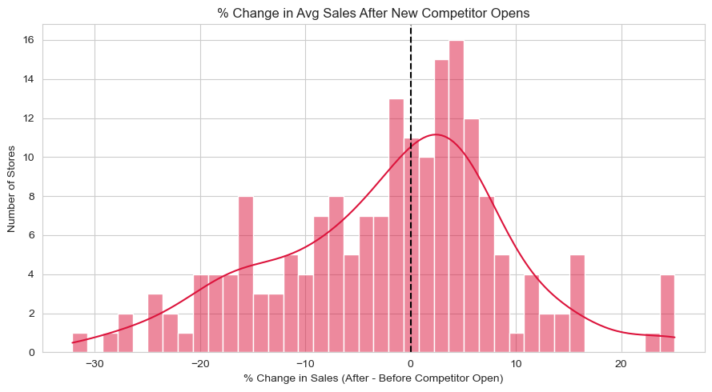
Store format and competition: context matters
Raw competitor distance is not enough; locality and store characteristics should be modelled together.
Assortment: extra/extended formats outperform basic on average; the 'extra' group is very small, so treat this as directional rather than causal.
Competition distance has a weak/counterintuitive relationship with sales — close competitors can coexist with high sales, likely reflecting high-footfall locations.
New competitor openings show no strong universal sales decline; impact is store-specific.
Modeling implication: combine competition with StoreType, Assortment and locality proxies rather than using distance alone.
Rossmann Store Sales | Task 1 — Customer Purchasing Behaviour

Slide 5
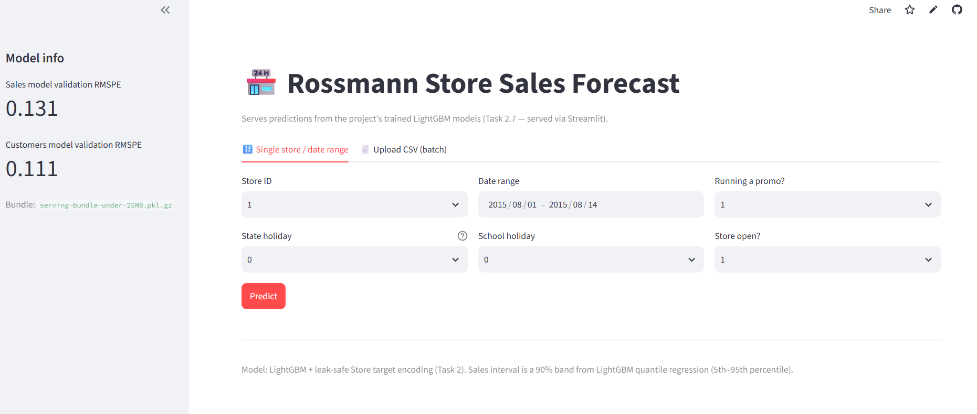
Decision, next steps & delivery evidence
The EDA supports deeper investigation and directly informs the forecasting pipeline.
GO: further investigation is useful.
Prioritize targeted promotions using store-level uplift.
Engineer holiday proximity, seasonality, weekday-open behaviour and store-level history.
Treat CompetitionDistance as contextual, not causal on its own.
v1 Random Forest | RMSPE 0.343 | MAE 1,523
v2 LightGBM + target encoding | RMSPE 0.131 | MAE 614
LSTM (aggregate) | RMSPE 0.104 | MAE 577
Deployed Streamlit dashboard — current production bundle: LightGBM v2.
GitHub: https://github.com/shakya362/rossmann_store_sales | App: https://rossmann-store-sales-forecast.streamlit.app/
Submission note: add a real DVC-store screenshot and, if required by the rubric, an MLflow/model-version screenshot. Do not present placeholders as evidence.

