Slide 1
CMPE-275
Team - 11
Highest random weight hashing (Rendezvous)
Presented by :
Mitash Gaurh
Shalabh Neema
Under Guidance of :
Prof. John Gash

Slide 2
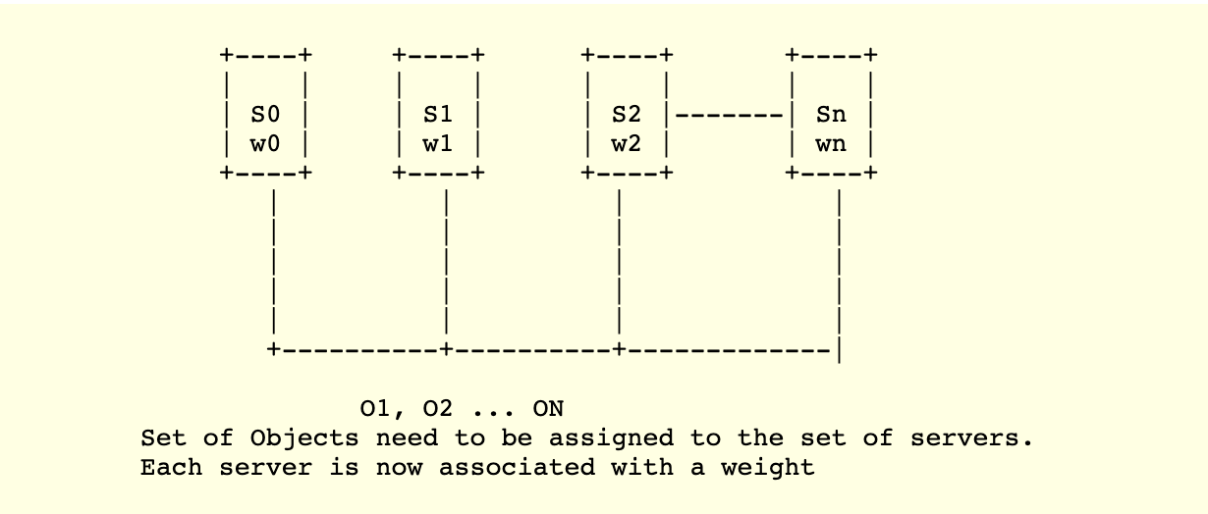
Introduction
Hashing is a process that maps data of a variable length to data of a fixed length.
A common way of load balancing across n cache nodes is to put object o in cache node number hash(o) mod n.
When you remove from cache nodes, every object needs to hash to a new location.

Slide 3
Rendezvous Hashing
Rendezvous hashing uses Highest Random Weight (HRW) to distribute objects uniformly over all nodes.
How to compute Weight for object?
• w(i ,j) = hash (Key(i) , Server(j) )
• For a given Key, compute weight for all Nodes.
• Assign Key (i) to the Server(m), whose weight w(i,m) is the largest.

Slide 4
Advantages
Low overhead
Load balancing
High hit rate
Minimal disruption

Slide 5
Demo of the Rendezvous Hashing

Slide 7
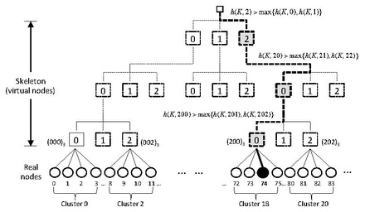
Skeleton-based HRW variant
This approach creates a virtual hierarchical structure (called a “skeleton”) and achieves O(log n) running time by applying HRW at each level by descending the hierarchy.
The idea is to first choose some constant m and organize the n sites into c = [n/m] clusters
C₁ = {S₁, S₂ … S_{m}}, C₂ = {S_{m+1}, S_{m+2} … S_{2m}} …
Next, build a virtual hierarchy by choosing a constant f and imagining these c clusters placed at the leaves of a tree T of virtual nodes, each with fanout f.
HRW Count :16000
Skeleton-based:10000
(For 16 servers)

Slide 8
Thank you

