Slide 1
YOUTUBE DATA ANALYSIS
USING HADOOP MAP REDUCE
BY:-
SHALABH AGARWAL-1306810131
VASU SONI-1306810173

Slide 2
PROJECT INTRODUCTION
The project aims to extract the raw youtube data, store it on hadoop and process this data using map reduce and draw out some insights like what are the top trending videos on youtube, in which category maximum videos are uploaded.

Slide 3
PROJECT OBJECTIVE
In this hadoop/map-reduce project we are going to perform the following activities:
1. Extracting the data from youtube and store it on the hadoop HDFS system.
2. Do some process on the data using the map reduce tool.
3. Draw some insights from this processed data and produce results.

Slide 4
PREREQUISITES
We need to have installed and configured IBM Biginsights on vmware.
Also we require raw youtube data in a text file.

Slide 5
TECHNOLOGY/TOOL USED
The technology we will use is Apache Hadoop for storing the data and Map Reduce for processing the data.
And the tool which we will use is IBM BigInsights .

Slide 6
IBM BigInsights
IBM BigInsights for Apache Hadoop is an industry standard Hadoop offering that combines the best of open source software with enterprise-grade capabilities.

Slide 7
HADOOP
Apache Hadoop is a highly scalable storage platform designed to process very large data sets across hundreds to thousands of computing nodes that operate in parallel. It provides a cost effective storage solution for large data volumes with no format requirements.

Slide 8
Map Reduce
MapReduce is the heart of Hadoop.
The term MapReduce actually refers to two separate and distinct tasks that Hadoop programs perform. The first is the map job, which takes a set of data and converts it into another set of data, where individual elements are broken down into tuples (key/value pairs). The reduce job takes the output from a map as input and combines those data tuples into a smaller set of tuples. As the sequence of the name MapReduce implies, the reduce job is always performed after the map job.

Slide 9
YOUTUBE RAW DATA
Youtube raw data is nothing but unstructured data from youtube which is available publicaly in a text file.
The data file contain following type of information in it:
1. Category of video.
2. Length of video.
3. Number of likes for video.
4. Rating on the video.

Slide 10
Contd…
5. Number of ratings given for the video.
6. Number of comments done on the video.
7. Related video ids with the uploaded video.
8. Up loader of the video.
9. Interval between day of establishment of Youtube and the date of uploading of the video.
10. Video id of 11 characters.

Slide 11
PROJECT WORKFLOW
The following is the step by step procedure to accomplish the task.
step 1: First of all the data is stored on the hadoop HDFS system.
step 2: Then using eclipse IDE we will write mapper, reducer and driver programs to solve our problem statement.
step 3: At last the map and reduce job will be executed to get the desired result.

Slide 12
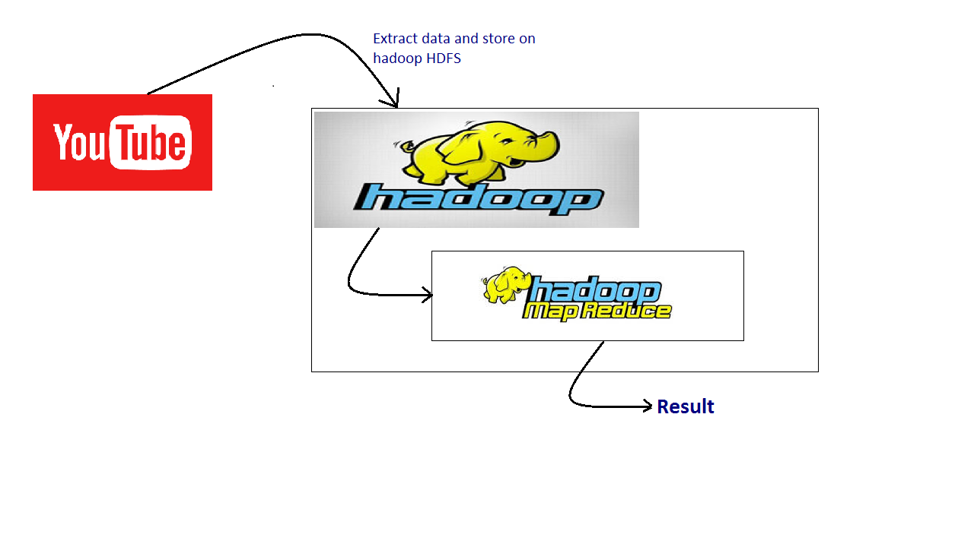
Fig: Project Workflow

Slide 13
THANK YOU

