Slide 1
Lambda Expression
Mohammad Shalabi
Berlin
Aktuelles Datum
Anlass/Abteilung

Slide 2
Overview
What is lambda expression?
Functional Intefaces
Examples

Slide 3
Lambda Expressions
They are function pointers.
They replace any interface with single method.
Syntax:
(parameters) -> expression
(parameters) -> { statements; }

Slide 4
Strategy Pattern

Slide 5
Example
Interface IGreeting
{
String sayHello(String to);
}
void sayHello(String to,IGreeting greeting)
Too way to call sayHello method:
sayHello(someTo, (String to)->"Hello, "+to);
IGreeting greeting=(String to)->"Greeting to "+to;
sayHello("shalabi", greeting);

Slide 6
Example
public interface Comparator<T> {
int compare(String s1, String s2);
}
Comparator<String> comparator=
(String s1, String s2)->Integer.compare(s1.length(), s2.length());
Comparator<String> comparator=
(s1, s2)->Integer.compare(s1.length(), s2.length());
(String s1, String s2)-> {
System.out.println("I am comparing strings");
returnInteger.compare(s1.length(), s2.length());
}

Slide 7
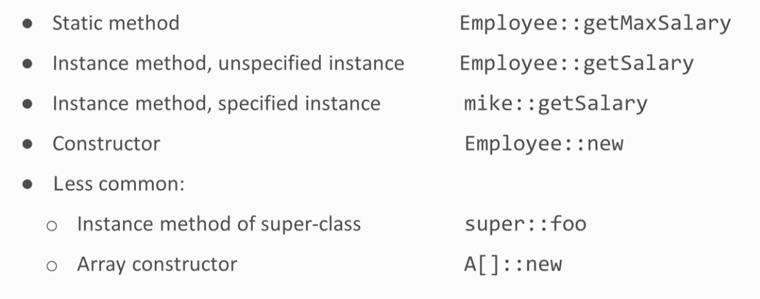
Method References

Slide 8
Method references
Interface Factory {
Employee create();
}
Factory factory = Employee::new;
() -> new Employee();
Method reference does not take arguments

Slide 9
Functional Interfaces
Single method interface
@FunctionalInterface this is just for compilation to force the single method need.
It can have any number of default methods.
It can have any number of static methods.
It can implement any function from Object class.
They are defined in the packge java.util.function.
Four categories:
The Consumers
The Supplier
The Functions
The Predicates

Slide 10
Consumers
A consumer consumes an object, and does not return anything
Public interface Consumer<T> {
void accept(T t);
}
Consumer<String> printer= s ->System.out.println(s);
(T t) -> void

Slide 11
Supplier
A supplier provides an object, and takes no parameter.
Public interface Supplier<T> {
T get();
}
Supplier<Person> personSupplier= () -> newPerson();
() -> T

Slide 12
Function
A function takes an object an returns another object
Public interface Function<T, R> {
R apply(T t);
}
Function<Person, Integer> ageMapper= person -> person.getAge();
(T) -> R

Slide 13
Predicate
A predicate takes an object an return a boolean
Public interface Predicate<T> {
Boolean test(T t);
}
Predicate<Person> ageGT20= person -> person.getAge() > 20;
(T) -> Boolean

Slide 14
Demo
We want to find if two objects are equal and have the ability to do OR and And operations

